Slide 1


LiFi Data
Transferring System
Text transmission through modulated visible light — from a smartphone flashlight to an LDR-based ATmega328P receiver.

Slide 2



02
INTRODUCTION
What is LiFi?
Light Fidelity (LiFi) is a wireless communication technology that carries information in rapid variations of visible light instead of radio-frequency signals.
Wi-Fi · Radio Frequency
Crowded spectrum, passes through walls, can interfere with sensitive equipment.
The light intensity changes far faster than the human eye can notice, yet a light sensor can detect and decode every change.
LiFi · Visible Light
Uses LED light, no RF interference, contained within the room.
ON / OFF
Switching the light ON and OFF in a predefined pattern represents a stream of binary bits.
Why it matters
= binary 1 / 0
Safer near medical and hazardous equipment and naturally more secure.
LiFi Data Transferring System
2 / 10

Slide 3





03
PROJECT OVERVIEW
Objective & Approach
WHY THIS APPROACH
Objective
Smartphone transmitter
Built in controllable LED flashlight — no separate high power optical transmitter needed.
To design and implement a low cost, short range visible light data transmission system where text is sent as rapidly modulated light from a smartphone flashlight, received by an LDR circuit, decoded by an ATmega328P, and shown on an LCD.
LDR receiver
Inexpensive, easily available and sensitive to changes in light intensity.
ATmega328P + LCD
Enough processing power to decode the signal, with instant visual output.
LiFi Data Transferring System
3 / 10

Slide 4








04
SYSTEM ARCHITECTURE
From Text to Light and Back
TRANSMITTER
OPTICAL CHANNEL
RECEIVER
LDR Sensor
Smartphone
Free-space visible light
Signal Conditioning
LiFi App (Encoding)
Rapid light variations
ATmega328P
Flashlight
Invisible to the human eye
LCD Display
LiFi Data Transferring System
4 / 10

Slide 5





05
WORKING PRINCIPLE
Step-by-Step Process
01
02
03
04
Text Input
Encoding
Transmission
Detection
User types a message in the LiFi transmitter app.
App converts the text into a predefined binary sequence.
Flashlight varies rapidly to represent the data bits.
LDR senses the light changes at the receiver.
05
06
07
End-to-end, no wires.
Conditioning
Decoding
Display
Signal is cleaned so the MCU can tell states apart.
ATmega328P decodes pulses back into characters.
Recovered message appears on the LCD.
Digital data carried entirely by visible light.
LiFi Data Transferring System
5 / 10

Slide 6
06
Receiver Circuit Design
LDR Sensor
Signal Conditioning
ATmega328P
LCD
LDR voltage divider
Regulated power
Controls & status
Light intensity changes become voltage changes. The signal is conditioned into cleaner pulses, reducing the effect of ambient light and noise.
A 7805 regulator supplies stable 5 V to the microcontroller, LCD and sensor, with decoupling capacitors for stability.
Push button resets the MCU, resistors set safe currents, and an LED indicates power / data status.
LiFi Data Transferring System
6 / 10

Slide 7
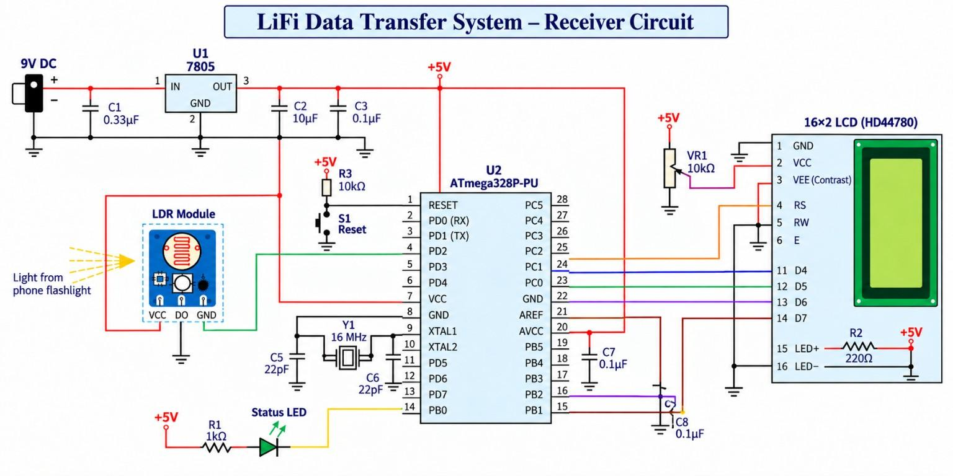
07
SCHEMATIC
Circuit Diagram
LiFi Data Transferring System
7 / 10

Slide 8






08
Main Components
ATmega328P
LDR sensor / module
LCD
Voltage regulator
Main processing unit
Light detection
Displays decoded text
Stable 5 V supply
Resistors
Capacitors
Transistors
Push buttons
Current limiting and biasing
Decoupling and stability
Signal conditioning
Reset and control
LEDs
Perfboard
Wires and connectors
Power supply
Power / data indicators
Compact assembly
Interconnection
9 V DC source
LiFi Data Transferring System
8 / 10

Slide 9






09
REAL-WORLD USE
Applications of LiFi
Hospitals & operation theatres
Aircraft cabins
Underwater communication
Light-based data doesn't disturb MRI machines, pacemakers or monitors.
Cabin LED lighting can provide connectivity without using the RF spectrum.
RF fails underwater while light travels reasonably well over short range.
Petrochemical plants, mines, rigs
Congested, dense areas
High-security rooms
No RF sparks, so far safer around flammable gases.
Every LED fixture can act as an access point in stadiums, malls and airports.
Light can't pass through walls, so data stays inside the room.
LiFi Data Transferring System
9 / 10

Slide 10
Team Members
LiFi Data Transferring System
Lotus P
Het Piyush Shah
2025UEE1448
2025UEE1344
Harshita Paliwal
Himanshu Yadav
2025UEE1335
2025UEE1348
Thank you
10 / 10

