Slide 1
Welcome to Lotus
Unlocking Global Opportunities For next 1bln web3 users
A comprehensive dApp for global investors in real-world asset (RWA) tokenization

Slide 2
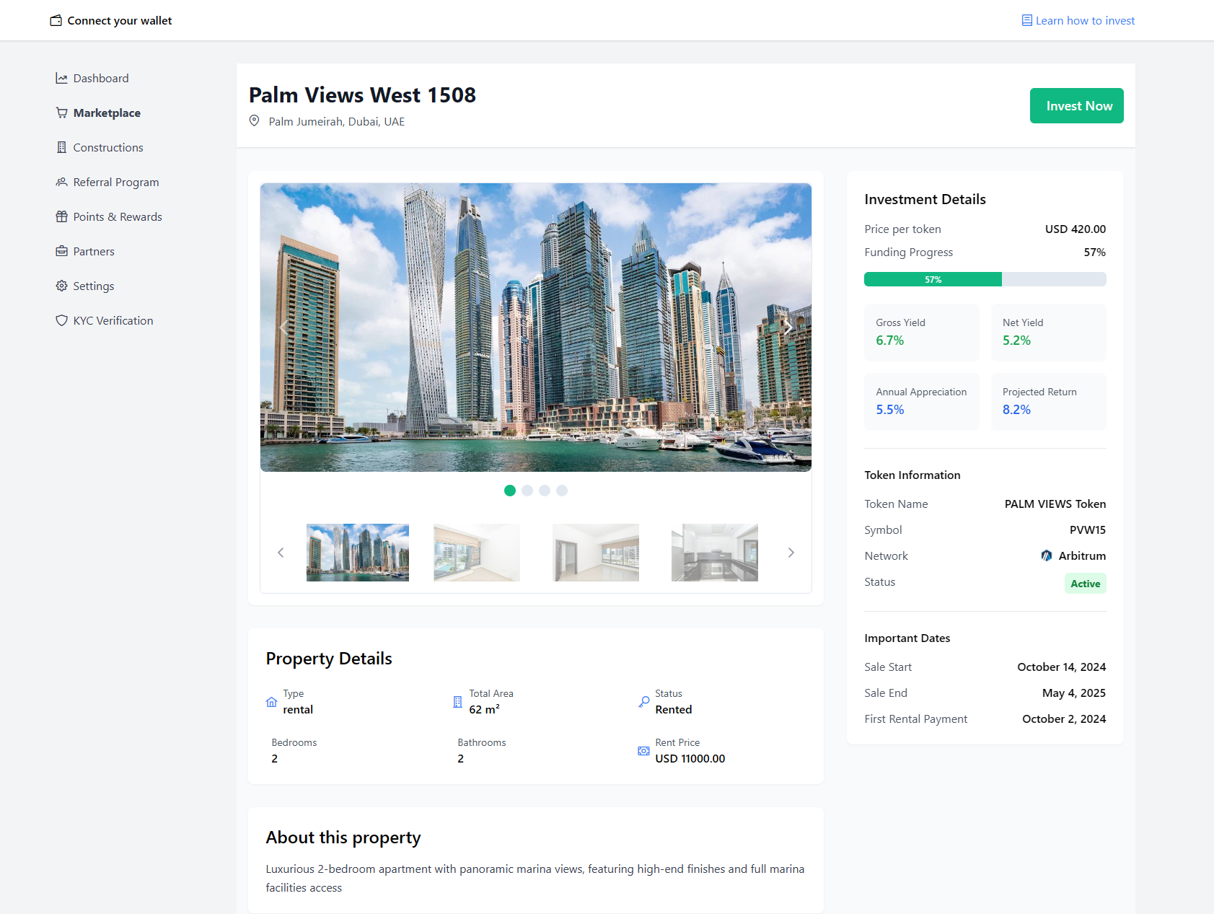
The Lotus mission
To Be the Ultimate Destination for RWA tokenization – Simplifying trading markets through the digitization of Assets
A platform that offers an easy way to deploy a property, enabling securities issuers, investors and YOU to seamlessly:
Issue
Manage
Leverage
Transfer
Digital Assets On A Secure And Efficient Blockchain Infrastructure.

Slide 3
The Problem
Valuable Assets like Global Real Estate are Inaccessible To Most –The Math Is Broken
Traditional markets are fragmented, characterized with siloed networks with little interoperability resulting in slow, inaccurate and costly processes.
Capital-intensive investment
Unlock access to the 98% Investors who don’t have full sum to buy real-estate
Low Efficiency & Transparency
Full deal history
Everything automatized, done in seconds
Limited Asset Liquidity
Intermediaries and qualification requirements slow down the buying and selling of assets
Geographical Barriers
High cross-border transaction costs and limited local market knowledge make it hard for investors to achieve their goals
It can be fixed - we believe Lotus is building the path to towards its evolution

Slide 4
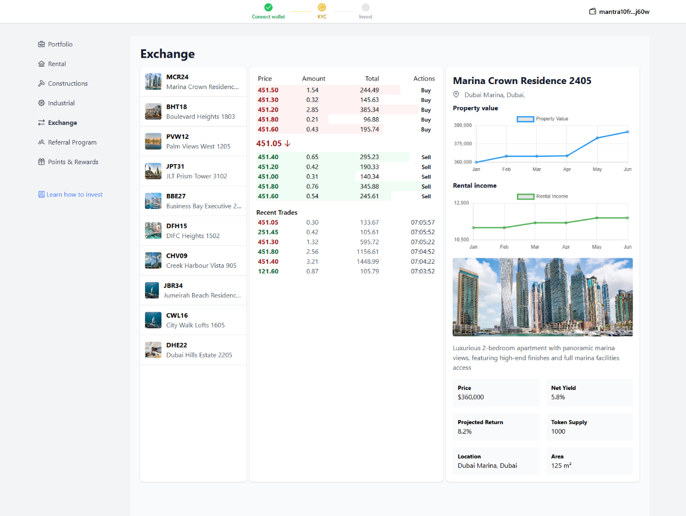
The Lotus Solution is Here
The Evolution of RWA Tokenization is Now
Smart contracts, tokenization and
regulatory compliance
Transaction Efficiency
Accessible Investment Opportunities
Long Tail Liquidity
No Geographical Barriers

Slide 5





The Process → Lotus
STAGE 01
STAGE 02
STAGE 03
Real Estate
Commercial
Residentials
Income Generating Assets
Industrial
ONBOARD
TOKENIZE
COMERICALISE
KYC/AML/KYB PAYMENT SET UP E-SIGN DOCS
DUE DILLIGENCE
TOKENIZE ASSET ELIGIBILITY RULES COMPLIANCE
RULES
LIST PRODUCT
ISSUE
BORROW
EXIT
Liquidity of assets increases relative to the use of the platform

Slide 6






















TOKENIZATION
Licensed infrastructure tailored for real-world asset tokenization
The Tokenization Engine utilizes the Mantra-licensed verifier partner
Security Token Creation
CW20
Compatibility
Fractionalizing
MANTRA Token Service
ERC20
Compatibility
Comprehensive controls

Slide 7
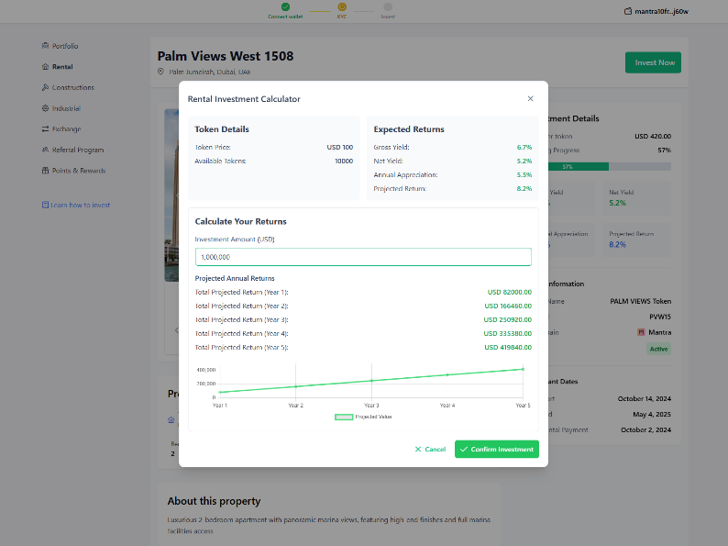
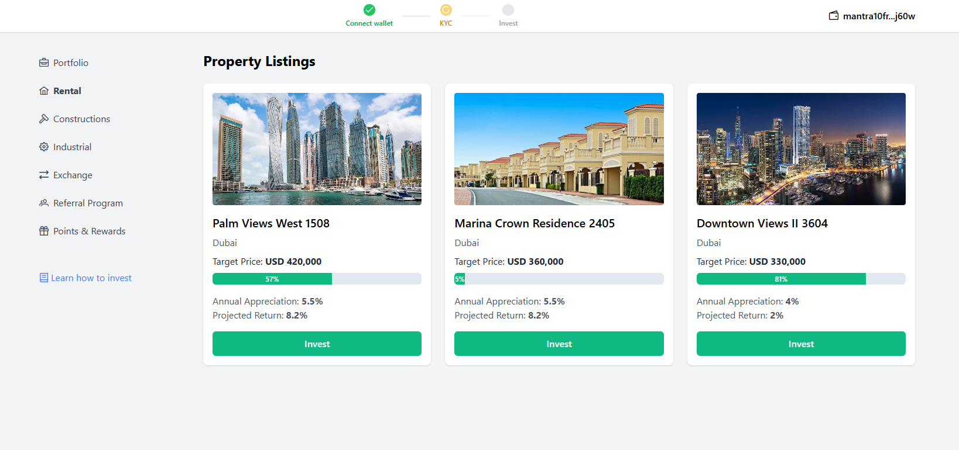

MARKETPLACE
The Evolution of Investments Opportunities
Explore
Discover
Fractional Purchasing:
a smarter way to buy
Ownership + Income distribution

Slide 8
LENDING PROTOCOL
DeFi Lending Markets: Banking Without Banks
Create Position
Collaterals
Financial Terms
Interest Rate
Approved Amount
Repayment Terms
Loan Expiration Dates
Earn interest by lending your assets
Borrow funds using crypto as collateral
Trade directly through smart contracts
Approved Position

Slide 9
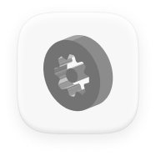


Why Now?
Lotus is unlocking new possibilities for investors worldwide
RWA Tokenization
Favorable Market
High Interest Rates
Market is projected to reach $1.5T by 2030*
*Projected by Citibank
Will drive unprecedented liquidity and TVL growth in the crypto market
Strong demand for alternative financing solutions

Slide 10

Our Traction
Partnerships
Early Achievement
Features
First year
Pilot Programme
Core to our success:
Brokerage partners
Property Partners
RWA Partners
Primary Market
Orderbook -exchange
Lending Protocol
KYC Complete
Smart Contracts
Multichain Platform
Social Logins
Portfolio & Dashboard
Property Value
$91M+
To tokenize 12000+ MAU
Launch in Q1 2025
600000 potential investors
Beta LIVE
UAE Market
Successful prototype
Web3 frontend app
Smart contracts set
Backend services
Key Resources
Community Building
Key Resources
Timing
Partners
Market Sentiment
X (Twitter)
Telegram
Discord
LinkedIn

Slide 11


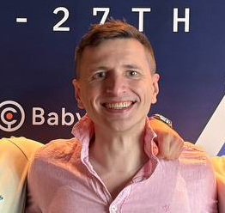
Team
Evgeny
CTO
15+ years of experience in Fintech and development leadership in various startups
Sergei
HEAD OF SALES
Ex-Google, Expert in GTM, Marketing and Sales. Leading sales in various startups
Alexey
HEAD OF PRODUCT
Focused on trends and developments in web3, particularly the tokenization of real assets

Slide 12
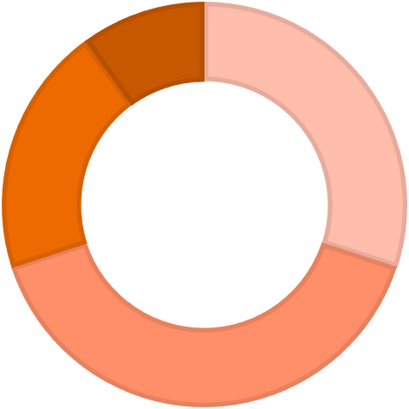

Use of Funds
Technology 58%
Functionality Enhancements, P2P Marketplace,
infrastructure scalability and white labeling
Operational 13%
Non-technical team in target countries with Local knowledge and relationship’s
13%
15%
14%
Legal and compliance 15%
Strengthen legal and compliance frameworks
Community Building/Marketing 14%
Expand and add value to our dedicated web3
and traditional partners
58%

