Slide 1
Range Sheet Streamlit Architecture
PiyapornP
20 May 2026

Slide 2
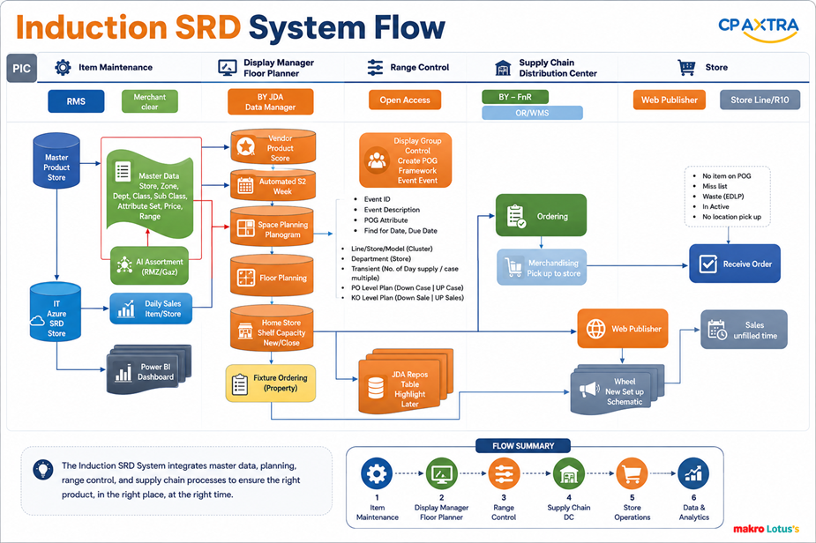
Induction : Space Range Display System Flow
PIC
Item Maintenance
Merchandiser
Display Manager Floor Planner
Range Control
Supply Chain
Store Operation
Distribution Center
System Tools
AI Assortment Optimization Tools
BY-JDA
Data Manager
BY –FnR
Web Publisher
R10
RMS
Open Access
Range Sheet
ORWMS
Vendor – Product - Store
Vendor – Product - Store
- Display Group Controls
- Create POG Framework
- Create Event - Master
Ordering
Receive Order
If product not on POG
Sales ได้ด้วยราคา EDLP
ปรับราคาไม่ได้
SC เปิด PO แล้วจะส่งสินค้าไม่ได้ (no location)
Daily Sales-Product-Store
Average sales 52 week
Event ID
Event Description
POG Attribute
Pending Date,Live Date
IT - Azure
Product - Sales - Store
DC Receiving
Range Sheet (Macro, Excel)
User can add new range , edit /delete/retain Range
Space planning
Planogram
Delivery to Store
Floor planning
Web Publisher
Item/Store/Shelf capacity
Equipment (Fixture)
Inventory rules (day supply ,case multiplies)
KPI Level Run Down Case (LRD Case)
KPI Level Run Down Sales (LRD Sales)
AI Assortment Optimization Tools (Mckinsey)
Product – Store - Shelf capacity
New / Delete
Week Live: Set up Schematic
JDA Report / Table / Highlight / Label
Power BI Dashboard
Fixture Ordering
(Property)
Sales
online/off line

Slide 3
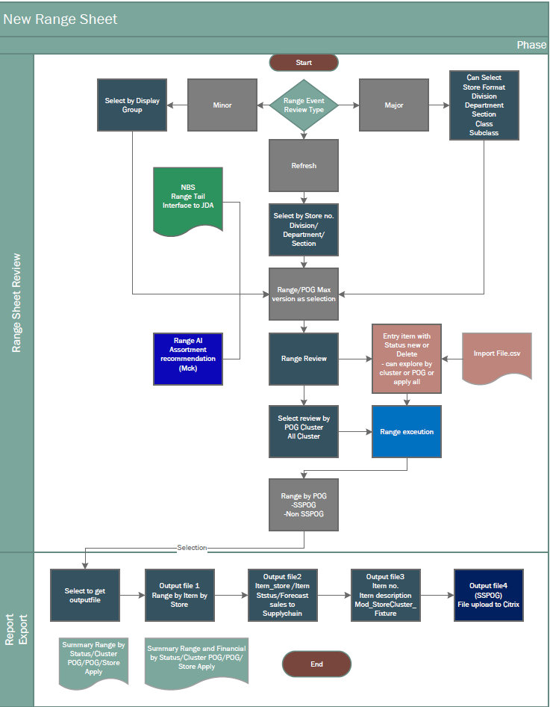
Range Sheet: High level design

Slide 4
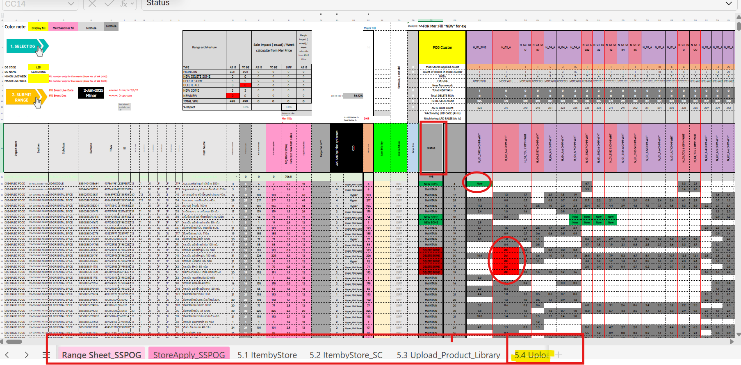
Range Sheet

Slide 5
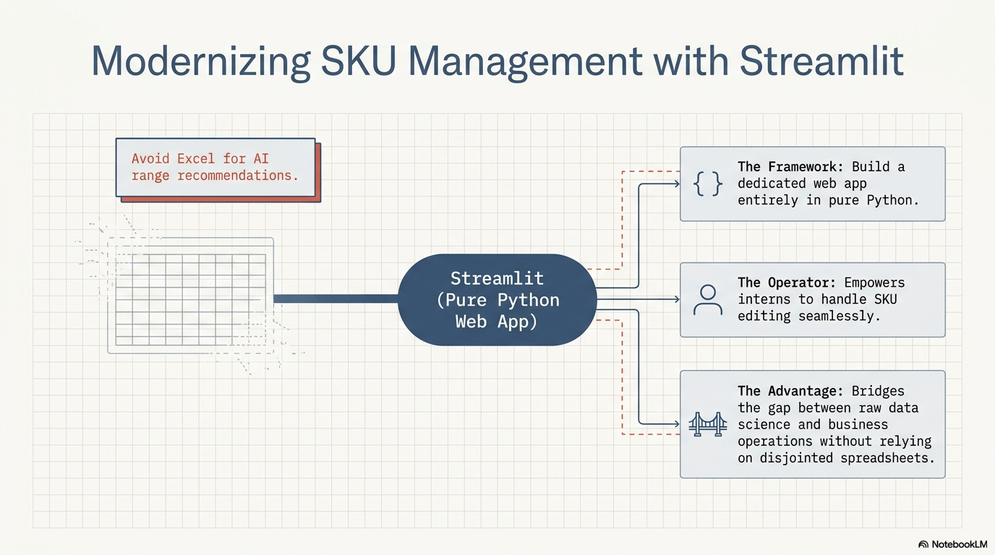

Slide 6
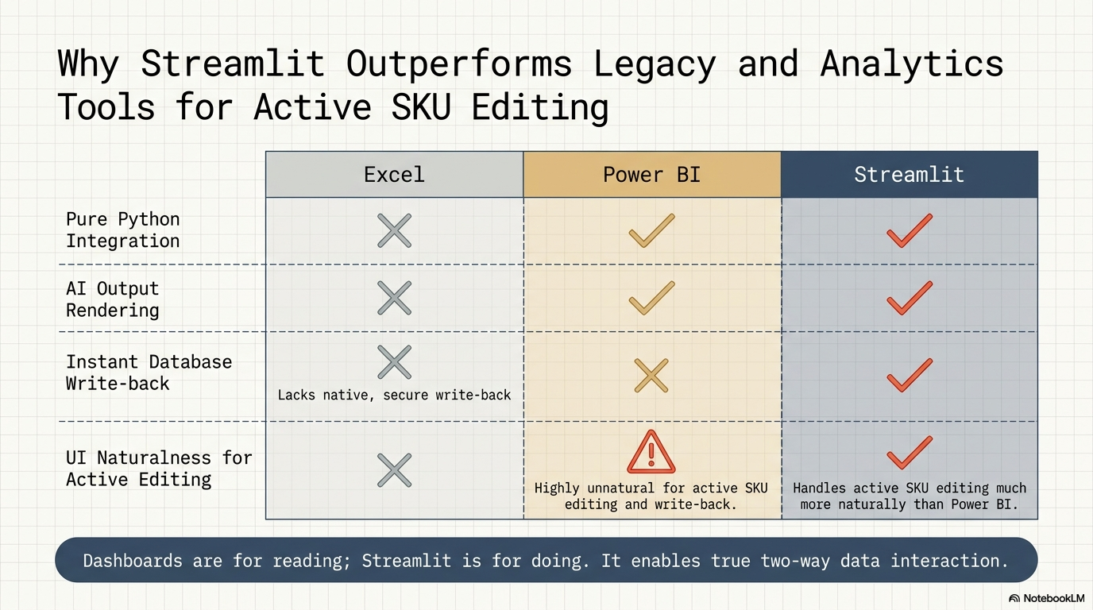

Slide 7
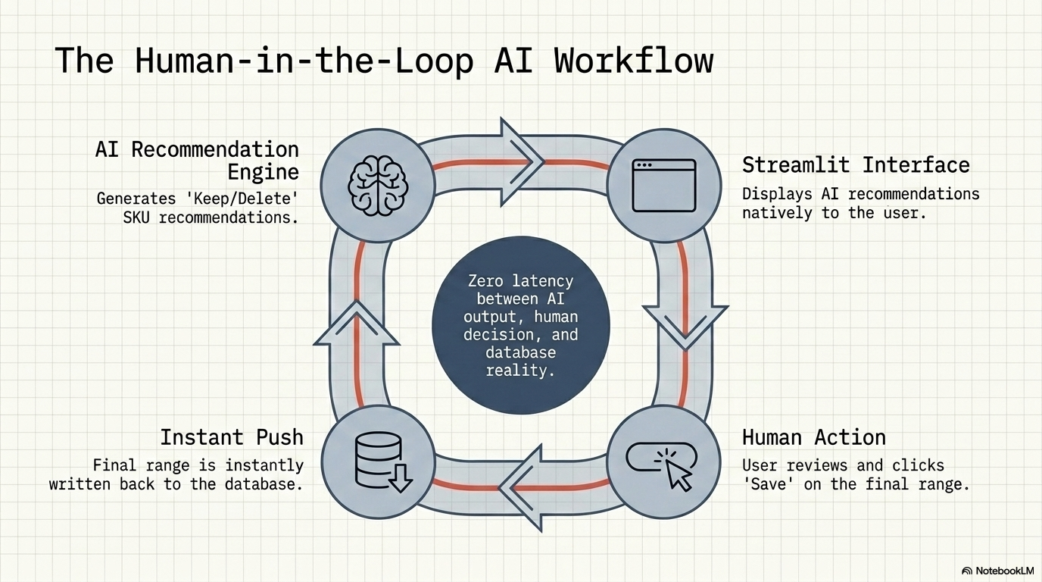

Slide 8
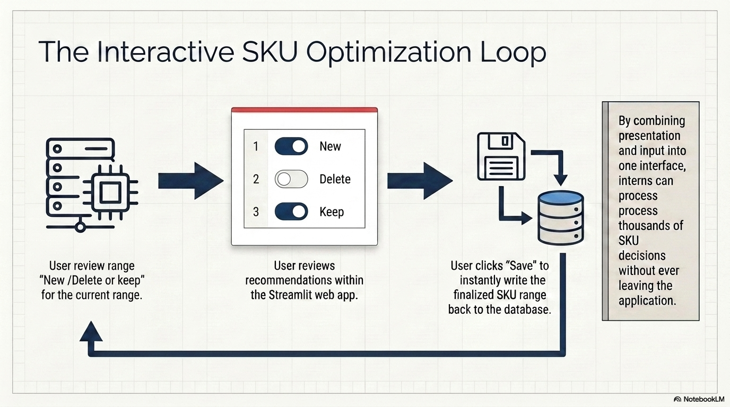

Slide 9
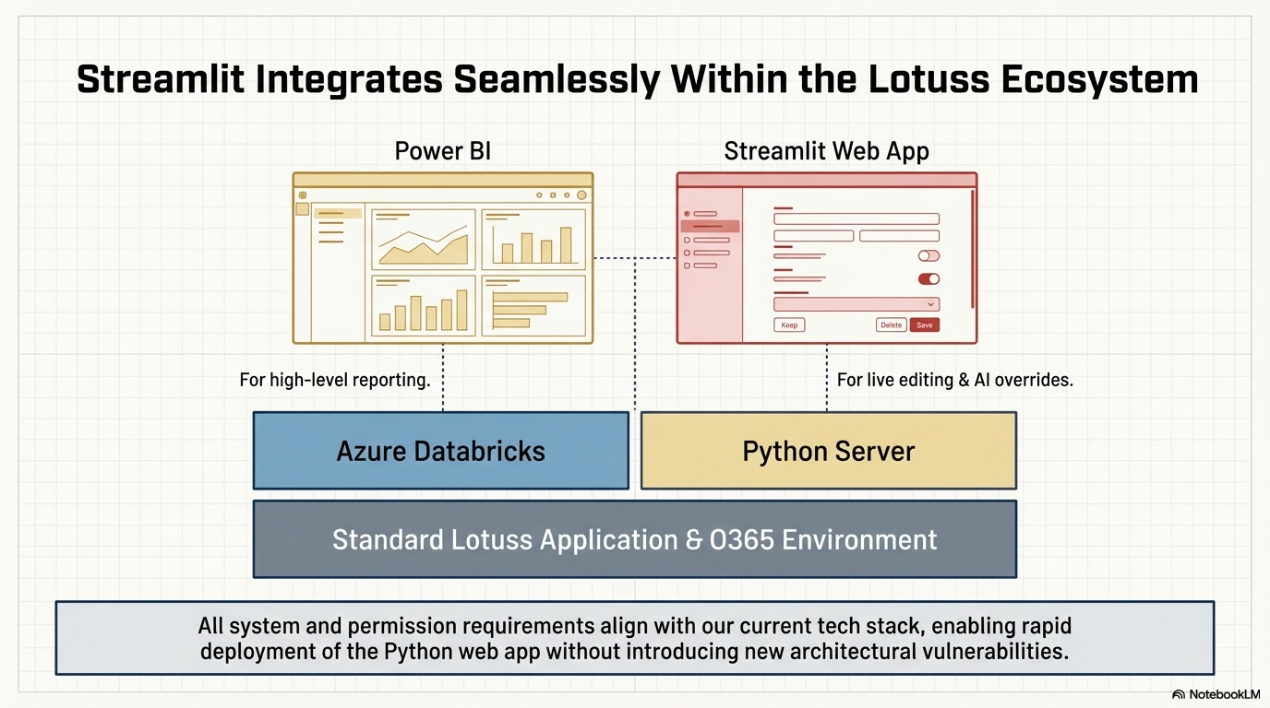

Slide 10
AI Range sheet Intelligence :Internship Program Plan
The goal of this internship project is to replace manual, error-prone Excel processes with a scalable, automated Python and Streamlit application. By utilizing a free, open-source stack, the project will streamline SKU management through a high-performance grid interface. This version of the project is optimized for rapid delivery, moving from static .csv data ingestion directly to database persistence and final deployment.
 | Environment & Tooling |  | .csv Data Ingestion & UI Foundations |  | SKU Management Interface |  | Persistence & Final Delivery |  | Phase 5 Implement
Intern Name | W1 1 – 5 Jun | W2 8 - 12 Jun | W3 15 - 19 Jun | W4 22 – 26 Jun | W5 29 Jun – 3 Jul | W6 6 – 10 Jul | W7 13 – 17 Jul | W8 20 – 24 Jul | Aug- Sep ชญากาณฑ์ 2Days/W
ชนิตสิรี ดัชถุยาวัตร์ (เมษา) ชญากาณฑ์ เฮงสุวรรณ (ปุยฝ้าย) | Establish the developer workflow and Git repository. Set up Python virtual environments (venv/Conda) and define code quality standards (Black/Flake8). |  | Develop ingestion scripts specifically for .csv files. Profile data from McKinsey AI, NBS, and Range Tail provided in CSV format to populate initial data frames using Pandas,. Build the core application layout in Streamlit. |  | Implement the st.data_editor grid for bulk editing and an "Excel-like" experience. Code the logic for AI recommendations: Keep, Delete (session removal), New (entry validation), and Delist (status change to Inactive),. |  | Finalize the "Save" functionality using SQLAlchemy to persist edits directly to the database. Note: In line with updated requirements, validation checks for race conditions or conflicts are omitted for the save trigger. |  | Conduct with uses & UAT Implement
Updated Technical Requirements Data Source: | All primary data inputs (McKinsey AI, NBS, Range Tail) will be handled via .csv file imports rather than live API/SQL connections. Save Trigger: The "Save" action initiates a direct database transaction. No additional validation layer is required for this internship scope. Interface: A high-performance grid supporting bulk edits with strict type-checking. Development Stack: 100% pure Python, leveraging Streamlit for the UI and Pandas for data manipulation,.
Success Criteria | The project will be evaluated on the delivery of a fully functional Streamlit web app capable of importing .csv data and demonstrating a verified write-back to the database. This ensures a robust, persistent data architecture is established even within the simplified internship scope.

Slide 12
AI IN DEVELOPMENT
AI helped make a complex real-data web app feasible within the timeline.
The project moved beyond classroom examples: large CSV files, connected filters, editable grids, business rules, reports, roles, audit logs, and performance constraints had to work together.
Time constraint
Real business data
Higher complexity
Manual coding alone would not have been enough to build and debug all requested features in the short development window.
The app handled large operational datasets where small logic errors could affect tables, reports, and user decisions.
Changes in one cell needed to update status, cluster summaries, range architecture, autosave, chatbot behavior, and report output.
Unexpected issues
AI as support
Human judgment
Performance bottlenecks, column-name mismatches, stale state, and UI reruns appeared during actual use.
AI was used to explain errors, suggest fixes, compare approaches, and speed up iteration.
Requirements, business rules, validation, and final decisions still had to be checked by the developer.
Key message: AI accelerated learning and delivery, but the logic was still guided by business requirements.

Slide 13
AI WORKFLOW
AI supported coding, debugging, and performance improvement across the application.
Instead of using AI as a one-click generator, it was used as a development partner during build-test-fix cycles.
Code writing
Debugging
Business logic mapping
Generated implementation drafts for Streamlit UI, grid behavior, chatbot logic, report sections, and export workflows.
Helped trace errors such as KeyError, undefined variables, stale session values, and dropdown state not persisting.
Translated user actions such as Delete Some, Delete All, New Some, and NewNew into consistent table and report calculations.
Performance thinking
UX iteration
Learning loop
Suggested caching, lighter recalculation, reduced reruns, and precomputed summaries to improve responsiveness.
Helped refine chatbot, login, report preview, export buttons, pinned tables, and full-screen views based on feedback.
Each AI suggestion became a chance to understand why the code behaved that way, not just copy the answer.

Slide 14
LEARNING OUTCOME
The biggest learning was connecting code behavior with business meaning.
The project required both technical debugging and an understanding of how range decisions affect item movement, planograms, and management reporting.
System thinking
Data quality awareness
State management
Learned to trace data from source files through filters, grids, status logic, cluster tables, and reports.
Learned why missing values, different column names, and inconsistent formats can break downstream logic.
Learned how autosave, refresh, role access, and edited dropdown states must remain consistent across pages and DGs.
Risk logic
Communication
Practical coding
Learned how business rules like Top 10% best seller and Tail 10% lowest seller can guide warnings and review points.
Learned to convert detailed app activity into manager-friendly reports and audit summaries.
Learned by debugging real problems that were not fully predictable at the design stage.

Slide 15
VALUE CREATED
The final app turns range editing into a connected review workflow, not just a spreadsheet screen.
Users can edit range decisions, see impact, ask the chatbot, export outputs, and send management reports while keeping auditability.
Connected tables
Decision support
Faster review
Main table changes update status, cluster counts, range architecture, and report outputs.
Warnings highlight risky actions such as deleting best sellers or adding lowest sellers.
Chatbot answers common range questions and supports quick action commands.
Manager summary
Governance
Export readiness
Reports summarize DG changes, SKU impact, planogram impact, product movement, and sales risk.
Login roles and audit logs support controlled access and traceability.
Range output and report files can be generated for business handoff.
Outcome: AI helped bridge the gap between limited time, unfamiliar technical areas, and real business complexity.

