Slide 1
Range Sheet Streamlit Architecture
PiyapornP
20 May 2026

Slide 2
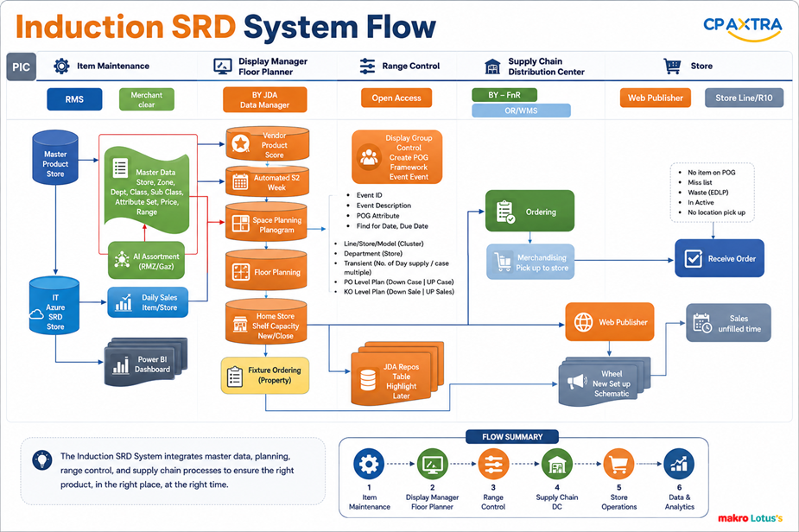
Induction : Space Range Display System Flow
PIC
Item Maintenance
Merchandiser
Display Manager Floor Planner
Range Control
Supply Chain
Store Operation
Distribution Center
System Tools
AI Assortment Optimization Tools
BY-JDA
Data Manager
BY –FnR
Web Publisher
R10
RMS
Open Access
Range Sheet
ORWMS
Vendor – Product - Store
Vendor – Product - Store
- Display Group Controls
- Create POG Framework
- Create Event - Master
Ordering
Receive Order
If product not on POG
Sales ได้ด้วยราคา EDLP
ปรับราคาไม่ได้
SC เปิด PO แล้วจะส่งสินค้าไม่ได้ (no location)
Daily Sales-Product-Store
Average sales 52 week
Event ID
Event Description
POG Attribute
Pending Date,Live Date
IT - Azure
Product - Sales - Store
DC Receiving
Range Sheet (Macro, Excel)
User can add new range , edit /delete/retain Range
Space planning
Planogram
Delivery to Store
Floor planning
Web Publisher
Item/Store/Shelf capacity
Equipment (Fixture)
Inventory rules (day supply ,case multiplies)
KPI Level Run Down Case (LRD Case)
KPI Level Run Down Sales (LRD Sales)
AI Assortment Optimization Tools (Mckinsey)
Product – Store - Shelf capacity
New / Delete
Week Live: Set up Schematic
JDA Report / Table / Highlight / Label
Power BI Dashboard
Fixture Ordering
(Property)
Sales
online/off line

Slide 3
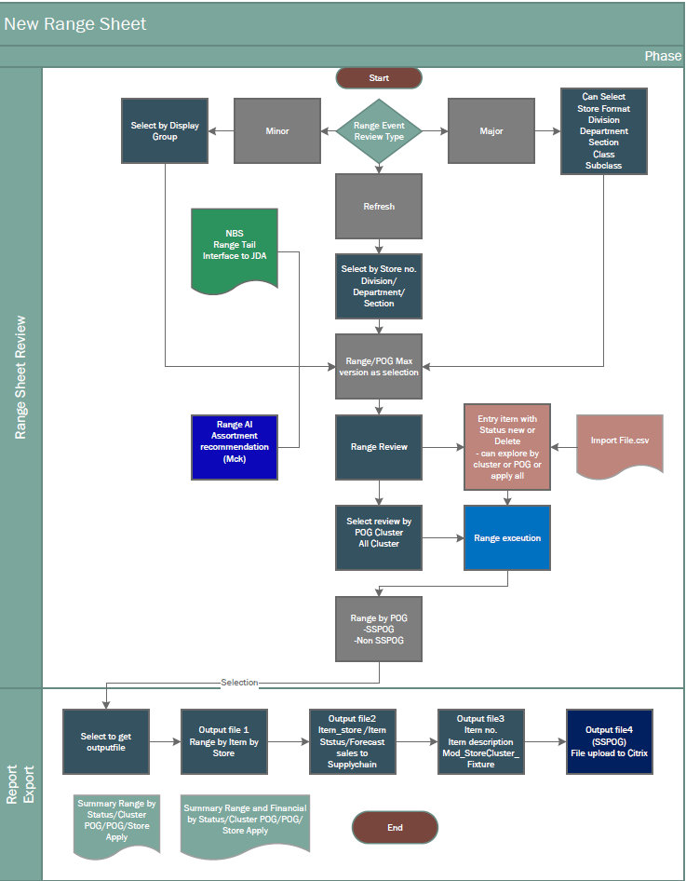
Range Sheet: High level design

Slide 4
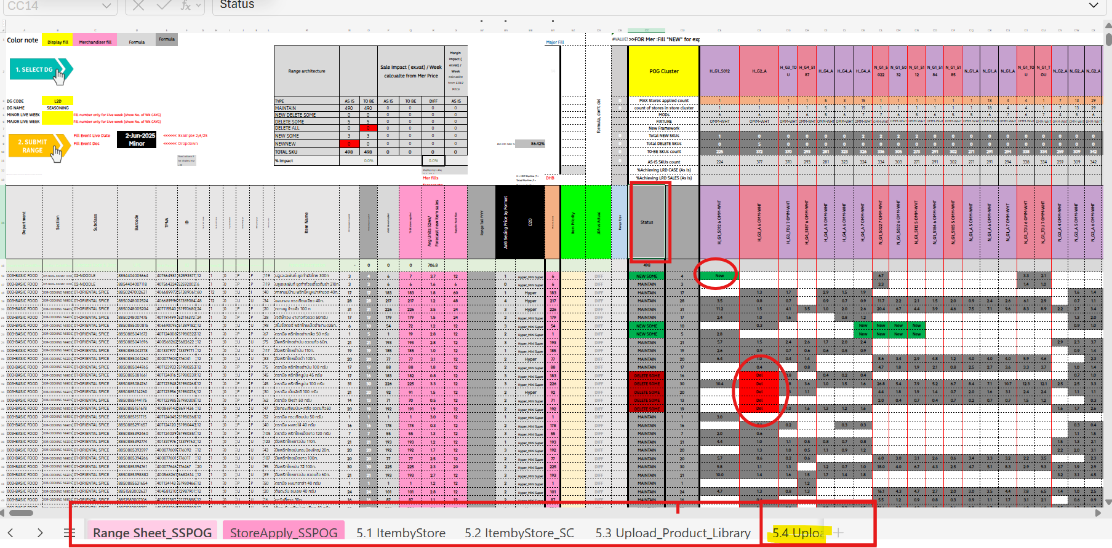
Range Sheet

Slide 5
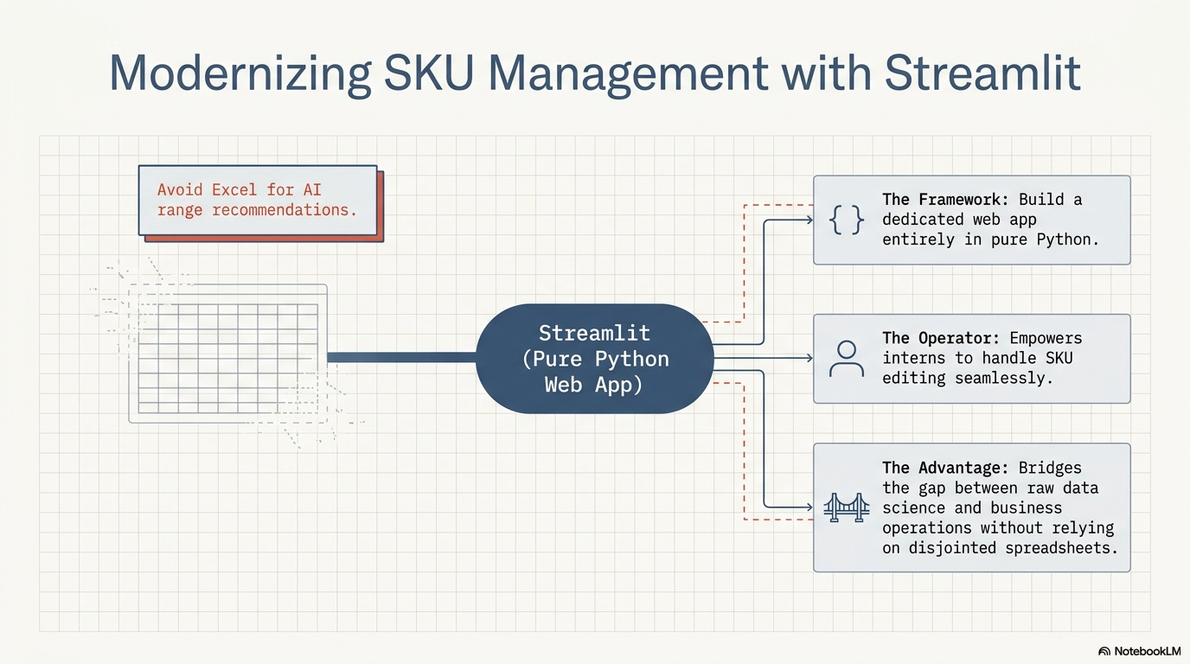

Slide 6
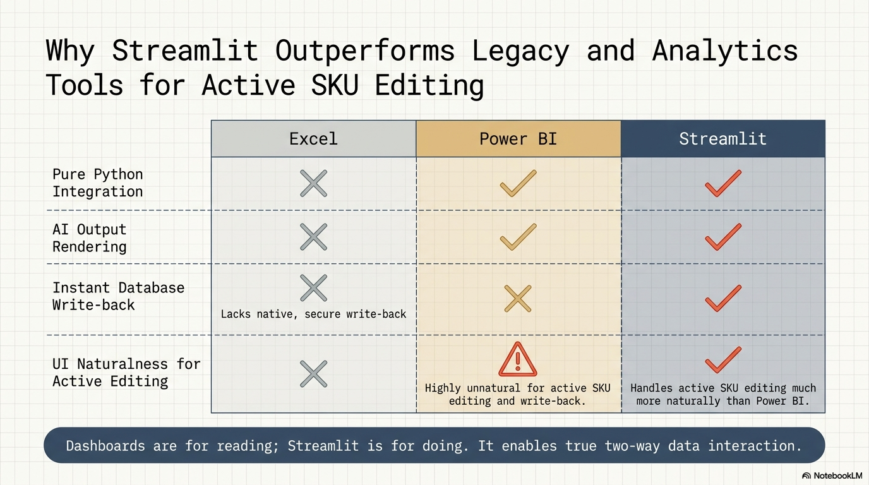

Slide 7
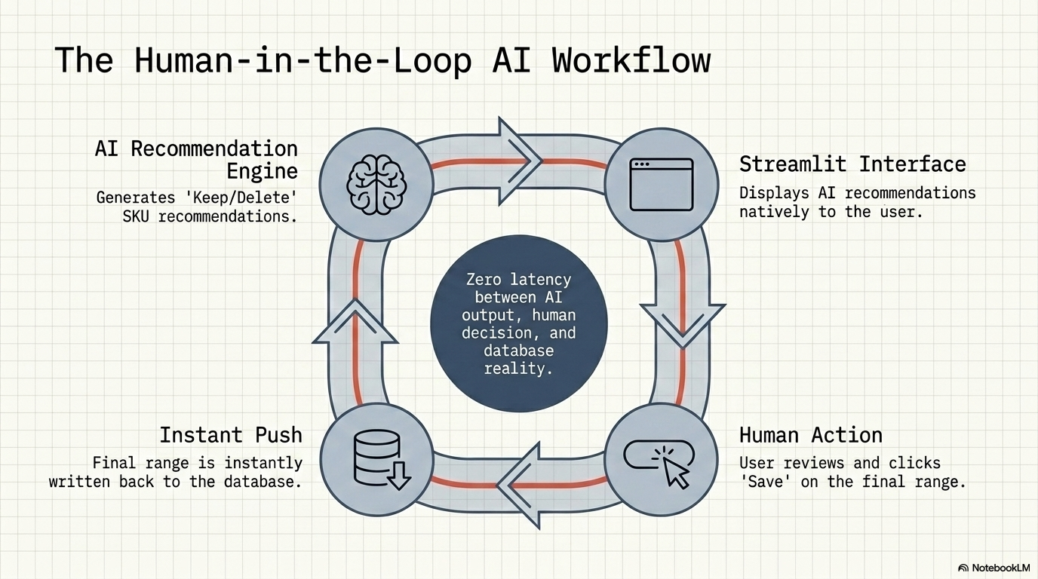

Slide 8
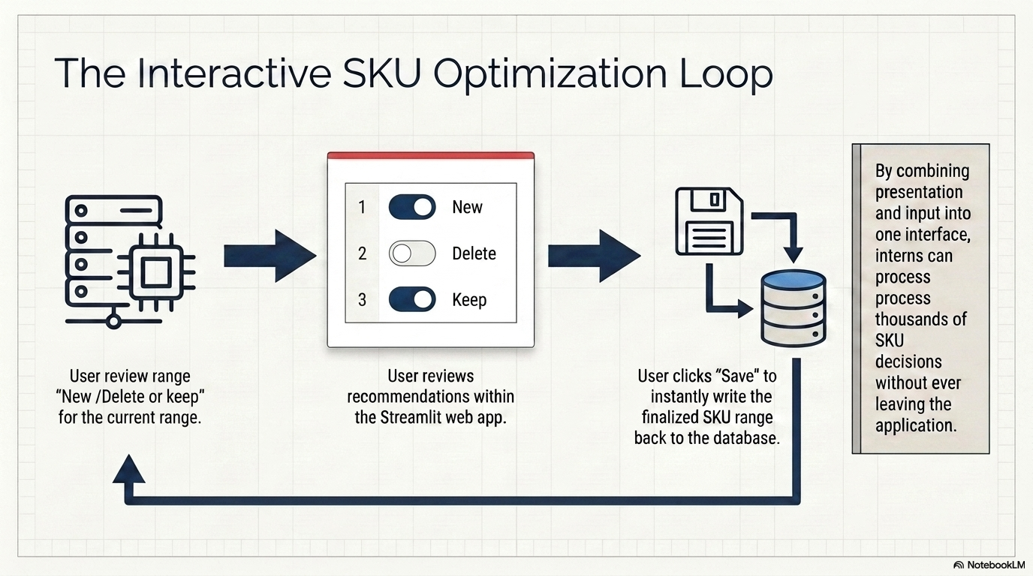

Slide 9
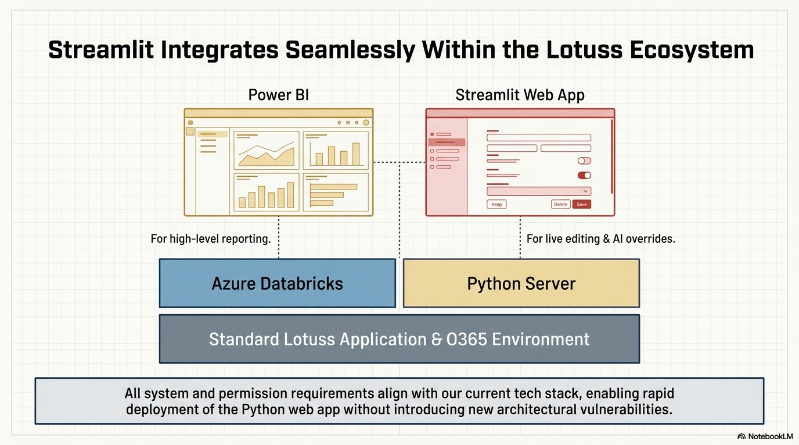

Slide 10
AI Range sheet Intelligence :Internship Program Plan
The goal of this internship project is to replace manual, error-prone Excel processes with a scalable, automated Python and Streamlit application. By utilizing a free, open-source stack, the project will streamline SKU management through a high-performance grid interface. This version of the project is optimized for rapid delivery, moving from static .csv data ingestion directly to database persistence and final deployment.
 | Environment & Tooling |  | .csv Data Ingestion & UI Foundations |  | SKU Management Interface |  | Persistence & Final Delivery |  | Phase 5 Implement
Intern Name | W1 1 – 5 Jun | W2 8 - 12 Jun | W3 15 - 19 Jun | W4 22 – 26 Jun | W5 29 Jun – 3 Jul | W6 6 – 10 Jul | W7 13 – 17 Jul | W8 20 – 24 Jul | Aug- Sep ชญากาณฑ์ 2Days/W
ชนิตสิรี ดัชถุยาวัตร์ (เมษา) ชญากาณฑ์ เฮงสุวรรณ (ปุยฝ้าย) | Establish the developer workflow and Git repository. Set up Python virtual environments (venv/Conda) and define code quality standards (Black/Flake8). |  | Develop ingestion scripts specifically for .csv files. Profile data from McKinsey AI, NBS, and Range Tail provided in CSV format to populate initial data frames using Pandas,. Build the core application layout in Streamlit. |  | Implement the st.data_editor grid for bulk editing and an "Excel-like" experience. Code the logic for AI recommendations: Keep, Delete (session removal), New (entry validation), and Delist (status change to Inactive),. |  | Finalize the "Save" functionality using SQLAlchemy to persist edits directly to the database. Note: In line with updated requirements, validation checks for race conditions or conflicts are omitted for the save trigger. |  | Conduct with uses & UAT Implement
Updated Technical Requirements Data Source: | All primary data inputs (McKinsey AI, NBS, Range Tail) will be handled via .csv file imports rather than live API/SQL connections. Save Trigger: The "Save" action initiates a direct database transaction. No additional validation layer is required for this internship scope. Interface: A high-performance grid supporting bulk edits with strict type-checking. Development Stack: 100% pure Python, leveraging Streamlit for the UI and Pandas for data manipulation,.
Success Criteria | The project will be evaluated on the delivery of a fully functional Streamlit web app capable of importing .csv data and demonstrating a verified write-back to the database. This ensures a robust, persistent data architecture is established even within the simplified internship scope.

