Slide 1


Slide 2
Topic:
Selenium with Cucumber BDD Framework
Series -1

Slide 3
1.What is BDD Framework
2. What is Cucumber
3. Components and Layer of Cucumber BDD
Framework
4. Software, Plugin and Dependencies Needed

Slide 4
Behavior Driven Testing is an extension of TDD-Test Driven Development.
Like in TDD, in BDD also we write tests first and add the application code.
The major difference that we get to see here are
Tests are written in plain descriptive English type grammar
Tests are explained as behavior of application and are more user focused

Slide 5
Cucumber is a testing framework which supports Behavior Driven Development (BDD).
It lets us define application behavior in plain meaningful English text using a simple grammar defined by a language called Gherkin.
Cucumber itself is written in Ruby, but it can be used to “test” code written in Ruby or other languages including but not limited to Java, C# and Python.

Slide 6


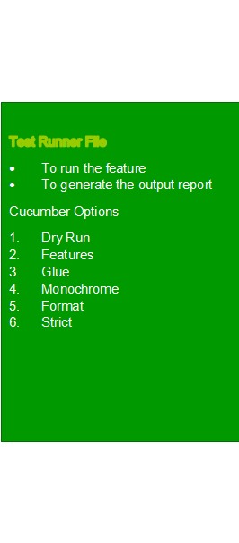

1.Feature File
  2.Step Definition File
  3.Test Runner File

Slide 7



Slide 8
