Slide 1

AWS SageMaker Demo: Solving Influencers in Social Networks
Revised by: Hoofar Pourzand
LAN2018 AI@Philadelphia
WiFi:12345978
Notes:
Author (original: _)

Slide 2
Challenge and Objectives :
To predict the impact various factors can add to the influence factor of an individual.
A binary classification problem on Kaggle to predict who is more influential when comparing two twitter users.
Compared the performance of several classification algorithms covered during the course.
https://www.kaggle.com/c/predict-who-is-more-influential-in-a-social-network#description
Notes:
Motivation: To implement by hand the various algorithms covered during the course. Then Talk about how we’d think follower count in intuitive, bots follow? Insight is lists added...more hold.

Slide 3
Data set
The dataset is provided by PeerIndex, and comprises a standard pairwise preference learning task.
Each datapoint describes two individuals, and for each person, 11 pre-computed non negative features based on twitter activity.
Train : 5500 Test : 5953
The 11 features per user are :
Followers Count
Following Count
Listed
Mentions received
Re-tweets received
Mentions sent
Re-tweets sent
Posts
Network Feature 1
Network Feature 2
Network Feature 3

Slide 4
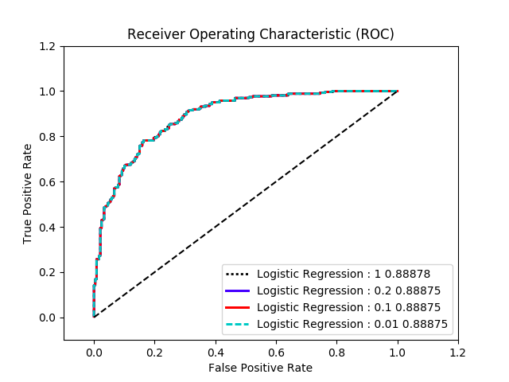
Evaluation Metric
Area under the ROC Curve. On the ROC Curve, we plot TPR v/s FPR for a range of prediction thresholds.
We present our analysis on the following :
Train
Dev
Test

Slide 5
Data Engineering
Feature Engineering 1 - Reduced the number of features from 22 to 11 using the following :
aj = x_{j} - x_{j+11} ; j = 1,2,3...11
Feature Engineering 2 - Logarithmic Transformation - Since the attributes are of a different scale, we convert every value to its log in order to reduce the scale disparities.
Feature Engineering 3 - For Gaussian Naive Bayes, we also tried z-score normalization in order to have 0 mean, 1 standard deviation distribution for all the attributes in the dataset.

Slide 6
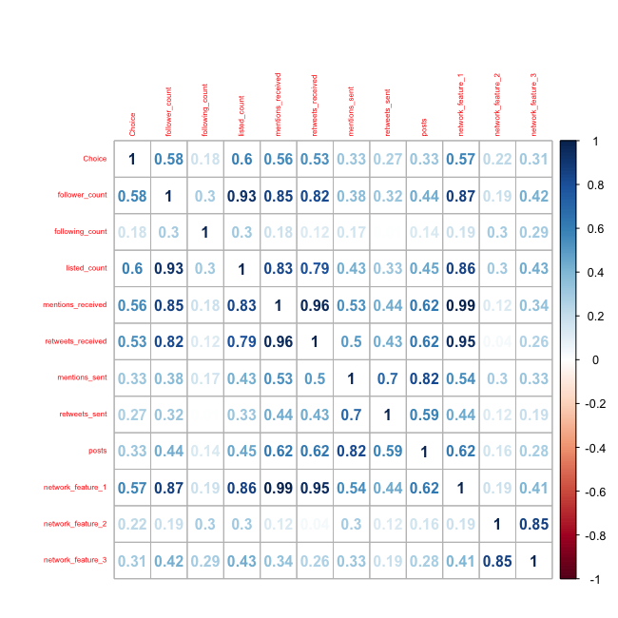
Correlation Matrix
Forward selection algorithm to zero in, on the best features in order to improve the test accuracy
Promising features
Follower Count
Listed Count
Retweets Received
Network Feature 1
Mentions Received
Network Feature 2

Slide 7
Model-Spotting
A. Linear Models
Logistic Regression (Different loss functions)
Gaussian Naive Bayes
Support Vector Machine
B. Non-linear Models
Neural Networks
C. Ensemble Methods
Boosting (XgBoost)

Slide 8
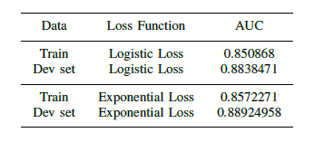
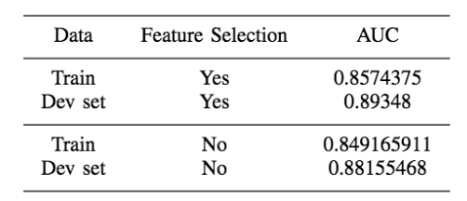
Logistic Regression
AUC for Logistic Regression (Our Implementation)
Implementation
Loss functions
Logistic Loss
Exponential Loss.
Hyperparameters tuned
L2 Regularization (0.1)
Learning Rate (0.001)
Scikit Learn
Hyperparameters tuned
C (Inverse of regularization) ( C = 100 )
AUC for Logistic Regression C = 100

Slide 9
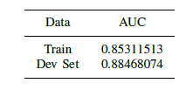
Gaussian Naive Bayes
Normalized the data using
Z-score normalization

Slide 10
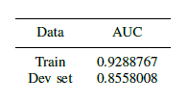
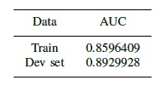
Support Vector Machines
SVM RBF
Hyperparameter tuned
Slack Penalty - C (0.3)
SVM Linear
Hyperparameter tuned
Slack Penalty - C (0.3)
SVM (RBF)
SVM (Linear)

Slide 11

Neural Networks
Notebook Implementation
Hyperparameters tuned
Hidden layers - 5
Units in each layer - 15, 10, 10, 10, 10
Learning rate - 0.1
Epochs - 100000
Activation Function - Identity, TanH, Sigmoid
Neural Nets - AUC

Slide 12

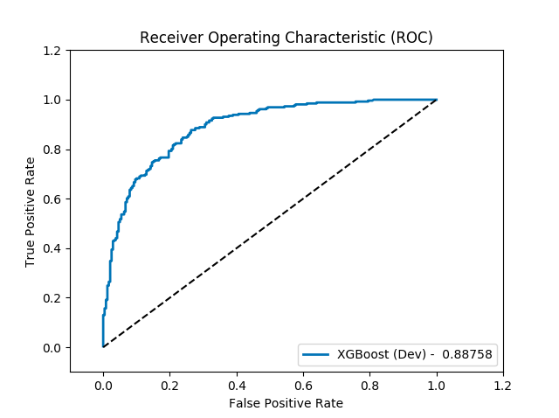
Boosting
(Ensemble)
XGBoost Classifier
Hyperparameters tuned
Subsample - 0.001
Colsample bytree - 0.5
Max Depth - 3
Min Child Weight - 9
Boosting rounds - 6000

Slide 13
Kaggle Results
(Test Dataset)
AUC on Test Data :
LR - 0.8606
XgBoost - 0.8616
Gaussian Naive Bayes - 0.82009
Neural Networks - 0.84182
SVM - 0.83786

Slide 14
Observations
The models which rely on linear decision boundaries provide the best results on the dataset.
Logarithmic transform proved to be the most effective because it removed the scale disparities between the various attributes.
The AUC for all our models on the dev set varies between 0.85 - 0.89.
ACLU submission of XGBoost model, author of the original scripts, on Kaggle Website achieved a best AUC score of 0.86168 on 2017.

