Slide 1
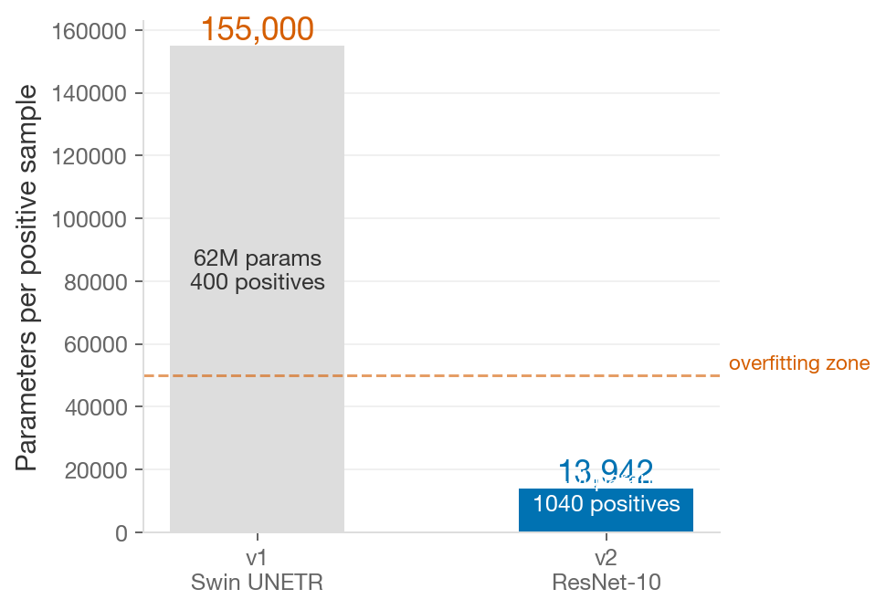
Pipeline v1 is stuck at AUPREC 0.16 — the model memorizes, it doesn't learn
1. 62M parameters for ~400 positives
155,000 params per positive sample. The model memorizes training subjects instead of learning WMH features. Rule of thumb: <1,000 params/positive.
2. APLoss without CE warmup
APLoss needs a reasonable starting score distribution. Without warmup, the surrogate loss has nothing to rank — gradients are near-random.
3. LR scheduler bug
Cosine annealing stepped per batch but T_max set in epochs. LR collapsed to zero after a few batches instead of decaying over epochs.
4. CT abdominal SSL pretraining
MONAI's Swin UNETR weights come from CT abdominal scans. The domain gap to pediatric brain MRI is enormous — effectively random init.
Result: val AUPREC = 0.16 — the model produces near-random rankings on held-out subjects
1 / 3

Slide 2
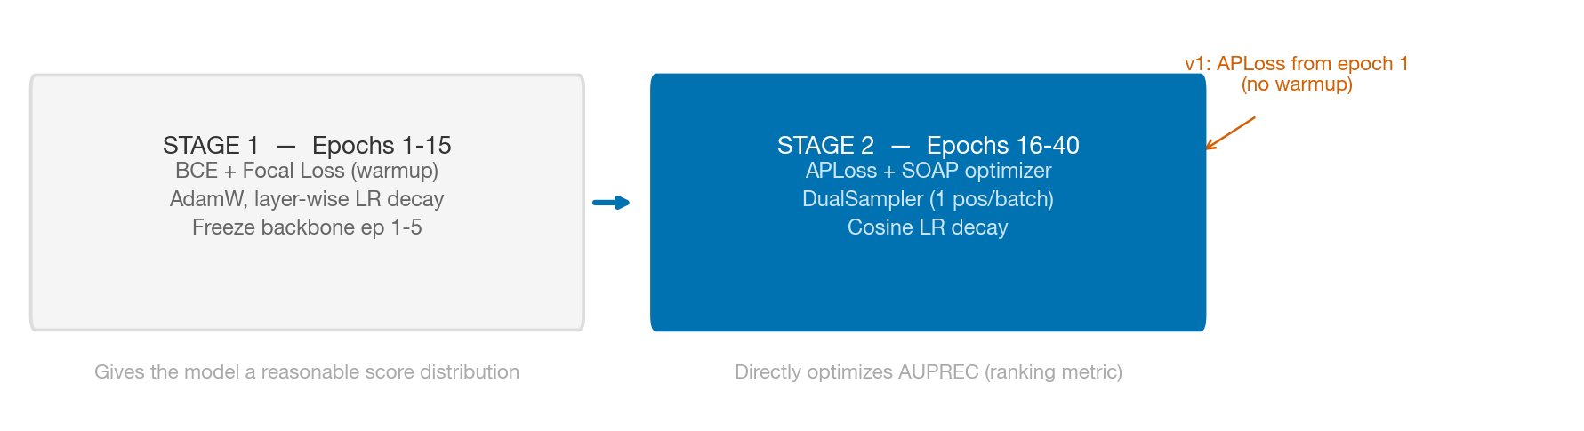
v2 addresses every diagnosed failure mode with evidence-based changes
v1 (before)
v2 (after)
Model
Swin UNETR 62M params
ResNet-10 14.5M params
11x
Positives
~400 (1 CSV, score >= 3)
1,040 (2 CSV, WMA match)
2.6x
Input
2ch (T1 + T2)
3ch (T1 + T2 + T2/T1 ratio)
Loss warmup
None — APLoss from epoch 1
15 ep BCE+Focal, then APLoss
LR schedule
Cosine/batch (bugged)
Cosine/epoch (fixed)
LR unfreezing
Uniform LR/10
Layer-wise decay (0.75/layer)
EMA
No
Yes (decay 0.9995)
Grad accum
No (bs=4)
Yes (effective bs=16)
4x
2 / 3

Slide 3
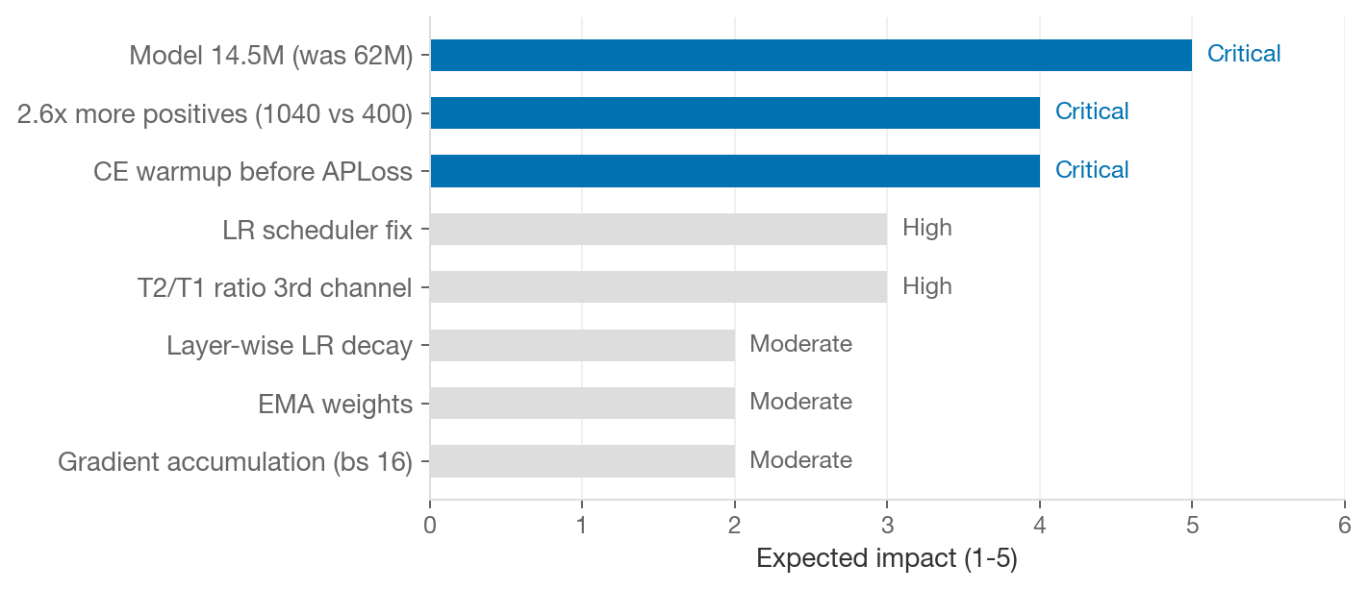
Realistic target: AUPREC 0.35–0.55
AUPREC Targets
0.16
v1 (current)
0.35–0.55
v2 realistic goal
> 0.55
publishable surprise
> 0.65
suspect data leakage
Early Warning Signals
Stage 1 ep 15 AUPREC < 0.18 -> stop, debug
Train AP > 0.40, Val < 0.20 -> overfitting
Per-site variance > 0.15 -> site shortcut
KEY INSIGHT
The single biggest lever is the model size: 14.5M params on 1,040 positives (14k params/pos) vs 62M on 400 (155k params/pos). Combined with CE warmup and the LR fix, this addresses the three root causes of v1's failure.
3 / 3

