Slide 1
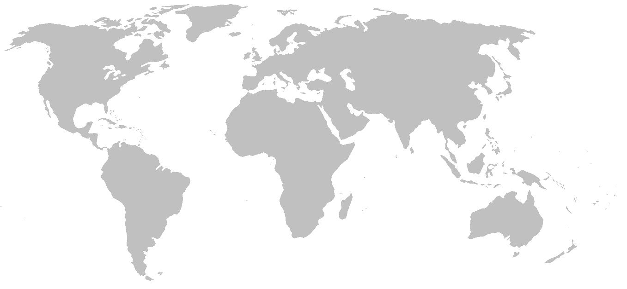
Abiotic
stress-tolerance
avoiding detection
Biotic
inter- and intra-specific interactions
pathogenicity (pathogen-host)
competitive ability (pathogen-pathogen)
predation (pathogen-natural enemy)
outcrossing
virulence
resting structures
cold-tolerance
desiccation resistance
RISK OF
ESTABLISHMENT
growth rate
cell wall–degrading enzyme families
host encounter rates
ability to self
outcrossing
virulence
transmission
realised range
IMPACT
RISK OF ARRIVAL
RISK OF ARRIVAL
local
aerial spread
surface water spread
soil--borne
RISK OF ARRIVAL
regional
soil-borne
resting structures
propagule pressure
Movement
dispersal
exploitation of transport pathways
avoiding detection
increasing global connectivity
Fig. 1 A conceptual trait-based framework for risk assessment of invasion potential and global impacts of plant pathogenic fungi and oomycetes. The BAM approach (biotic, abiotic, movement: Soberon et al. 2007, 2009) identifies three filters restricting species distributions in geographic space. The abiotic niche (red circle) represents suitable environmental conditions for a species to persist. The biotic niche (green circle) represents favourable inter- and intra-specific interactions. The movement niche (blue circle) represents accessibility via dispersal and human transport (risk of arrival). Adaptive traits (red, blue and green text) mediate how species are filtered by these abiotic, biotic and movement processes. A species realised range is the intersection of these three niches. The intersection between the abiotic and the biotic niches includes both the realised range and also suitable, but currently inaccessible geographic space. This is a useful quantity to predict for the purposes of risk mapping (risk of establishment). Increasing global connectivity (blue arrows) erodes the movement filter and increases the geographic space that is accessible (blue dashed circles). Measuring the extent of this incursion is an indicator of pathogen global impact (e.g. geographic spread, host range expansion, novel host mortality).

