Slide 1

Stock Trading Algorithms From Brute Force to Dynamic Programming
To watch the presentation video click here
By : Loubna Benchakouk

Slide 2
INTRODUCTION
Analysis of 5 different algorithms for stock trading optimization
Tasks covered:
Problem-1
Brute Force (Task 1) → O (m×n²)
Greedy (Task 2) → O (m×n)
Single-Transaction DP (Task 3) → O (m×n)
Problem-2
Multi-Transaction DP (Task 5) → O (m×n×k)
Problem-3
Multi-Transaction DP With Cooldown Period (Task 6) → O (m×n²)
Focus: Algorithm design, performance analysis, and practical trade-offs
Learning objective: Understanding how algorithm choice impacts real-world performance

Slide 3

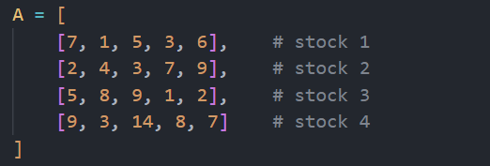
THE STOCK TRADING PROBLEM
Input: Matrix A[m × n] where m = stocks, n = days
Goal: Maximize profit from buy/sell transactions
Example:
Stock 4, buy day 2 ($3) → sell day 3 ($14) = $11 profit
Constraints: Must buy before selling, temporal ordering matters
Variations: Single transaction vs. multiple transactions (up to k)

Slide 4
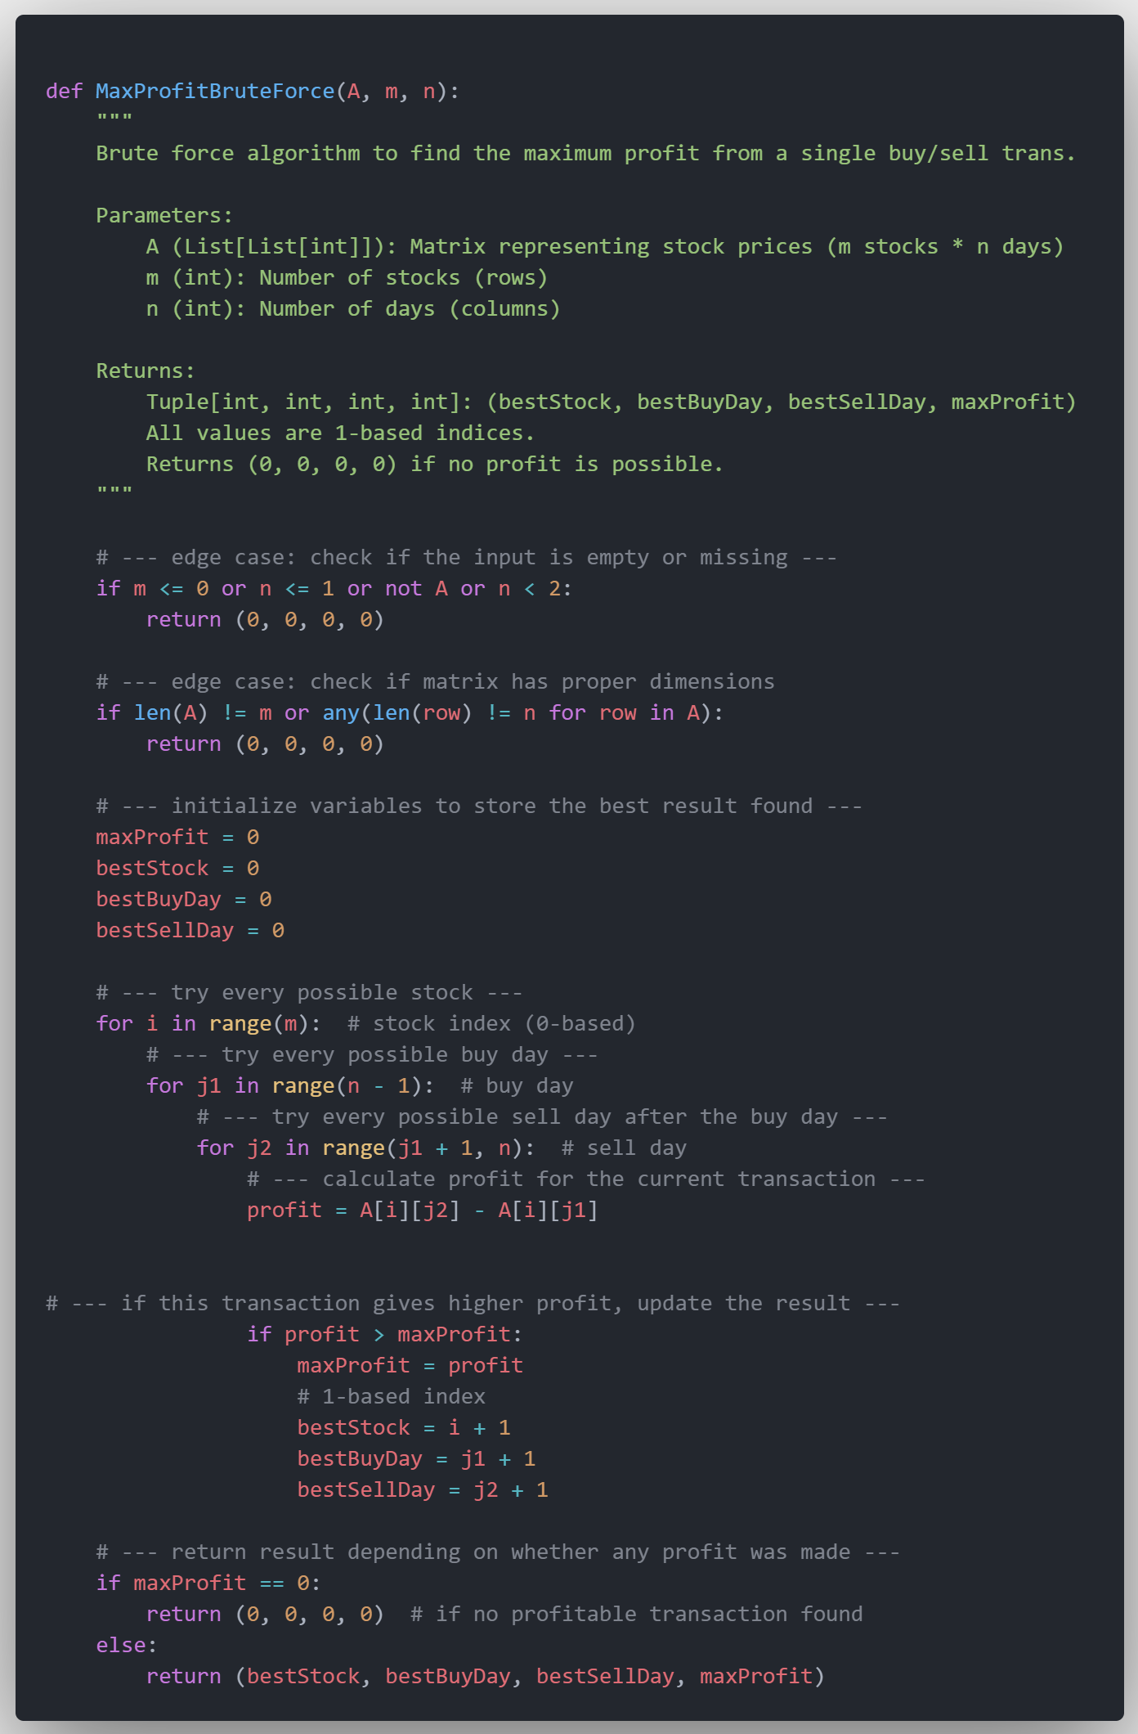
Task 1 - Brute Force Approach: Check Everything
Algorithm
Three nested loops (stocks → buy days → sell days)
Time Complexity
O(m × n²)
Example
1000 stocks × 1000 days = ~1 billion operations
Advantages
Simple to understand, guaranteed correct answer
Disadvantages
Extremely slow for large datasets
Best Use
Learning, small problems, algorithm verification

Slide 5
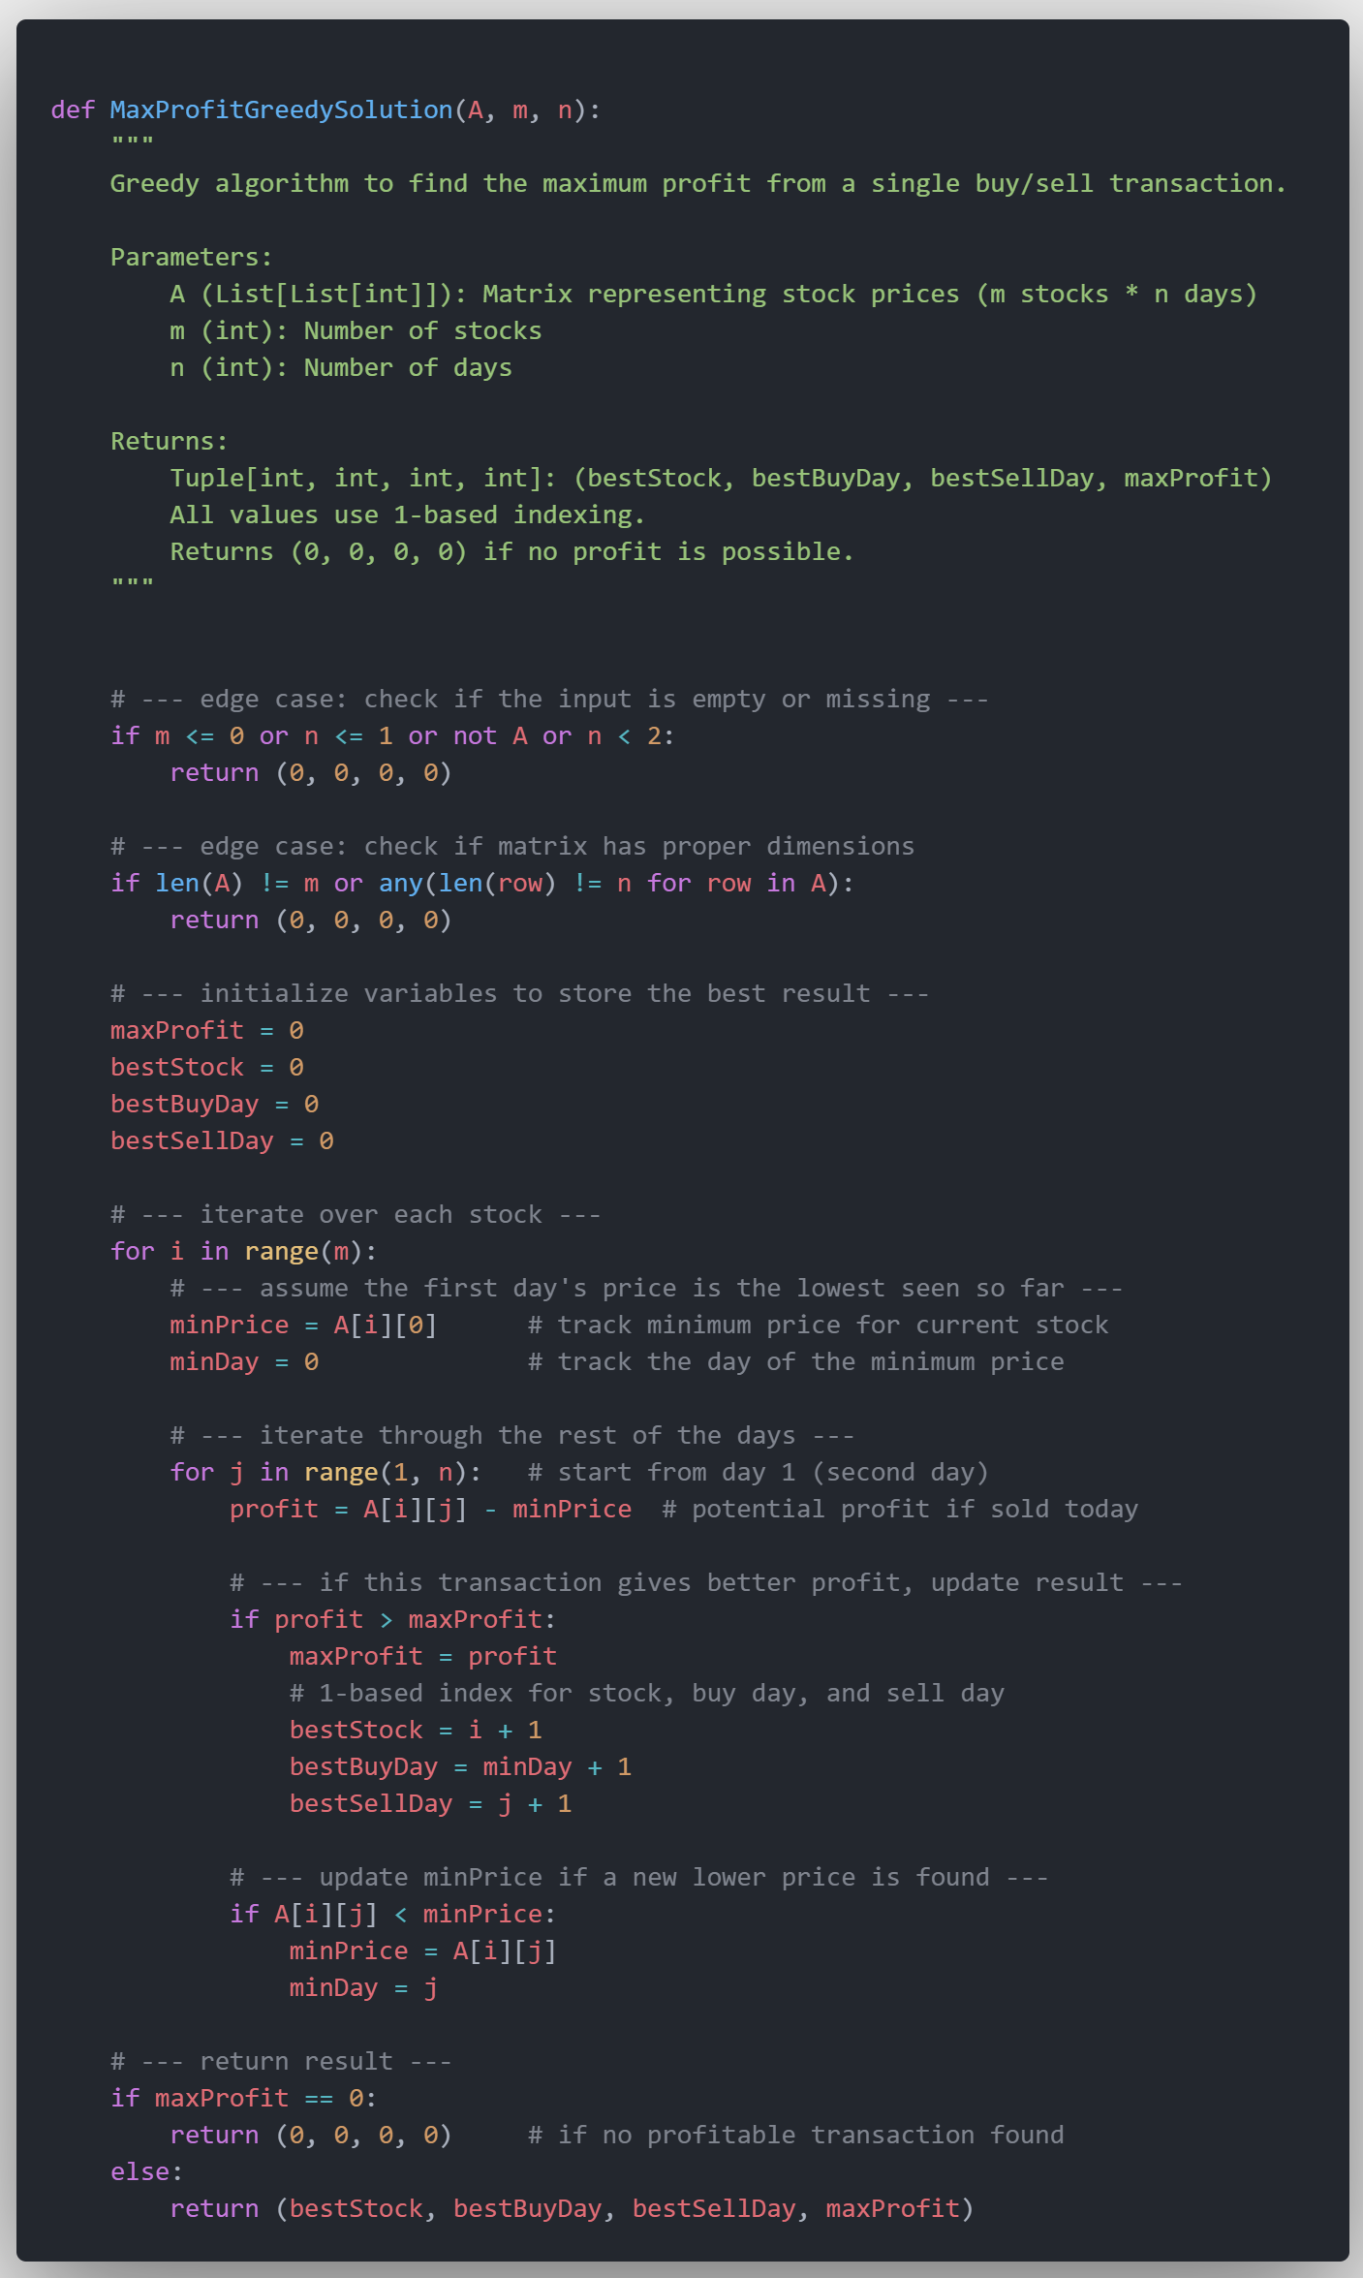
Task 2 - Greedy Optimization
For any sell day, optimal buy day = lowest previous price
Algorithm
Track minimum price while processing days sequentially
Time Complexity
O(m × n) - 1000× improvement!
Example
1000×1000 dataset = ~1 million operations
Advantages
Fast, elegant, mathematically optimal
Best Use
Production systems, single-transaction scenarios

Slide 6
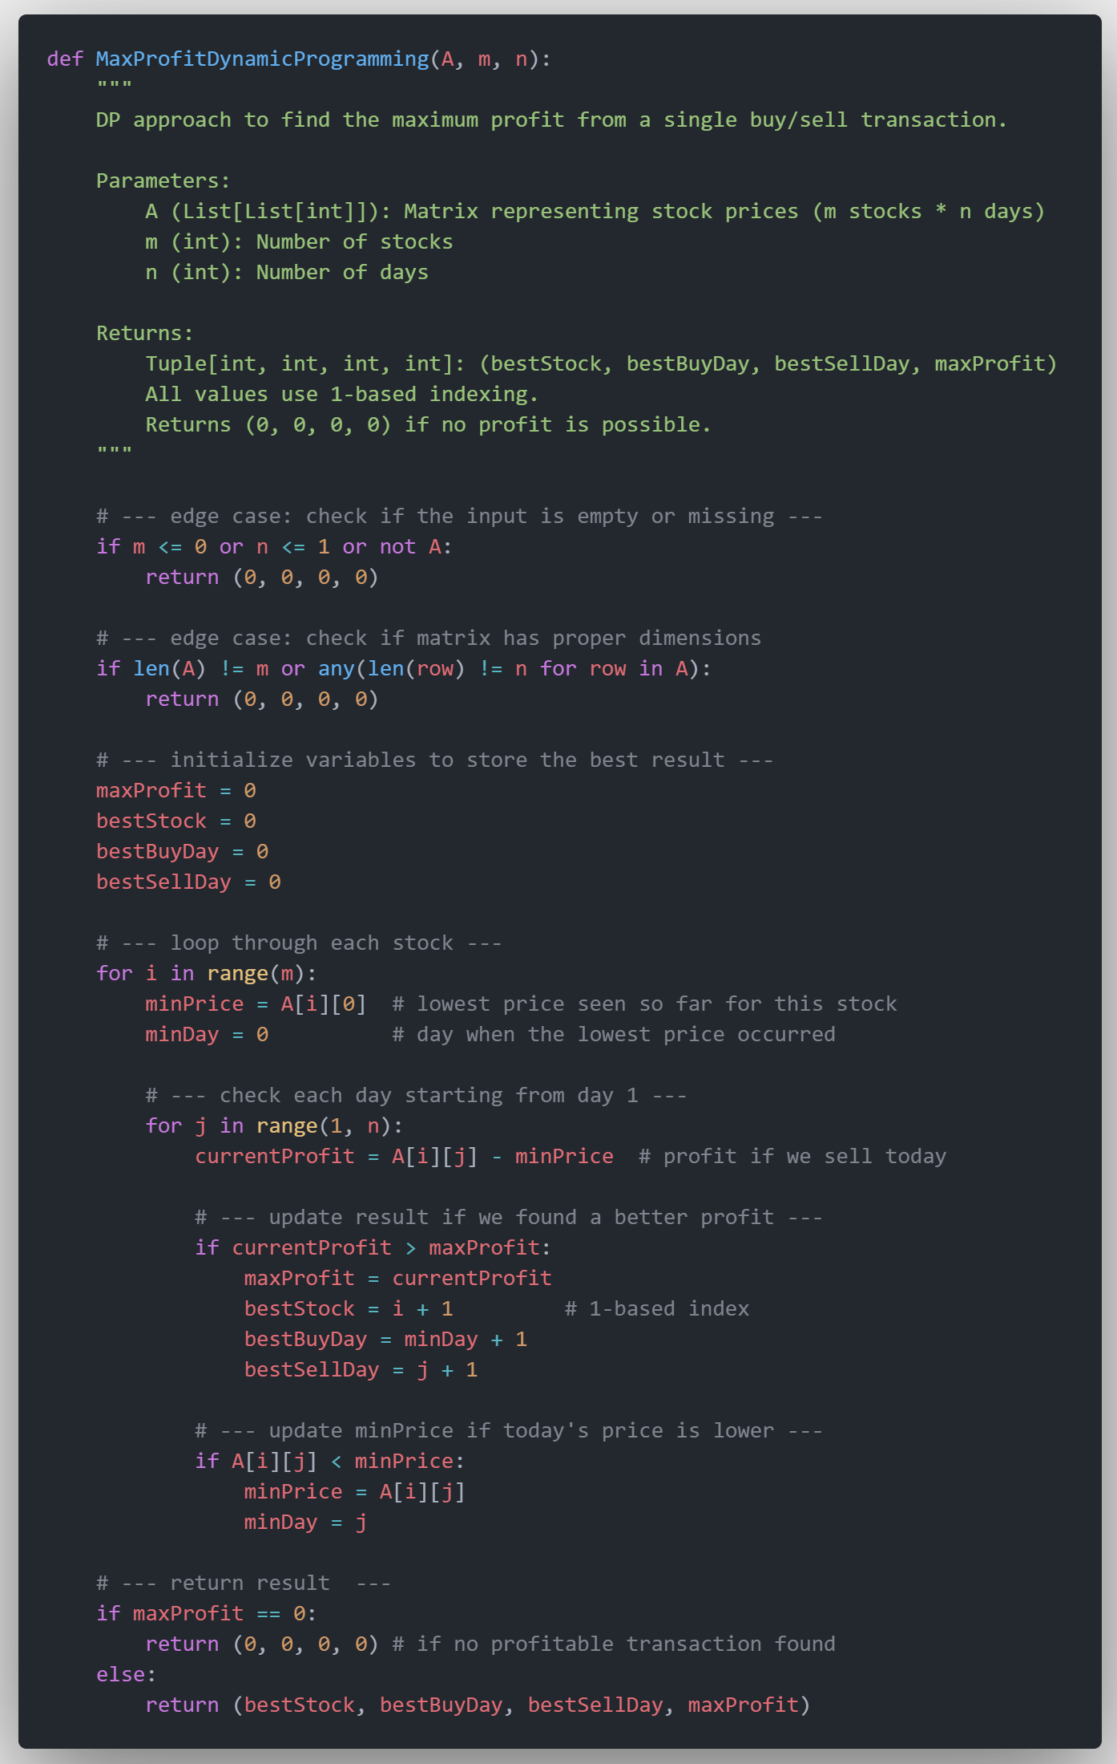
Task 3 - Single Transaction DP
Dynamic Programming Foundation
Approach:
DP principles applied to single-transaction problem
Performance:
O(m × n) - identical to greedy algorithm
Purpose:
Framework for extensibility, not immediate speed gains
Value:
Foundation for complex multi-transaction scenarios
Comparison:
Same performance as greedy, better structure for extensions
Best Use:
When planning to extend to Tasks 5-6 later

Slide 7
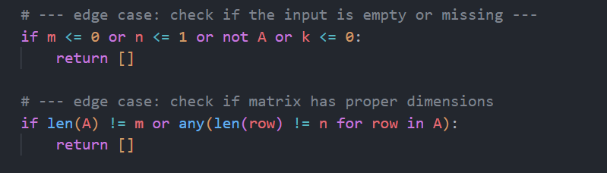
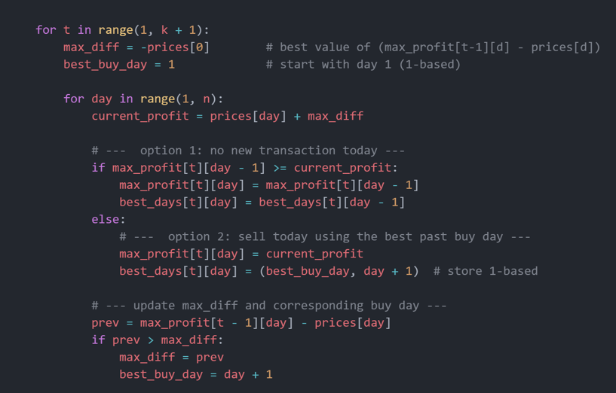
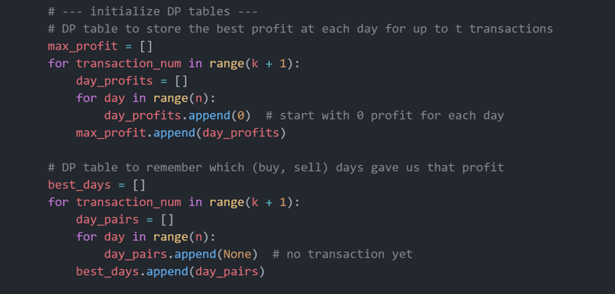
Task 5 - Multiple Transactions DP
Section 1: Algorithm Overview & Input Validation
Section 3: Core DP Algorithm
Section 2: DP Table Initialization

Slide 8
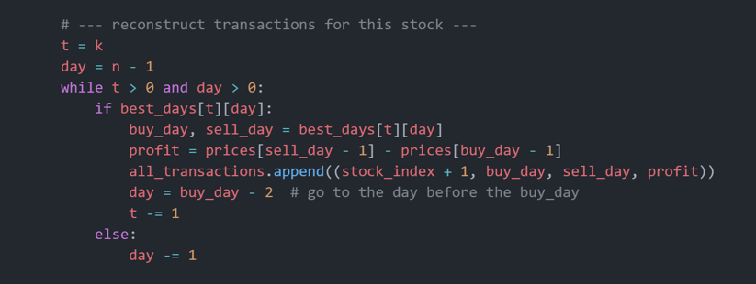
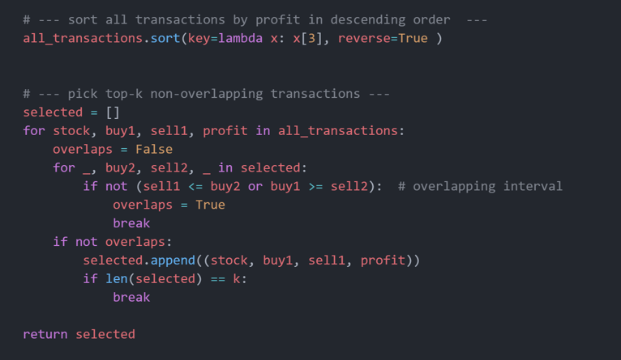
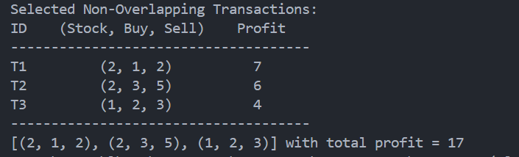
Task 5 - Multiple Transactions DP
Section 4: Transaction Reconstruction
Section 5: Global Selection & Return
Test Result

Slide 9
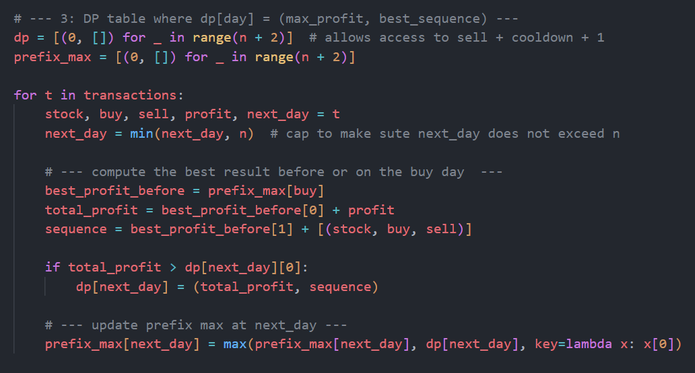
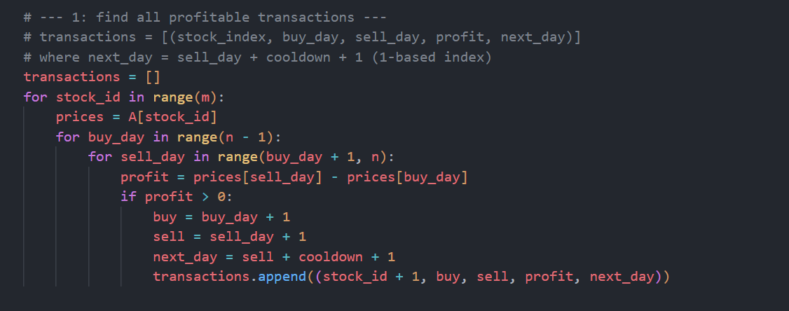
Task 6 - Multiple Transactions With Cooldown period DP
Problem Overview
Challenge: Cannot buy any stock for c days after selling any stock
Real-World Application: Models trading restrictions, settlement periods, or regulatory constraints
Example: If you sell on day 3 with cooldown=2, you cannot buy until day 6
Algorithm: Dynamic Programming with constraint handling
Section 1: Input Validation
Similar to Task-5
Section 3:Dynamic Programming Optimization
Section 2: Find all profitable transactions

Slide 10
Performance Comparison
Complexity Overview
Task | Problem | Algorithm Type | Time Complexity | Problem Description
Task 1 | Problem 1 | Brute Force | O(m × n²) | Single transaction
Task 2 | Problem 1 | Greedy | O(m × n) | Single transaction
Task 3 | Problem 1 | Dynamic Programming | O(m × n) | Single transaction
Task 5 | Problem 2 | Dynamic Programming | O(m × n × k) | Multiple transactions
Task 6 | Problem 3 | Dynamic Programming | O(m × n²) | Cooldown constraints
Performance Analysis (1000×1000 Dataset)
Task | Operations Required | Relative Speed | Best Use Case
Task 2/3 | ~1 million | 1000× faster | Production single-transaction
Task 1 | ~1 billion | Baseline (slowest) | Learning/verification
Task 6 | ~1 billion | Similar to Task 1 | Cooldown scenarios
Task 5 (k=10) | ~10 million | 100× faster than brute force | Multiple transactions

Slide 11
Algorithm Selection Guide Brute Force: Learning, datasets <100×100, algorithm verification Greedy: Production systems, single transactions, speed priority Single DP: Planning future extensions to multi-transaction problems Multi DP: Realistic trading, portfolio optimization, k-transaction scenarios, cooldown period Decision Factors: Dataset size, performance requirements, future extensibility needs Understanding level, maintenance complexity, correctness guarantees

Slide 12
THANK YOU

