Slide 1
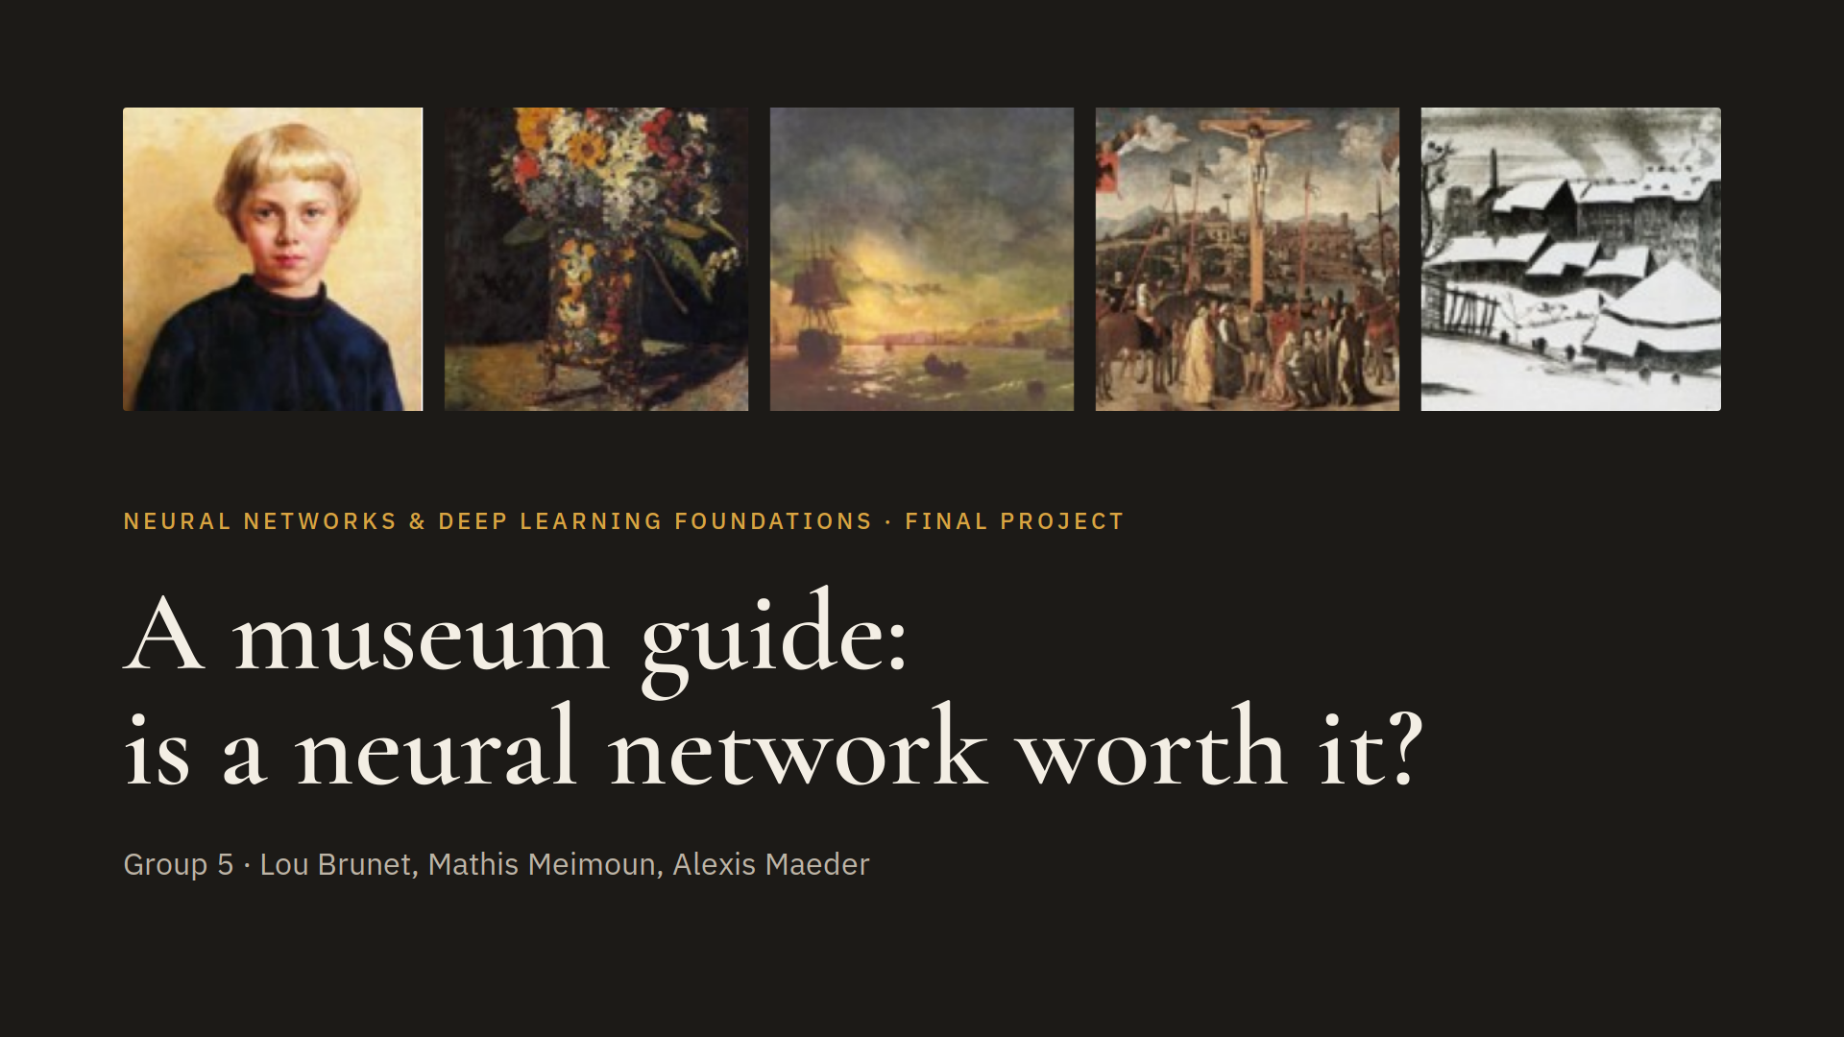
Notes:
SPEAKER: LOU (about 35 seconds)
Good morning. We are Group 5: Lou, Mathis and Alexis.
The Museum wants a guide on phones and gallery kiosks that recognises a painting and answers questions in plain words. The director asks: on modest kiosk CPUs, is a neural network worth it, or would a classical model do?
Our answer: yes, but not just any network. A pretrained CNN beats the best classical model by 21 points at a similar latency. A plain feed-forward network does not even beat it.

Slide 2
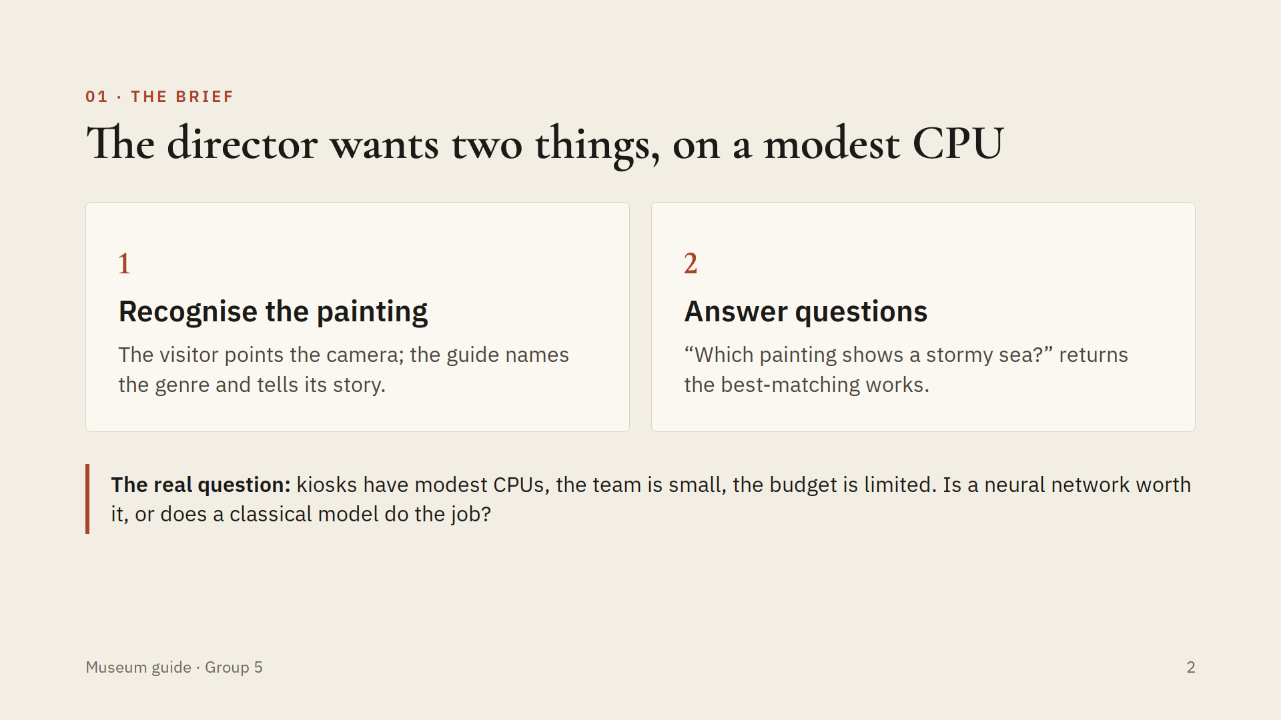
Notes:
SPEAKER: LOU (about 45 seconds)
The brief has two missions. First, recognition: a visitor points a camera at a painting and the guide names what kind of painting it is. We chose genre, which the brief allows as an alternative to style. The story told to the visitor is content to write on top; we did not build it here.
Second, search: a visitor types a question and gets the matching artworks.
Behind both, one constraint: modest CPUs, a small team, a limited budget. So every model comes with two numbers: accuracy on a test set split by artist, and time per image on one CPU core.

Slide 3
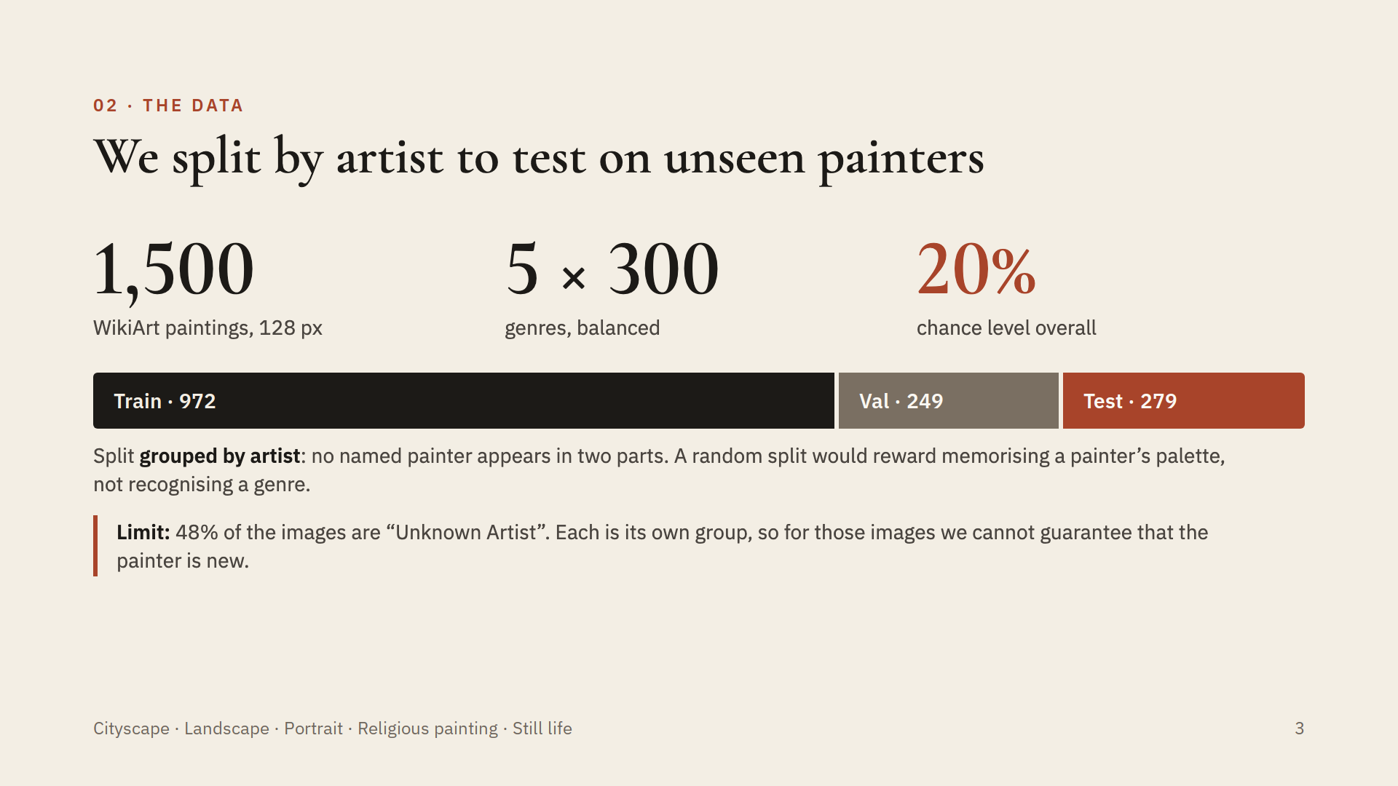
Notes:
SPEAKER: MATHIS (about 50 seconds)
Our data is a WikiArt subset built with the course script: 1,500 paintings, five genres, 300 each. Overall, random guessing gives 20%.
The key choice is the split. A painter's hand is easy to memorise: palette, brushwork, framing. If one painter appears in training and in test, the model can score by recognising Renoir, not a portrait. So we split by artist: 972 images for training, 249 for validation, 279 for test, and no named painter is in two parts.
One honest limit: 48% of the images are labelled Unknown Artist. Each is its own group, because it is not one person. So for those images, we cannot guarantee that the painter is new.
If asked: the parts are about 65/17/19 because GroupShuffleSplit splits groups, not images. Classes are balanced overall, not inside each part.

Slide 4
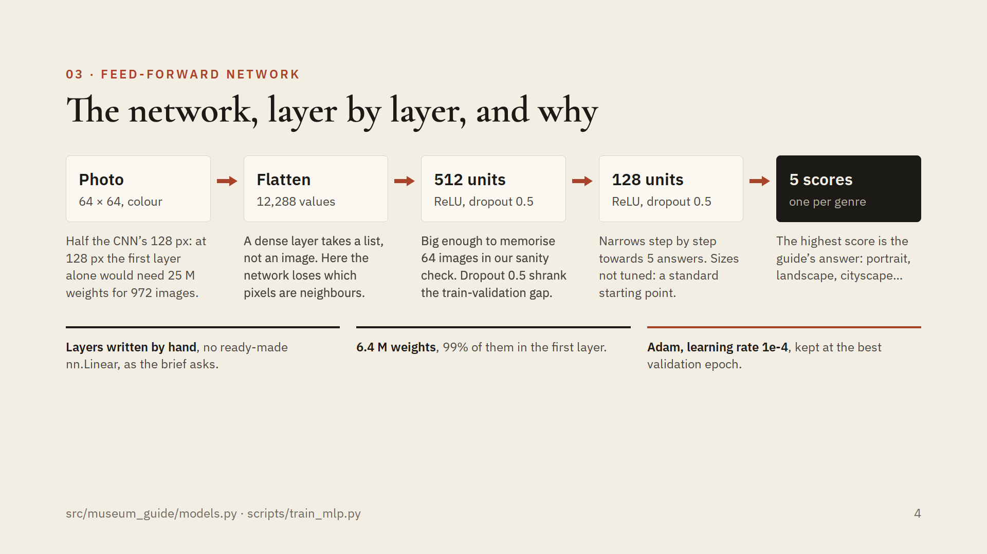
Notes:
SPEAKER: MATHIS (about 1 min 15)
Here is the feed-forward network, layer by layer.
The input is the image at 64 by 64 pixels, half what we give the CNN: at 128 pixels the first layer alone would need 25 million weights for fewer than a thousand images.
Then we flatten: a dense layer takes a list, not a picture, so the image becomes 12,288 values. Remember this step. The network no longer knows which pixels are neighbours, and every weight stays tied to one position. Lou will show why this hurts.
Then two hidden layers, 512 and 128 units, with ReLU and dropout. 512 is big enough to memorise 64 images in our sanity check, so capacity is not the issue. We did not tune these sizes: it is a standard funnel. The output is five scores, one per genre.
We wrote the layers ourselves rather than using nn.Linear, as the brief asks. That gives 6.4 million weights, 99% in the first layer. We train with Adam at 1e-4 and keep the epoch with the best validation accuracy.

Slide 5
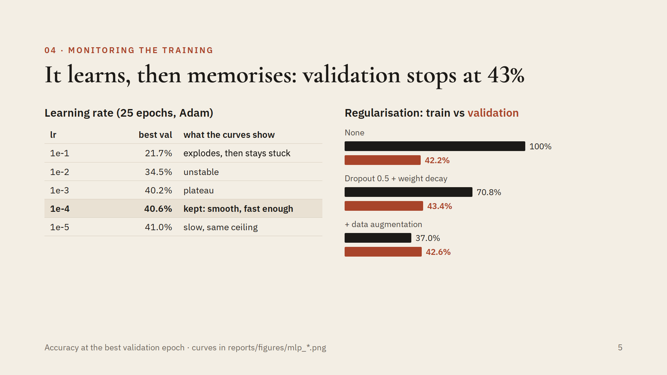
Notes:
SPEAKER: LOU (about 1 min 00)
For every run we log loss, accuracy and gradient norm at each epoch; the curves are in the repository.
On the left, the learning rate. At 0.1 the loss explodes in the first epoch, then stays stuck near ln 5, about 1.61: the loss of a uniform guess. The network has stopped learning. At 0.01 it is unstable. From 1e-3 to 1e-5 every run reaches 40 to 41% on validation. We kept 1e-4: smooth curves, reasonable speed.
On the right, overfitting. With no regularisation, training accuracy reaches 100% while validation stays at 42%: the network memorises. Dropout 0.5 with weight decay brings training down to 71%, and validation is 43%. Those validation differences are only a few images, so we treat them as equal.
Regularisation closes the gap; it does not raise the ceiling. Something else limits this network.

Slide 6
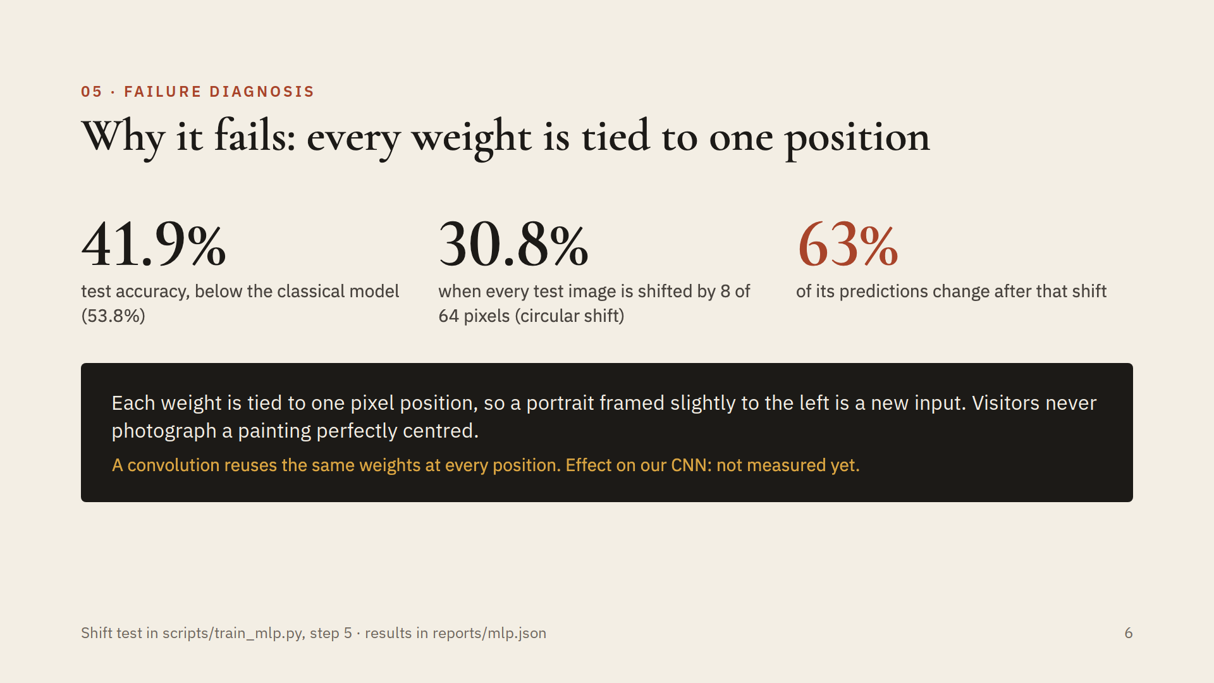
Notes:
SPEAKER: LOU (about 50 seconds)
On the test set, the feed-forward network reaches 41.9%: twice chance, but below the classical model at 53.8%.
To test one precise explanation, we shifted every test image by 8 pixels, one eighth of its side. Accuracy falls to 30.8%, and 63% of the predictions change. Same paintings; only their position moved.
The reason: every weight is tied to one pixel position. And nobody points a phone perfectly centred on a painting, so a kiosk using this network would contradict itself.
A convolution reuses the same small filter at every position, which should help. We have not run this test on our CNN yet, so that part is an argument, not a measurement. Alexis.
If asked: the shift is circular (torch.roll), so pixels leaving one edge come back on the other. It is a stress test of position sensitivity, not a simulation of a camera move.

Slide 7
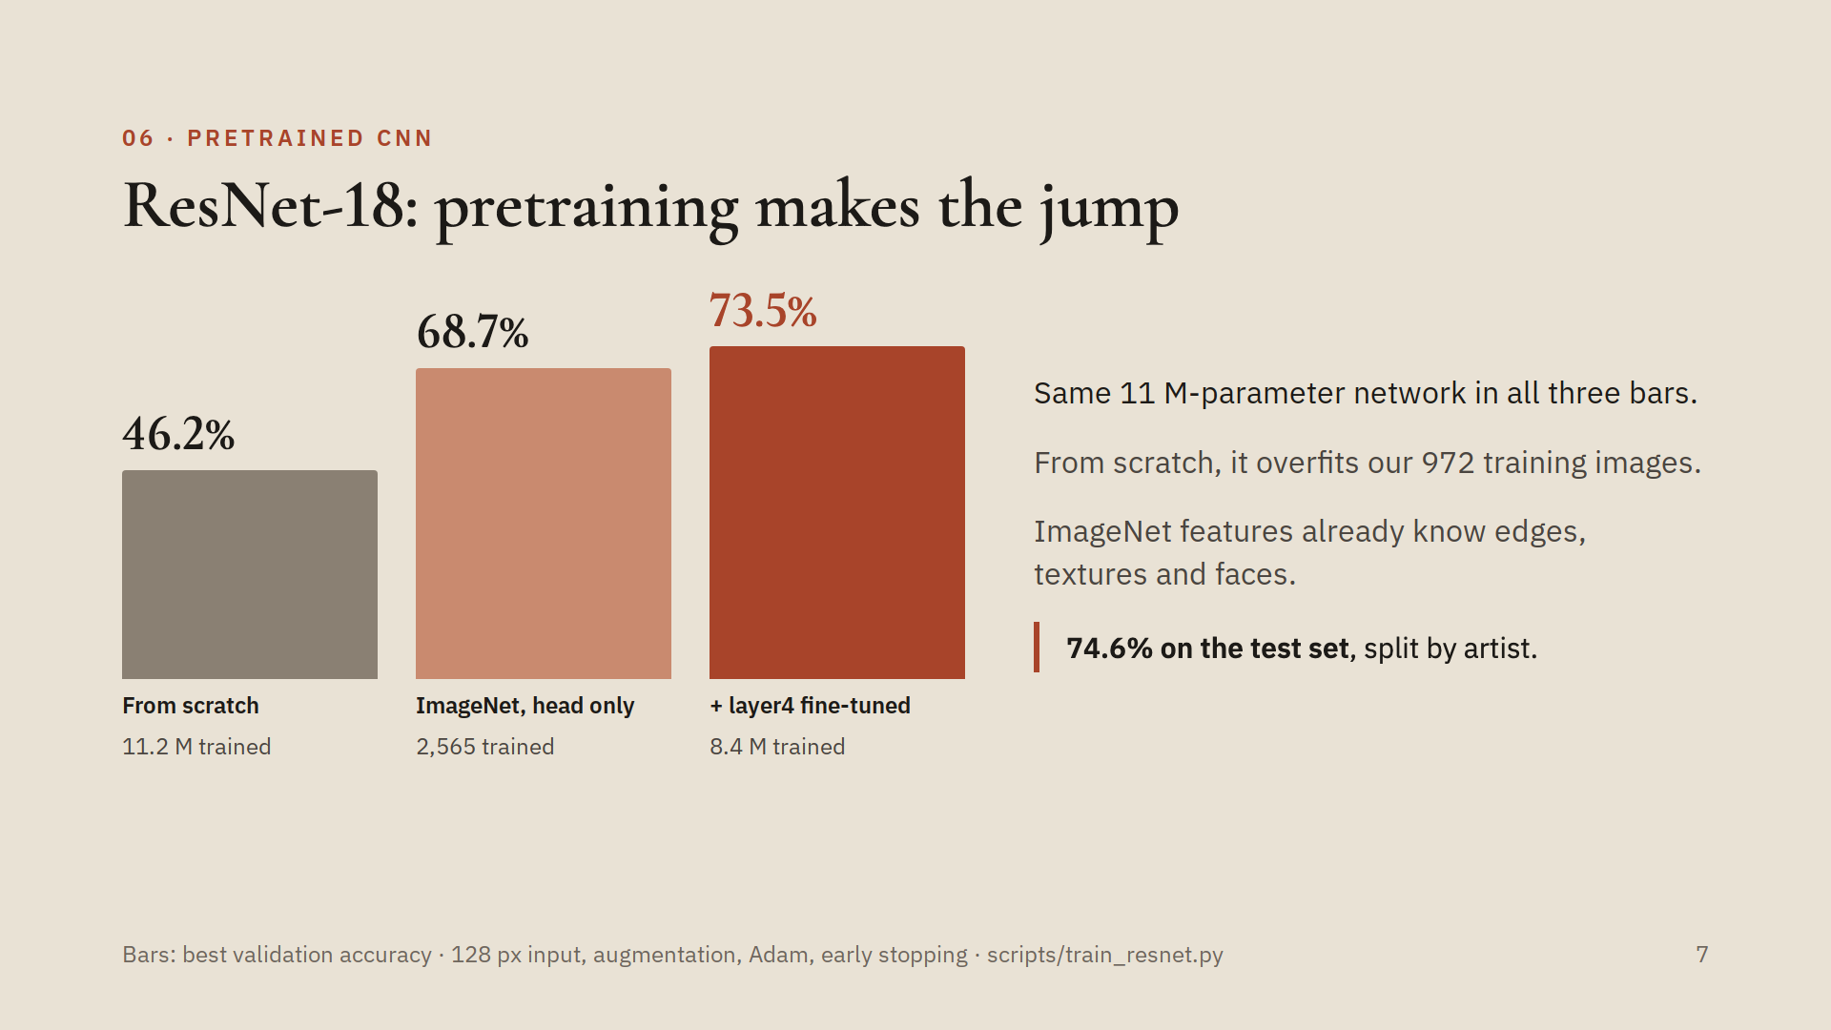
Notes:
SPEAKER: ALEXIS (about 55 seconds)
The third deliverable is a pretrained CNN. We trained ResNet-18 three ways, on the same network.
From scratch on 972 images, it reaches 46.2% on validation: eleven million parameters, fewer than a thousand images, so it overfits. That is no better than the random forest, at 47.4% on the same validation set.
With ImageNet weights, we froze the network and trained only a new final layer: 2,565 parameters. Validation jumps to 68.7%. Features learnt on more than a million photos transfer to paintings.
Then we also unfroze the last block, layer4, at a smaller learning rate. Validation reaches 73.5%, and the test set 74.6%.
So the jump comes from pretraining. For a small museum, that is the key: we do not need a big dataset, we reuse one.

Slide 8
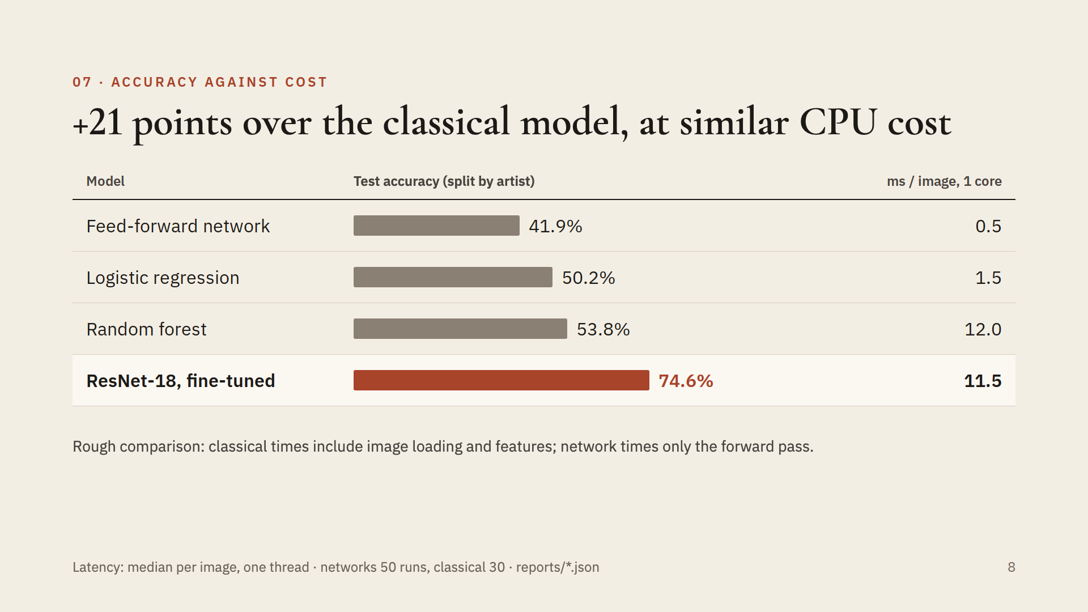
Notes:
SPEAKER: ALEXIS (about 50 seconds)
This slide answers the director. Same 279 test paintings for everyone.
The classical baseline uses 126 hand-made features: colour histograms, edge orientations and a coarse layout, then a logistic regression or a random forest. The forest reaches 53.8%, which beats our feed-forward network. The fine-tuned ResNet reaches 74.6%: 21 points more.
Now cost. The median time per image on one thread is 11.5 milliseconds for the ResNet and 12 for the forest. One caveat: the classical time includes loading the image and computing its features, while the ResNet time is only the pass through the network. So read this as the same order of magnitude, not a tie.
If asked: with 279 images, each accuracy has a 95% interval of about 5 points, and the gap about 8. The gap of 21 is well beyond that.

Slide 9
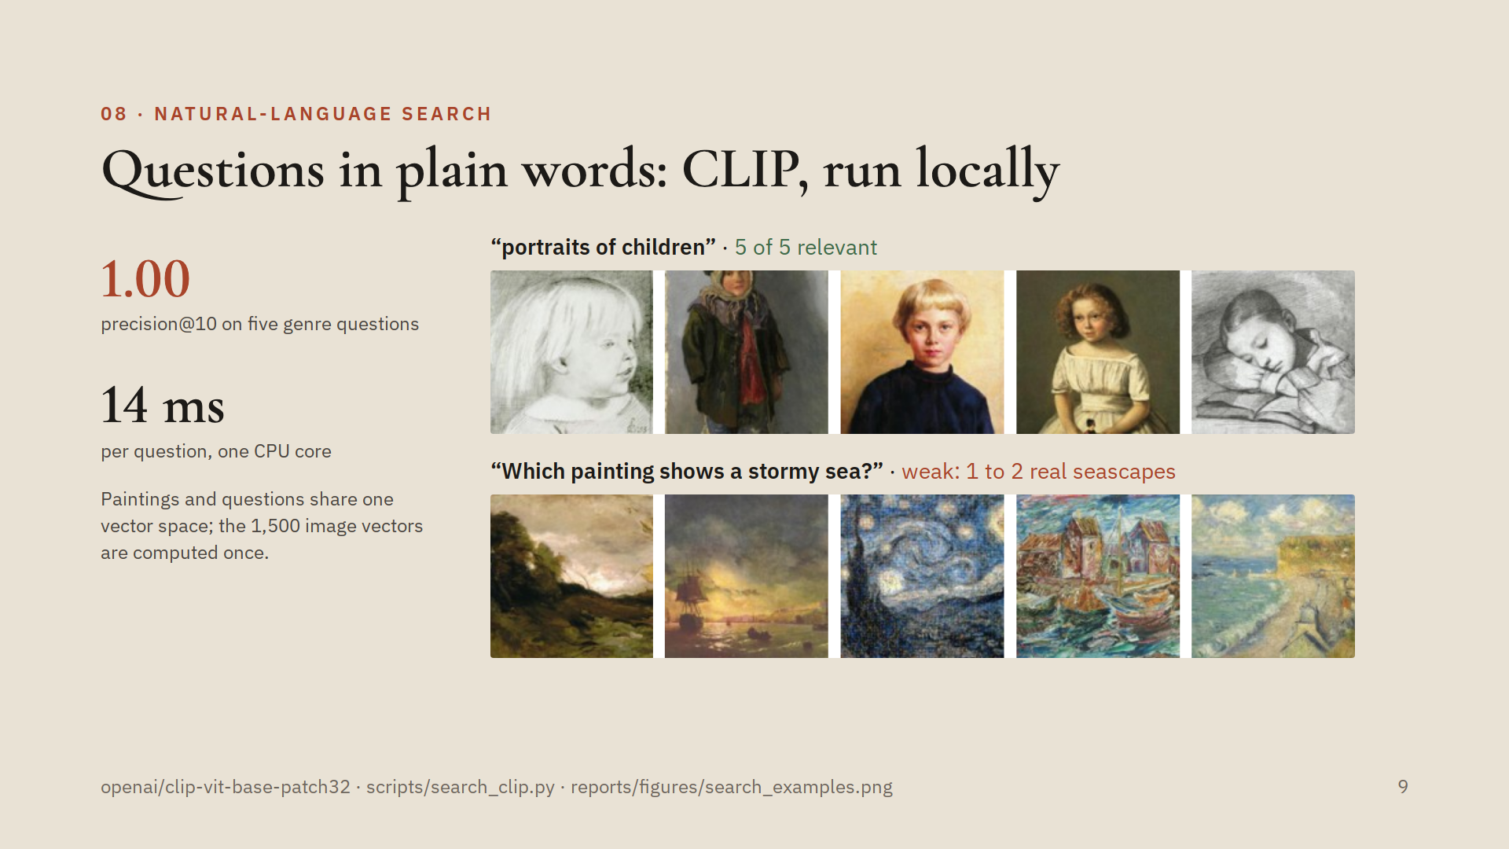
Notes:
SPEAKER: MATHIS (about 1 min 05)
Second mission: search. We use CLIP, a pretrained model with two encoders, one for images and one for text, which place paintings and sentences in the same vector space. We compute the 1,500 image vectors once. A question then costs one text encoding and a dot product: 14 milliseconds on one CPU core.
To measure it, we wrote one visitor-style question per genre, like “I would like to see portraits of people”. For all five, the top ten results are the right genre: precision at 10 equals 1. That test is easy, because genres are broad.
Free questions are more interesting, and we judged those by eye. “Portraits of children” returns five out of five. But “Which painting shows a stormy sea?” is our weak case: dramatic skies and boats, only one or two real seascapes. The likely reason is the data: we downloaded no marine genre.

Slide 10
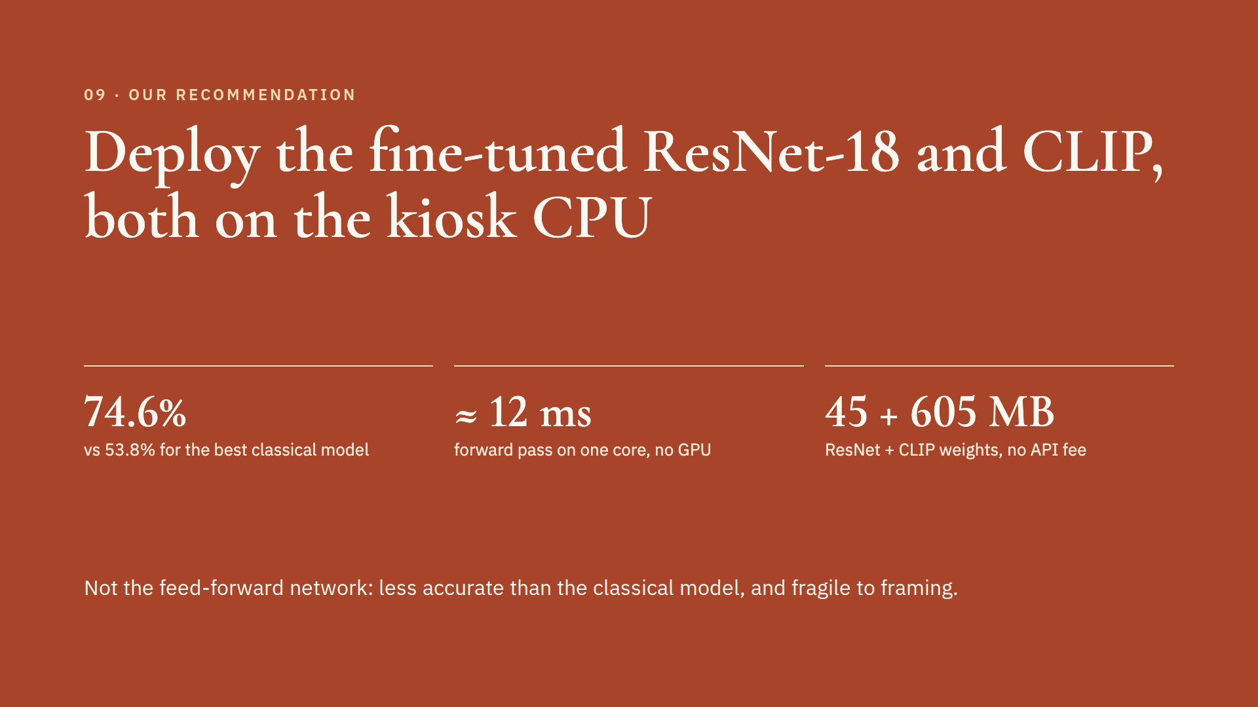
Notes:
SPEAKER: ALEXIS (about 40 seconds)
Our recommendation: yes, a neural network is worth it, but a pretrained one.
Use the fine-tuned ResNet-18 to recognise the painting and CLIP to answer questions, both locally on the kiosk. It is 21 points more accurate than the best classical model, at about 12 milliseconds of model time on one core, with no GPU and no API fee. The weights are 45 megabytes for the ResNet and about 600 for CLIP, so kiosk memory must be checked.
We would not deploy the feed-forward network: less accurate than the classical model, and fragile to framing.

Slide 11
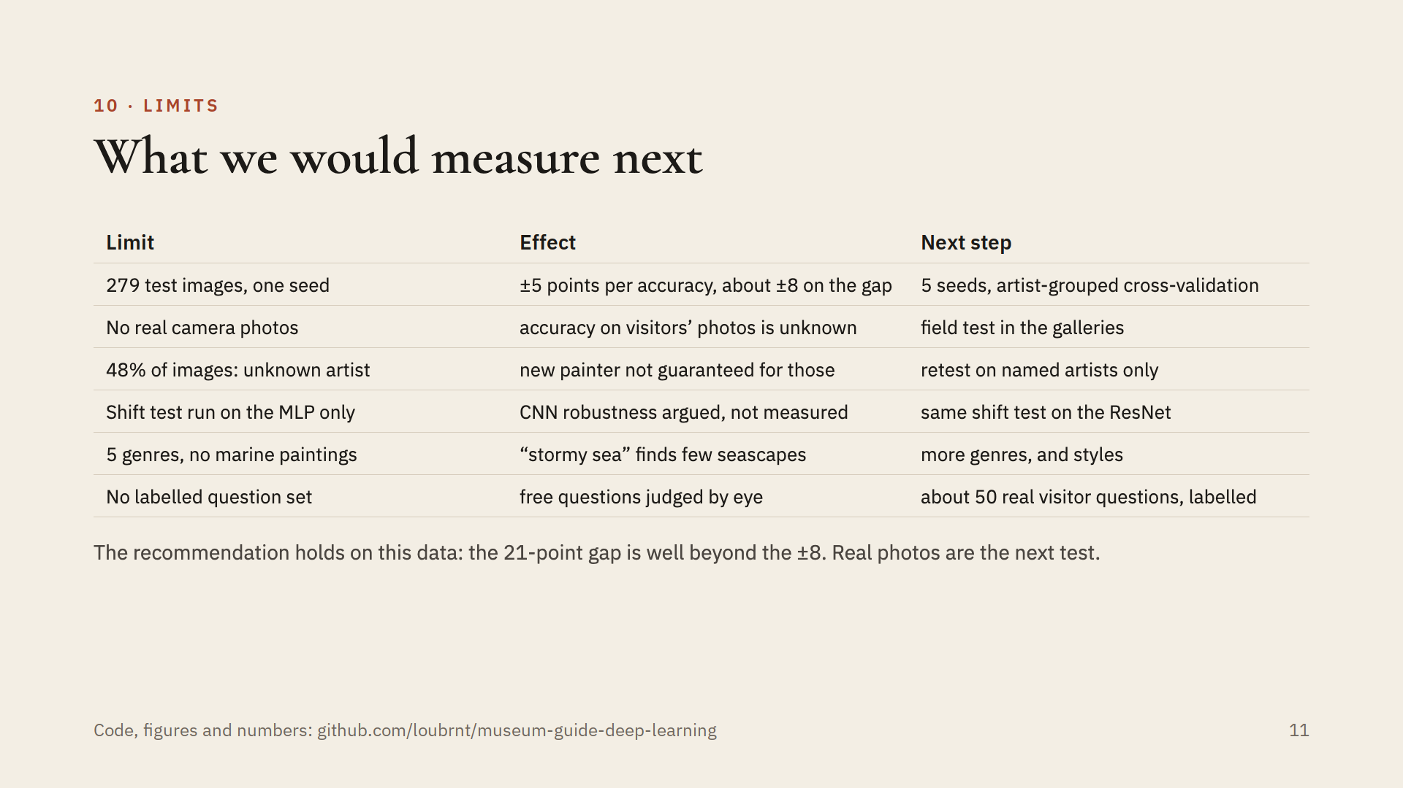
Notes:
SPEAKER: ALEXIS (about 45 seconds)
To finish, the limits we know. We ran one seed on 279 test images: about plus or minus 5 points per accuracy, and about 8 on the gap, which is still 21.
We have not tested real camera photos, and almost half the images have no known artist. The shift test ran only on the feed-forward network, and free questions are judged by eye.
So the recommendation holds on this data, and the next step is a field test in the galleries. Code, figures and numbers are all in the repository. Thank you, we are happy to take your questions.

