Slide 1

Characterizing the Google Books Corpus:
Strong Limits to Inferences of Socio-Cultural
and Linguistic Evolution
Pechenick, Danforth, & Dodds (2015)
Data Science Brownbag
10/27/2015

Slide 2
Google Books
(2009) 5 million books (subset of 15mil from libraries)
361 billion English words (i.e. tokens)
(2012) 500 billion English words
15% of the world's books
N-grams computed
The quick brown fox jumped over the lazy dog
1g | 2g | 3g | 4g | 5g
the | the quick | The quick brown | The quick brown fox | The quick brown fox jumped
quick | Quick brown | Quick brown fox | Quick brown fox jumped | Quick brown fox jumped over
brown | Brown fox | Brown fox jumped | Brown fox jumped over | Brown fox jumped over the

Slide 3
Corpus
Corpus – collection of written texts
Google n-books is a “library” of books with exactly one copy.
The simplest possible analysis involving any Google Books data set is to track the relative frequencies of a specific set of words or phrases. Examples of such analyses involve words or phrases surrounding individuality, gender, urbanization, and time all of which are of profound interest.
The strength of all conclusions drawn from these must take into account both the number of words and phrases in question and the sampling methods used to build the Google Books corpus

Slide 4
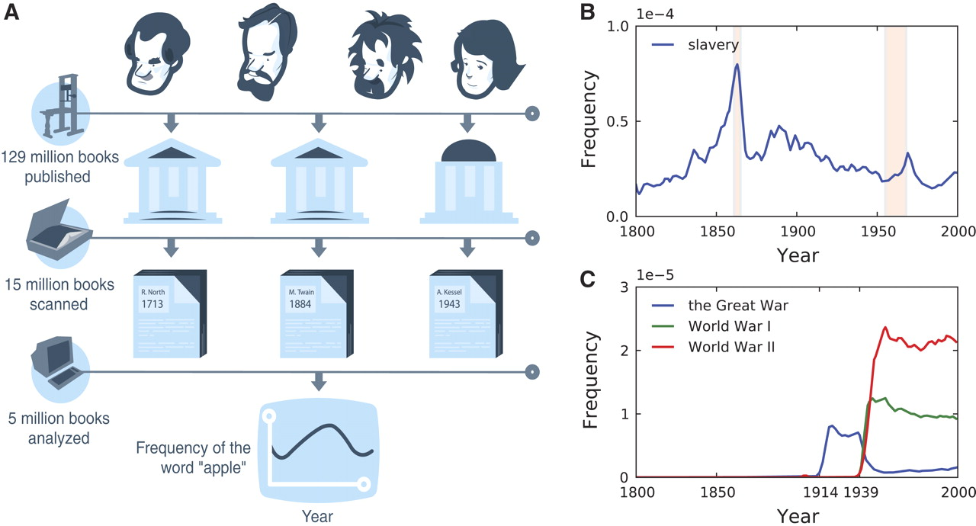

Slide 5
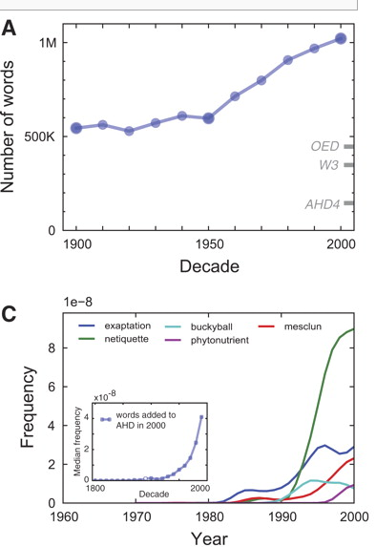
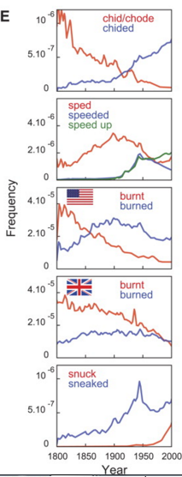

Slide 6
Examples using Google n-gram
https://books.google.com/ngrams
Frequency of terms (Albert Einstein, Frankenstein, Sherlock Holmes)
Cultural popularity of terms (flapper, yuppie, hippie)
Disambiguation (cheer_NOUN, cheer_VERB)
Relative growth (record player / vitrola + record player)

Slide 7
Basic Position
Claims that google n-grams reflect “true culture” is questionable as the “Google Books library has ultimately been furnished by the efforts and choices of authors, editors, and publishing houses.” - Pechenick, Danforth, & Dodds (2015)

Slide 8
What is google ngram a measure of?
Measures small-scale popularity
How often n-grams appear in a library with all books given equal importance tied to their year of print.
Corpus is more like a lexicon for a collection of texts, rather than a collection itself.
B/c n-grams have frequency, data-set conveys illusion of large-scale popularity.

Slide 9
Authors' contribution
A principled approach for exploring word and phrase evolution
How the google books corpus is challenged by the inclusion of scientific and medical journals
How future analyses of the Googel Books corpus should be considered

Slide 10
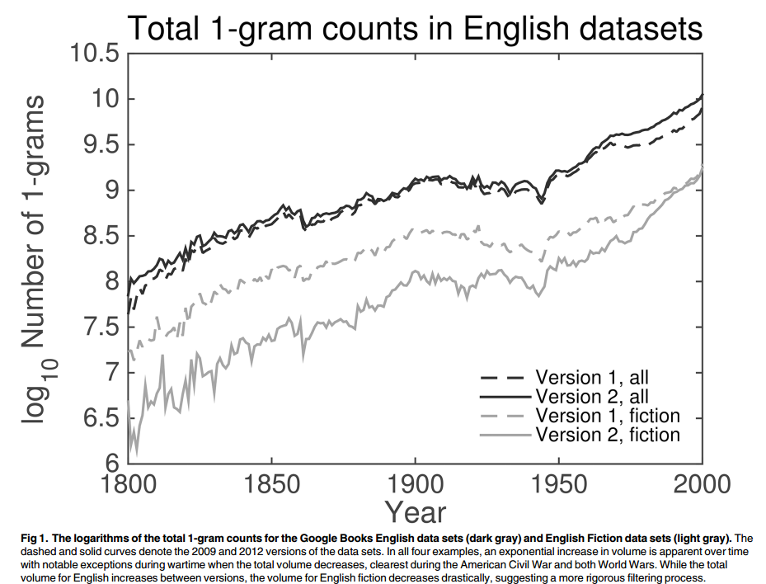
Methodology
Focused on English 1-grams from 1800 – 2000.
We examine the dynamics of the Google Books corpus by calculating the statistical divergence
between the distributions of 1-grams in two given years. A commonly used measure of statistical divergence is
Kullback-Leibler (KL) divergence

Slide 11
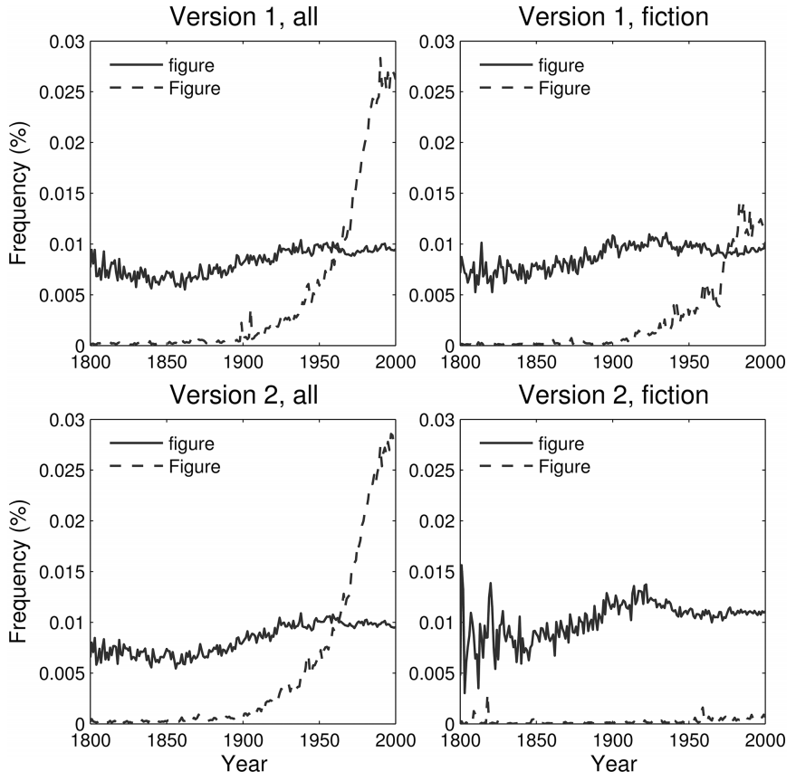
Since the majority of
books in the corpus originated in university libraries, a major effect of scientific texts on the
dynamics of the data set is quite plausible.
This trend is also apparent—albeit delayed—in the
first version of the English Fiction data set, which again suggests insufficient filtering during
the compilation process for that version.

Slide 12
Lexical Divergence
Words with larger average probability yield greater contributions as do those with smaller ratios, r, between the smaller and average probability. So while a common 1-gram—such as “the,” “if,” or a period—changing subtly can have a large effect on the divergence, so can an uncommon(or entirely new) word given a sufficient shift from one year to the next.
This measure of divergence is bounded between 0 when the distributions are the same and 1 bit in the extreme case when there is no overlap between the 1-grams in the two distributions.

Slide 13
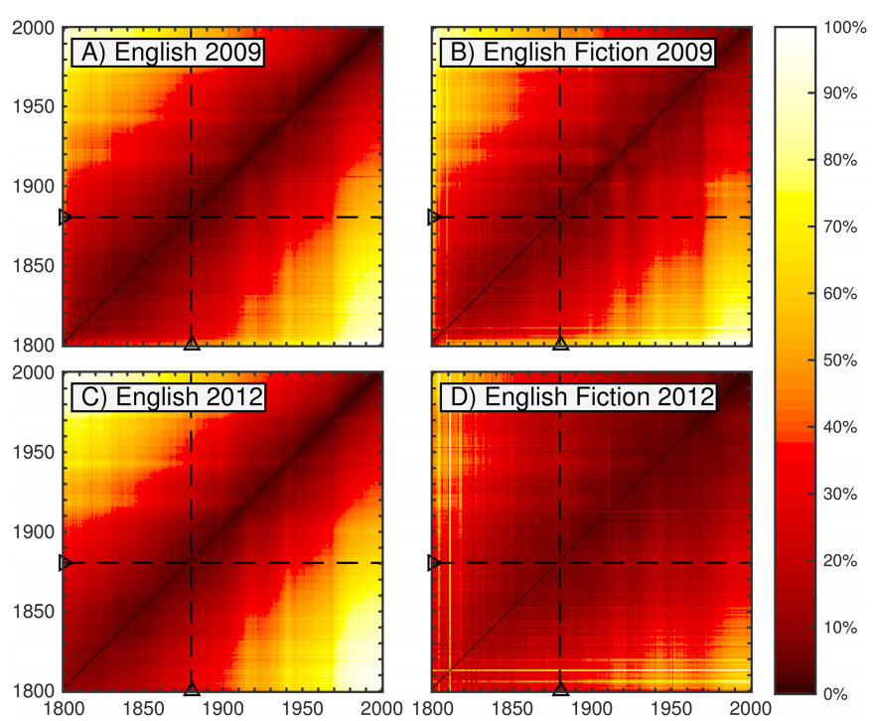

Slide 14
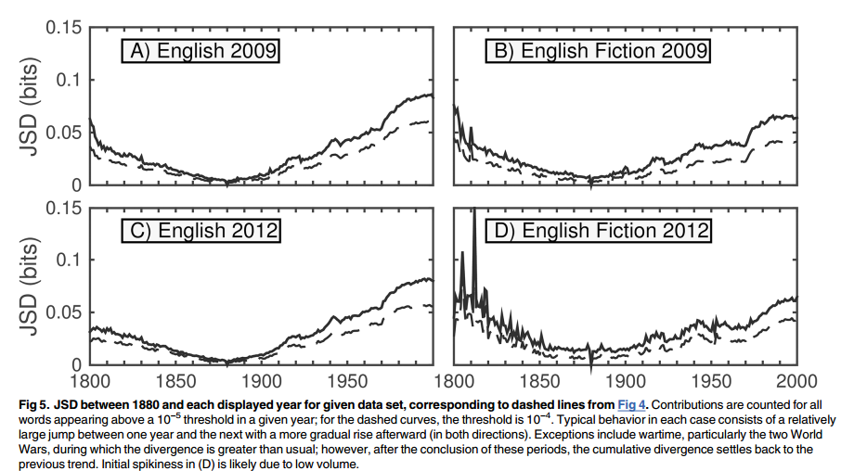

Slide 15
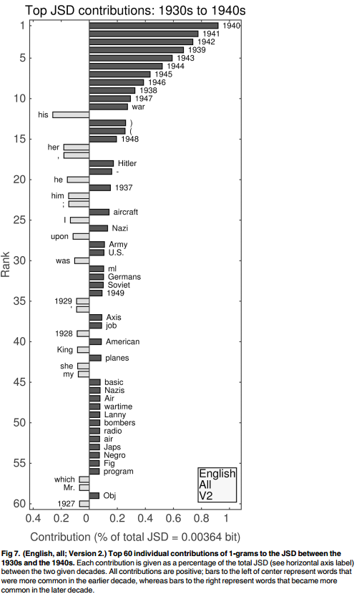
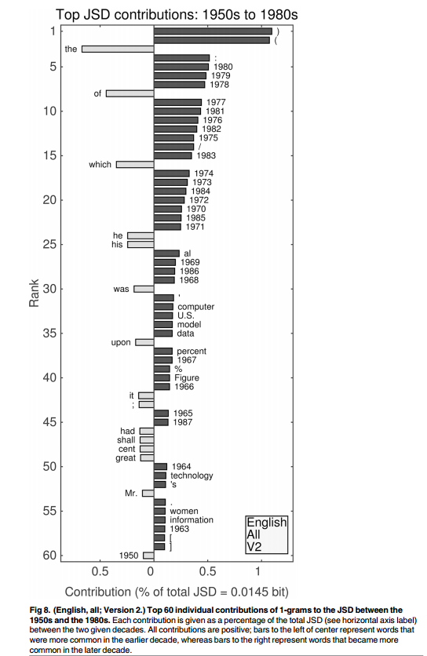
General observations:
Largest contributor of decade-decade divergence is increased word frequency
Increase year-mention
1940s – increased war terms (Nazi, Army)
1980 – increase tech terms (data, technology)

Slide 16
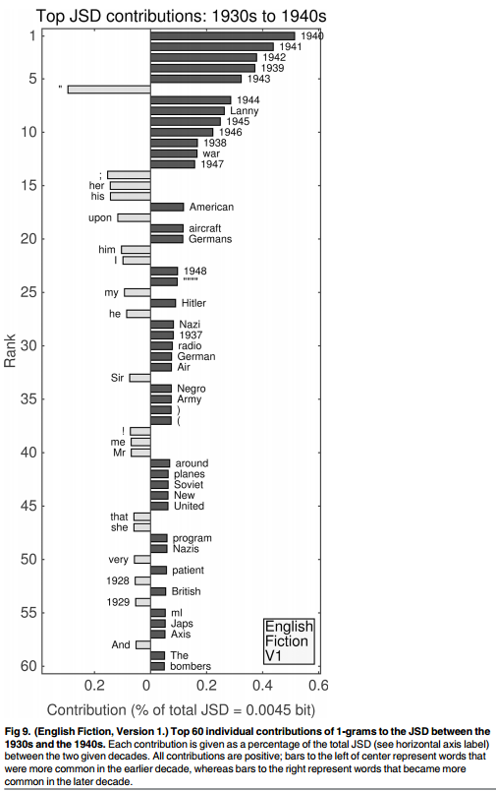
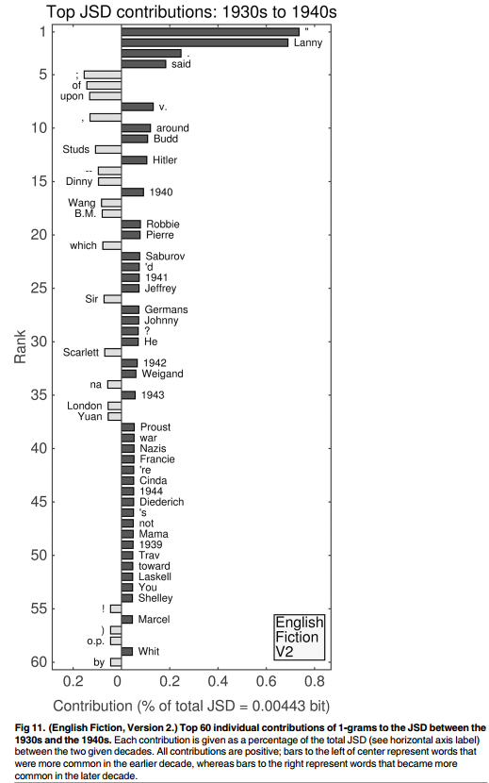
1930s v 1940s

Slide 17
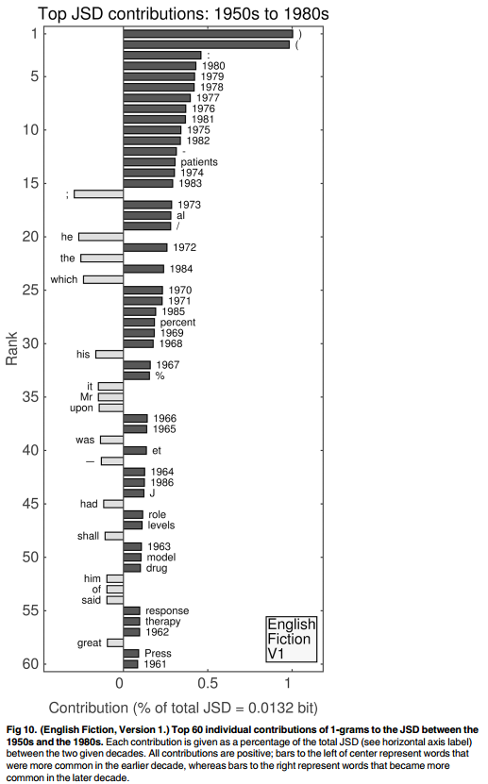
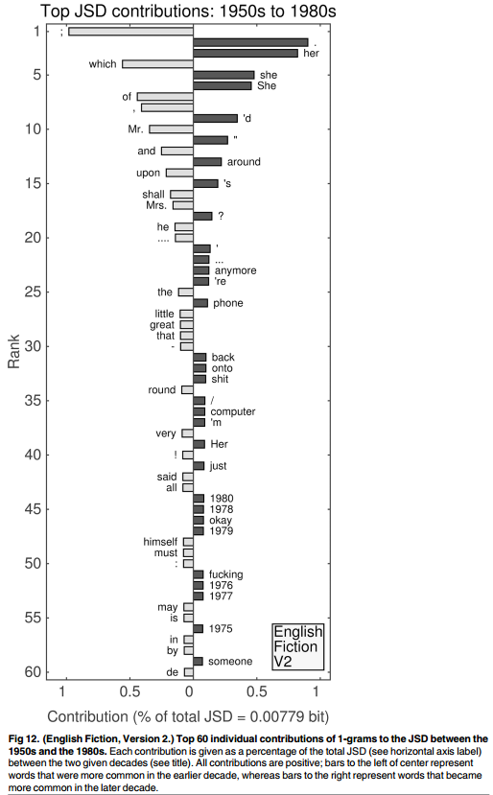

Slide 18
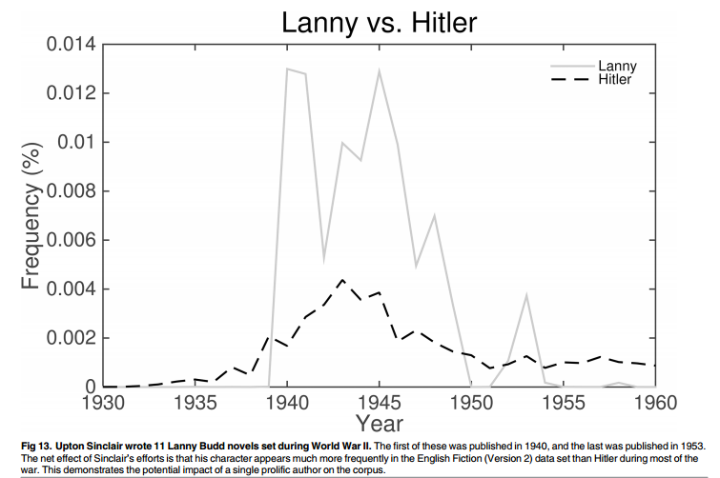

Slide 19
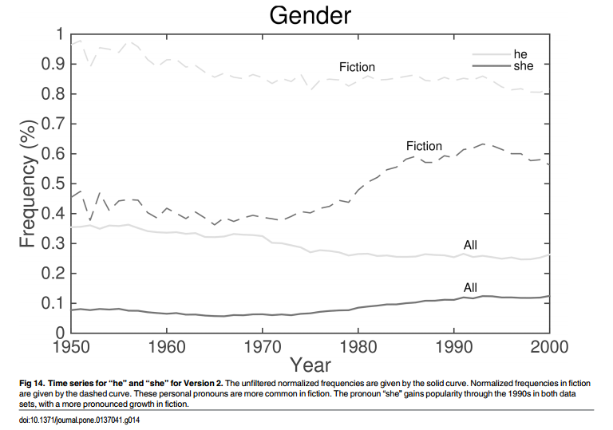

Slide 20
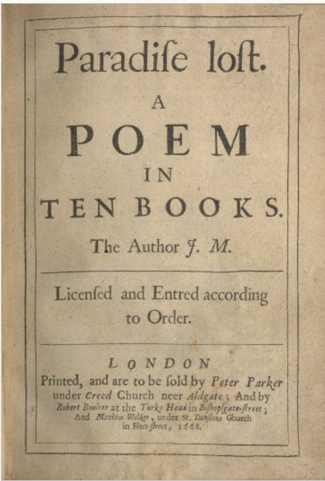
For divergences to and from the first decade of the 1800s, many of the contributions are due to a reduction of optical character recognition confusion between the letters ‘f’ and ‘s’.
For example, in the second unfiltered data set between the 1800s and 1810s, the top two contributions are due to reductions in “fame” and “os,” respectively.
The word “same”(ranked 11th) is the first increasing contribution. Decreased relative frequencies of “os,” “sirst,” “thofe,” “fo,” “fay,” “cafe,” “fays,” “fome,” and “faid” (ranks 3 through 10, respectively) and “lise” (12th) all suggest digital misreadings of both ‘f’ and the long ‘s’.

Slide 21
Conclusion: the contents of the Google Books corpus do not represent an unbiased sampling of publications.
Beyond being library-like, the evolution of the corpus throughout the 1900s is increasingly dominated by scientific publications rather than popular works.
We have shown that even the first data set specifically labeled as fiction appears to be saturated with medical literature.

