Slide 1
A Performance Evaluation of the Mobile Agent Paradigm
Leila Ismail, Daniel Hagimont
Sirac Project - INRIA Rhône-Alpes
Daniel.Hagimont@inrialpes.fr
http://sirac.inrialpes.fr

Slide 2
Motivations
Client-server model
  remote procedure or method invocation
  simple
  wide spread (eg: Web)
Mobile agents (MA)
  process migration
  more complex
  emerging model, lacks evaluation
Contribution: an evaluation of the MA model
  implementation of a MA platform on Java
  experimentation with application examples
  comparison between client-server and MA models
  performance evaluation

Slide 3
Outline of the talk
Presentation of the MA model
  principles
  advantages
  application examples
Implementation of a MA platform on Java
  key Java mechanisms
  implementation principles
  performance evaluation
Experiments with application examples
  two scenarios: forward and compress
  performance figures
Conclusion et perspectives

Slide 4
MA model: principles
Agents
  stationary and mobile agents
  unit of construction and allocation of resources
  includes data and code (autonomous)
Place
  site that an agent may visit
  can be virtual (naming and protection)
Displacement
  aims at co-locating agents
Interactions
  between co-located agents or remote agents
  synchronous or asynchronous interactions

Slide 5
MA model: principles
interaction
displacement
agent
place
site
support system

Slide 6
MA model: advantages
Comparison between
  remote method invocation (RMI)
  mobile agents
App
Service
RMI based program
App
mobile agent based program
Service
server specialization

Slide 7
MA model: advantages
Regarding the number of messages
  efficiency
  privileges local interactions
  reduces remote communications
Regarding extensibility
  extension of servers functionality
  allows clients to adapt servers to their specific needs

Slide 8
MA model: application example
Example of reduction of the number of messages
  a server returns a list of names (e.g. hotels)
  a server manages a telephone repository
Service
rpc (1)
Service
App
App
rpc (n)
repository
repository

Slide 9
MA model: application example
Example of server extension
  a client requests a document to a server
  the client passes an algorithm for encrypting or compressing the returned data
  the encryption or compression code is specific to the client
agent with compression code
App
Server
compressed document

Slide 10
MA platform: key Java mechanisms
Why Java ?
  wide spread
  enforces homogeneity
  enforces security
Key Java mechanisms
  code mobility: dynamic binding and class loading (ClassLoader)
  object mobility: object serialization

Slide 11
MA platform: implementation
Serialization of the agent data and construction of a message which includes the agent’s data and code
Sending of the above message to the target agent server
Destruction of the agent in the origin agent server
Reception of the message in the destination agent server
Creation of a new thread for the execution of the agent
Creation of a class loader associated with the incoming agent (initialized with the agent code)
De-serialization of the agent data
Restart of the agent (weak migration)

Slide 12
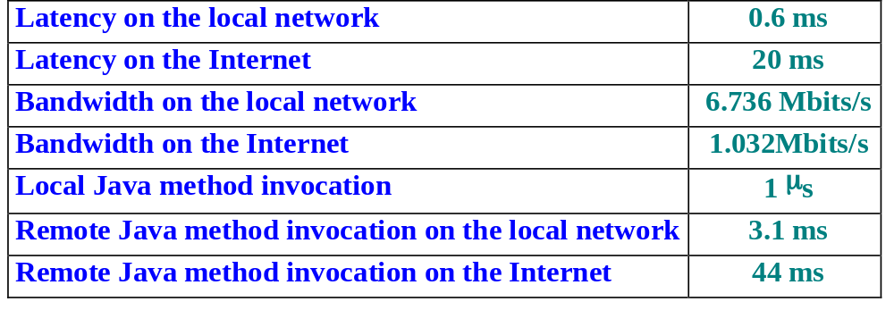
MA platform: evaluation
Objective: measure the cost of the main Java mechanisms involved in the implementation of a MA platform
Development of a minimal platform
Experiment environment:

Slide 13
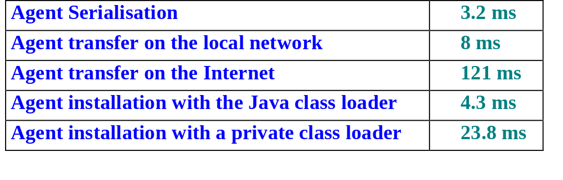
MA platform: evaluation
Cost of the main steps in an agent migration
  costs induced by Java
    prohibitive compared to the cost of the local network
    acceptable compared to the cost of the Internet
  large overhead induced by per-agent private class loaders

Slide 14
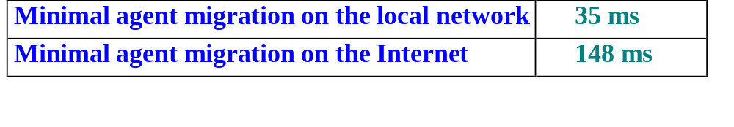
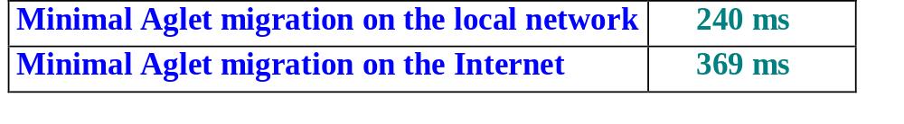
MA platform: evaluation
Cost of agent migration with the minimal platform
Cost of agent migration with Aglets

Slide 15
Experiments
Objective : evaluate the MA model by comparison with the client-server model
  a client-server platform (Java-RMI)
  a minimal MA platform that we implemented (Agent)
  a well-known MA platform (Aglets)
Target results
  comparison between the client-server and the MA models
  comparison between a minimal platform and a full-scale platform

Slide 16
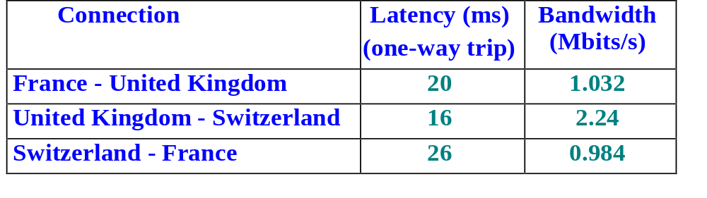
Experiments: testbed
Three machines distributed over the Internet
  in France (INRIA)
  in United Kingdom (QMW)
  in Switzerland (University of Geneva)

Slide 17
Experiments: forward application
A join between two information sources
    rpc_{C-A}(n) + n*rpc_{C-B}(1) > Ag_{C-A}(0) + Ag_{A-B}(n) + Ag_{B-C}(2*n)
    Ag(n) >> rpc(n)
    for which value of n should we use MA ...
A
A
rpc (1)
C
C
rpc (n)
B
B

Slide 18
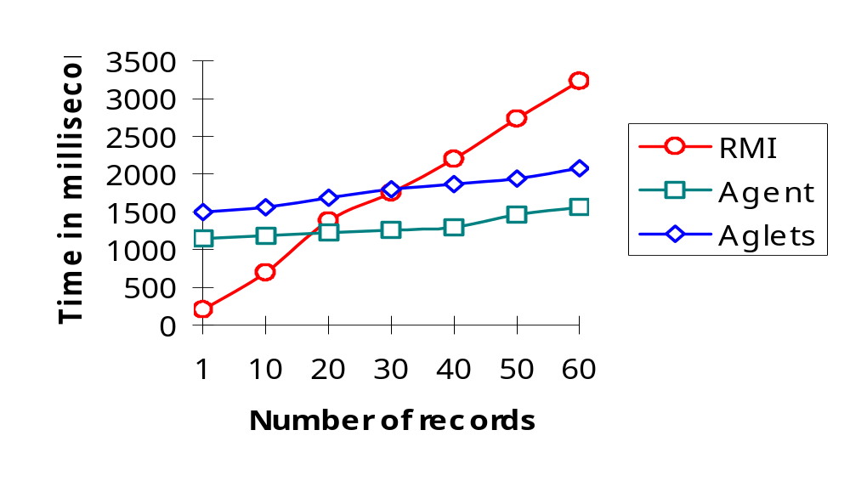
Experiments : forward application

Slide 19
Experiments : compress application
  Compression is potentially beneficial if
    tc + fc * S/dr + td < S/dr
    which gives:
      dr < 74 Kb/s for a 100 Kb file
      dr < 164 Kb/s for a 500 Kb file
  Ag(n) >> rpc(n)
App
Server
compressed document

Slide 20
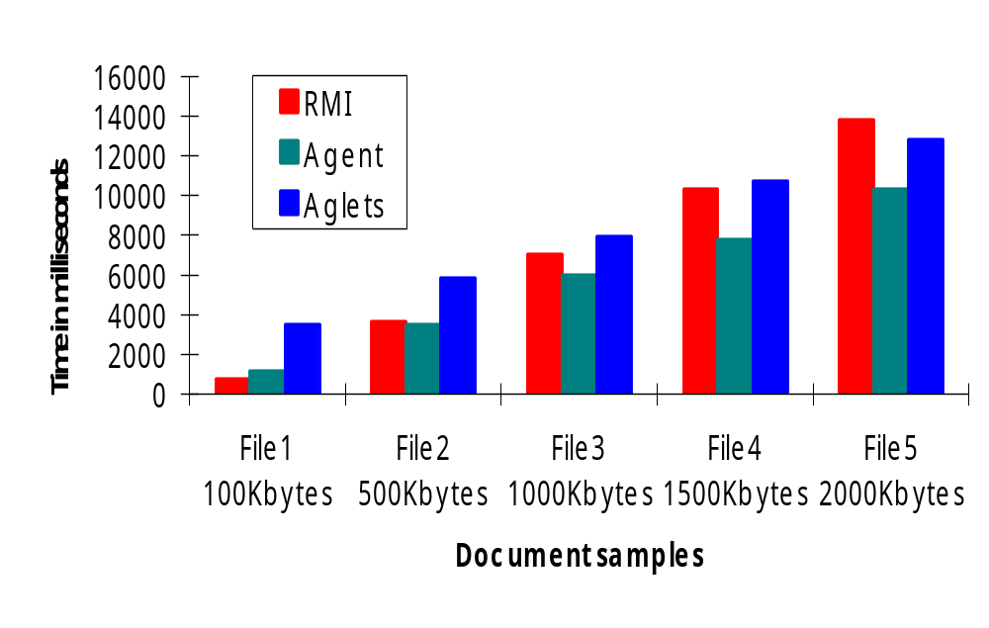
Experiments : compress application

Slide 21
Conclusion and perspectives
Objectives: evaluation of MA
  involved Java mechanisms
  comparison with client-server
Results
  implementation of a minimal platform
  evaluation (basic costs) and comparison with Aglets
  experiments with application examples
  evaluation and comparison with RMI
Perspectives
  the main interest is in mobile code
  develop an application in terms of components (like EJB)
  dynamically reconfigure the application according to the required services
  keep a uniform, simple programming paradigm

