Slide 1



Can a Machine Reason?
Software and Symbolic AI
Team 风味小吃 (Fengwei Xiaochi) · PPT Slides V1
After each library shift, Pip waits tables at our restaurant and tells the diners what went wrong today.
风味小吃 · Software and Symbolic AI · Slides V1
Notes:
TIME: about 40 s (running total under 1 min)
BEFORE THIS SLIDE:
• HOW TO USE THESE SLIDES. There are twelve numbered files, one for each chapter, in teaching order. This first file also holds the module’s opening, and file 12 holds the finale.
• FULL LENGTH: Part A (files 01 to 05) takes about 80 minutes and Part B (files 06 to 12) about 137 minutes, so about 3 hours 37 minutes in all. Teach it as two or three sessions: a natural extra break comes after Chapter 9.
• Timings are in these notes, and each file’s running total starts from zero. Click once for each slide: many steps are separate slides joined by Morph, so an answer never appears until you click.
• Learners need no device. Ask them to bring paper and a pen: several activities use them, and each file says when. Every online tool has screenshots or expected results in the deck, so nothing depends on the internet.
• Morph needs PowerPoint 2019 or Microsoft 365. Older versions show a simple fade, and the teaching is unchanged.
READ ALOUD:
Welcome. Here is the question for this whole module. Can a machine reason?
This is Pip, the library’s brand-new robot helper. After each library shift, Pip waits tables at our restaurant and tells the diners what went wrong today.
Pip is made up. Real programs do not feel confused or try their best. So when we say “Pip thinks”, we mean “the program does”.
So, what went wrong on day one?
SEE ALSO: Study Guide V1.4 and the Test Bank, Pip’s Library Trials, share this story and these examples.
SOURCE: The restaurant sentence is from the Study Guide, “About the book”.
READ BEFORE CLASS:
FILE PLAN: File 01 of 12, Chapter 1: Software, AI and Symbolic AI. 12 slides, about 13 minutes. It also holds the module’s opening.
GOAL: By the end, learners can say: Software is the broader category. Symbolic AI is one way to build software that reasons from explicitly represented knowledge.
PREPARE: Nothing to set up. Learners answer by show of hands.
ACTIVITIES:
• Slide 3, about 2 min 10 s: Which of these four use AI?
• Slide 8, about 55 s: Start with a decision
• Slide 11, about 1 min 15 s: Chapter 1: last challenge
IF SHORT OF TIME: On “Your own decision, written as facts and a rule”, skip the Extension (working memory and the library-loan preview). On “Which of these four use AI?”, take votes on the calculator and the library program only.
IF MANY GET IT WRONG: Key check: “Which of these four use AI?” If most of the room calls the calculator AI, or votes by how clever each one seems, ask of one card at a time: are these fixed steps, or does it work out something new? Then vote again on the email filter.
LIKELY QUESTIONS:
• Q: A rule-based program also just follows instructions, so why is it AI? A: The engine does run fixed steps, but they only say how to match facts with rules. The conclusion is worked out from the knowledge base. Change a rule, and the conclusion changes while the engine stays the same.
• Q: Is all AI machine learning? A: No. Machine learning uses patterns learned from data. Symbolic AI uses facts and rules that are written out. Both count as AI because both infer.
• Q: Why is Pip dressed as a waiter? A: After each library shift, Pip waits tables at our restaurant and tells the diners what went wrong today. The kitchen and the dishes are only comparisons to help you remember.
TIMES: Each time assumes speech at about 120 words a minute, the pauses written in the script and a few seconds to change the slide. Allow a little extra for settling after pair work and for questions.
CHECK: On a computer without Bahnschrift and Segoe UI, or a version of PowerPoint without Morph, the slides may look different. Use the matching PDF in PDF_copies instead, and read from Reading_Scripts, because the PDF copies carry no notes.

Slide 2


Day one at the library
START
LIBRARY
“Are you intelligent, or do you just follow instructions?”
A visitor asks Pip. Pip has no idea.
Over twelve missions,
you will help Pip find out.
风味小吃 · Software and Symbolic AI · Slides V1
Notes:
TIME: about 55 s (running total about 2 min)
READ ALOUD:
It is day one at the library, and a visitor asks Pip a question.
“Are you intelligent, or do you just follow instructions?”
[Pause 5 seconds. Do not define anything yet.]
Pip has no idea.
Pip is fast, polite and tireless, and takes every instruction completely literally. In each chapter, Pip makes a mistake that real software and real beginners also make.
Over twelve missions, you will help Pip find out. And here is my promise. We will return to this exact question at the very end.
Before we define AI, let us see what the room already thinks.
SEE ALSO: Study Guide, “Welcome: meet Pip” and Chapter 1, Pip’s problem.

Slide 3

Which of these four use AI?
START
Predict first
Calculator
adds 2 and 3
Email filter
trained on labelled messages
Library program
applies stored facts and
IF–THEN rules
Music app
plays a saved playlist
Decide for each one: AI, or not AI?
Think for 30 seconds. Then hands up for each card.
风味小吃 · Software and Symbolic AI · Slides V1
Notes:
TIME: about 2 min 10 s (running total about 4 min)
READ ALOUD:
Here are four programs, and one decision for each: AI, or not AI?
Predict first. Think silently for 30 seconds. Then I will point to each card, and you will put your hands up.
[Pause 30 seconds.]
Time is up. For each card, hands up for AI, then hands up for not AI.
First card, the calculator. AI or not?
[Take a show of hands. Note the split. Do not comment on it.]
Second card, the email filter. AI or not?
[Take a show of hands. Note the split. Do not comment on it.]
Third card, the library program. AI or not?
[Take a show of hands. Note the split. Do not comment on it.]
Fourth card, the music app. AI or not?
[Take a show of hands. Note the split. Do not comment on it.]
What made you say so?
[Take two or three answers. Do not comment on them.]
Thank you. Keep your votes in mind. Now let us use one test instead of a feeling.
EXPECTED ANSWER: Calculator: not AI. Email filter: AI. Library program: AI, if it infers its conclusion from the facts and rules. Music app: not AI. Keep this to yourself for now. Expect a split, because most people judge by how clever a system seems.
SEE ALSO: Study Guide, Check yourself 1.1. Test Bank T01, M01.

Slide 4
Ask how the output is produced, not how clever it seems
START
To infer: to work out a conclusion from knowledge or learned patterns, not just run fixed steps
Calculator
Not AI
fixed procedure
Email filter
AI
learned patterns:
machine learning
Library program
AI, if it infers
facts and rules:
symbolic AI
Music app
Not AI
fixed procedure
Common mistake: “It always gets the right answer, so it must be AI.”
风味小吃 · Software and Symbolic AI · Slides V1
Notes:
TIME: about 1 min 35 s (running total about 5 min)
READ ALOUD:
Here is the test. Ask how the output is produced, not how clever it seems. In this module, an AI system infers from inputs how to produce outputs, such as predictions, recommendations or decisions. To infer is to work out a conclusion from knowledge or learned patterns, not just to run fixed steps.
Now check your votes. The calculator and the music app follow fixed procedures, so they are not AI. A calculator’s steps are its whole job. It has no separate knowledge to reason from.
The email filter infers a label for a new email from patterns it learned. That is machine learning.
The library program uses symbolic AI if it infers a conclusion by applying its facts and rules. Notice that word, if. A program that only carries out fixed steps is ordinary software.
Now the common mistake. Pip told everyone the calculator was AI, because it always gets the right answer. But a calculator infers nothing. Being correct or useful does not make a system AI. Pip finds this very unfair to the calculator.
You now have the test. Here is where we are going.
SEE ALSO: Study Guide, Check yourself 1.1 and Common mistake. Test Bank T01, M01; O01 after Ch. 3.
SOURCE: Study Guide Chapter 1; Module Contents V3, Chapter 1; OECD (2019, amended 2024) definition as used in the module; the “no separate knowledge” wording also appears in Test Bank O01.

Slide 5
Your mission today: explain, trace, decide
START
Explain
software, AI,
machine learning
and symbolic AI
Trace
a program, a chain
of rules and a search
Decide
which job suits a
program, rules or
a trained model
Part A
How software
follows steps
Chapters 1–5
Part B
How software
reasons from rules
Chapters 6–12
Finale
Which Pip would
you trust?
Real results
风味小吃 · Software and Symbolic AI · Slides V1
Notes:
TIME: about 35 s (running total about 6 min)
READ ALOUD:
By the end, you can do the three things on the top row: explain, trace and decide.
[Trace the route on screen with your finger.]
Here is our route. Part A shows software that follows written steps. Part B shows software that reasons from written facts and rules.
The finale asks: which Pip would you trust? It compares rules with a trained model on real results.
Let us start with Part A.
SEE ALSO: Study Guide learning goals and Figure 0.1, the module map.

Slide 6
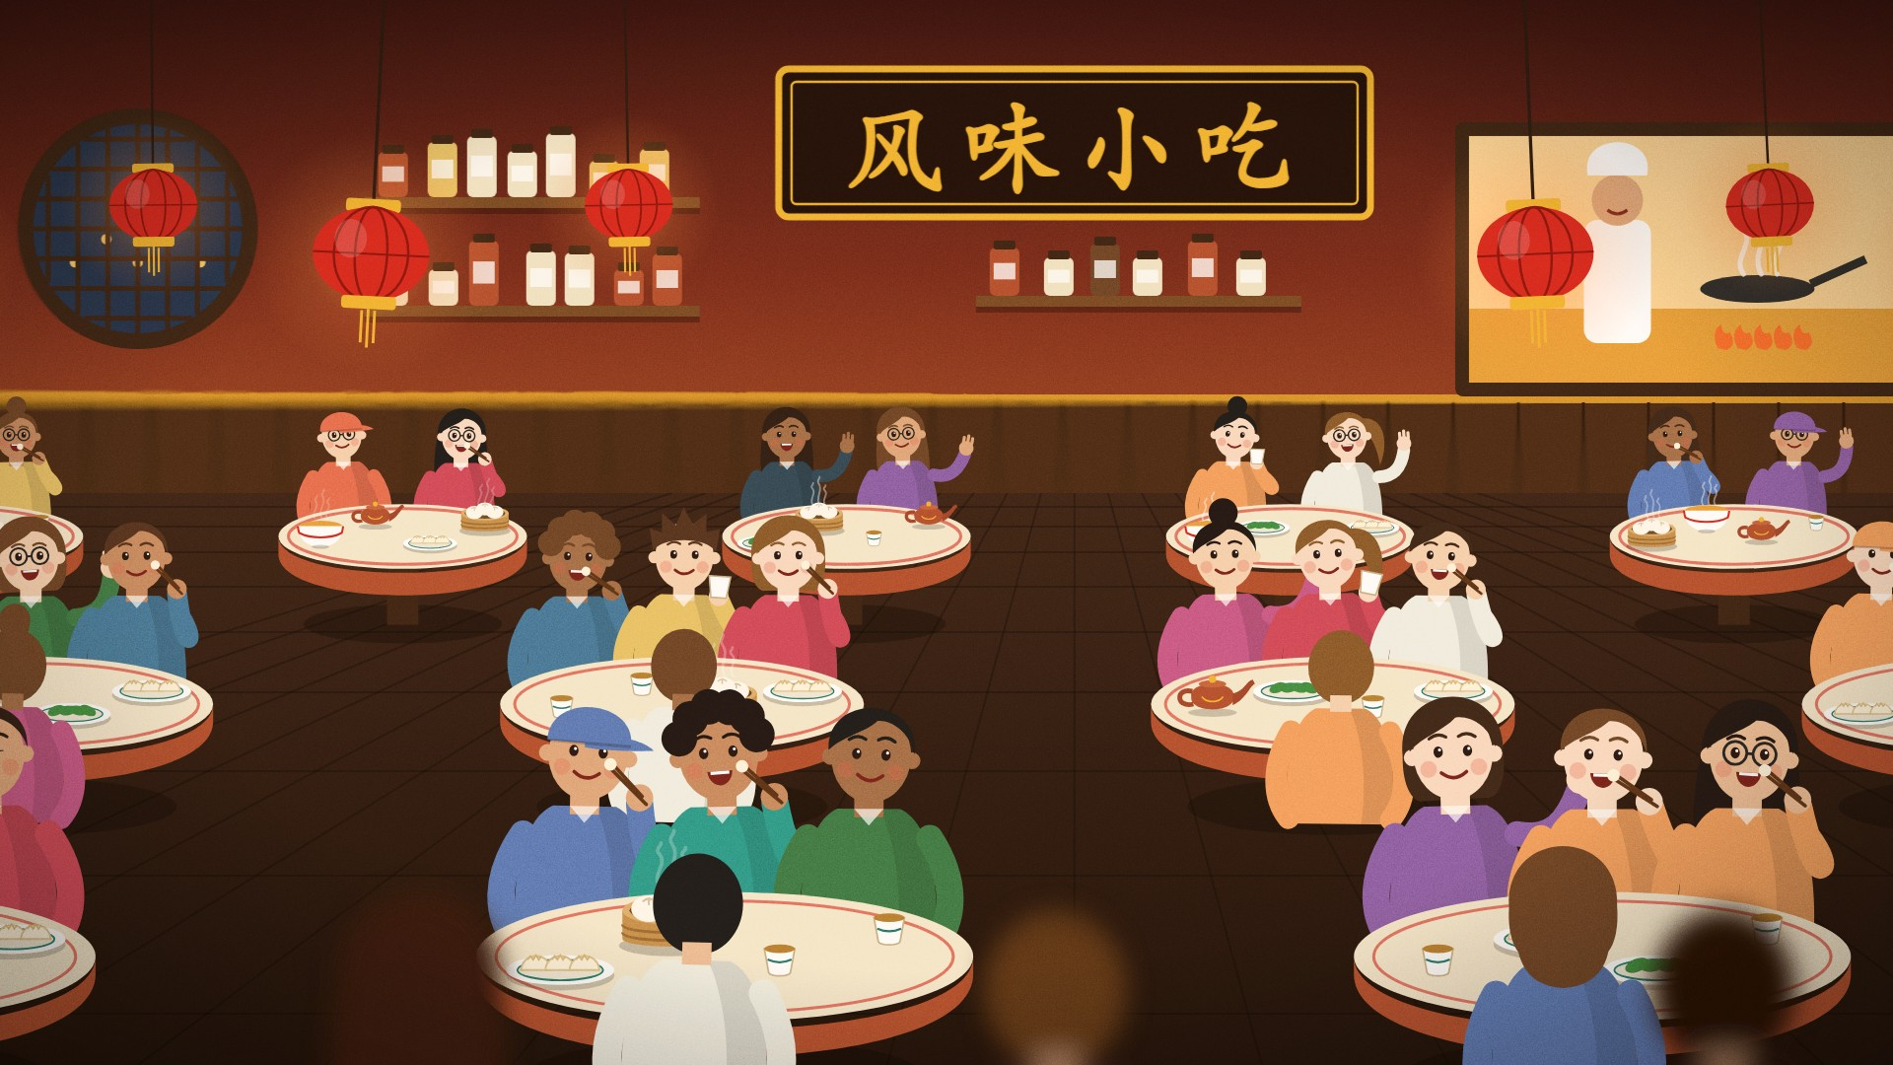

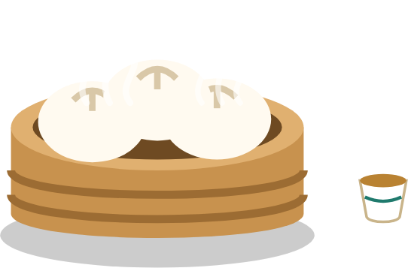
Part A: Software and Algorithms
How software follows steps · Chapters 1 to 5
Chapter 1: Software, AI and Symbolic AI
On today’s menu: steamed buns
A bun looks simple until you ask what is inside. So does the word “AI”.
风味小吃 · Software and Symbolic AI · Slides V1
Notes:
TIME: about 35 s (running total about 7 min)
READ ALOUD:
Part A is how ordinary software is built, and how it follows written steps. By the end, you can say exactly how the library’s loan program works, and where it goes wrong.
We begin with Chapter 1. On today’s menu: steamed buns. A bun looks simple until you ask what is inside. So does the word “AI”.
So let us look inside.
SEE ALSO: Study Guide, Part A and Chapter 1, pp. 15–19.

Slide 7
Software is the big box. Symbolic AI is one way inside it
CH
1
Software input → processing → output: calculator, playlist
Artificial intelligence infers how to produce its outputs
Machine learning
patterns learned
from data
Symbolic AI
explicit facts and rules:
this module
A sat-nav trained on past trips: which box? Hands up in 20 seconds.
风味小吃 · Software and Symbolic AI · Slides V1
Notes:
TIME: about 1 min 40 s (running total about 8 min)
READ ALOUD:
Start with the big outer box. Software is the programs and procedures that tell a computer how to do a task, along with their data and documents.
One useful picture is input, processing, output.
Inside the big box sits AI, a broad field. Machine-learning systems commonly use patterns learned from data. Symbolic AI uses knowledge that is written out, such as facts and rules. That is this module.
Try a new case. A sat-nav predicts how long your trip will take, and it was trained on past trips. Which box holds it? You have 20 seconds. Then hands up: Software only, Machine learning, or Symbolic AI.
[Pause 20 seconds.]
[Take a show of hands, then ask for one reason.]
Machine learning, because it uses patterns learned from past trips. That box sits inside AI, inside Software. The calculator stays in the outer box.
Let us write one decision down in the symbolic way.
EXPECTED ANSWER: Machine learning. It infers its prediction from patterns learned from past trips. That box is inside AI, which is inside Software, so all three describe it.
SEE ALSO: Study Guide, Chapter 1, “Software, AI and symbolic AI”. Test Bank M01.
SOURCE: IEEE (1990); OECD (2019, amended 2024); Module Contents V3, Chapter 1.

Slide 8
Start with a decision
CH
1
Predict first
It is raining
and you are going outside.
What would you do?
Which facts did you use?
Think for 20 seconds. Then I will ask.
风味小吃 · Software and Symbolic AI · Slides V1
Notes:
TIME: about 55 s (running total about 9 min)
READ ALOUD:
Here is a decision of your own. It is raining and you are going outside. What would you do? And which facts did you use? You have 20 seconds.
[Pause 20 seconds.]
[Take one answer.]
Now let us write that down so that a program can use it.
EXPECTED ANSWER: Take an umbrella. The facts used: it is raining, and you are going outside.
SEE ALSO: Study Guide, Chapter 1, “Start with a decision”.

Slide 9
Your own decision, written as facts and a rule
CH
1
Knowledge base stores facts and rules
Inference engine
checks which rules match
CONCLUSION
Take an umbrella
FACTS
raining
going_outside
RULE
IF raining
AND going_outside
THEN
recommend_umbrella
It stops raining. Does the rule still fire? Hands up: 10 seconds.
风味小吃 · Software and Symbolic AI · Slides V1
Notes:
TIME: about 1 min 25 s (running total about 11 min)
READ ALOUD:
Here is your decision, written out. A symbol is a named representation of something in a problem. Here, raining is a symbol.
A fact states information about this case. A rule connects conditions with a conclusion: if raining and going outside, then recommend umbrella.
The inference engine checks which rules match. Both conditions match, so the rule fires, and the conclusion is: take an umbrella.
[Extension: skip if short of time.]
Chapter 9 keeps the facts of the current case in a separate working memory. It also traces a library loan that needs two steps, because one rule’s conclusion feeds the next.
[End of extension.]
Now look at the bar. Suppose it stops raining. Does the rule still fire? Hands up, yes or no, in 10 seconds.
[Pause 10 seconds.]
[Take a show of hands.]
Let us see.
EXPECTED ANSWER: No. One condition no longer matches, so this rule gives no recommendation.
SEE ALSO: Study Guide Figures 1.1 and 1.2. Test Bank T02, M02: these use rules R1 and R2, which are in the Guide’s “A first look at the library loan”.
SOURCE: Study Guide, Chapter 1; Module Contents V3, Chapter 1, Sections 2 and 4.

Slide 10
It stops raining, so the rule does not fire
CH
1
Check
Knowledge base stores facts and rules
Inference engine
checks which rules match
CONCLUSION
None
FACTS
raining
going_outside
RULE
IF raining
AND going_outside
THEN
recommend_umbrella
Same engine, different facts, different conclusion
风味小吃 · Software and Symbolic AI · Slides V1
Notes:
TIME: about 25 s (running total about 11 min)
READ ALOUD:
With no rain, one condition no longer matches. So this rule does not fire, and it gives no recommendation.
Look at what stayed the same: the engine. Only the facts changed, and the conclusion changed with them.
That is Chapter 1. One last challenge before we close it.
SEE ALSO: Study Guide, Chapter 1, “A first look at the library loan”, for a rule that needs two steps.

Slide 11
Chapter 1: last challenge
CH
1
Try it
A coffee machine follows a saved recipe and makes a perfect cup every time. Is it AI? Why?
Tell a neighbour. You have 30 seconds.
风味小吃 · Software and Symbolic AI · Slides V1
Notes:
TIME: about 1 min 15 s (running total about 12 min)
READ ALOUD:
Before we close this chapter, one last challenge. A coffee machine follows a saved recipe and makes a perfect cup every time. Is it AI? Why? Tell a neighbour.
[Pause 30 seconds.]
[Take one or two answers.]
No, because it follows fixed steps and infers nothing. A perfect cup does not make it AI, just as being right does not make the calculator AI.
EXPECTED ANSWER: No, because it follows fixed steps and infers nothing. A perfect cup does not make it AI, just as being right does not make the calculator AI.

Slide 12
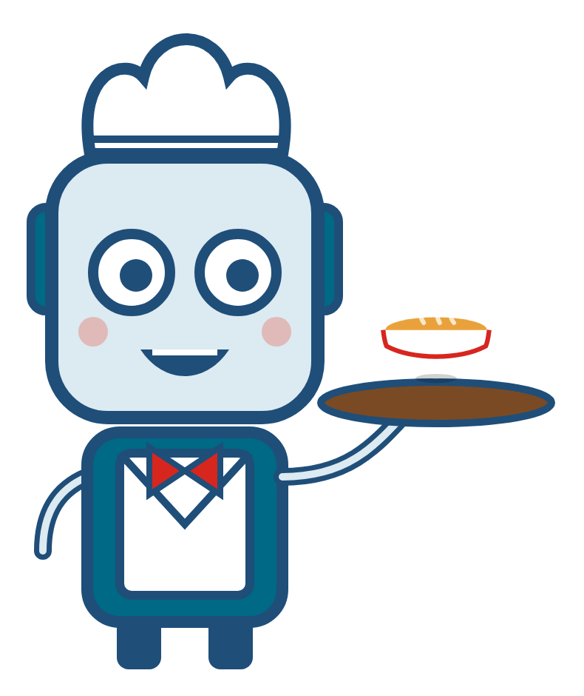
Chapter 1: mission complete
CH
1
Software is the broader category. Symbolic AI is one way to build software that reasons from explicitly represented knowledge.
Pip’s log “The calculator is software. I count as AI only if I infer my answers, for example from facts and rules.”
STUDY GUIDE
“A first look at the library loan”; Check yourself 1.1
VIDEO TUTORIAL
Video 01: From Everyday Decisions to Software
TEST BANK
T01–T02, M01–M02; O01 after Ch. 3
风味小吃 · Software and Symbolic AI · Slides V1
Next File 02: Software Overview
Notes:
TIME: about 50 s (running total about 13 min)
READ ALOUD:
Software is the broader category. Symbolic AI is one way to build software that reasons from explicitly represented knowledge.
Pip’s log: “The calculator is software. I count as AI only if I infer my answers, for example from facts and rules.”
Your next steps are on the slide. The video leaves out the history of AI: for that, try Try it 1.2.
Before you try the Test Bank, read “A first look at the library loan”, because its questions use rules R1 and R2. In Chapter 2, Pip deletes something “useless”. Let us see what happens.
SEE ALSO: Study Guide, Chapter 1, pp. 15–19. Try it 1.2 covers the history. T02 and M02 use R1 and R2, from “A first look at the library loan”.
SOURCE: IEEE (1990); OECD (2019, amended 2024); McCarthy et al. (1955); Davis et al. (1977).
NEXT FILE: File 02: Software Overview. This file ends here. If you carry on, open file 02.

