Slide 1




SmartRecruiters &
Example Company
ROI Presentation
2026

Slide 2
ROI Philosophy
How SmartRecruiters approaches ROI

Slide 3


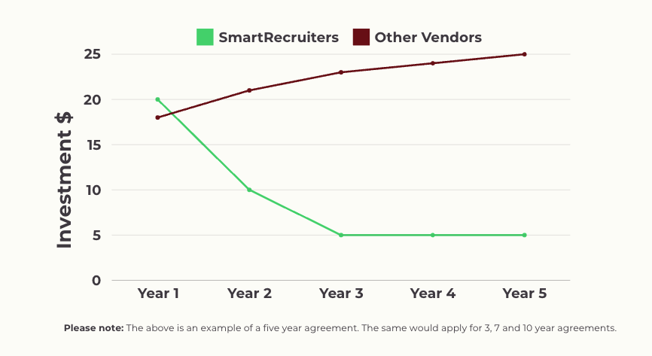
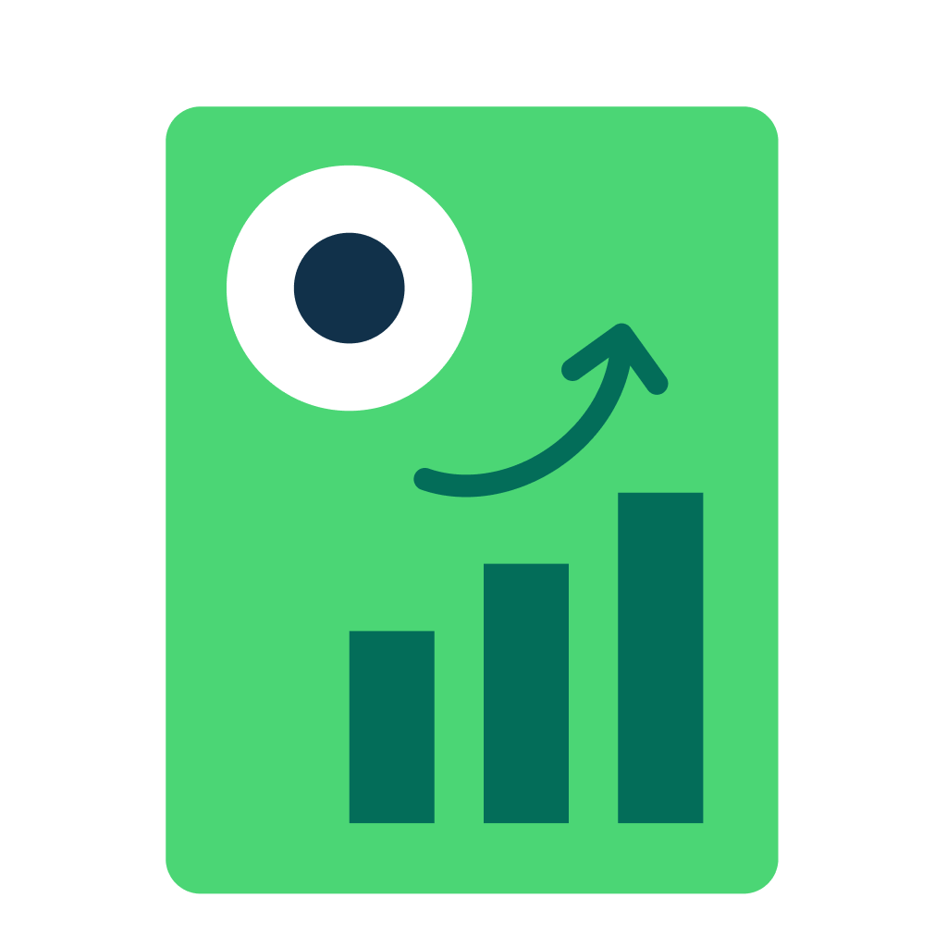
Total Cost of Ownership
Your bold selection, that’s commercially astute
Annual Software Cost | Yes
Once off Implementation & Integration | Yes
Configuration Changes | No
Activation Fees | No
Maintenance Fees | No
We are an investment upfront but don’t come with increasing costs over the tenure of our agreement in any hidden areas.

Slide 4







Commercial Model
Outside of Annual Software Licensing and Implementation (One-Time Fee) there is no additional cost for your Ongoing Configuration, Training, Support, Hosting or HR Tech/Marketplace integration activation & maintenance etc.
We understand you may currently be being charged $X USD per month (on top of X ATS Licensing) for these services. With SmartRecruiters (unlike most other vendors) this cost is $zero.
SmartRecruiters has built a model that will please any CFO & CIO looking at how to best optimise their ongoing OPEX & CAPEX around people and technology support towards the Talent Organisation.
SmartRecruiters is an investment upfront, but doesn't come with increasing costs over the tenure of our agreement in any hidden areas.

Slide 5





Now more than ever, hiring requires flexibility
With a rapidly evolving market, companies need their technology to keep up with changing demands.
03
01
02
Modern Tactics
Market Volatility
Emerging Technology
In a competitive market, TA has embraced strategies around internal mobility, skills-first sourcing, and a stronger focus on DE&I to hire top talent faster.
Market uncertainty has led to shifting goals and priorities for talent acquisition.
Advancements in AI continue to alter, improve, and accelerate hiring workflows.
Notes:
Slide Objectives
Reinforce why it is important for companies today to invest in innovative recruitment technology
Acknowledge the various external factors affecting how companies hire today
Talk Track
Before getting into your projected ROI, it’s important for us to acknowledge all of the different factors that go into how companies hire today, and the technology they choose to do it with. It’s essential for TA to have hiring tech that keeps up with a rapidly changing market. Over the last few years, market uncertainty, advancements in AI, and new recruiting tactics have all impacted hiring strategies. These are just a few of the different reasons it’s crucial to invest in technology that can adapt alongside market trends.

Slide 6
Recruiting Drives Business Value
It all starts with recruiting excellence, powered by great recruiting tech
Recruiting Excellence
Hiring Success
Business Outcomes
Easy, Efficient & Effective Attraction, Selection & Hiring
On Time Hires, On Budget, Quality Hires
Revenue Growth, Cost Control, Compliance, High Impact Employees
TA Team Value
Leadership Value
Business Value
Recruiters · Sourcers · Coordinators
IT + HRIT Interviewers
Head of Recruiting · Head of HR · Hiring Managers VPs & Functional Leaders
C-Suite (CFO, CHRO, CEO) · Procurement
Notes:
Slide Objectives
Provide confidence to your prospect that we have a well thought through methodology
Establish clear connection between business outcomes and recruitment tech investment
Talk Track
Recognizing the factors we just discussed and their impact is important because we are firm believers that recruiting drives business outcomes. We also believe, that there is value to be created by having incredible recruitment tech across multiple levels. It’s not just about making your recruiters productive, it’s not just about allowing you as the head of TA to justify the incredible work you all or doing, and it’s not just about improving your CFO’s bottom line. It’s about all 3 coming together.

Slide 7









The C-Suite Perspective
How SmartRecruiters Drives Business Outcomes
Business Outcomes
Operating Margin
Asset Efficiency
Revenue Growth
Technology investment
Efficiency gains
Revenue gains
SmartRecruiters ROI
Notes:
Slide Objectives
Show that we have thought about our ROI calculator through the lens of how businesses truly work
Tee up / empower your point of contact to take this slide into the meeting with procurement/CFO and show how easy we have made it for them to invest in SR.
Talk Track
Okay so now that we have touched on our general thoughts around why it’s important to invest in premier recruiting tech, I wanted to tee up how we built our ROI analysis. What we have done is essentially look at the general way that most organizations are run, and mapped our ROI buckets accordingly. So within Operating Margin, Asset Efficiency, and Revenue Growth - all areas your C-Suite is going to be very familiar with - we have nestled in 1 clear ROI bucket unearth each category. Collectively the 3 areas of Technology Savings, Efficiency Gains, and Revenue gains = our SmartRecruiters ROI and should give you a balanced scorecard of sorts when you step into the meeting.

Slide 8








How We Calculate ROI
Technology Investment
Efficiency Gains
Revenue Gains
+
+
Direct cost of SmartRecruiters
vs.
Maintaining cost of current system(s)
Cost Per Applicant Reduction
Reduction in Agency Costs
Higher Applicant Conversion Rate
Improved Recruiter Efficiency
Improved Hiring Team Efficiency
Accelerated Revenue Impact by Hiring Faster
Notes:
Slide Objectives
Give the prospect a summary of the calculations within each ROI category
Talk Track
This slide that breaks down the exact values of each category with a little but of a summary to explain what that grouping is talking about. For CFOs / Procurement who are sometimes very unfamiliar in our world, we have found this to be very helpful.

Slide 9





Winston was created in collaboration with world-class businesses.
Winston Impact
2 x Conversion Rate
80% Reduction in Admin Time
70% Reduction in Time to Hire

Slide 10
ROI Output
Summary of projected business impact

Slide 11







ROI Summary
$175,790,475
Inputs & Assumptions
Total Expected 5 Year ROI
(Expected gains minus SmartRecruiters investment)
Company | Recruiters | Req. Volume
Example | 10 | 5,000
Industry | Annual Hires | Candidates
TBC | 5,000 | 150,000
Technology Investment
Efficiency Gains
Revenue Gains
Notes:
Slide Objectives
Provide high level summary of prospect’s projected ROI
Talk Track
Now that we have set the stage, let's dive in to your projected return with SmartRecruiters. What you have here is your summary. As noted before, the top right number is the sum of Tech Savings, Efficiency Gains and Revenue gains.

Slide 12
Expected gains
$1,614,793
$4,286,315
$175,270,685
Technology Investment
Efficiency Gains
Revenue Gains
14,539 hours saved annually
Employees and candidates are fed up with the
amount of tools it takes to from application to offer.
The more efficient your hiring process, the more likely you’ll keep candidates interested and progressing.
+
+
Recruiters and sourcers need roadblocks and silos broken down to get their jobs done quickly.
By investing an additional $1,614,793 in to SmartRecruiters you will consolidate your tech stack and realise the following Efficiency and Revenue gains.
By investing in SmartRecruiters you can potentially save $175,270,685 by streamlining the phases and steps it takes to close new hires faster.
By investing in SmartRecruiters you can potentially save $4,286,315 which is 14,539 hours annually with effective tools and channels to source, interview, offer, hire and onboard without switching tabs.
Notes:
Slide Objectives
Category level summary of our ROI
Note: Efficiency Gains will have outputs in $ and in hours per year, feel free to choose whichever will resonate more with your prospect.
Talk Track
Building off of the previous slide, we now have a breakdown of the exact value of each category with a short summary to explain what that grouping is talking about. For CFOs / Procurement who are sometimes very unfamiliar in our world, we have found this to be very helpful. In terms of some of the more granular areas where we do see efficiencies come to life is through these product areas:
Creating and approving a job description
Posting the job on various job boards and social media
Screening resumes
Scheduling and conducting interviews
Evaluating interview performance
Conducting background checks and sending assessment tests
Preparing and negotiating a job offer
Receiving acceptance of the job offer
Preparing onboarding materials and conducting training
Setting up necessary systems for the new hire
Gathering necessary documents

Slide 13






Before and after SmartRecruiters
Based on the information you’ve provided
Challenges
What Success Looks Like
Example Company’s ATS platform is manual, lacks advanced CRM, and hinders internal mobility. New processes risk high costs.
SmartRecruiters automates processes, offers advanced CRM, improves internal mobility, and reduces costs with efficient, scalable solutions.
Applications per role are up 80%, straining candidate management and filtering.
SmartRecruiters and Winston AI streamline candidate management, automate filtering, and enhance scalability to handle increased application volumes efficiently.
30% of applicants face slow responses and poor engagement, hurting Example Company’s brand.
SmartRecruiters and Winston AI boost response times, personalise engagement, and enhance candidate experiences, strengthening Example Company's employer brand.
Notes:
Slide Objectives
This slide doesn’t have to be used - AE can make the call
If used, it’s design to add some color (qualitative reasons and goals) around the challenges the prospect has told us about and their hopes and dreams of what they want to achieve with this investment.

Slide 14
Revenue gain or revenue loss?
It’s all in the candidate experience
Applications per year: 150,000
Number of rejections: 146,000
Number of customers: 13,000,000
Average revenue per customer: $615
03
01
02
Small changes in experience can make a big difference in Example Company business revenue $$$
If 5% of applicants become Example Company customers = +$4.61 million per year
If 1% of rejected applicants refer 2.5 friends and family to Example Company as customers = +$2.24 million per year

Slide 15


ROI Case Study
Notes:
Talk track: "Let’s be as relevant as possible, since we know your time is really valuable." (our ulterior motive is that we want to get a better sense if they are a real prospect or not

Slide 16


Customer ROI
1300%
in overall ROI achieved within Y1
KPMG Australia
+$44.1m in revenue opportunity created by quicker time to hire.
+$22m in efficiency gains from Talent & IT OPEX.
421,284 applications processed since Nov 22.
7,741 hires made since Nov 22.
+46% reduction in time to hire.
+570% increase in Graduate and Vocational applications.
Recruitment Agency spend reduced from $13m to $500k per annum.
$1.8m saved on Executive Search fees.
14,500hrs saved in recruitment team administration time.
4,000hrs saved in hiring manager admin time.
“SmartRecruiters has given talent acquisition a license to operate and think differently about solving problems. Greater productivity and trust allows us to achieve our vision to deliver talent to the business faster, easier and with purpose.”
Rob Dunderdale, Head of Talent Attraction and People Analytics
KPMG Australia

Slide 17

Thank You!
Let’s make hiring superhuman together!
Copyright © 2025 SmartRecruiters, Inc.

