Slide 1
Cross-Lagged Model: Gentrification and Felony Crime Rates
-0.382
FELONY
(2010)
FELONY
(2018)
-0.146
-0.181
-0.462
0.005
0.186
GENTRIFICATION
(2010)
GENTRIFICATION
(2018)

Slide 2
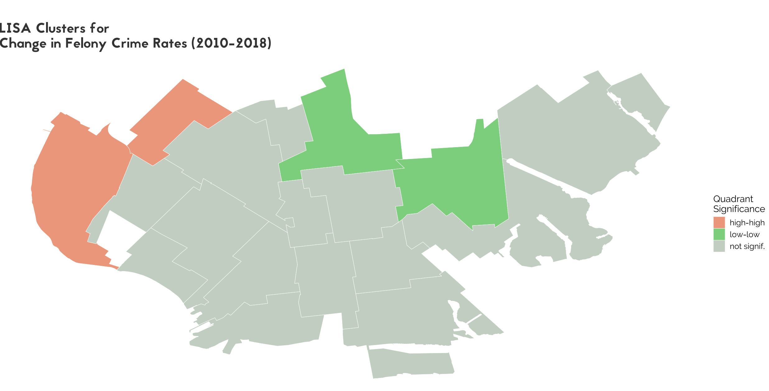
Sunset Park
Flatbush
Fort Hamilton – Bay Ridge
Flatlands

