Slide 1
Cross-Lagged Model: Gentrification and Felony Crime Rates
-0.382
FELONY
(2010)
FELONY
(2018)
-0.146
-0.181
-0.462
0.005
0.186
GENTRIFICATION
(2010)
GENTRIFICATION
(2018)

Slide 2
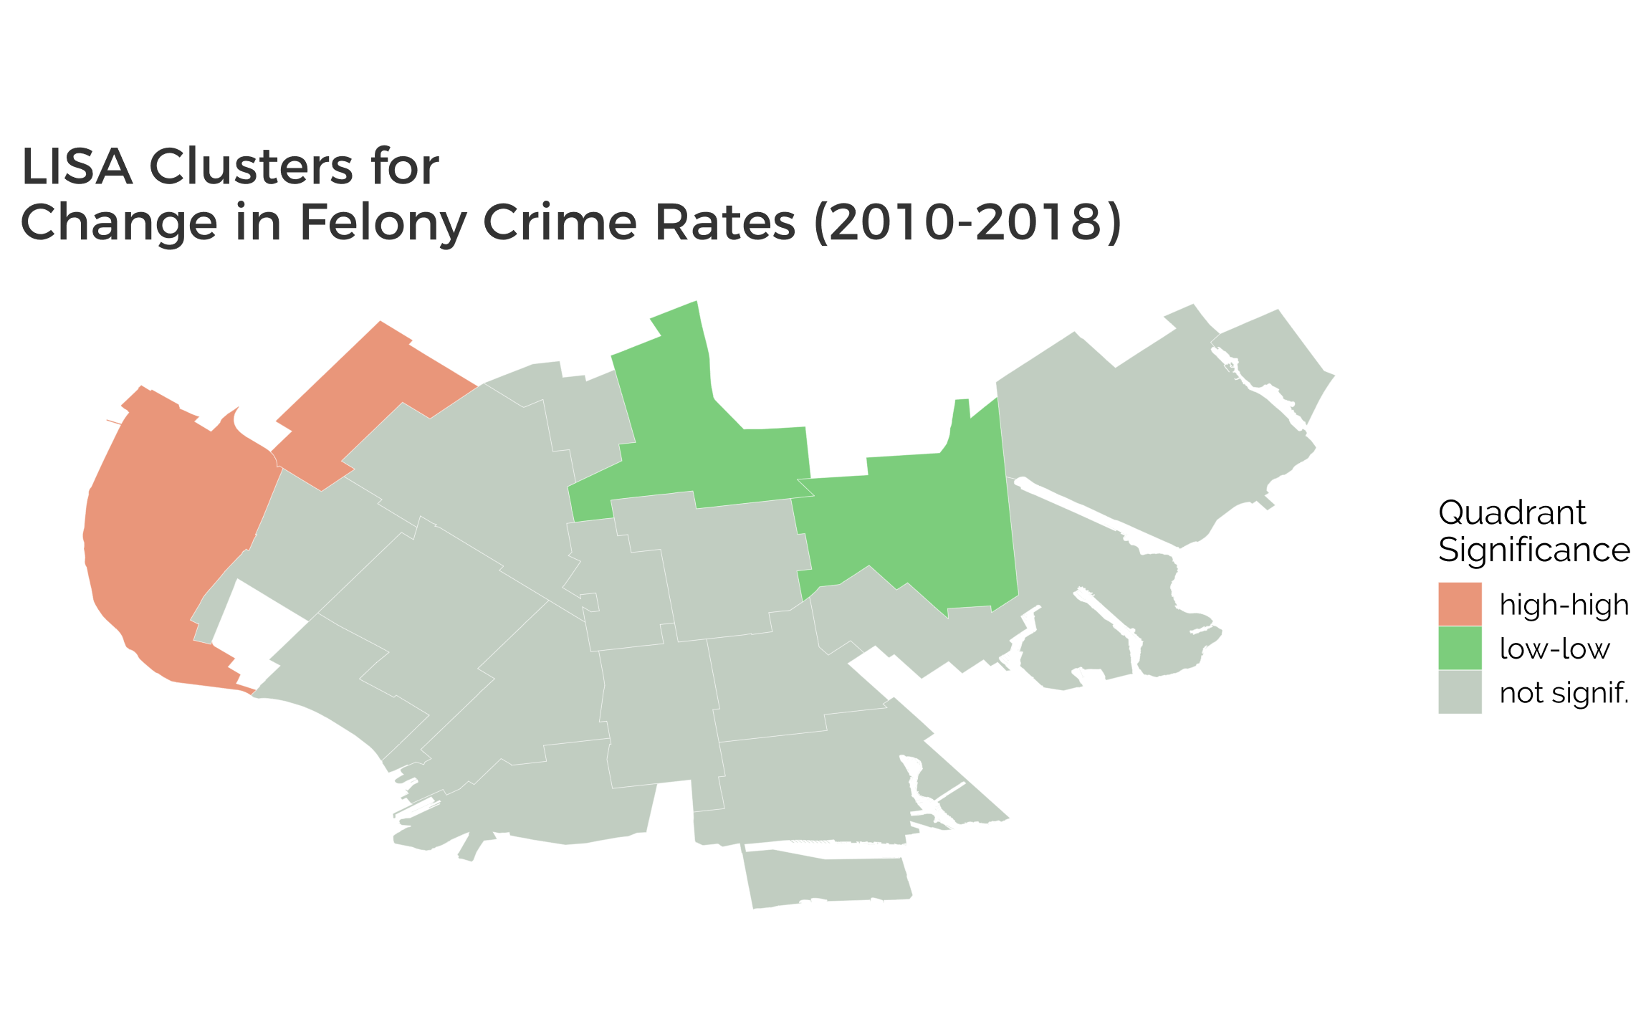
Sunset Park East
Flatbush
Bay Ridge
Flatlands

Slide 3
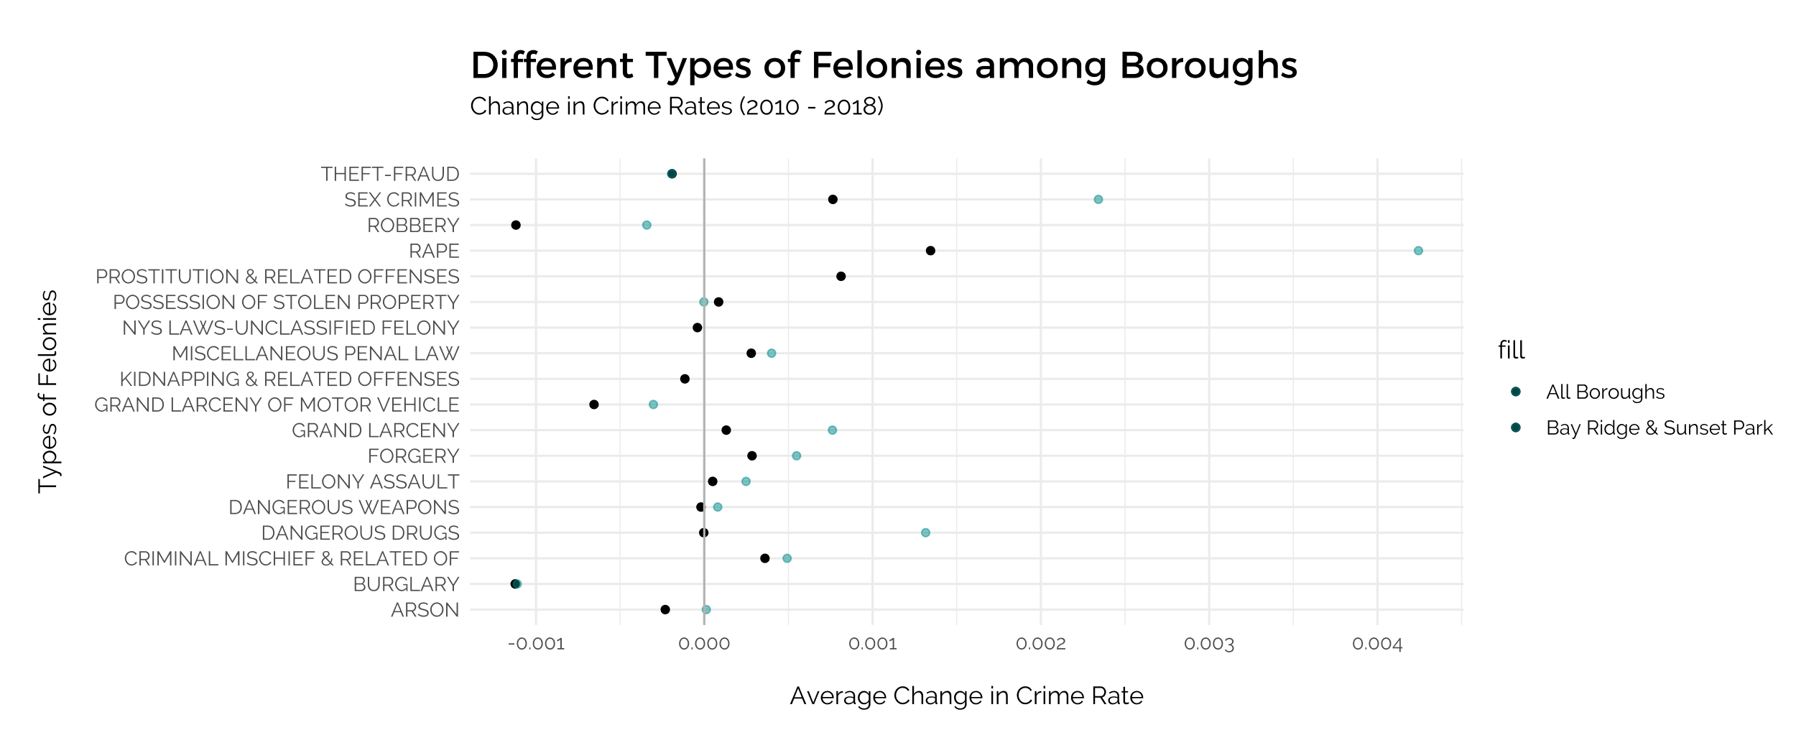
All Neighborhoods

Slide 4
Moran’s I of Felony Rates for Non-Gentrified Areas
===============================================================
Statistic N Mean St. Dev. Min Pctl(25) Pctl(75) Max
------------------------------------------------------------------------------------
Ii 19 0.366 0.653 -0.445 -0.084 0.492 2.021
E.Ii 19 -0.056 0.000 -0.056 -0.056 -0.056 -0.056
Var.Ii 19 0.257 0.189 0.088 0.142 0.267 0.896
Z.Ii 19 0.908 1.352 -1.034 -0.063 1.454 4.015
Pr(z > 0) 19 0.309 0.256 0.00003 0.074 0.525 0.849
------------------------------------------------------------------------------------

Slide 5
Stan_glm Linear Regression for Non-Gentrified Neighborhoods
Family: gaussian [identity]
Formula: Change in Crime Rate ~ Gentrification Score
Observations: 19
Predictors: 2
------
Median MAD_SD
(Intercept) -0.001651 0.000755
Gentrification Score -0.000204 0.000435
Auxiliary parameter(s):
Median MAD_SD
sigma 0.001646 0.000292

Slide 6
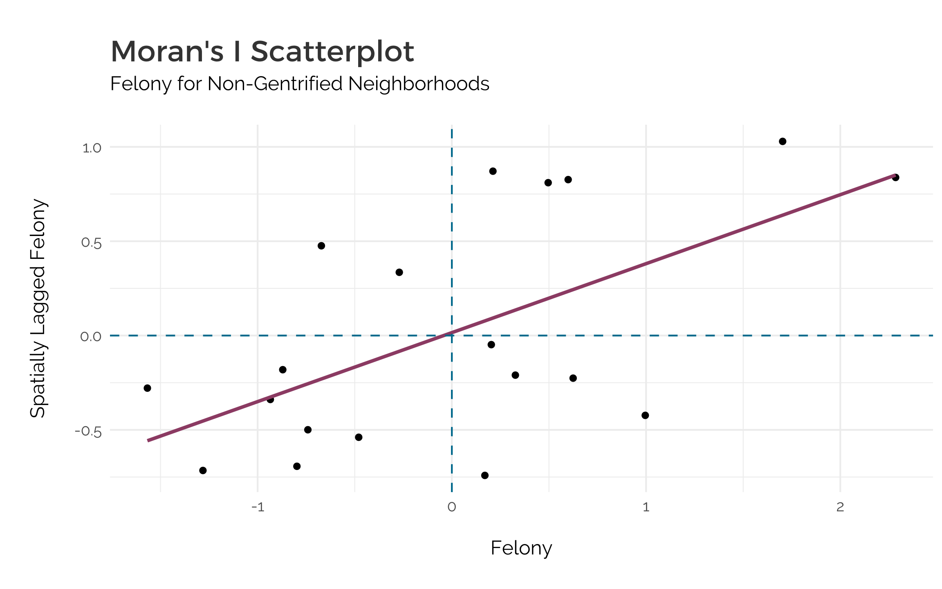
Low-High
outliers
High-High
Positive Correlation
Low-low
Positive correlation
High-low
outliers
Felony

