Slide 1
Cross-Lagged Model: Gentrification and Felony Crime Rates
-0.382
FELONY
(2010)
FELONY
(2018)
-0.146
-0.181
-0.462
0.005
0.186
GENTRIFICATION
(2010)
GENTRIFICATION
(2018)

Slide 2
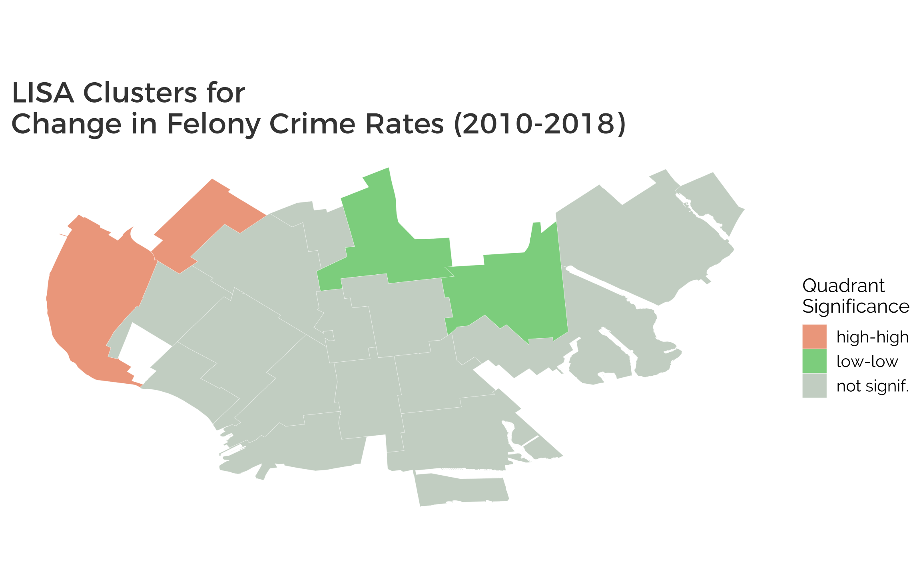
Sunset Park East
Flatbush
Bay Ridge
Flatlands

Slide 3
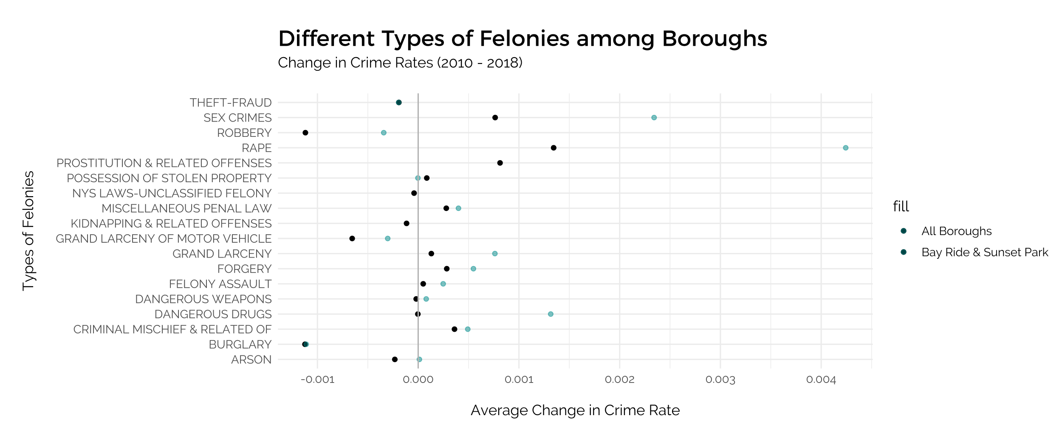

Slide 4
Moran’s I of Felony Rates for Non-Gentrified Areas
===============================================================
Statistic N Mean St. Dev. Min Pctl(25) Pctl(75) Max
------------------------------------------------------------------------------------
Ii 19 0.366 0.653 -0.445 -0.084 0.492 2.021
E.Ii 19 -0.056 0.000 -0.056 -0.056 -0.056 -0.056
Var.Ii 19 0.257 0.189 0.088 0.142 0.267 0.896
Z.Ii 19 0.908 1.352 -1.034 -0.063 1.454 4.015
Pr(z > 0) 19 0.309 0.256 0.00003 0.074 0.525 0.849
------------------------------------------------------------------------------------

Slide 5
Stan_glm linear regression
family: gaussian [identity]
formula: FEL_NTA_CHANGE ~ NTA_GENTRI_SCORE
observations: 19
predictors: 2
------
Median MAD_SD
(Intercept) -0.001651 0.000755
NTA_GENTRI_SCORE -0.000204 0.000435
Auxiliary parameter(s):
Median MAD_SD
sigma 0.001646 0.000292
------

Slide 6
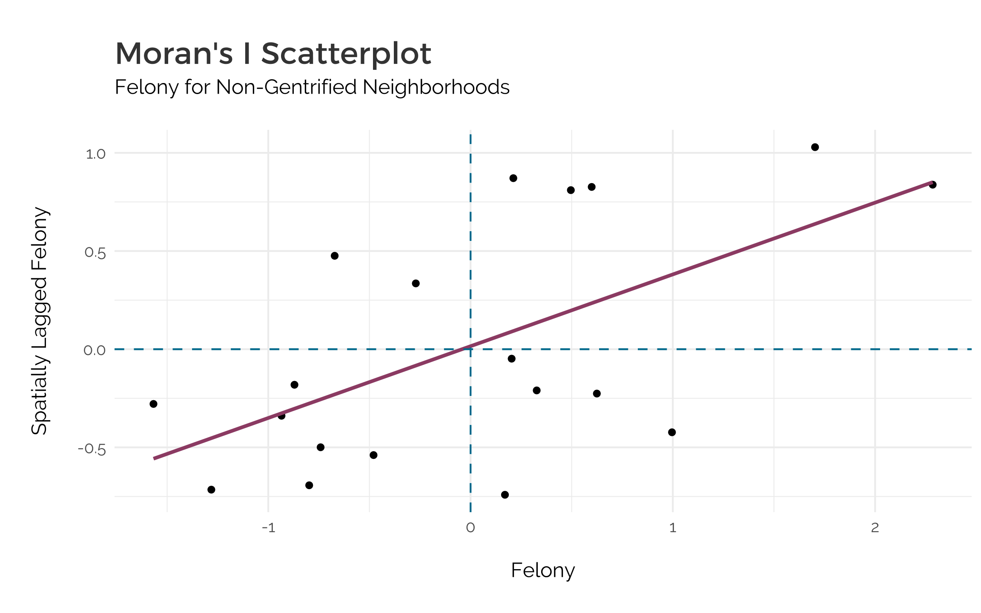
Low-High
outliers
High-High
Positive Correlation
Low-low
Positive correlation
High-low
outliers
Felony

Slide 7
 | NYU Furman Center 1990 – 2014 New York City | Loretta Lee (1970 – 2000) Brooklyn Heights | Arthur O’ Sullivan (1990 - 2000) Portland Inner City | Gerard Torrats-Espinosa (1990 – 2000) American Cities
Demographic | % White ↑ % Black Households ↓ | Age % White ↓ % African American ↑ % Hispanic ↓ % 25 years completing > 15 years school ↑↑ | % Black ↓ % High school completion ↓ % Graduate or professional degree ↑ | % White Households ↑ % Black Households ↓ % Hispanic Households ↓ % Children ↓/ Without ↓/ Non-Family ↑ % College ↑
Economic | Low income in 1990 | % Professional, Technical occupations ↓ % Employed as managers, administrators ↑ % Employed in Finance, Insurance, Real Estate ↑ | % Income 2x higher than poverty income ↑ Median Income ↑ | % Poverty ↓ Income percentile ↑
Housing | Experienced rent growth above the median | No. of Housing Units ↓ % Owner-occupied ↑ % Renter-occupied ↓ Avg Rent ↑ Avg Value ↑ | Median House Value ↑ Median Rent
Notes:
Espinosa has increase in ↑↓↓↑
Housing - Increase in comparison to NYC
Loretta Lee’s for Brooklyn Heights
In areas that gentrified
Striked out
Inconclusive
1980 – 1990
2000 - 2016

Slide 8
Time Series Regression –
Gentrification on Crime (2010 – 2018)
===============================================
Dependent variable:
-----------------------------------------------
Crime in Neighborhoods
----------------------------------------------------------------
Gentrification Score
2010 – 2011 0.0005**
(0.0002)
2011 - 2012 0.0001
(0.0004)
2012 - 2013 -0.001*
(0.0004)
2013 - 2014 -0.001**
(0.0004)
2014 - 2015 -0.001
(0.0004)
2015- 2016 -0.002***
(0.0004)
2016 - 2017 -0.001
(0.0004)
2017- 2018 -0.001*
(0.0004)
----------------------------------------------------------------
Observations 152
R2 0.239
Adjusted R2 0.081
F Statistic 4.914*** (df = 8; 125)
===============================================
Note: *p<0.1; **p<0.05; ***p<0.01
Time Series Regression – Gentrification on Crime (2010 – 2018)
Call:
plm(formula = FEL_NTA_C ~ NTA_G + as.factor(YEAR), data = all_years_poly,
index = c("NTA_C", "YEAR"))
Balanced Panel: n = 19, T = 8, N = 152
Residuals:
Min. 1st Qu. Median 3rd Qu. Max.
-5.8864e-03 -6.0499e-04 1.4802e-05 7.3477e-04 3.8679e-03
Coefficients:
Estimate Std. Error t-value Pr(>|t|)
NTA_G 0.00046617 0.00021491 2.1691 0.03197 *
as.factor(YEAR)2011 0.00010764 0.00043057 0.2500 0.80301
as.factor(YEAR)2012 -0.00077468 0.00043183 -1.7939 0.07524 .
as.factor(YEAR)2013 -0.00089802 0.00042805 -2.0979 0.03793 *
as.factor(YEAR)2014 -0.00067262 0.00042817 -1.5709 0.11873
as.factor(YEAR)2015 -0.00209265 0.00042867 -4.8817 3.144e-06 ***
as.factor(YEAR)2016 -0.00061026 0.00042773 -1.4268 0.15614
as.factor(YEAR)2017 -0.00078886 0.00042843 -1.8413 0.06795 .
---
Signif. codes: 0 ‘***’ 0.001 ‘**’ 0.01 ‘*’ 0.05 ‘.’ 0.1 ‘ ’ 1
Total Sum of Squares: 0.00028549
Residual Sum of Squares: 0.00021718
R-Squared: 0.23926
Adj. R-Squared: 0.081022
F-statistic: 4.91413 on 8 and 125 DF, p-value: 2.6977e-05

Slide 9
Multivariate Regression of Gentrification predictor variables on Crime (2010 – 2018)
==============================================
Dependent variable:
-----------------------------------------------
Change in Crime Rate
in NTA (2010 – 2018)
---------------------------------------------------------------
% Change in Population
Without High School Diploma 0.0001
(0.0002)
White Residents -0.00003
(0.0001)
Non-Family Residents 0.0001
(0.0003)
Constant -0.001*
(0.001)
--------------------------------------------------------------
Observations 18
R2 0.031
Adjusted R2 -0.177
Residual Std. Error 0.002 (df = 14)
F Statistic 0.147 (df = 3; 14)
===============================================
Note: *p<0.1; **p<0.05; ***p<0.01

