Slide 1


The 2015 NAT
Test Administration Guidelines
National Education Testing and Research Center
Department of Education
2015
Edited 2015 NETRC-Admin/TAD

Slide 2
NAT Acronyms
SDS - Schools Division Superintendent
RTC -Regional Testing Coordinator
DTC -Division Testing Coordinator
PSS -Private School Supervisor
SH -School Head
STC -School Testing Coordinator
CE -Chief Examiner
RS -Room Supervisor
RE -Room Examiner
LRN -Learner Reference Number
TMs -Test Materials
TB -Test Booklet
AS -Answer Sheet
EH -Examiner’s Handbook
SSH -Scannable School Header
ETRE -Examiner’s Transmittal Report Envelope
CETRE -Chief Examiner’s Transmittal Report Envelope
COR - Certificate of Rating

Slide 3
The Testing Staff and
Their Roles and Responsibilities

Slide 4
The Testing Staff at the Division Level
Division Level
SDS*
DTC
PSS
School Level
School Head/ Chief Examiner – School Head of the Testing Center
School Testing Coordinator –
Guidance Counselor or designate
Room Supervisors
Coming from other schools
RE ₁
RE ₂
RE ₃
RE ₄
RE _{n}
Notes: 1. Assignment of the testing staff shall be done by the SDS.
2. The NAT is administered in the respective school of the examinees.

Slide 5
The Schools Division Superintendent (SDS)
Responsible for the smooth conduct of the test in the division;
Assigns one of the division supervisors as DTC;
Designates REs from the teaching staff who are reliable, competent, experienced in the conduct of the NAT, and have no history of lost TBs; and
Assigns the PSS to manage the tardiness of some private school teachers on examination day.

Slide 6
The Division Testing Coordinator (DTC)
Prepares accurately, with the assistance of PSS, the enrolment data using the prescribed format and corresponding guidelines
On behalf of the SDS, the DTC chooses REs who are credible, trustworthy and with testing experience
Orients the SHs or STCs prior to test administration
Maintains the security and confidentiality of test materials received from the NETRC through a courier and issues an Oath of Confidentiality for the SHs on this regard
Examines the packing guide of TMs upon receipt
Notifies NETRC on the condition of TMs received
Accounts all the TMs before final packing

Slide 7
The Private School Supervisor (PSS)
Disseminates information and latest issuances regarding the NAT to private schools in the division
Coordinates with private school principals regarding the test and its proper administration
Checks closely that private schools operating without permit were EXCLUDED in the NAT administration vis-à-vis the official list from the region
Ensures that listed schools with permit are still operating

Slide 8
The Private School Supervisor (PSS)
Prepares and provides the DTC with the enrolment data on private schools to be tested, which will be used in the budget preparation and allocation of TMs
Assists the DTC in the echo-orientation of private schools in the division level*
Closely supervises the delivery and retrieval of TMs on testing day and assists the DTC in the accounting of TMs
Oversees the conduct of the test in private schools
*No extra funding from NETRC is provided for this activity.

Slide 9
The Chief Examiner (CE)
Maintains the security and confidentiality of the TMs upon receipt from the DTC (test boxes are opened on examination day);
Has the accountability and responsibility for all the TMs received and this ends when the TMs are returned to the DTC;
Assigns a Distribution Room where all REs can be met before and after the test administration;
Counts all packs of TBs and ASs before releasing them to the REs;
Records pertinent data about the TMs released to and received from the REs in the Accounting Form (Form 3) and Forms 4, 5, 6 and in the SSH.
Note: The School Head is the Chief Examiner of his/her
respective school.

Slide 10
Distributes the TBs to each RE and instructs him/her to count these without opening the pack and before leaving the room;
Monitors the REs’ proper accomplishment of the different forms while the test proper is in progress;
Follows the instructions in the Accounting and Packing of TMs found at the latter part of the EH.
Has full awareness of the details of the testing program to be conducted; and
Orients every teacher in his/her respective school on the guidelines and EH relative to the test administration.

Slide 11
The Room Examiner (RE)
Counts the TBs in front of the CE in the Distribution Room while the plastic bag is still sealed and before proceeding to the testing room;
Signs Form 3 as he/she receives the TMs from the CE/STC while still inside the Distribution Room.
Checks if the examinees have lead pencils to use and a sheet of blank paper for computation purposes;
Facilitates the recording of the Examinee Number and TB Number of the Examinees in the NETRC Form 2 (Seat Plan);

Slide 12
Supervises closely the shading of bubbles in the Name Grid, LRN and other data/non-test items in the AS;
Follows strictly the EH during test administration;
Keeps custody of all the used and unused TBs but are not allowed to read the contents; otherwise, he/she will be given corresponding sanctions based on DECS Order No. 85, s. 1999;
Checks the contents of the ETRE before he/she seals it while still inside the testing room; and
Accomplishes Form 7.
Notes: 1. Teachers from private schools will be assigned in public schools as
REs.
2. Likewise, teachers from public schools will be assigned in private
schools.
3. If teachers are not enough, those from other districts can be
assigned.

Slide 13
Insufficient number of Private School Teachers to Serve as REs in Public Schools
  Public school teachers from other districts may serve as REs when there is insufficiency on the number of private school teachers.
  For divisions with only few public and private high schools, elementary school teachers from public schools may serve as REs.
  Teachers from big schools may be dispersed in small private schools.

Slide 14
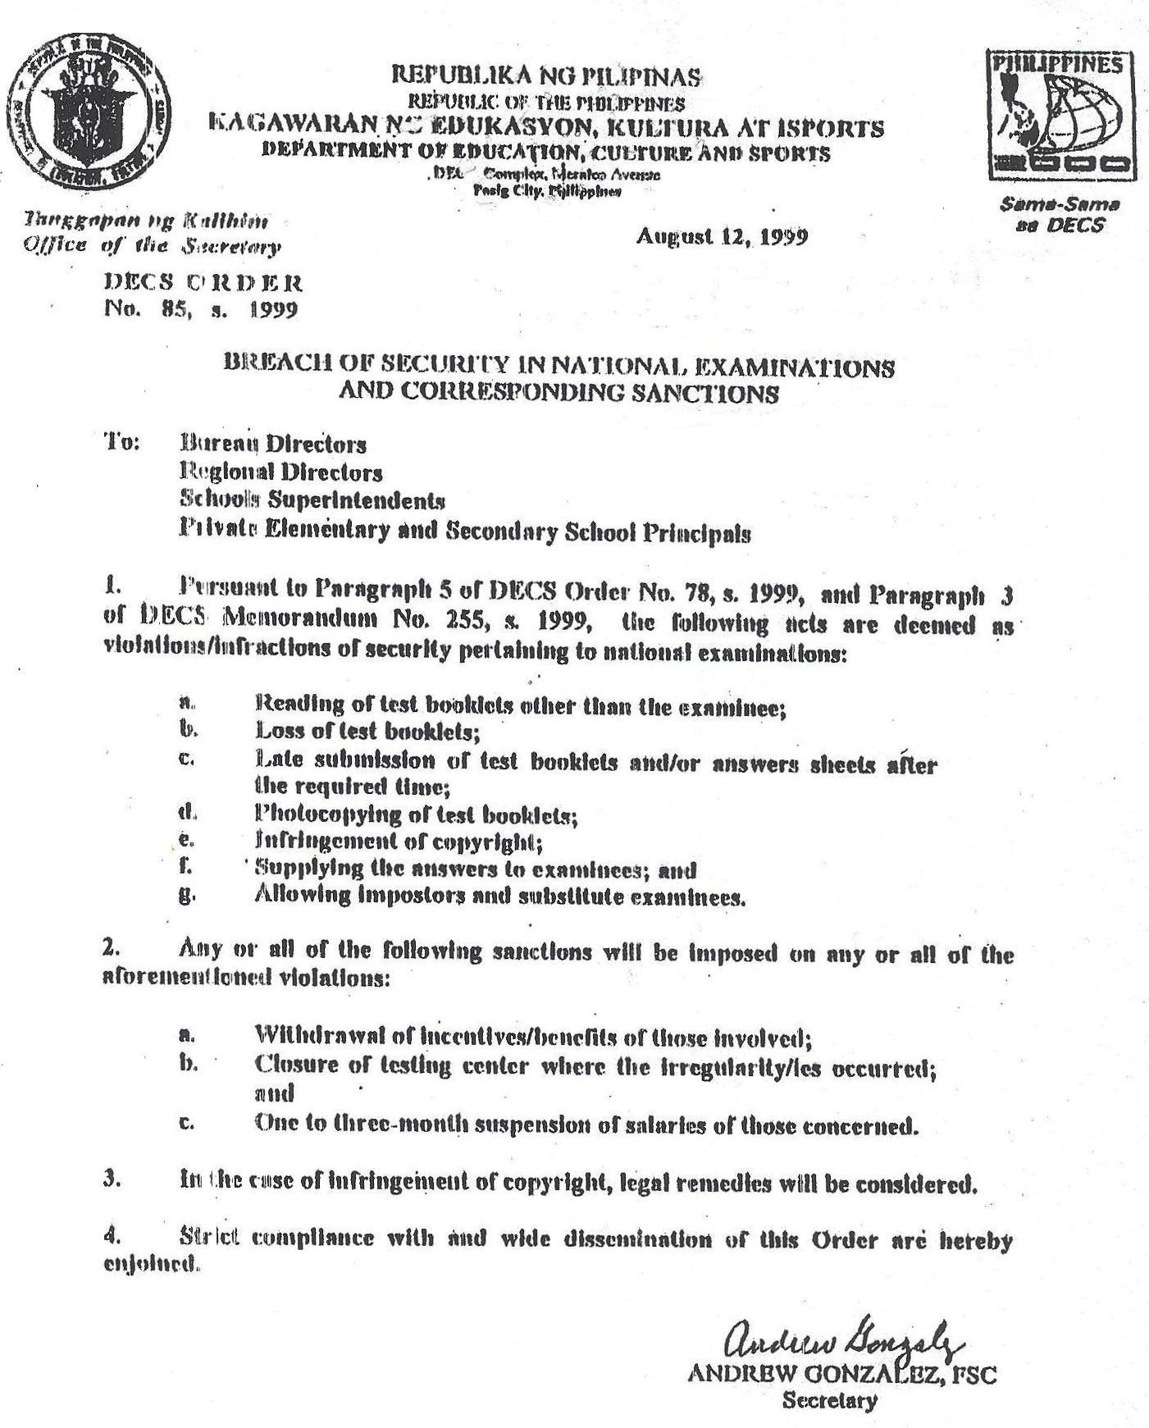

Slide 15
The Room Supervisor (RS)
Monitors the conduct of the test in a testing center with 5 or more testing rooms for Grade 6 and Year 4, and 10 or more rooms for Grade 3;
Checks if the REs adhere to the instructions in the EH;
Collects from the REs the unused ASs when the examinees are answering the last subtest;
Facilitates the completion in filling out the data in Form 3;
Reminds every RE that the ETREs should be sealed inside the testing room; and
Counts and double counts the TBs per pack and the number of ETREs.

Slide 16
Assignment of Room Supervisors:
1. The RS must come from another school other than those schools where REs shall be assigned.
2. The number of RSs assigned in a testing center will depend on the number of examinees in a testing room.
Below is the ratio:
1 RS is assigned in every 10 rooms if there are 20 examinees/room
1 RS is assigned in every 5 rooms if there are 30 examinees/room

Slide 17
The School Testing Coordinator (STC)*
Double checks the enrolment data of the school prior to submission to the DTC;
Attends the orientation at the division level in the absence (or on behalf) of the SH;
Accomplishes the SSH;
Assists the CE in all the testing activities; and
Double checks the TMs before final packing, being accountable also on these materials.
Note: The STC stays in his/her respective school to assist the Chief Examiner in all the testing activities.

Slide 18
The Monitors
NETRC staff-monitors will be assigned to any testing center(s) nationwide, unannounced in the field.
The expenses incurred by external-volunteers are not chargeable to NETRC funds.

Slide 19
Orientation at the Division Level
This is primarily aimed to orient all the testing staff in the NAT administration. But due to budgetary constraints only one representative per school is authorized to attend - either the SH or the STC. However, a 100% attendance is imposed for the school representative. Sanctions should be meted out for non-attendance.
Hence, a mechanism should be devised so that all testing staff are properly oriented; one of which is orienting all the teaching force in the school by the SH/STC to be ready on exam day in case there will be shortage of REs in other testing centers.

Slide 20
The Enrolment Data, School ID and Learner Reference Number

Slide 21
Guidelines in the Preparation and Submission of Enrolment Data (NAT & NCAE)
DTCs are instructed to submit the NAT enrolment data during the NCAE national conference.
Data must be prepared as of July 1 of the current school year in soft (CD) and hard (printed) copies for EACH grade / year level: Grade 3, Grade 6, Grade 9 and Year 4.
Using the EXCEL format, tabulate the data in a matrix found below:
Enrolment Data for the Elementary /Secondary Level
Region | Division | City / Municipality | Region Code | Division Code | Legislative District | School Type (Public or Private) | School ID | School Name | School Year
 |  |  |  |  |  |  |  |  | Grade / Year Level

Slide 22
Guidelines on the Use of School IDs
BEIS and NETRC are using similar School IDs both recognized by the Department;
New schools without School IDs are given temporary ones by NETRC and no other sources to avoid duplication and to facilitate allocation of TMs;
The School IDs issued by NETRC will be used temporarily for future test administrations until such time BEIS issues the permanent ID

Slide 23
School ID to be used by
students who already transferred:
The School ID of the present/new school
schools affected by the calamities and those who are temporarily relocated:
Same School ID

Slide 24
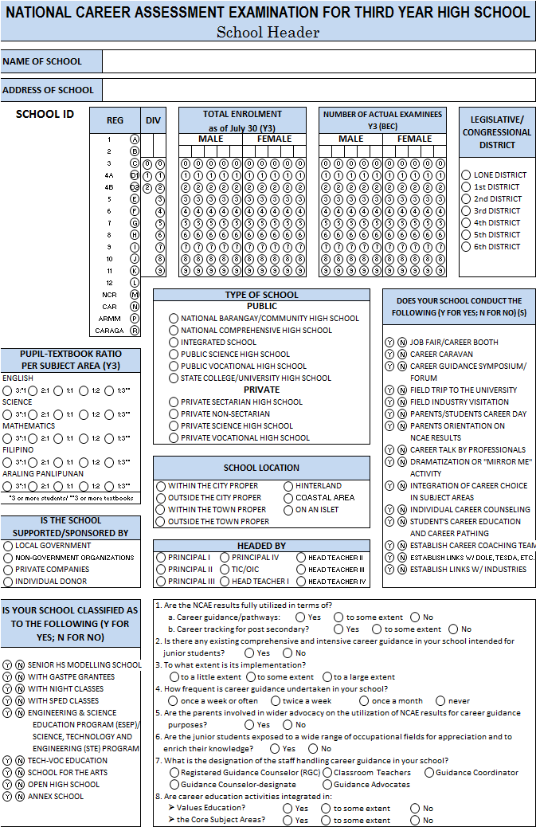
Discrepancy in the School ID (NAT and NCAE)
(School Header vs. EBEIS)
1. Update the School ID
Cross out the temporary School ID
Write the EBEIS School ID below the bar code

Slide 25
Special Group of Examinees in the NAT
  Allot a separate testing room for the special group of examinees from the regular ones (BEC) as indicated in the submitted enrolment data (as the case may be) listed below:
  Special Science Curriculum (SSC)
  Technical-Vocational Education (TVE)
  Science and Technology, Engineering and Mathematics (STEM) /Engineering and Science Education Program (ESEP)
  Special Program for the Arts (SPA)
  Open High School Program (OHSP)
  Note: This is for public schools only.

Slide 26
Special Group of Examinees in the NAT
  Examinees must be alphabetically arranged (Males then Females) in Form 1 and Form 2.
  Instruct the examinees to properly shade in their AS the curriculum/program they belong to. This is to correspondingly provide a report on their test results separate from the others.
  Elementary: Do you belong to a section with Special Science Curriculum? (Yes or No)
  Secondary: Do you belong to a section with any of the following programs? (Tech-Voc, ESEP/STEM, SPA, OHS)

Slide 27
Special Group of Examinees in the NAT
  The ETRE(s) of the special group of examinees must be specifically labelled at the upper right hand corner with bold ink to separately process their ASs from the BEC examinees.
  ETRE Label:
  SSC / TVE / ESEP or STEM / SPA / OHSP
  The SSC examinees will use the same school ID with the regular examinees.

Slide 28
Guidelines on the Use of
Learner Reference Number (LRN)
Use the LRN that was provided by the Office of the Planning Service, DepED Central Office.
The LRN must be reflected in each of the examinees’ AS and in Form 1.
In case the LRN is still not available, leave it blank.

Slide 29
Test Administration Guidelines

Slide 30
Pre-Test Guidelines
Concern | Guidelines
Distribution of TMs | Early in the morning of exam day in nearby schools A day before the test to far schools or even earlier to far flung schools DTC issues the Oath of Confidentiality to each SH
Information Dissemination | To Examinees: Inform the examinees to bring pencils (lead#2) on exam day. Inform the fourth year students taking NAT to bring snacks/lunch on exam day. They are not allowed to leave the campus. Inform the examinees that they should know the curriculum / program they belong to (BEC, ESEP/STEM, TVE, SPA and OHSP) Inform the examinees to have a copy of their ratings in the third grading period: Math, English, Science, Filipino and HeKaSi/Araling Panlipunan. Advise the examinees to have a copy of their LRN. The coverage of NAT Y4 includes the core subjects and the Critical Thinking Skills Test. Only the Grade 6 examinees are issued with individual CORs. Hence, their ASs are provided with Examinee Stubs.

Slide 31
Concern | Guidelines
Information Dissemination | To Schools: The list of examinees must be alphabetically arranged in the whole school. All males first then females. Each listed examinee should have his/her corresponding LRN. Inclusion Policies Examinees with Hearing Impairment (HI) may take the test and may be included in the regular testing room Only those Y4 students graduating in March 2015 will be allowed to take the NAT Y4 Non-testing officials are not allowed to stay in the vicinity of the testing rooms.
Preparation of Classrooms | Well lighted and conducive for testing. For Grade 6 and Year 4, 30 armchairs should be provided. The arrangement of the seats must be well-spaced & spread out; first and last rows are close to the walls.

Slide 32
Concern | Guidelines
Merging of Excess Examinees and Testing Centers | In case there are five or less examinees in excess in a large testing center, they can be integrated in the last five rooms, each accommodating an examinee. The examinee will be the last in the list/seat plan. Customize Forms 1 and 2 in order to include the additional examinee. Add another box/space in the forms. Examinees from small-size private schools can be merged and tested in one testing center in a city or in a municipality. A Master Teacher shall be assigned as the CE. There should be separate C/ETREs for each school in case there is merging of small size schools into one testing center. In case merging with other small testing center is not possible, e.g. 35 registrants only, all examinees maybe accommodated in one testing room. Another set of Forms 1 and 2 will be used for the 5 examinees. No integration of excess examinees will be done if there are enough testing rooms and room examiners (coming from other schools) to serve in the testing center.

Slide 33
Concern | Guidelines
On Checking the Identity of the Examinee | Countercheck the identity of each examinee through his/her School ID. If the ID is not available, ask the examinee to present a notebook or any personal belonging bearing his/her name. In the absence of # 1 and # 2 identification materials, ask the classmates inside the testing room to attest his/her identity.
Test Materials Allocation | Grade 6 Schools with more than 90 examinees – The allocation should be 50% TBs and 100% ASs of the total enrolment There will be 2 testing sessions for schools allocated with only 50% TBs 2. Schools with 90 examinees and below – The allocation should be 100% TBs and ASs of the total enrolment Year 4 100% allocation of TBs and ASs based on the total enrolment

Slide 34
Board Work : NAT Grade 3
Items Number Time Limit Time Started Time to End
General Directions 5 mins _____ _____
Part I (EDQ) 1- 11 10 mins
Part II (Test Proper)
Test Booklet 1
Listening Test in English 1 – 12 25 mins.
English 13 - 45 50 mins.
Listening Test in Filipino 1 – 12 20 mins.
Filipino 13 - 45 35 mins.
Total Time Limit 2 hrs. 10 mins

Slide 35
Board Work : NAT Grade 6
Time Started Time to End
General Directions
& Sample Items 5 mins __________
Part I (EDQ) 1 – 15 5 mins __________
Part II (Test Proper)
Filipino 1 – 40 ___________
Mathematics 1 – 40
English 1 – 40 __________
Break 15 mins
Science 1 – 40 ____________
HEKASI 1 – 40 __________
Total time limit: 3 hrs & 50 mins
Notes: 1. Use same board work for the second session.
2. There is only one TB for Filipino, Mathematics, English, Science and HeKaSi

Slide 36
Board Work : NAT Fourth Year
Parts of the Test Item Time Time Time
Numbers Limit Started Ended
General Directions and
Sample Items 1 – 5 5 mins. ______
Part I (EDQ) 1 – 15 5 mins. ______
Part II (Test Proper )
(A.M.)
Filipino 1 – 60 60 mins. ______
Araling Panlipunan 1 – 60 60 mins. ______
BREAK 10 mins.
Mathematics 1 – 50 70 mins. ______ ______
LUNCH BREAK
(P.M.)
Science 1 – 60 80 mins. ______
English 1 – 60 60 mins.
Critical Thinking Skills Test 1 – 20 30 mins. ______
Note: There is only one TB for Filipino, Mathematics, English, Science, Araling Panlipunan and Critical Thinking Skills
Total Time Limit: 6 hrs.

Slide 37
Filling Out the Scannable School Header (SSH)
Data must be prepared by the STC days ahead before exam day.
Transcribe the data in the SSH using a PENCIL (lead# 2) during exam day.
Every variable is labeled with S if a school concern and G/Y if a grade/year concern.
There are variables specific only for private schools (such as GASTPE) and for the public schools (CFSS, etc.)
GASTPE grantees must be properly identified by year level and type of grant (EVS or ECS).

Slide 38
Filling Out the SSH
Observe the place values in filling in boxes requiring nominal data. The right most box is for ones followed by tens, hundreds and thousands. Empty boxes have to be filled in with zeroes.
  Ex. Actual number of examinees: 203
An actual number of 94 examinees is filled out as:
In 2015 NAT, there is an inclusion of a checklist on teachers’ trainings / staff development activities on raising learners’ achievement level in the core subjects at the school level.
0
2
0
3
0
0
9
4

Slide 39
Instructions for the Recording of Time
Time allocation serves as guide in the recording of time but the corresponding actual time in answering each subject should be written in the Time Started and Time to End.
The recording of time is done by cluster of subjects answered before and after breaks (snacks and lunch); for which the time records should be written in the blanks provided.

Slide 40
Pretest : Entrance and Seating Arrangement
LAPG - Grade 3:
20 examinees in a room
Seats are 4 rows of 5
NAT Grade 6 and Year 4:
30 examinees in a room
Seats are 6 rows of 5
Count the TBs before opening package in front of examinees.
Do not allow electronic devices (calculator & cell phones), references (dictionaries) and rulers in the exam room.
All belongings shall be placed in front beneath the blackboard. Only pencils, sharpeners and a computation paper shall be with the examinees while test is going on.
Seat Assignment must be strictly based on the Seat Plan.
Seats of late comers/absentees must be left vacant.
Count the TBs and ASs in front of the examinees prior to distribution
Note: No other persons should be allowed in the premises of the Examination Rooms except the testing staff and authorized monitors.

Slide 41
Pretest : Distributing and Checking the TBs and ASs
TBs and ASs must be distributed correspondingly by Serial Number based on the Seat Plan. Hence, TMs of absentees must remain in the plastic bag under the custody of the RE.
Distribute TMs from right to left and from lowest serial number.
Check page by page.
Place defective/unused TB and AS, if any, in the plastic bag.
Check and double check if all examinees have shaded the correct circles pertaining to the NAME GRID and all the necessary information about the examinee.
Remind examinees to use eraser for pencils. Tape or liquid erasers are NOT allowed.
No examinees should start accomplishing the NAME GRID unless they have shown their pencils.
Do not start the Test Proper unless each examinee has properly shaded the NAME GRID.

Slide 42
Test Proper
Read verbatim the information in boxed portions of the handbook. Do NOT translate in local language/dialect.
Always record the time started and the time when clustered subject tests will end.
Do NOT add nor subtract minutes in the time allocated.
Accomplish the Seat Plan while the examinees are answering the EDQ.
Accomplish Form 7 while test is in progress.
Closely supervise the examinees in accomplishing the AS so that reliable data can be generated.

Slide 43
Post Test
Give five minutes to inspect and clean the ASs.
The Examinee Stubs should be turned over by the RE to the Guidance Counselor or SH.
Count the TBs and ASs before allowing examinees to leave the testing room.

Slide 44
Post Test : Accounting of Test Materials and Preparation of Reports
Count and arrange the TBs and ASs consecutively by serial number.
Accomplish the ETRE’s data. Indicate the number of registrants and the actual number of examinees.
After the contents have been accounted for, SEAL the ETRE with the DepED-NETRC tape and sign across it while still inside the testing room.
Account for and submit to the CE the TMs used.

Slide 45
Post Test : Contents of ETRE
Report on time test started and ended by cluster of subjects (Board Work on Actual Time Record)
Used ASs placed in original plastic bag
Form 1 and Form 2
Form 7
Post Test : Contents of CETRE
Unused ASs
Form 3
Form 4
Scannable School Header
Note: Forms 5 & 6 shall be submitted separately to the DTCs

Slide 46
Post Test : Materials for Submission to the Division Office
Bundles of ETREs and CETREs placed in the original boxes
Bundles of used and unused TBs placed in the original boxes
Examiner’s Handbook
NETRC Form 5 to be placed inside Box No. 1 for the TBs of the Division (on top of the TBs)
NETRC Form 6 to be placed inside Box No. 1 of ETRE’s/CETRE’s of the Division (on top of the CETREs)
Reminders:
The SHs have to return the TMs within 24 hours.
Take note of the guidelines regarding the time and date of the Forwarder’s retrieval of the TMs.
Accomplish the Questionnaire on Forwarder’s Performance.
Notify the NETRC if TMs are ready for retrieval or if they were not retrieved promptly.

Slide 47
The Forms
Oath of Confidentiality
Form 1 – List of Actual Examinees
Form 2 – Seat Plan
Form 3 – Test Materials Accounting Form
Form 4 – Chief Examiner’s Report Form
Form 5 – Test Booklet Quantity and Completeness Verification Sheet
Form 6 – Answer Sheet Quantity and Completeness Verification Sheet
Form 7 – Room Examiner’s Test Administration Evaluation Report

Slide 48
Oath of Confidentiality
As part of the testing staff nationwide, tasked to receive, administer and retrieve the Test Materials for the National Achievement Test (NAT), I hereby solemnly swear that I will strictly observe security measures to maintain the confidentiality of said materials.
Received from: Received by:
(The Division Testing Coordinator) (School Head/School Testing Coordinator)
________________________ ________________________
Printed Name and Signature Printed Name and Signature
____________________ ____________________
Date Date

Slide 49
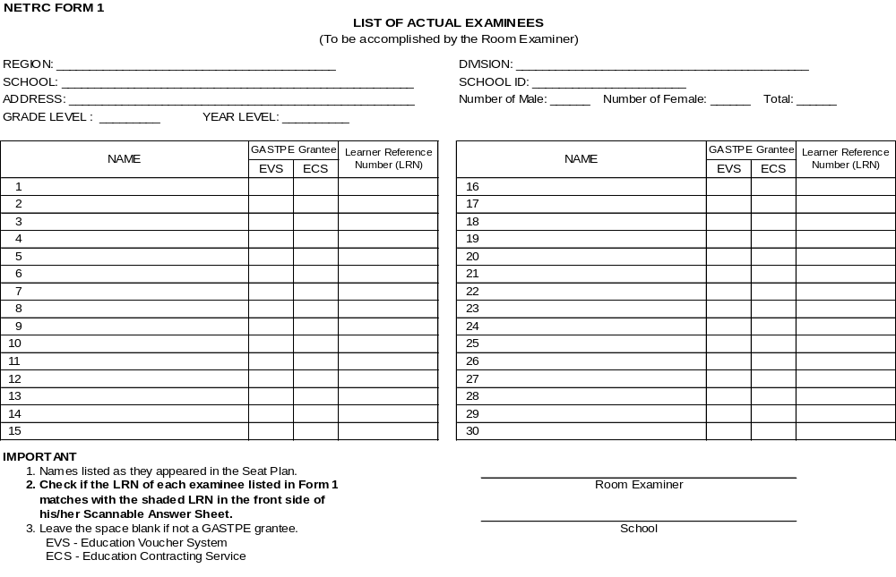
The Generic Forms
Form 1

Slide 50
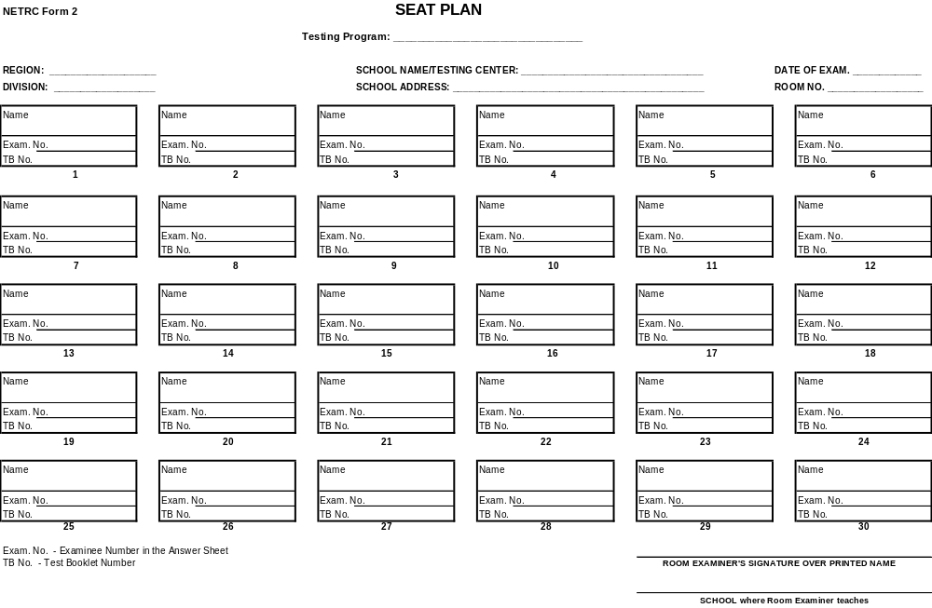
Form 2
Note: Only 20 examinees for NAT-Grade 3.

Slide 51
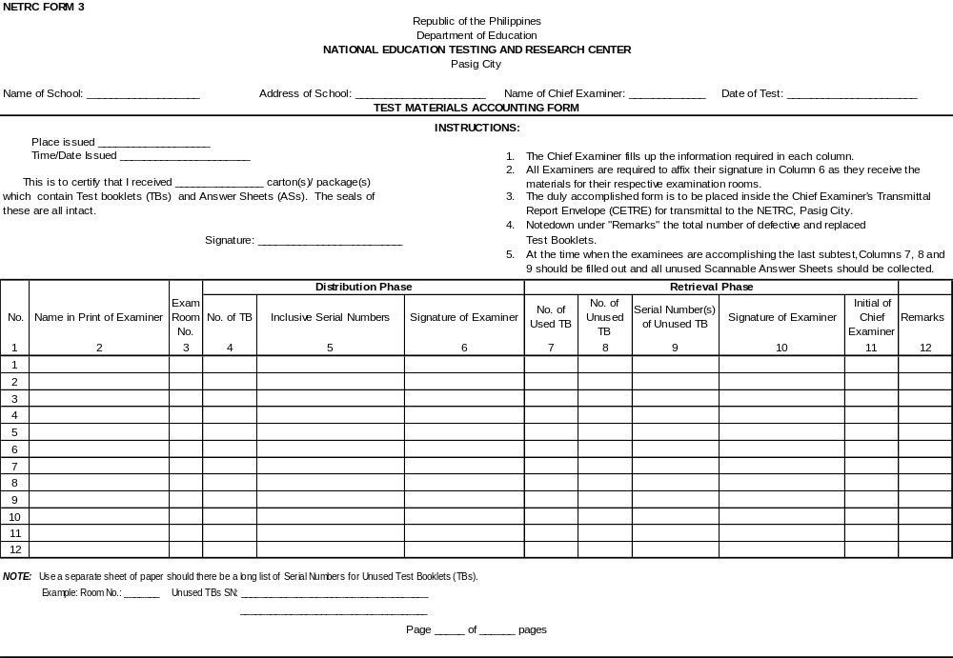
Form 3

Slide 52
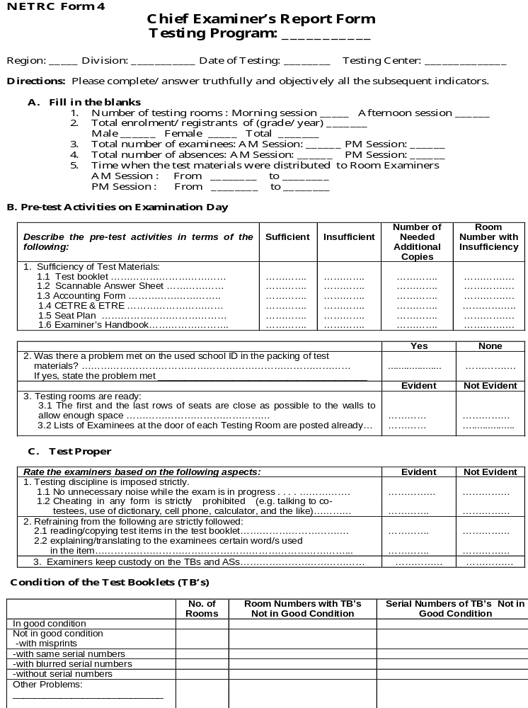
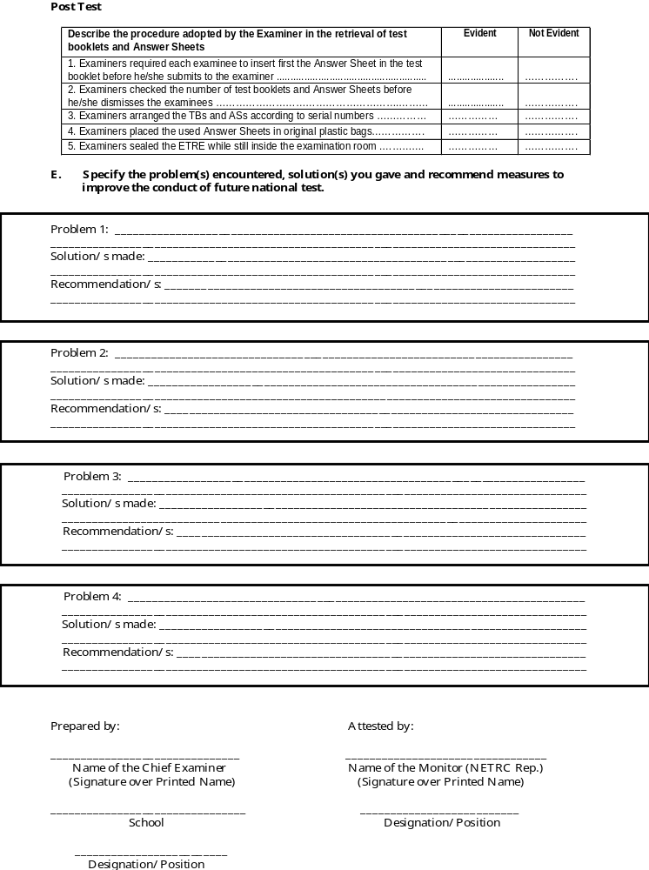
Form 4

Slide 53
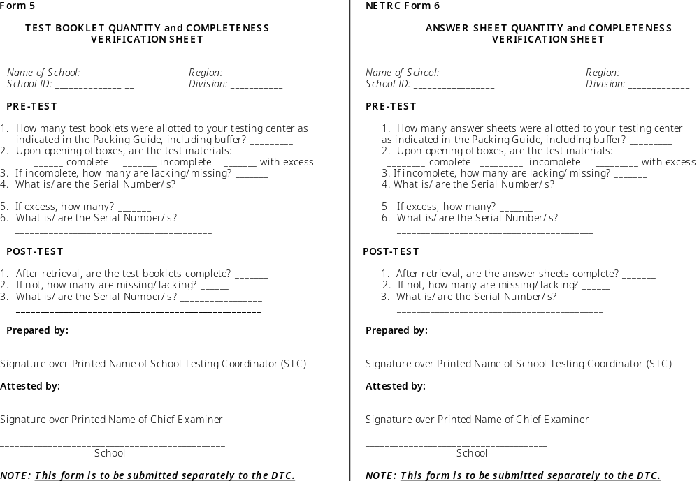
Forms 5 and 6

Slide 54
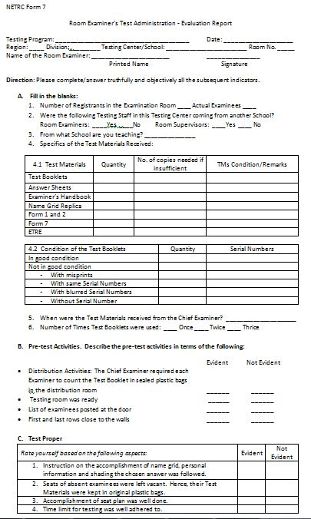
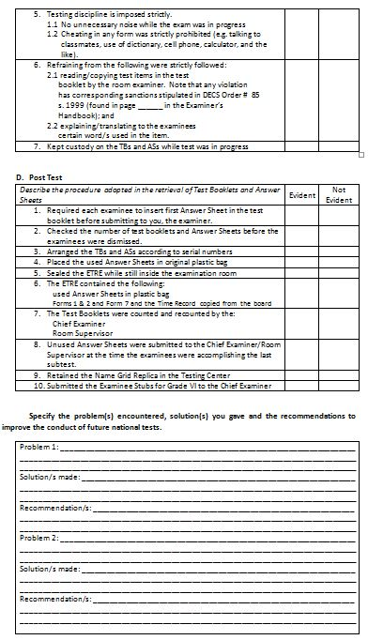
Form 7 – This will suffice the narrative report of the RE

Slide 55
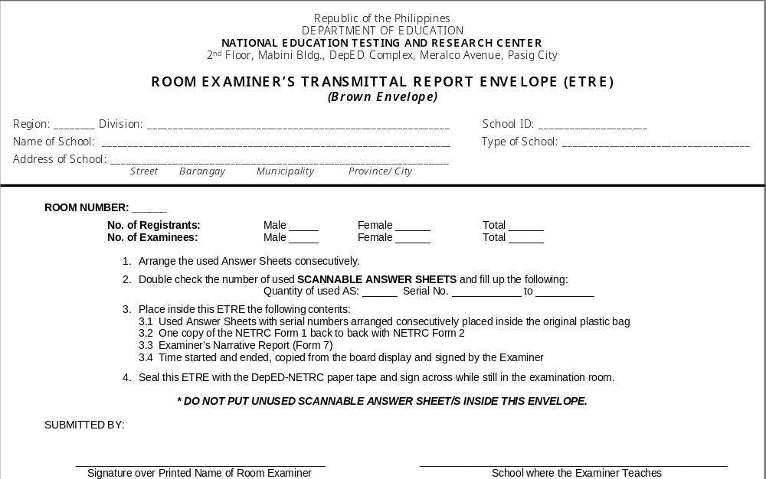
Room Examiner’s Transmittal Report Envelope

Slide 56
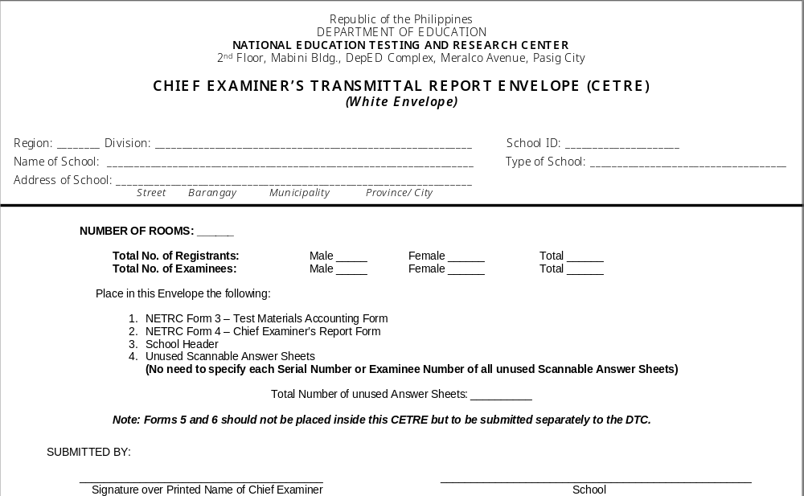
Chief Examiner’s Transmittal Report Envelope

Slide 57
On Photocopied Answer Sheets
In case there will be a shortage of Answer Sheets (ASs) in one testing center, Scannable Answer Sheets (SASs) may be photocopied.
The photocopied ASs SHOULD BE PLACED INSIDE THE RESPECTIVE ETRE corresponding with the list of actual examinees in Forms 1 and 2.
No Examinee Number should be written in Form 2 (Seat Plan) for the examinees with photocopied ASs. Instead, indicate in the blank “(Photocopied).”
Sample:
Using a red marker, indicate at the upper right corner of the ETRE this note:
The instructions above are important in order for NETRC to locate, transcribe and electronically process the photocopied ASs.
Name | Kristina M. Dela Cruz
Exam. No. | (Photocopied)
TB No. | 016657
With _______Photocopied Answer Sheets (quantity) ROOM EXAMINER’S TRANSMITTAL REPORT ENVELOPE (ETRE) (Brown Envelope)

Slide 58
On the Storage of Examiner’s Handbook, Replicas of Name Grid and Board Displays
EHs will be stored in the Division Office. Name Grid replicas and Board Works will be stored in the schools or testing centers. These documents are for future use.
Replicas of the name grid intended for each testing program should be properly stored and utilized in school. These are generic to all testing programs; hence, may be used in future testing activities in case no reprints will be provided.

Slide 59
TMs for Retrieval by the NETRC thru Courier
    All TBs packed in original boxes;
    All used ASs in ETREs (Forms 1, 2 and 7 inside);
    All unused ASs in CETREs (Forms 3 and 4, and School Headers inside) packed in original boxes for ASs ; and
    Forms 5 and 6 submitted to DTCs for proper placement in respective boxes
    Reminder: Do NOT mix up TBs with ASs. There are two separate warehouses for these TMs. Otherwise, misplaced TMs will not be accounted for properly.

Slide 60
The Scannable School Header

Slide 61
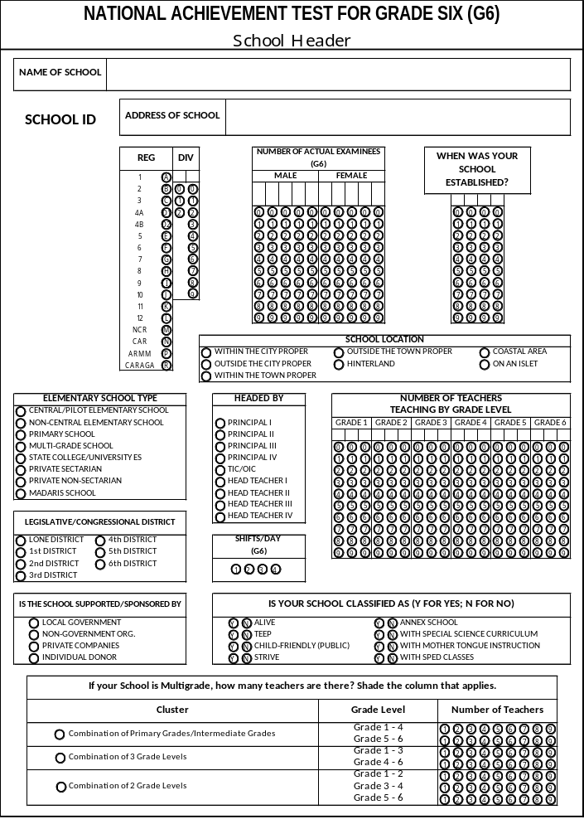
NAT Grade 6

Slide 62
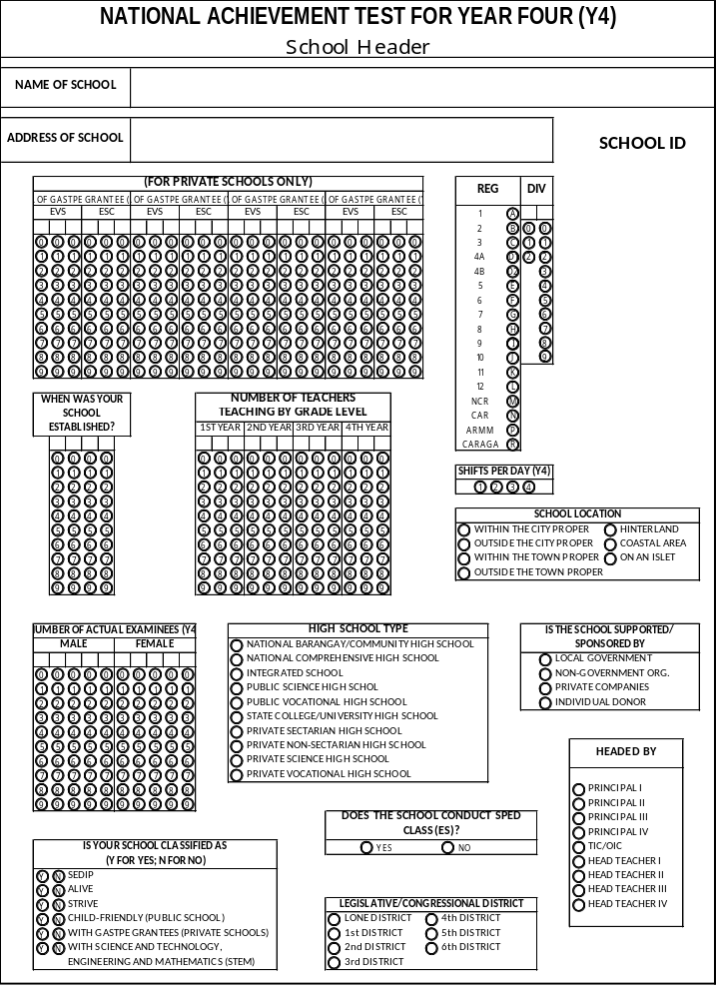
NAT Year 4

Slide 63
Test Results Dissemination

Slide 64
Test Results Dissemination
No hardcopy will be provided to all Division Offices. This in line with the Secretary’s mandate to utilize ICT in education.
Explore the NETRC website to avail of the NETRC test results.
Schools can only log in by using their own School ID as Username and Password.
Example: Username: 702406
Password: 702406
The results will be posted for six (6) months only.
Secure soft copy of the results, which is convertible to Excel file, from the Website.
NETRC Website Homepage: http://netrc.sysportal.net/HomePage.aspx
Log In Page: http://netrc.sysportal.net/signin.aspx

Slide 65
Other Concerns

Slide 66
Utilization of the Certificate of Ratings (COR)
The utilization of the COR is stipulated in the following issuances:
DepED Memo NO. 228, s. 2007
DepED Memo No. 278, s. 2010

Slide 67
Practices in Some Divisions Relative to the Utilization of the COR
Attach the COR in the Form 137 in Grade 6 as part of the student’s credentials prior to enrolment.
The COR is photocopied. One copy is for the school where the student intends to enroll while the original COR is given to him/her.

Slide 68
End

