Slide 1


Slide 2

The K to 12 Graduate

Slide 3
Republic Act 10533
Enhanced Basic Education
Act of 2012

Slide 4
Main Features
1. Kindergarten
Part of the Basic Education Curriculum
Institutionalized starting SY 2011 – 2012
(Made into law by RA 10157)

Slide 5
Main Features
2. Mother Tongue
Taught as a subject in grades 1 to 3
Used as medium of instruction in some subjects in Grades 1 - 3

Slide 6
Main Features
3. Senior High School
- additional two years (grades 11 – 12)

Slide 7
K+6+4+2 Model
Senior High School
Grades 11-12 (16-17 years old)
Junior High School
Grades 7-10 (12-15 years old)
Elementary School
Grades 1-6 (6-11 years old)
Kindergaten (5 years old)

Slide 8


Slide 9
Core Subjects: English, Filipino, AP, EsP,
Math, Science, MAPEH
Elective Technology and Livelihood Educ
Core Subjects: English, Filipino, AP, EsP,
Math, Science, MAPEH
Exploratory Technology and Livelihood Educ
Math, Science, MAPEH
GRADES 9-10
Junior High
GRADES 7-8
Junior High
Core Subjects: English, Filipino, AP, EsP,
Math, MAPEH, Science (Grades 3-6)
EPP (Grades 4-6), MTB- MLE (Grades 1-3)
GRADES 1-6
KINDERGARTEN
Learning Domains: English, Filipino, AP,
EsP, Math, Science, MAPEH

Slide 10


Slide 11
SHS Tracks
TECHNICAL VOCATINAL-LIVELIHOOD
ARTS AND DESIGN
ACADEMIC
SPORTS
Strands:
ABM
STEM
HumSS
GAS

Slide 12


Slide 13
Grades 11 – 12 (4 Semesters)
31 TOTAL SUBJECTS
15 CORE Subjects | 16 TRACK SUBJECTS
 | 7 Contextualized Subjects | 9 Specialization Subjects
Each subject will have 80 hours per semester
P.E. and Health will have 20 hours per semester
Number of Hours
Core | Track | Total
1,200 | 1,280 | 2,480
2,480 hours divided by 400 school days (50 school days/semester)
= 6.2 hours per day

Slide 14
Senior High School
Core Subjects | Same content | Same competencies
Contextualized Subjects | Different content | Same competencies
Specialization Subjects | Different content | Different competencies

Slide 15
SHS CORE SUBJECTS for all Tracks and Strands
 |  | HOURS/ SEMESTER
Language | Oral Communication | 80
 | Reading and Writing | 80
 | Komunikasyon at Pananaliksik sa Wikang Pilipino | 80
 | Pagbasa at Pagsuri ng Iba’t Ibang Teksto Tungo sa Pananaliksik | 80
Humanities | 21st Century Literature from the Philippines and the World | 80
 | Contemporary Philippine Arts from the Regions | 80
Communication | Media and Information Literacy | 80
Mathematics | General Mathematics | 80
 | Statistics and Probability | 80
Science | Earth and Life Science (Lecture and Laboratory) | 80
 | Physical Science (Lecture and Laboratory) Disaster Readiness and Risk Reduction (for STEM Strand only) | 80
Social Science | Personal Development/ Pansariling Kaunlaran | 80
 | Understanding Culture, Society and Politics | 80
Philosophy | Instruction to the Philosophy of Human Person | 80
Health | Physical Education and Health | 80
 | Total | 1,200

Slide 16
Academic, Tech-Voc-Livelihood, Sports, and Arts & Design Tracks CONTEXTUALIZED SUBJECTS
1 | English for Academic and Professional Purposes
2 | Research in Daily Life 1
3 | Research in Daily Life 2
4 | Pagsulat sa Filipino sa Piling Larangan (Akademik, Isports, Sining at Tech-Voc)
5 | Empowerment Technologies (E-Tech); ICT for Professional Tracks
6 | Entrepreneurship
7 | Research Project Culminating Activity
Each subject will have 80 hours

Slide 17

Accountancy, Business and Management Strand (under Academic Track) SPECIALIZATION SUBJECTS
8 | ABM Strand 1 – Applied Economics
9 | ABM Strand 2 – Business Ethics and Social Responsibility
10 | ABM Strand 3 – Fundamentals of Accountancy, Business and Management 1
11 | ABM Strand 4 – Fundamentals of Accountancy Business and Management 2
12 | ABM Strand 5 – Business Math
13 | ABM Strand 6 – Business Finance
14 | ABM Strand 7 – Organization and Management
15 | ABM Strand 8 – Principles of Marketing
16 | ABM Strand 9 – Work Immersion/Research/Career Advocacy/Culminating Activity i.e. Business Enterprise Simulation
Each subject will have 80 hours

Slide 18
Science, Technology, Engineering and Mathematics Strand (under Academic Track) SPECIALIZATION SUBJECTS
8 | STEM Strand 1 – Pre-Calculus
9 | STEM Strand 2 – Basic Calculus
10 | STEM Strand 3 – General Biology 1
11 | STEM Strand 4 – General Biology 2
12 | STEM Strand 5 – General Physics 1
13 | STEM Strand 6 – General Physics 2
14 | STEM Strand 7 – General Chemistry 1
15 | STEM Strand 8 – General Chemistry 2
16 | STEM Strand 9 – Work Immersion/ Research/Career Advocacy/Culminating Activity
Each subject will have 80 hours

Slide 19
Humanities and Social Sciences Strand (under Academic Track) SPECIALIZATION SUBJECTS
8 | HUMSS Strand 1 – Creative Writing
9 | HUMSS Strand 2 – Creative Nonfiction: The Literary Essay
10 | HUMSS Strand 3 – World Religions and Belief System
11 | HUMSS Strand 4 – Trends, Networks and Critical Thinking in the 21st Century
12 | HUMSS Strand 5 - Philippine Politics and Governance
13 | HUMSS Strand 6 – Community Engagement, Social Participation and Citizenship
14 | HUMSS Strand 7 – Disciplines and Ideas in the Social Sciences
15 | HUMSS Strand 8 – Disciplines and Ideas in the Applied Social Sciences
16 | HUMSS Strand 9 – Work Immersion/ Research/Career Advocacy/Culminating Activity
Each subject will have 80 hours

Slide 20
General Academic Strand (under Academic Track) SPECIALIZATION SUBJECTS
8 | Strand 1- Humanities 1
9 | Strand 2 – Humanities 2
10 | Strand 3 – Social Science 1
11 | Strand 4 – Applied Economics
12 | Strand 5 – Organization and Management
13 | Strand 6 – Disaster Readiness and Risk Reduction
14 | Strand 7 – Elective 1 (from any Track/Strand)
15 | Strand 8 – Elective 2 (from any Track/Strand)
16 | Strand 9 - Work Immersion/ Research/Career Advocacy/Culminating Activity
Each subject will have 80 hours

Slide 21
Sports Track SPECIALIZATION SUBJECTS
8 | Sports Track 1 – Safety and First Aid
9 | Sports Track 2 – Human Movement
10 | Sports Track 3 – Fundamentals of Coaching
11 | Sports Track 4 – Sports Officiating and Activity Management
12 | Sports Track 5 – Fitness, Sports and Recreation Leadership
13 | Sports Track 6 – Psychosocial Aspects of Sports and Exercise
14 | Sports Track 7 – Fitness Testing and Exercise Programming
15 | Sports Track 8 – Practicum (in-campus)
16 | Sports Track 9 - Work Immersion/ Research/Career Advocacy/Culminating Activity
Each subject will have 80 hours

Slide 22
Arts and Design Track SPECIALIZATION SUBJECTS
8 | Arts Track 1 – Creative Industries I: Arts and Design Appreciation and Production
9 | Arts Track 2 – Creative Industries II: Performing Arts
10 | Arts Track 3 – Physical and Personal Development in the Arts
11 | Arts Track 4 – Developing Filipino Identity in the Arts
12 | Arts Track 5 – Integrating the Elements and Principles of Organization in the Arts
13 | Arts Track 6 – Leadership and Management in Different Arts Fields
14 | Arts Track 7 - Apprenticeship and Exploration of Different Arts Fields
15 | Arts Track 8 – Apprenticeship and Exploration of Different Arts Fields
16 | Arts Track 9 - Work Immersion/ Research/Career Advocacy/Culminating Activity
Each subject will have 80 hours

Slide 23
Tech-Voc-Livelihood (TVL) Track Specialization Subjects
 | Subjects | Example
8 | TVL Track 1 | Beauty Care/ Nail Care
9 | TVL Track 2
10 | TVL Track 3 | Hair-dressing
11 | TVL Track 4
12 | TVL Track 6
13 | TVL Track 7
14 | TVL Track 8
15 | TVL Track 9
16 | TVL Track 10
TESDA Training Regulations-Based Specialization
HE | ICT | Agri-Fishery Arts | Industrial Arts
1. Hairdressing 2. Tailoring 3. Caregiving 4. Food and Beverage Services 5. Bread and Pastry Production 6. House- keeping 7. Tour Guiding Services 8. Travel Services 9. Attractions and Team Park Tourism 10. Handicraft Fashion Accessories Paper Craft Woodcraft Leathercraft | 1. Computer Programming 2. Medical Transcription 3. Animation | AGRICROP PRODUCTION 1. Horticulture 2. Landscape Installation and Maintenance 3. Organic Agriculture Production 4. Pest Management 5. Rice Machinery Operation ANIMAL PRODUCTION 1.Artificial Insemination 2. Raising Large Ruminants (Dairy Cattle, Buffaloes) 3. Raising Swine 4. Slaughtering FISH PRODUCTION 1.Fish Nursery Operation 2. Fish or Shrimp Grow Out Operation 3. Fish port/ Wharf Operation | 1.Automotive Servicing 2. Refrigeration and Air- conditioning 3. Consumer Electronic Servicing 4. Electrical Installation and Maintenance 5. Shielded Metal-Arc Welding 6. Carpentry 7. Plumbing 8. Masonry 9. Tile Setting

Slide 24
Strengthened Technical Vocational Education Program (STVEP) is a special Tech-Voc Program conceptualized in 2007
Goal To provide high school graduates with opportunities
to acquire certifiable vocational and technical skills
Curriculum
competency-based reflecting what are required
by the industry through TESDA Training Regulations
Progressive type where mastery of skills in all the qualifications within the industry is facilitates
Type of STVEP | Number of Schools
Arts and Trades | 155
Agriculture | 80
Fishery | 45
Total | 280

Slide 25
Who can offer Senior High School?
Private entities
Public Schools

Slide 26
Sample Class Program
(JHS) (SHS)
Mon-Fri Mon-Fri
6:30am-7:30am 2:20-3:20pm
7:30am-8:30am 3:20-4:20pm
8:30am-9:30am 4:20-5:20pm
9:30am-9:50am brunch 5:20-5:40pm break
9:50am-10:50am 5:40-6:40pm
10:50am-11:50am 6:40-7:40pm
11:50am-12:50pm 7:40-8:40pm
12:50pm-1:50pm Saturday( 8am-1pm understanding culture)
(2 pm-4pm PE&HEALTH)

Slide 27
SAMPLE CLASS SCHEDULE(G-11)
(Time) 1ST SEM 2ND SEM
2:20-3:20pm
3:20-4:20pm
4:20-5:20pm
5:20-5:40pm break
5:40-6:40pm
6:40-7:40pm
7:40-8:40pm

Slide 28
SAMPLE CLASS SCHEDULE(G-11)
(Time) 1ST SEM
2:20-3:20pm 1 Language(English) –Oral Comm.
3:20-4:20pm 2Language(Filipino)-Kom at Pananaliksik
4:20-5:20pm 3 Humanities- 21st Century Lit
5:20-5:40pm BREAK
5:40-6:40pm 4Communication-Media & Info Literacy
6:40-7:40pm 5Mathematics- General Mathematics
7:40-8:40pm 6Earth & Life Science ( Lecture & Lab)
Saturday 7Understanding Culture.. 8 PE &Health

Slide 29
SAMPLE CLASS SCHEDULE(G-11)
(Time) 2nd SEM
2:20-3:20pm 9 Language(English) –Reading & writing
3:20-4:20pm 10 Language(Filipino)-Pagbasa at Pagsuri
4:20-5:20pm 11 Humanities- Contemporary Phil Arts
5:20-5:40pm BREAK
5:40-6:40pm 12 Communication-Media & Info Literacy
6:40-7:40pm 13Mathematics- Statistics & Probability
7:40-8:40pm 14Physical Science ( Lecture & Laboratory)
Saturday (8am-10am)-15PE &Health

Slide 30
SAMPLE CLASS SCHEDULE(G-12)
Academic ,TVL, Sports, Arts & Design( for G-12 , 2 electives and 3 substitutions are ALLOWED)
(Time) 1st SEM (Contextualized Subjects)
2:20-3:20pm English for Academic & Professional Purposes
3:20-4:20pm Research in Daily Life 1
4:20-5:20pm Research in Daily Life 2
5:20-5:40pm BREAK
5:40-6:40pm contextualized subj
6:40-7:40pm contextualized subj
7:40-8:40pm contextualized subj
Saturday contextualized subj

Slide 31
SAMPLE CLASS SCHEDULE(G-12)
General Academic Strand
(Time) 2nd SEM (Specialized Subjects)
2:20-3:20pm Strand 1-Humanities 1
3:20-4:20pm Strand 2-Humanities 2
4:20-5:20pm Strand 3- Social Science 1
5:20-5:40pm BREAK
5:40-6:40pm Strand 4-Applied Economics
6:40-7:40pm Strand 5-Organization & Management
7:40-8:40pm Strand 6-Disater Readiness & Risk Reduction

Slide 32
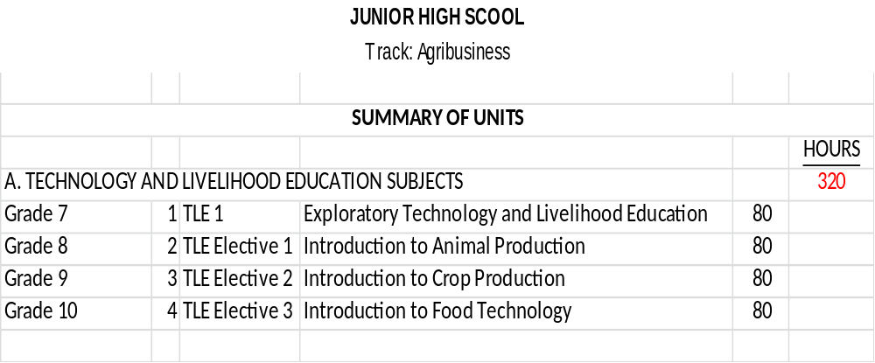

Slide 33
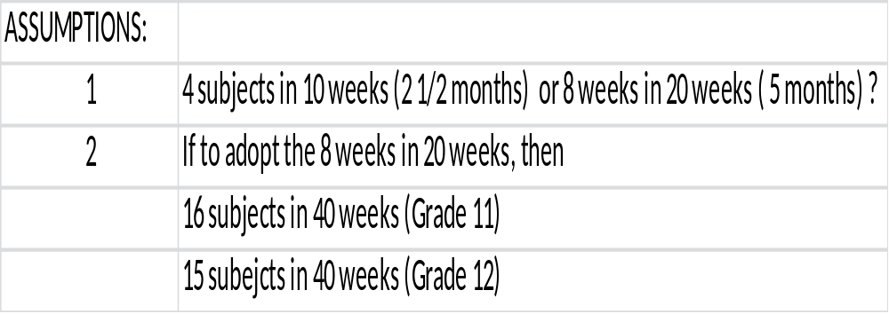

Slide 34
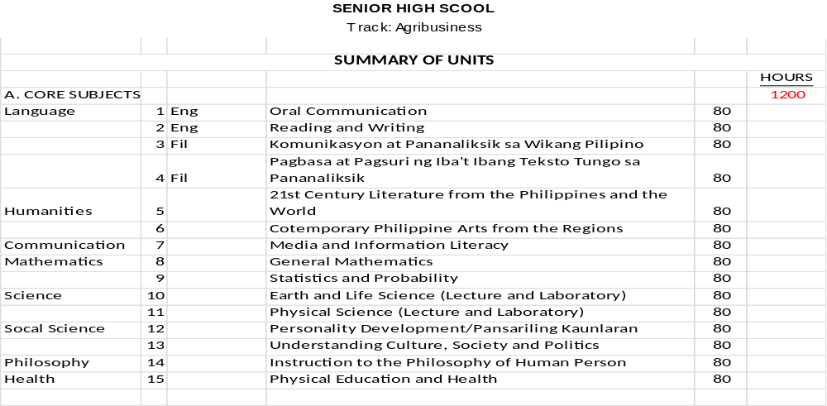

Slide 35
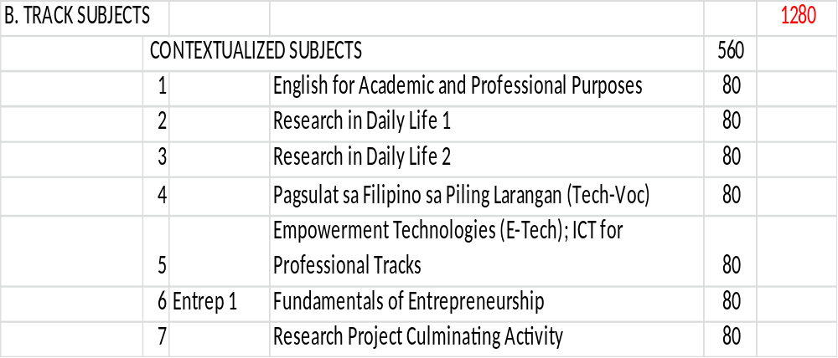

Slide 36
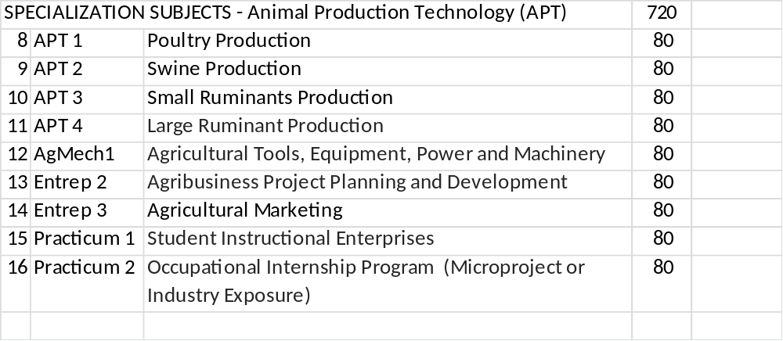

Slide 37
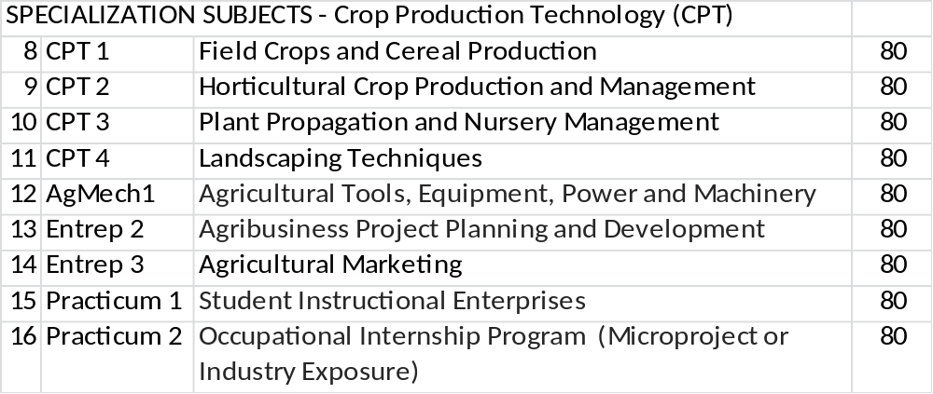

Slide 38
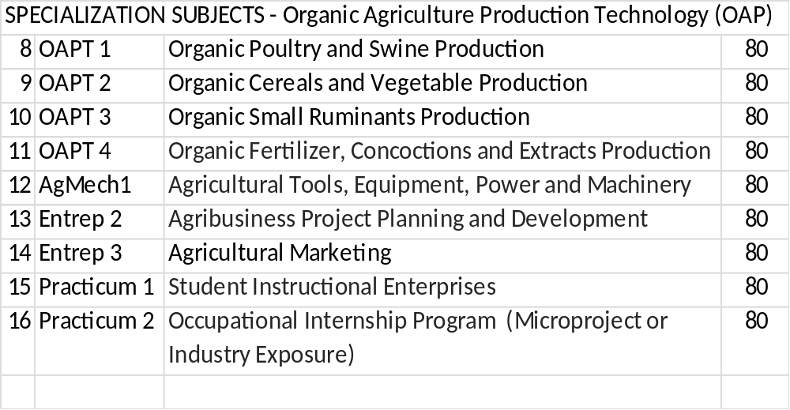

Slide 39
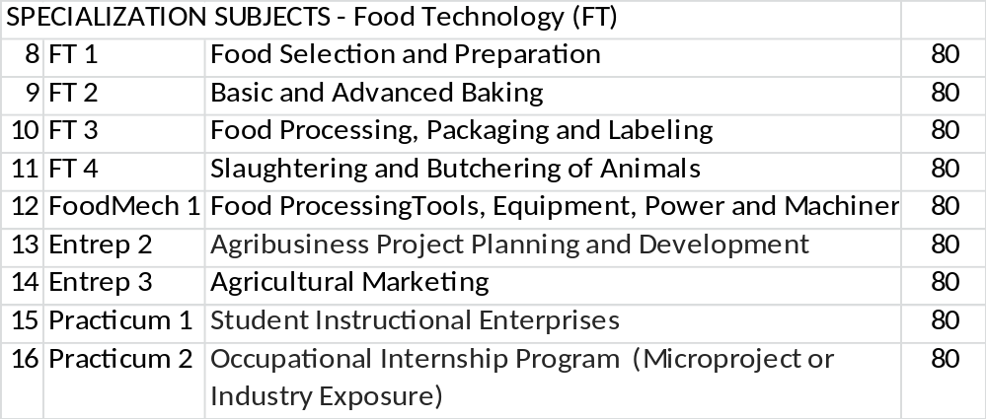

Slide 40
THANK YOU
FOR LISTENING!

