Slide 1

BARANGAY PROJECT TRACKER SYSTEM
BY
LOUIE JAY M LACBAYO
JOEVER SAPUNGAY
JADE MARION TAPIC

Slide 2

FUNCTIONAL REQUIREMENTS
The system allows Barangay users to create an account and log in.
The system allows Barangay users to assign or identify project status (planned, ongoing, completed).
The system allows Barangay users to input materials and resources needed for each project.
The system allows Barangay users to set project duration and timelines.
The system allows Barangay users to input and manage project budgets (planned budget, actual expenses).

Slide 3
The system allows Barangay users to upload supporting files (PDF, JPG, PNG).
The system allows Barangay users to update project information if changes occur, including marking a project as canceled.
The system allows Barangay residents to view project details and status.
The system allows Barangay residents to comment on projects (planned, ongoing, completed).
The system allows Barangay users to view a summary dashboard of all projects.

Slide 4
NON-FUNCTIONAL REQUIREMENTS
The system should be easy to use, so both officials and residents can understand it quickly.
The system should be fast, showing project details and comments without long waiting times.
The system should be safe, keeping accounts and project data protected from unauthorized access.
The system should be dependable, always available when users need it.

Slide 5
The system should be able to grow, handling more projects and users in the future.
The system should work on different devices, like computers and mobile phones.
The system should keep private information secure, especially project budgets and sensitive data.
The system should have a way to save and recover data, so information is not lost if something goes wrong.

Slide 6
DOMAIN REQUIREMENTS
The system should follow barangay rules, so only officials can add or change project details.
The system should use project stages that barangays normally follow (planned, ongoing, completed, canceled).
The system should handle budgets properly, showing both planned amounts and actual spending.
The system should allow residents to join, by viewing and giving comments on projects.
The system should keep records of projects to support barangay transparency and accountability.
The system should follow the Philippines Data Privacy Act of 2012, keeping sensitive information safe.
The system should support local languages (like Filipino or Cebuano) so residents can understand easily.
The system should make project details easy to share in barangay meetings or assemblies.

Slide 7
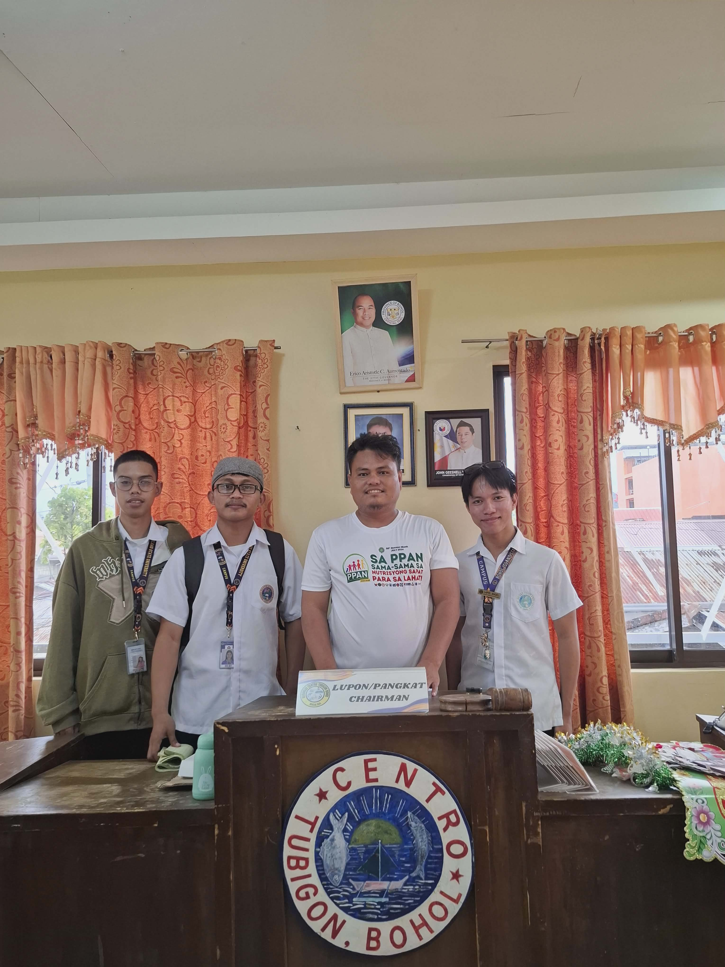
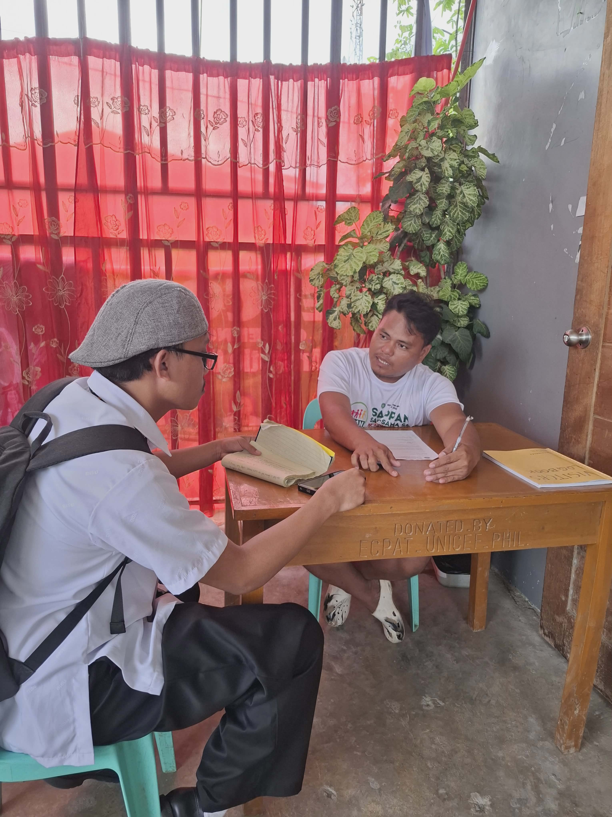

Slide 8
THANK YOU

