Slide 1
CS427: Software Engineering I
Core XP Practices

Slide 2
Previous lectures
Software engineering and process
Process = A set of activities/steps/practices
Eclipse and iTrust
Building and running (later extending) iTrust
We’ll use Eclipse for development
Software Configuration Management
Four aspects of SCM: change control, version control, building, releasing
All slides can be on FINAL EXAM

Slide 3
This lecture’s goals
What is traditional waterfall process?
What is eXtreme Programming (XP)?
How extremely does XP differ?
When (not) to use XP?

Slide 4
Software development processes
Many way to develop software
Plan-driven / agile
Centralized / distributed
High math / low math
Close / little interaction with customers
Much testing / little testing
Organize by architecture / features

Slide 5
Waterfall process activities
Requirements – what software should do
Design – structure code into modules
Implementation – hack code
Integration – put modules together
Testing – check if code works
Maintenance – keep making changes

Slide 6
Theoretical waterfall model
Requirements
Design
Implementation
Integration
OR Testing
Maintenance

Slide 7
Modified waterfall model
Requirements
Analysis
Design
Checking
Implementation
Unit Testing
Integration
System Testing
Maintenance
Regression Testing

Slide 8
eXtreme Programming (XP)
Radically different from waterfall
Big ideas
Don’t write much documentation
Working code is the main written product
Implement features one by one
Release code frequently
Work closely with the customer
Communicate a lot with team members

Slide 9
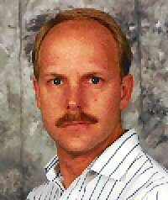
Main figure
Kent Beck

Slide 10
XP: Some key practices
Planning game for requirements
Test-driven development for design and testing
Refactoring for design
Pair programming for development
Continuous integration for integration

Slide 11
XP is an iterative process
Iteration = two week cycle (1-3 weeks)
Plan each iteration in an iteration meeting that is held at the start
Iteration is going to implement set of user stories
Divide work into tasks small enough to finish in a day
Each day, programmers work in pairs to finish tasks

Slide 12
Group Discussion: Pros/Cons in Team Work vs. Solo Work
Requirement: get into a group of three neighbor students
share and discuss respective answers based on your current/past team/solo work experiences either at school or outside of school
Instructor will call for volunteer groups and sometimes randomly pick groups
5 minutes for discussion

Slide 13
What Is Pair Programming?
"Pair programming is a simple, straightforward concept. Two programmers work side-by-side at one computer, continuously collaborating on the same design, algorithm, code, and test. It allows two people to produce a higher quality of code than that produced by the summation of their solitary efforts.“
Driver: types or writes
Navigator: observer (looking for tactical & strategic defects)
Periodically switch roles of driver and navigator
possibly every 30 minutes or less
Pair coding, design, debugging, testing, etc.
©L. Williams

Slide 14
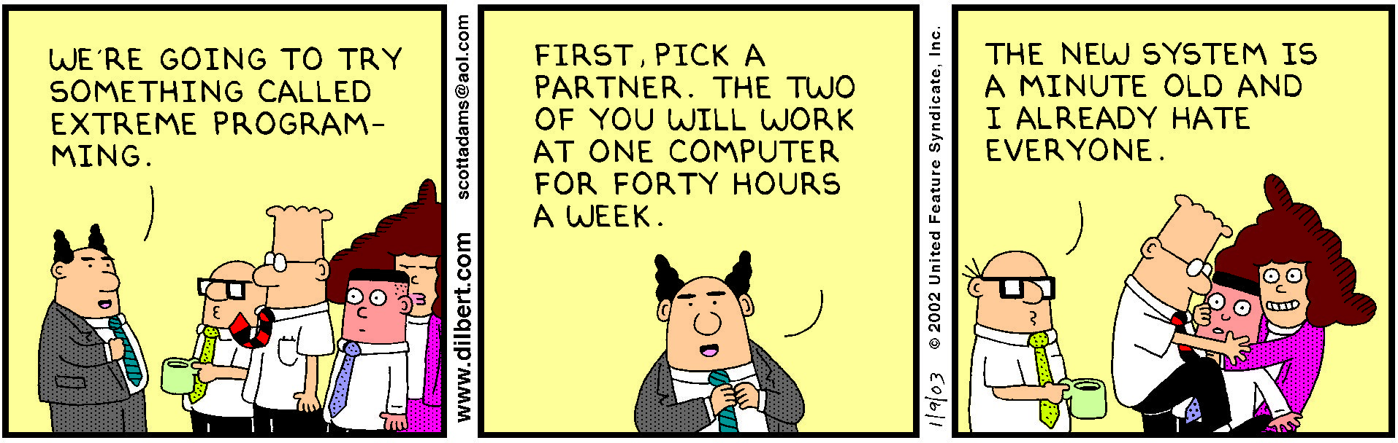
Pairs (should) rotate

Slide 15
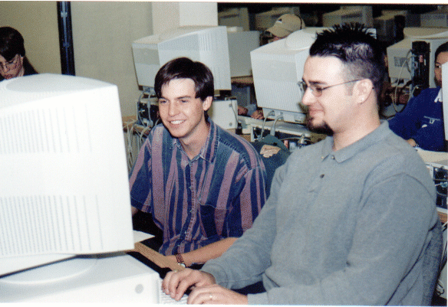
Pair Programming
©L. Williams

Slide 16

This is NOT Pair Programming
©L. Williams

Slide 17
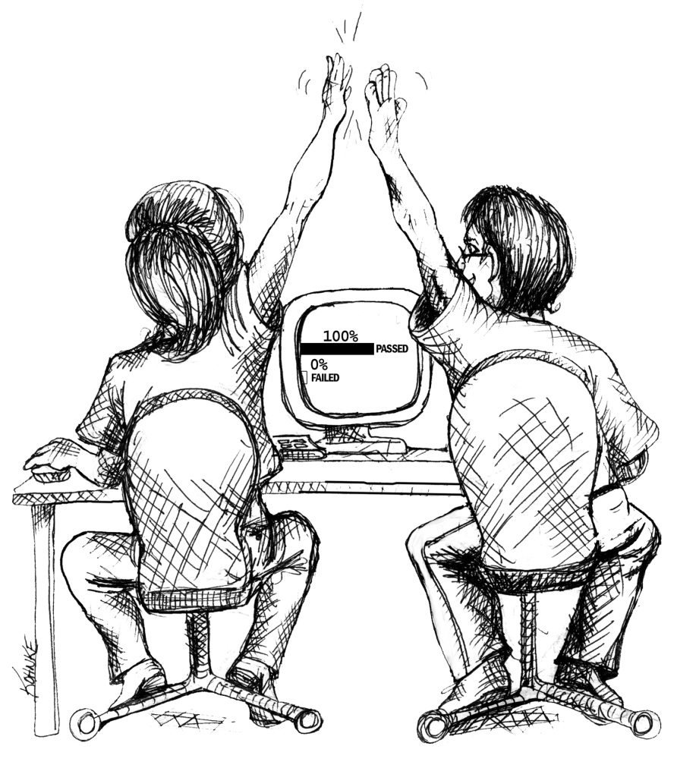
The Benefits of Pair Programming
©L. Williams

Slide 18
Research Findings to Date
Strong anecdotal evidence from industry
“We can produce near defect-free code in less than half the time.”
Empirical Study
Pairs produced higher quality code
15% fewer defects
Pairs completed their tasks in about half the time
58% of elapsed time
Pair programmers are happier programmers
Pairs enjoy their work more (92%)
Pairs feel more confident in their work products (96%)
©L. Williams

Slide 19
Expected Benefits of Pair-Programming
Higher product quality
Improved cycle time
Increased programmer satisfaction
Enhanced learning
Pair rotation
Ease staff training and transition
Knowledge management/Reduced product risk
Enhanced team building
©L. Williams

Slide 20
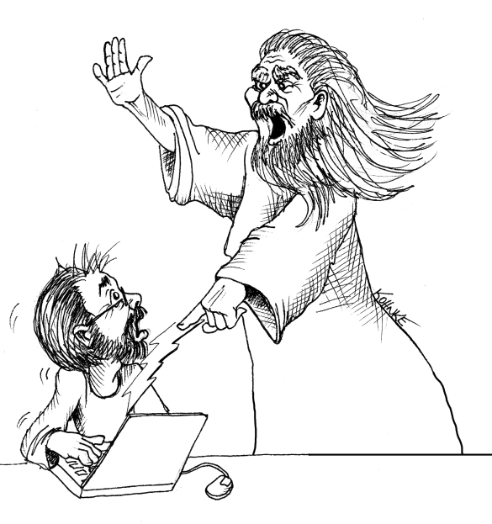

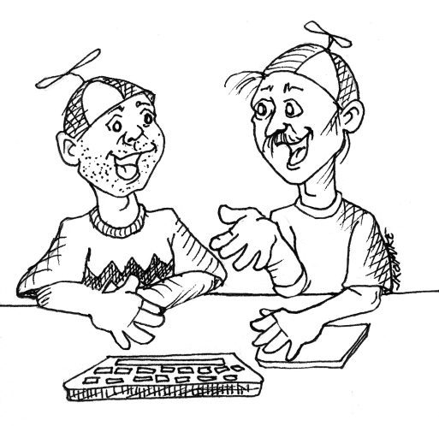
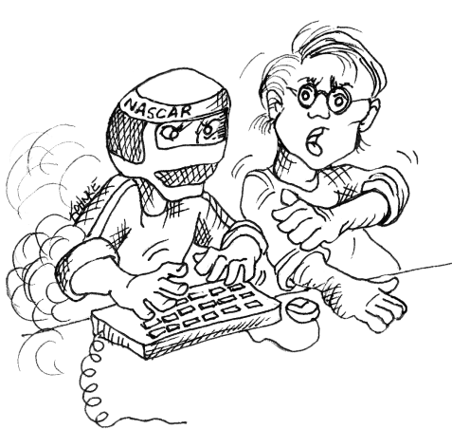
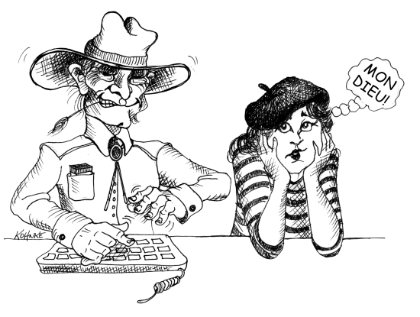
Issues: Partner Work
Expert paired with an Expert
Expert paired with a Novice
Novices paired together
Professional Driver Problem
Culture
©L. Williams

Slide 21
Issues: Process
Used in eXtreme Programming
Used in the Collaborative Software Process
Pair programming can be added to any process
©L. Williams

Slide 22
How does this work?
Pair Pressure
Keep each other on task and focused
Don’t want to let partner down
“Embarrassed” to not follow the prescribed process
Pair Negotiation
Distributed Cognition: “Searching Through Larger Spaces of Alternatives”
Have shared goals and plans
Bring different prior experiences to the task
Different access to task relevant information
Must negotiate a common shared of action
Pair Courage
“if it looks right to me and it looks right to you – guess what? It’s probably right!”
©L. Williams

Slide 23
How does this work (part two)?
Pair Reviews
“Four eyeballs are better than two”
Continuous design and code reviews
Removes programmers’ distaste for reviews
80% of all (solo) programmers don’t do them regularly or at all
Pair Debugging
Explaining the problems to another person → “Never mind; I see what’s wrong. Sorry to bother you.”
Pair-Learning
Continuous reviews → learn from partners techniques, knowledge of language, domain, etc.
Take turns being the teacher and the student minute by minute
©L. Williams

Slide 24
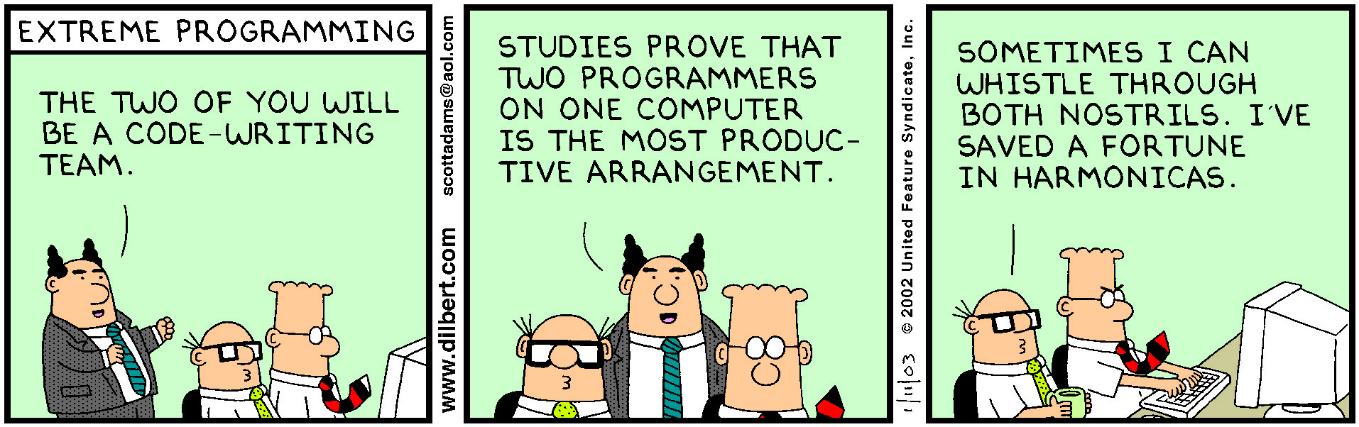
Pairs means working together

Slide 25
XP is an iterative process
Iteration = two week cycle (1-3 weeks)
Plan each iteration in an iteration meeting that is held at the start
Iteration is going to implement set of user stories
Divide work into tasks small enough to finish in a day
Each day, programmers work in pairs to finish tasks

Slide 26
What are User Stories?
A user story represents
a feature customers want in the software
A user story is the smallest amount of information (a step) necessary to allow the customer to define (and steer) a path through the system
Written by our customers (communication w/ developers)
Typically written on index cards
System
©L. Williams

Slide 27
Writing User Stories
Materials
A stack of blank index cards
Pens or pencils
Rubber bands
Start with a goal of the system (e.g., Applicant submits a loan application)
Think about the steps that the user takes as he/she does the activity
Write no more than one step on each card
©L. Williams
© Randy Miller

Slide 28
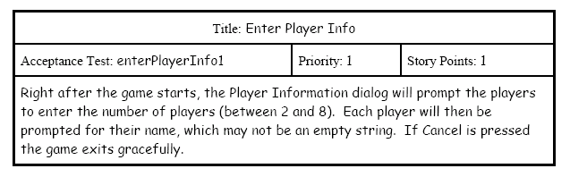
Format of a User Story
Title: 2-3 words
Acceptance test
Priority: 1-2-3 (1 most important)
Story points (can mean #days of ideal development time)
Description: 1-2 sentences (a single step towards achieving the goal)
©L. Williams

Slide 29
Ex. Acceptance Test for a Story
Create Receipt
Keep a running receipt with a short description of each scanned item and its price.
Setup: The cashier has a new customer
Operation: The cashier scans three cans of beans @ $.99, two pounds of spinach @ $.59/lb, and a toothbrush @$2.00
Verify: The receipt has all of the scanned items and their correctly listed prices
©L. Williams
© Randy Miller

Slide 30
XP is an iterative process
Iteration = two week cycle (1-3 weeks)
Plan each iteration in an iteration meeting that is held at the start
Iteration is going to implement set of user stories
Divide work into tasks small enough to finish in a day
Each day, programmers work in pairs to finish tasks

Slide 31
Estimating size: concepts
Story point: unit of measure for expressing the overall size of a user story, feature, or other piece of work. The raw value of a story point is unimportant. What matters are the relative values.
Related to how hard it is and how much of it there is
NOT related to amount of time or # of people
Unitless, but numerically-meaningful
Ideal time: the amount of time “something” takes when stripped of all peripheral activities
Example: American football game = 60 minutes
Elapsed time: the amount of time that passes on the clock to do “something”
Example: American football game = 3 hours
Velocity: measure of a team’s rate of progress
©L. Williams
Notes:
We next illustrate how we estimate story points and ideal days

Slide 32
Priorities
High
“Give us these stories to provide a minimal working system.”
Medium
“We need these stories to complete this system.”
Low
“Bells and whistles? Which stories can come later?”
©L. Williams
© Randy Miller

Slide 33
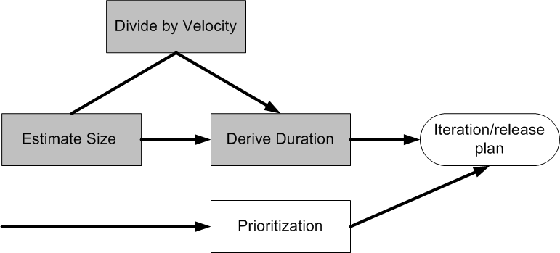
Coming up with the plan
Desired
Features
©L. Williams

Slide 34

Coming up with the plan
Desired
Features
©L. Williams

Slide 35
Estimating story points
Choose a medium-size story and assign it a “5”
Estimate other stories relative to that
Twice as big
Half as big
Almost but not quite as big
A little bit bigger
Only values:
0, 1, 2, 3, 5, 8, 13, 20, 40, 100
Near term iteration
“stories”
A few iterations away
“epic”
©L. Williams

Slide 36
Estimating ideal days
Ideal days vs. elapsed time in software development
Supporting current release
Sick time
Meetings
Demonstrations
Personal issues
Phone calls
. . . .
When estimating ideal days, assume:
The story being estimated is the only thing you’ll work on
Everything you need will be on hand when you start
There will be no interruptions

Slide 37
Ideal days vs. Story points
Favoring story points:
Help drive cross-functional behavior
Do not decay (change based on experience)
Are a pure measure of size (focus on feature, not person)
Estimation is typically faster in the long run
My ideal days are not your ideal days (focus on person and their speed ☹)
Favoring ideal days:
Easier to explain outside of team
Estimation is typically faster at first

Slide 38
Deriving an estimate for a user story
Expert opinion
Rely on gut feel based on (extensive) experience
Disadvantage for agile: need to consider all aspects of developing the user story, so one expert will likely not be enough
Analogy
Relative to (several) other user stories
Triangulation: little bigger than that “3” and a little smaller than that “8”
Disaggregation
Break up into smaller, easier-to-estimate pieces/tasks.
Need to make sure you don’t miss any tasks.
Sanity check: does the sum of all the parts make sense?
Planning poker
Combines expert opinion, analogy, disaggregation

Slide 39
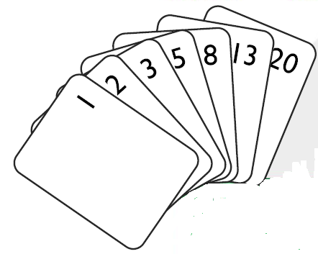
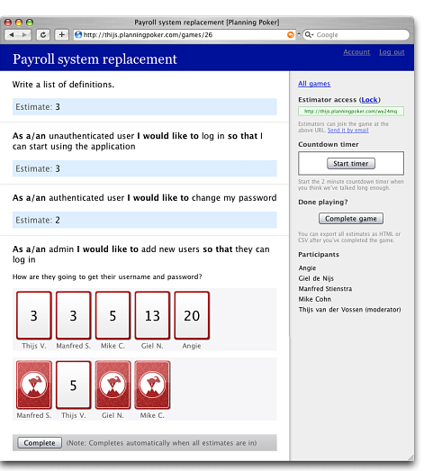
Planning Poker (http://planningpoker.com)
©L. Williams

Slide 40
Playing Planning Poker
Include all players on the development team (but less than 10 people overall):
Programmers
Testers
Database engineers
Requirements analysts
User interaction designers . . .
Moderator (usually the product owner or analyst) reads the description and answers any questions
Each estimator privately selects a card with their estimate
All cards simultaneously turned over
Re-estimate
Repeat until converge
©L. Williams

Slide 41
Coming up with the plan
Desired
Features
©L. Williams

Slide 42
Velocity
Velocity is a measure of a team’s rate of progress.
Velocity is calculated by summing the number of story points assigned to each user story that the team completed during the operation.
We assume that the team will produce in future iterations at the rate of their past average velocity.
“Yesterday’s weather”
http://agilesoftwaredevelopment.com/blog/pbielicki/predicting-team-velocity-yesterday-weather-method
©L. Williams

Slide 43
Coming up with the plan
Desired
Features
©L. Williams

Slide 44
Prioritization
Driven by customer, in conjunction with developer
Choose features to fill up velocity of iteration, based on:
Desirability of the feature to a broad base of customers or users
Desirability of a feature to a small number of important customers or users
The cohesiveness of the story in relation to other stories. Example:
“Zoom in” a high priority feature
“Zoom out” not a high priority feature
But it becomes one relative to “Zoom in”

Slide 45
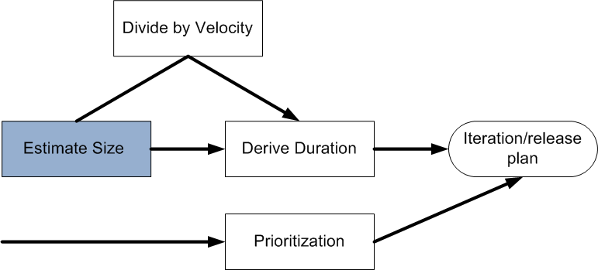
Coming up with the plan
Desired
Features
5 story points/two- week iteration
October 30
30 story points
6 iterations
©L. Williams

Slide 46
Planning game
Customer writes user stories
Programmers estimate time to do each story
If story is too big, customer splits it
Customer chooses stories to match project velocity
Project velocity is amount of work done in the previous iteration(s)

Slide 47
Planning
Programmers only worry about one iteration at a time
Customer can plan as many iterations as desired, but can change future iterations

Slide 48
Simplicity
Add one feature (user story) at a time
Don’t worry about future stories
Make program as simple as possible
The simplest thing that could possibly work

Slide 49
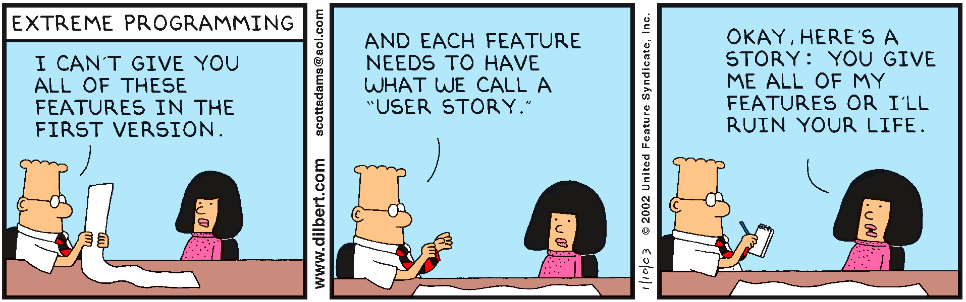
Need educated customer

Slide 50
XP works best when
Educated customer on site
Small team
People who like to talk
All in one room (including customer)
Changing requirements

Slide 51
Unit tests and refactoring
Because code is as simple as it can be, adding a new feature tends to make it less simple
To recover simplicity, you must refactor the code
To refactor safely, you should have a rigorous set of unit tests

Slide 52
Working software
All software has automated (unit) tests
All tests pass, all the time
Never check in broken code
How to work on a task
Get latest version of the code. All tests pass.
Write test first. It fails.
Write code to make test pass. Now all tests pass.
Refactor (clean up)
Check in your code

Slide 53
One key practice
Write tests first, then write code
Various names
Test-first programming
Test-driven development
Is it testing or designing?
Degree to which you stick to it for MP?

Slide 54
Why test?
Improve quality - find bugs
Measure quality
Prove there are no bugs? (Is it possible?)
Determine if software is ready to be released
Determine what to work on
See if you made a mistake
Learn the software

Slide 55
What is a test?
Run program with known inputs, check results
Tests pass or fail
Tests can document bugs
Tests can document code
Some terminology
Failure, error, fault, oracle

Slide 56
Who should test?
Developer? Separate “quality assurance” group?
Programmer? User? Someone with a degree in “testing”?

Slide 57
When to write tests
During requirements analysis
During architectural design
During component design
During coding
After all coding

Slide 58
Timing
Standard practice:
Worry about testing after you build the system
Testers tradition:
Plan tests early, before code is written
XP:
Write tests early, before code is written

Slide 59
XP Testing
Write tests before code
A design technique, not a testing technique
Doesn’t find bugs, but eliminates them
Doesn’t measure quality, but improves it

Slide 60
What kind of tests?
Programmer tests / non-programmer tests
Developer / Tester
Unit tests / Integration tests / Functional tests / System tests
Automated tests / Manual tests
Regression tests
Exploratory testing

Slide 61
New bugs or old bugs?
Regression tests – test to make sure that everything that worked in the past still works
Exploratory testing – look for new bugs
Name also used to contrast scripted testing

Slide 62
Regression tests: good
Should be automated
Set of tests that are rerun every time the software is changed
Makes sure that things that are fixed stay fixed
Each new bug results in an addition to the regression tests

Slide 63
Regression tests: can be bad
Can take a long time to run
Select a subset
Remove obsolete tests
Can be expensive to maintain
Changes to program can invalidate tests
Fix or delete?
If it will never fail, why test it?

Slide 64
What kind of tests?
Manual
Good for exploratory
Good for testing GUI
Manual regression testing is BORING
Automatic
Test is a program
Test is created by a tool that records user actions

Slide 65
Test automation
Tests are code or scripts (which is code)
Real projects can often have more test code than production code
Test code is boring
Build some complex data values
Run a function
Check the result

Slide 66
xUnit testing tools
Programmer’s testing tools
Automated testing!
Unit testing, but also integration testing and functional testing
Regression testing
Test-first design
Each code unit requires several tests

Slide 67
JUnit
Unit testing framework for Java
Test is a method annotated with @Test (use JUnit 4, not JUnit 3), check assert
Can extract common pieces into setup and teardown methods (@Before, @After)
More on Wiki
Please ask TAs or instructors for help if needed

