Slide 1
CS427: Software Engineering I
Testing

Slide 2
Today’s goals
Why do we have so many kinds of tests?
How do we write high-quality tests?
How much code is exercised by tests?

Slide 3
Validation & Verification (V&V)
Validation: the process of evaluating a system or component during or at the end of the development process to determine whether it satisfies specified requirements
Validation: Are we building the right product?
Verification: the process of evaluating a system or component to determine whether the products of a given development phase satisfy the conditions imposed at the start of that phase
Verification: Are we building the product right?
Definitions: IEEE, "IEEE Standard 610.12-1990, IEEE Standard Gloss. of Software Engineering Terminology," 1990.
©L. Williams

Slide 4
Validation and Verification
Refinement
Requirement Specification
Design Specification
Implementation
Validation:
Requirement Against itself
Requirement
Review
Design
Review
Code Inspection
BlackBox Testing
Verification:
Design Against Requirement
Verification:
Implementation Against Design

Slide 5
Why test?
Improve quality - find faults
Measure quality
Prove there are no faults? (Is it possible?)
Determine if software is ready to be released
Determine what to work on
See if you made a mistake
Learn the software

Slide 6
What is a test?
Run program with known inputs (test inputs/data), check results (w/ test oracles)
Tests pass or fail
Tests can document faults
Tests can document code
Some terminology
Mistake, fault, error, failure, fault, oracle

Slide 7
Mistake, Fault, Error, Failure
Programmer makes a mistake.
Fault (defect, bug) appears in the program.
Fault remains undetected during testing (running test inputs).
The program fails (based on test oracles) during execution
i.e. it behaves unexpectedly.
Error: difference between computed, observed, or measured value or condition and true, specified, or theoretically correct value or condition
What does Bug mean in “Bug Report”?

Slide 8
What is fault, error, failure?
Doubling the balance and then plus 10
int calAmount () {
int ret = balance * 3;
ret = ret + 10;
return ret; }
void testCalAmount() { Account a = new Account();
Account.setBalance(0);
int amount = Account.calAmount();
assertTrue(amount == 10);
}
Where is test input? Where is test oracle?

Slide 9
What is fault, error, failure?
Doubling the balance and then plus 10
int calAmount () {
int ret = balance * 3;
ret = ret + 10;
return ret; }
void testCalAmount() { Account a = new Account();
Account.setBalance(1);
int amount = Account.calAmount();
assertTrue(amount == 13);
}
Where is test input? Where is test oracle?

Slide 10
What is fault, error, failure?
Should not allow withdrawal when there is a balance of 100 or less
boolean doWithdraw(int amount) { if (Balance<100) return false; else return wthDraw(amount); }
void testWithDraw() { Account a = new Account();
Account.setBalance(100);
boolean success = Account.doWithdraw(10);
assertTrue(!success);
}

Slide 11
Who should test?
Developer? Separate “quality assurance” group?
Programmer? User? Someone with a degree in “testing”?

Slide 12
Types of Test Activities
Testing can be broken up into four general types of activities
Test Design
Test Automation
Test Execution
Test Evaluation
Each type of activity requires different skills, background knowledge, education and training

Slide 13
Test Design
Design test values to satisfy coverage criteria or other engineering goal
This is the most technical job in software testing
Requires knowledge of :
Discrete math
Programming
Testing
Requires much of a traditional CS degree
This is intellectually stimulating, rewarding, and challenging
Test design is analogous to software architecture on the development side
Using people who are not qualified to design tests is a sure way to get ineffective tests

Slide 14
Test Automation
Embed test values into executable scripts
This is slightly less technical
Requires knowledge of programming
Fairly straightforward programming – small pieces and simple algorithms
Requires very little theory
Very boring for test designers
Programming is out of reach for many domain experts
Who is responsible for determining and embedding the expected outputs ?
Test designers may not always know the expected outputs
Test evaluators need to get involved early to help with this

Slide 15
Test Execution
Run tests on the software and record the results
This is easy – and trivial if the tests are well automated
Requires basic computer skills
Interns
Employees with no technical background
Asking qualified test designers to execute tests is a sure way to convince them to look for a development job
If, for example, GUI tests are not well automated, this requires a lot of manual labor
Test executors have to be very careful and meticulous with bookkeeping

Slide 16
Test Evaluation
Evaluate results of testing, report to developers
This is much harder than it may seem
Requires knowledge of :
Domain
Testing
Usually requires almost no traditional CS
A background in the domain of the software is essential
An empirical background is very helpful (biology, psychology, …)
A logic background is very helpful (law, philosophy, math, …)
This is intellectually stimulating, rewarding, and challenging
But not to typical CS majors – they want to solve problems and build things

Slide 17
Types of Test Activities – Summary
1. | Test design | Design test values to satisfy coverage criteria or other engineering goal
 |  | Requires technical knowledge of discrete math, programming and testing
2. | Test automation | Embed test values into executable scripts
 |  | Requires knowledge of scripting
3. | Test execution | Run tests on the software and record the results
 |  | Requires very little knowledge
4. | Test evaluation | Evaluate results of testing, report to developers
 |  | Requires domain knowledge
These four general test activities are quite different
It is a poor use of resources to use people inappropriately
But most test organizations use the same people for ALL FOUR activities !!

Slide 18
When to write tests
During requirements analysis
During architectural design
During component design
During coding
After all coding

Slide 19
Timing
Standard practice:
Worry about testing after you build the system
Testers tradition:
Plan tests early, before code is written
XP:
Write tests early, before code is written

Slide 20
XP Testing
Write tests before code
A design technique, not a testing technique
Doesn’t find bugs, but eliminates them
Doesn’t measure quality, but improves it

Slide 21
What kind of tests?
Programmer tests / non-programmer tests
Developer / Tester
Unit tests / Integration tests / Functional tests / System tests
Automated tests / Manual tests
Regression tests
Exploratory testing

Slide 22
What kind of tests?
Manual
Good for exploratory
Good for testing GUI
Manual regression testing is BORING
Automatic
Test is a program
Test is created by a tool that records user actions

Slide 23
Test automation
Tests are code or scripts (which is code)
Real projects can often have more test code than production code
Test code is boring
Build some complex data values
Run a function
Check the result

Slide 24
xUnit testing tools
Programmer’s testing tools
Automated testing!
Unit testing, but also integration testing and functional testing
Regression testing
Test-first design
Each code unit requires several tests

Slide 25
New bugs or old bugs?
Regression tests – test to make sure that everything that worked in the past still works
Exploratory testing – look for new bugs
Name also used to contrast scripted testing

Slide 26
Regression tests: good
Should be automated
Set of tests that are rerun every time the software is changed
Makes sure that things that are fixed stay fixed
Each new bug results in an addition to the regression tests

Slide 27
Regression tests: can be bad
Can take a long time to run
Select a subset
Remove obsolete tests
Can be expensive to maintain
Changes to program can invalidate tests
Fix or delete?
If it will never fail, why test it?

Slide 28
Automate tests
When you run them over and over
As you build the software incrementally
As you change it
When you want to use them as documentation (example runs)
If you follow XP

Slide 29
Manual testing
When you are only going to run the test once
Should you automate the second time you run?
When tester doesn’t know how to program
… or maintainer doesn’t know how to program
When tests are too expensive to automate
… and maintain automated

Slide 30
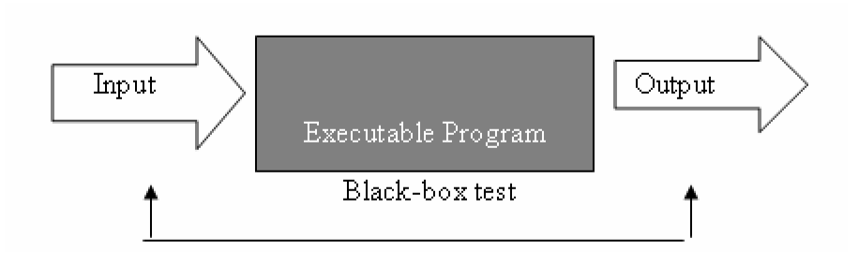
Testing Model – Black Box Testing
You know the functionality
Given that you know what it is supposed to do, you design tests that make it do what you think that it should do
From the outside, you are testing its functionality against the specs
For software, this is testing the interface
What is input to the system?
What you can do from the outside to change the system? (controllability)
What is output from the system? (observability)
Impossible to thoroughly exercise all inputs
Exhaustive testing grows without bound
Tests the functionality of the system by observing its external behavior
No knowledge of how it goes about meeting the goals
©L. Williams

Slide 31
Testing Model – White Box Testing
You know the code
Given knowledge of the internal workings, you thoroughly test what is happening on the inside
Close examination of procedural level of detail
Logical paths through code are tested
Conditionals
Loops
Branches
Status is examined in terms of expected values
Impossible to thoroughly exercise all paths
Exhaustive testing grows without bound
Can be practical if a limited number of “important” paths are evaluated
Can be practical to examine and test important data structures
©L. Williams

Slide 32
Group Exercise
A program needs to be developed so that given an integer value
it outputs 0 when the integer value is 0
it outputs 1 when the integer value > 0
It outputs -1 when the integer value < 0
What would be your black box tests?
How would you generate your white box tests?
Would black box tests alone be good enough to find bugs/faults in the program? Why?
Would white box tests alone be good enough be find bugs/faults in the program? Why?

Slide 33
Black-box vs. White-box
White-box - look at code to write test
Tests are based on code
Better for finding crashes, out of bounds failures, file not closed failures
Better at finding faults of extra logic
Black-box - don’t look at code to write test
Tests are based on specifications
Better at telling if program meets spec
Better at finding faults of omission

Slide 34
When to test
Pressman says: “Unlike white-box testing, which is performed early in the testing process, black-box testing tends to be applied during later stages of testing”
For XP,
Base tests on user stories - can be early
Write black-box tests for each component
Apply white-box techniques to measure coverage of tests
Add more tests to improve coverage

Slide 35
Bottom up or top down?

Slide 36
Typical policies
Developers write unit tests bottom-up
QA writes functional and system tests top down
All faults discovered by QA or customers are recorded
Developers write unit tests to corroborate faults

Slide 37
Types of Testing
Unit Testing (white)
testing of individual hardware or software units or groups of related units
Done by programmer(s)
Generally all white box
Automation desirable for repeatability
Integration Testing (black and white)
testing in which software components, hardware components, or both are combined and tested to evaluate the interaction between them
Done by programmer as they integrate their code into code base
Generally white box, maybe some black box
Automation desirable for repeatability
©L. Williams

Slide 38
Types of Testing -II
Functional/System Testing (black)
testing conducted on a complete, integrated system to evaluate the system compliance with its specified requirements
stress testing, performance testing, usability testing
it is recommended that this be done by external test group
mostly black box so that testing is not ‘corrupted’ by too much knowledge
test automation desirable
Acceptance Testing (black)
formal testing conducted to determine whether or not a system satisfies its acceptance criteria (the criteria the system must satisfy to be accepted by a customer) and to enable the customer to determine whether or not to accept the system
Generally done by customer/customer representative in their environment through the GUI . . . Definitely black box
©L. Williams

Slide 39
Types of Testing -III
Regression Testing (black and white)
Regression testing is selective retesting of a system or component to verify that modifications have not caused unintended effects and that the system or component still complies with its specified requirements
Smoke test group of test cases that establish that the system is stable and all major functionality is present and works under “normal” conditions
Beta Testing (black)
(1~many) potential users or beta testers install software and use it as they wish and report any revealed errors to the development organization.
©L. Williams

Slide 40
Techniques for writing tests
Black-box (from specifications)
Equivalence partitioning
Boundary value analysis
White-box (from code)
Branch coverage
Fault-based testing (from common errors)
Reading online: catalog from Brian Marick

Slide 41
Specifications
Document what system is supposed to do
Should be unambiguous, consistent, clear, simple, …
Example: “If you are senior students and junior students, raise your hand”

Slide 42
JavaDoc (Used in MP1)
Specify Java classes and methods
JavaDoc starts out as comments in code
System produces web pages for easy browsing
Google “javadoc String” to find the JavaDoc for class String

Slide 43
Low-level specification
JavaDoc is a good example
Classes
Invariants - things that are always true
Methods
Given this input, return this output
Specification helps you write tests

Slide 44
High-level specification
UI
Tasks user can perform
Commands, what user sees
Web server
URLs, behavior of GET and POST
Internet server
Message format
Response for message (internet RFC)

Slide 45
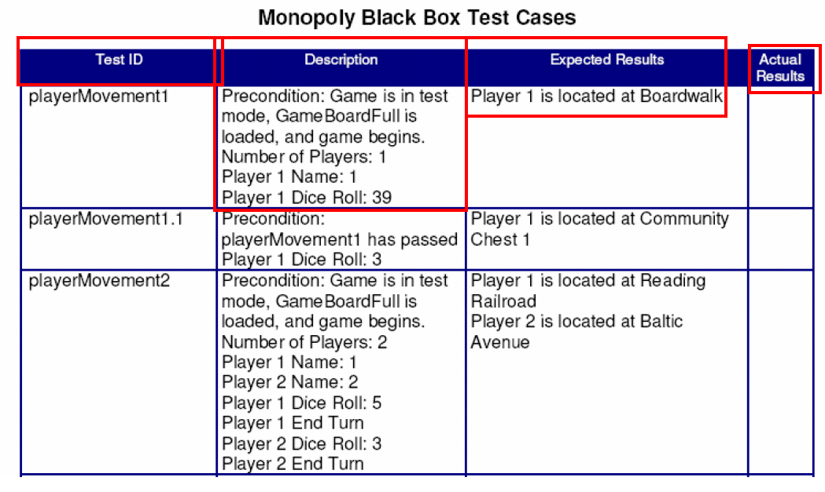
Planning a Black Box Test Case
©L. Williams

Slide 46
Important Consideration for Black Box Test Planning
Look at requirements/problem statement to generate.
Test cases need to be traceable to a requirement.
You must write the repeatable test case so anyone on the team can run the exact test case and get the exact same result/sequence of events.
The inputs must be very specific.
Example: “Students who receive a grade of 70 or higher pass the exam.”
Correct test cases: Grade = 80; Grade =20
Incorrect test cases: “input a passing grade” “input a failing grade”
The expected results must be very specific. “Pass” “Fail”
©L. Williams

Slide 47
Important Consideration for Black Box Test Planning (cont.)
Run the simplest test case first – or you won’t know if the test case failed because basic functionality doesn’t work or if the hard stuff doesn’t work.
Plan the simplest test to test the failure that you are looking for. If the test case fails, you don’t want to have to work *too* hard to re-run the test when the code is (supposedly) fixed.
©L. Williams

Slide 48
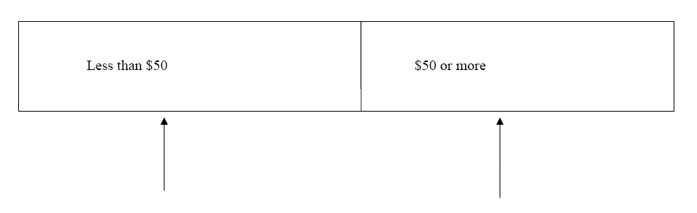
Equivalence Class Partitioning
Divide your input conditions into groups (classes).
Input in the same class should behave similarly in the program.
Be sure to test a mid-range value from each class.
Example: for tests of “Go to Jail” the most important thing is whether the player has enough money to pay the $50 fine
Test input values clearly in the two partitions: 25 and 75.
©L. Williams

Slide 49
Equivalence partitioning
Example: sorting
sort(array,len) takes an array of integers of length len and sorts them in ascending order, i.e. permutes them so that each element of the array is less than or equal to the succeeding one.
len = 0,1, 2, 17
Array is already sorted, has duplicates, has negative numbers

Slide 50
Equivalence class test ideas
Any object: the null pointer
Strings: the empty string
Collections:
The empty collection
Contains exactly one element
Contains the maximum number of elements (or at least more than one)

Slide 51
Equivalence class test ideas
Linked structures (trees, queues, etc.)
Empty
Minimal but non-empty
Circular
Depth greater than one (or maximally deep)
Equality comparison of objects
Equal but not identical
Different at lowest level, the same at upper

Slide 52
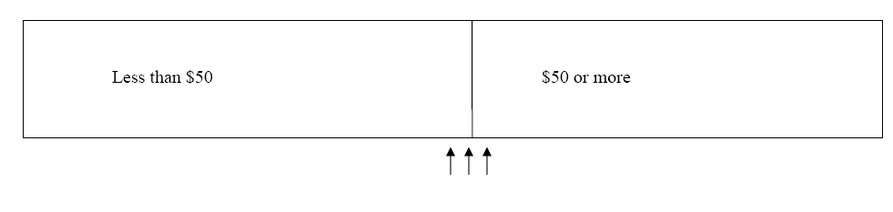
Boundary Value Analysis
Focus on boundaries . . . because a greater number of faults tend to occur at the boundaries of the input domain
Range input, a to b, test with a, b, a-1, a+1, b-1, b+1 if integer range; otherwise, slightly less than a and slightly more than b.
If you can only have a certain quantity (q) of something, try to create q-1, q, q+1
©L. Williams

Slide 53
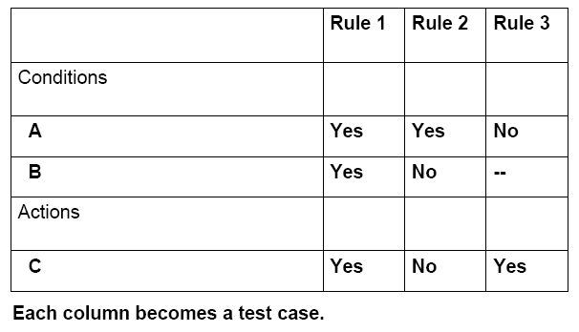
Decision Table Testing
©L. Williams

Slide 54
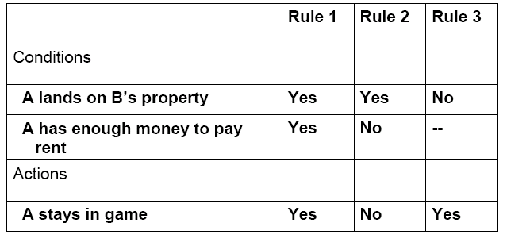
Monopoly Decision Table
If a Player (A) lands on property owned by another player (B), A must pay rent to B. If A does not have enough money to pay B, A is out of the game.
©L. Williams

Slide 55
Dirty/Failure Test Cases
Can something cause division by zero?
What if the input type is wrong (You’re expecting an integer, they input a float. You’re expecting a character, you get an integer.)?
What if the customer takes an illogical path through your functionality?
What if mandatory fields are not entered?
What if the program is aborted abruptly or input or output devices are unplugged?
Robustness Testing
Think diabolically!
©L. Williams

Slide 56
Techniques for writing tests
Black-box (from specifications)
Equivalence partitioning
Boundary value analysis
White-box (from code)
Branch coverage
Fault-based testing (from common errors)
Reading online: catalog from Brian Marick

Slide 57
Coverage
Make sure tests cover each part of program
Every statement
Every branch
Every condition
Every pass through a loop
Every path(?)
Measures the quality of tests
How much of the program do the tests cover?

Slide 58
Coverage tools
Tool “instruments” the program
You run your tests, it builds database
Tool looks at database to see which parts of the program were executed, and reports test coverage
Some Java open source tools: EclEmma, Quilt, NoUnit, InsECT, Jester, jcoverage, Coverlispe, Hansel…

Slide 59
White-box tests
Purpose: exercise all the code
Large number - take a long time to write
Good for finding run-time errors
Null object, array-bounds error
In practice, coverage is better for evaluating tests than for creating them

Slide 60
White Box Testing - Review
You know the code
Given knowledge of the internal workings, you thoroughly test what is happening on the inside
Close examination of procedural level of detail
Logical paths through code are tested
Conditionals
Loops
Branches
Status is examined in terms of expected values
Impossible to thoroughly exercise all paths
Exhaustive testing grows without bound
Can be practical if a limited number of “important” paths are evaluated
Can be practical to examine and test important data structures
©L. Williams

Slide 61
Types of Testing
Unit Testing
Done by programmer(s)
Generally all white box
Automation desirable for repeatability
Integration Testing
Done by programmer as they integrate their code into code base
Generally white box, maybe some black box
Automation desirable for repeatability
Functional/System Testing
It is recommended that this be done by external test group
Mostly black box so that testing is not ‘corrupted’ by too much knowledge
Test automation desirable
Acceptance Testing
Generally done by customer/customer representative in their environment . . . Definitely black box
©L. Williams

Slide 62
Build Scaffolding for Incomplete Code
Stubs and drivers are code that are (temporarily) written in order to unit test a program
Driver is a software module used to invoke a module under test and often, provide test inputs, controls, and monitor execution and report test results main () { movePlayer(Player, diceRoll);
}
Stub is a module that simulates components that aren’t written yet, formally defined as a computer program statement substituting for the body of a software module that is or will be defined elsewhere
public void movePlayer(Player player, int diceValue) {
player.setPosition(1);
}
©L. Williams

Slide 63
Devising a prudent set of test cases
Equivalence Class/Boundary Value Analysis
Still applies!
A metric for assessing how good your test suite is
Method Coverage
Statement Coverage
Decision/Branch Coverage
Condition Coverage
Think diabolically
©L. Williams

Slide 64
100% Method Coverage
All methods in all classes have been called
Test case 1: Foo(0, 0, 0, 0, 0) = 0.0
float foo (int a, b, c, d, e) {
if (a == 0) {
return 0.0;
}
int x = 0;
if ((a==b) OR ((c==d) AND bug(a) )) {
x =1;
}
e = 1/x;
return e;
}
©L. Williams

Slide 65
100% Statement Coverage
All lines in a method have been executed
Test case 2: Foo(1, 1, 1, 1, 1) = 1.0
float foo (int a, b, c, d, e) {
if (a == 0) {
return 0.0;
}
int x = 0;
if ((a==b) OR ((c==d) AND bug(a) )) {
x =1;
}
e = 1/x;
return e;
}
©L. Williams

Slide 66
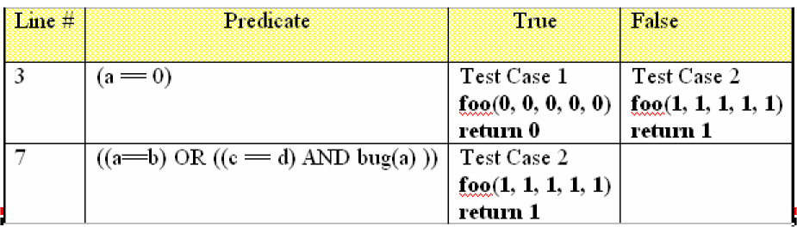
100% Branch/Decision Coverage
All predicates have been true and false
Test case 3: Foo(1, 2, 1, 2, 1) ← division by zero!
float foo (int a, b, c, d, e) {
if (a == 0) {
return 0.0;
}
int x = 0;
if ((a==b) OR ((c==d) AND bug(a) )) {
x =1;
}
e = 1/x;
return e;
}
©L. Williams

Slide 67
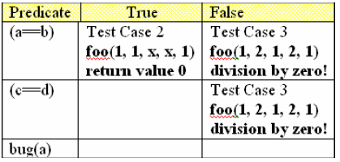
100% Condition Coverage
All sub-expression predicates have been true and false
Test case 4: Foo(1, 2, 1, 1, 1) ← a bug!
float foo (int a, b, c, d, e) {
if (a == 0) {
return 0.0;
}
int x = 0;
if ((a==b) OR ((c==d) AND bug(a) )) {
x =1;
}
e = 1/x;
return e;
}
©L. Williams

Slide 68
Every condition
if (A && B) …
has four cases, not just two
But consider
if ((j>=0) && salary[j] > 10000) ...

Slide 69
Loops
Write a test case such that you:
Don’t go through the loop at all
Go through the loop once
Go through the loop twice
Go through the loop many times
©L. Williams

Slide 70
Infeasible coverage
There are parts we cannot cover
for (i=0; i<100; i++)
{
printf(“%d\n”, i);
}
if (i == 200) panic(“program internal error: 3”)

Slide 71
Relationship Among Coverage Criteria
Assume
X: {Statement, Branch, Condition}
Y: {Statement, Branch, Condition}
X != Y
No exceptions/crashes occur during executions
All executions terminate
If some test cases achieve 100% X coverage of the code under test, can these test cases always achieve 100% Y coverage?
If not, please construct a simple Java method and test cases for the method to demonstrate a counterexample.

Slide 72
Triangle Program
Given: three sides that ARE a triangle, determine if the triangle is equilateral, isosceles, or scalene
What test cases do you need? [testid, description, expected results, actual results]
What kind of method, statement, branch, and condition coverage do these test cases have?
©L. Williams

Slide 73
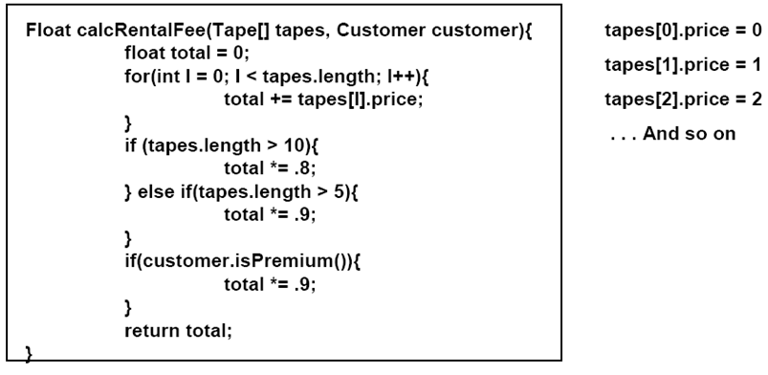
What Test Cases Should You Run?
Consider
Equivalence class partitioning
Boundary value analysis
Diabolical testing
Statement coverage
Branch coverage
Condition coverage

Slide 74
Devising a Prudent Set of Test Cases
Equivalence Class/Boundary Value Analysis
Still applies!
A metric for assessing how good your test suite is.
Method Coverage
Statement Coverage
Decision/Branch Coverage
Condition Coverage
Think diabolically
©L. Williams

Slide 75
More kinds of tests
Fault-based testing
Look for common faults
Scenario-based testing
Write tests based on user stories
Random testing
See if random input will crash the program
See if random input agrees with the oracle

Slide 76
Even more kinds of tests
Performance tests - measure time of each test
Load tests - test system under heavy load
Usability tests - see how well people can use the software
Configuration tests
Security? Portability? Interoperability?

Slide 77
When to run tests
When you change the components of the tests
When you deliver the components
To customer
To next phase of project

Slide 78
XP specification and testing
Usually don’t write specs before code
Write JavaDoc after writing code
Don’t write anything - only talk about specs
Talk about specs when writing unit tests
Write tests
Write code
Document code

Slide 79
XP specification and testing
Customer (team) writes functional tests
Tests are derived from user stories
Some preserve user stories
Tests need to be documented to ensure traceability to specs
Tie back to user stories
Just write comments

Slide 80
XP and white-box tests
Measure coverage periodically (at end of iteration?)
Use as feedback
To write more tests
To improve how you write tests

Slide 81
Recall: Mistake, Fault, Error, Failure
Programmer makes a mistake.
Fault (defect, bug) appears in the program.
Fault remains undetected during testing (running test inputs).
The program fails (based on test oracles) during execution
i.e. it behaves unexpectedly.
Error: difference between computed, observed, or measured value or condition and true, specified, or theoretically correct value or condition
What does Bug mean in “Bug Report”?

Slide 82
Fault & Failure Model
Three conditions necessary for a failure to be observed
Execution/Reachability : The location or locations in the program that contain the fault must be reached
Infection : The state of the program must be incorrect
Propagation : The infected state must propagate to cause some output of the program to be incorrect
PIE model

Slide 83
Conversation 1: Tester ⬄ Test Manager
Test Manager: Looks like the code under test is not achieving high statement coverage. Please work hard to achieve high statement coverage.
Tester: Hmm… boss, our goal is to detect faults. I don’t think I need to spend more efforts to achieve high statement coverge.
Test Manager: Well, according to the PIE model, …..[You fill in here]

Slide 84
Conversation 2: Tester ⬄ Test Manager
Tester: Boss, following your command, I work very hard and I have already achieved 100% statement coverage! I would like to take a vacation in Hawaii. Could you approve?
Test Manager: Well, according to the PIE model, …..[You fill in here]

Slide 85
Testing & Debugging
Testing : Finding inputs that cause the software to fail
Debugging : The process of finding a fault given a failure

Slide 86
Testing & Debugging
Testing : Finding inputs that cause the software to fail
Debugging : The process of finding a fault given a failure

