Slide 1

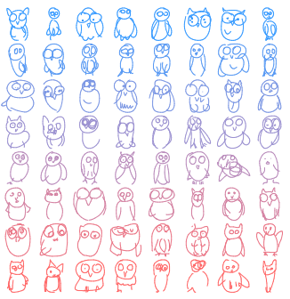
Neural sketch generation
Group 9A: Abdel-Hamid Mohamed Cheikh, Louis Gautier

Slide 2
Presentation summary
I- Architecture presentation
II- Conditional generation
III- Unconditional generation
IV- Latent space exploration
V- Architecture tuning
VI- Sketch drawing completion implementation

Slide 3

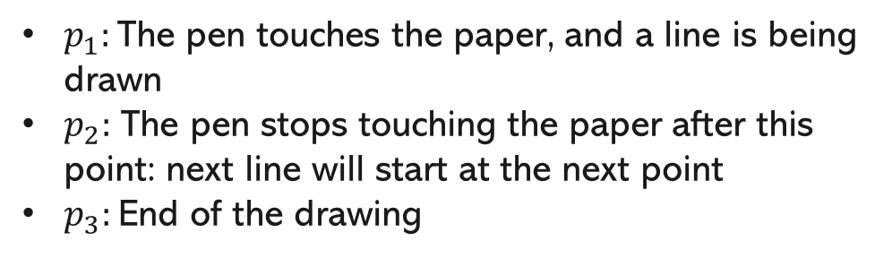
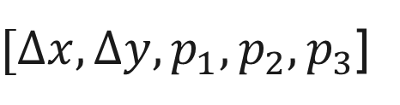
I- Architecture presentation
The dataset: The Google QuickDraw! dataset
Intuition: Reason in terms of lines and shapes rather than in terms of pixels.
Data format:
$p_{1}:$The pen touches the paper, and a line is being drawn
$p_{2}:$ The pen stops touching the paper after this point: next line will start at the next point
$p_{3}:$End of the drawing
For each line between 2 points:
$[∆x,∆y,p_{1},p_{2},p_{3}$]

Slide 4
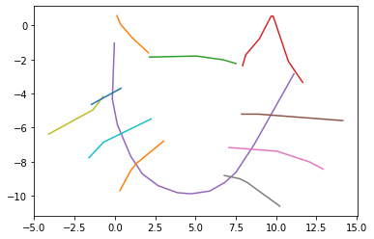
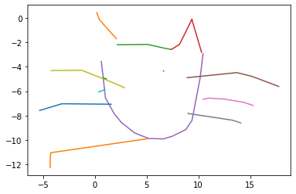
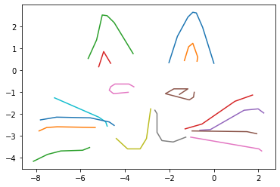
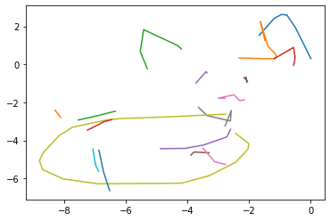
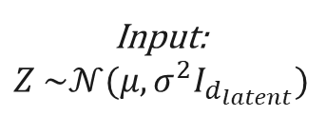
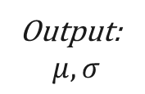
I- Architecture presentation
The model: A Sequence-to-Sequence Variational Autoencoder
Dataset drawings
Latent space
Reconstructions
Encoder
RNN
Decoder
RNN
Output:
$$μ,σ$$
Input:
$$Z \sim 𝒩(μ,σ^{2}I_{d_{latent}})$$
GMM + softmax parameters

Slide 5
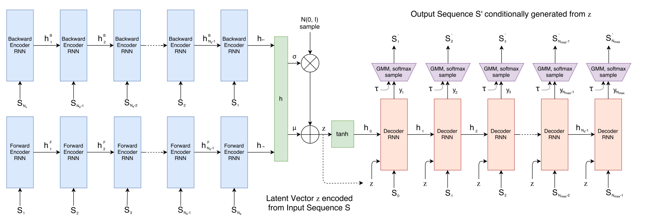
I- Architecture presentation
The architecture in detail

Slide 6

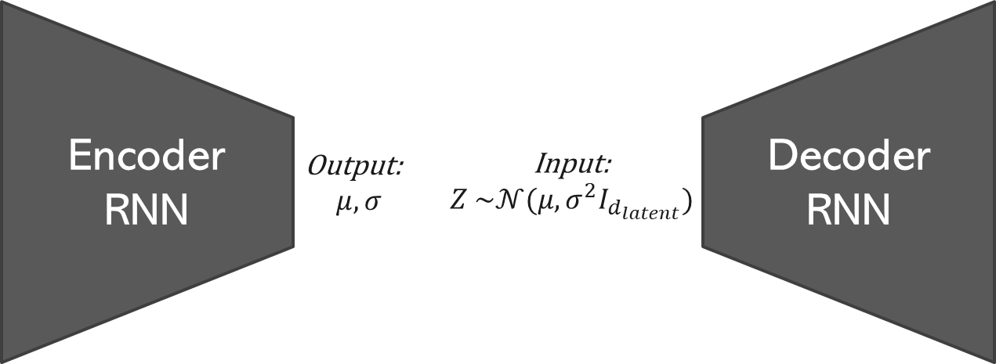
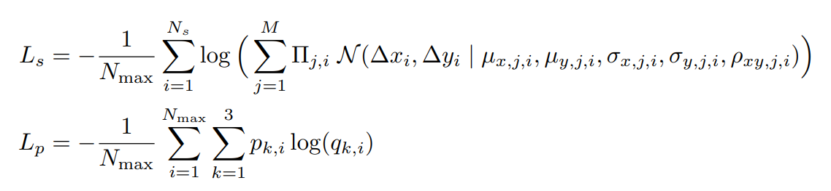


II- Conditional generation
Conditional training principle
Reconstruction loss
KL divergence
Reconstruction loss
KL divergence
$$L_{KL}=D_{KL}(P|\left|𝒩(0,I_{d_{latent}})\right)=−\frac{1}{2N_{z}}(1+\hat{σ}−\hat{μ^{2}}−e^{\hat{σ}})$$
$$L_{R}=L_{s}+L_{p}$$

Slide 7
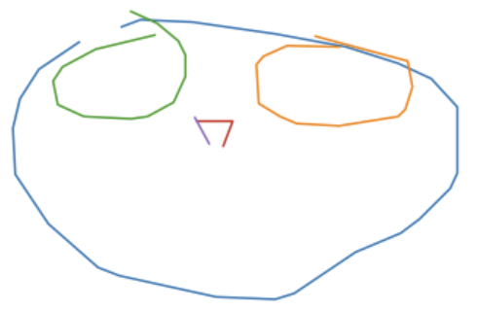
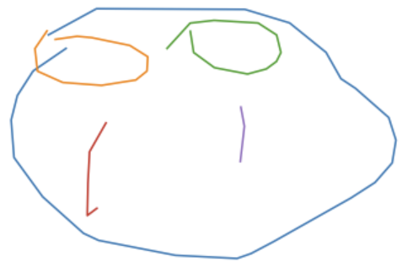
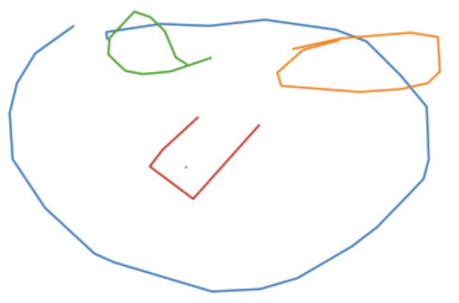
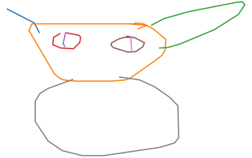
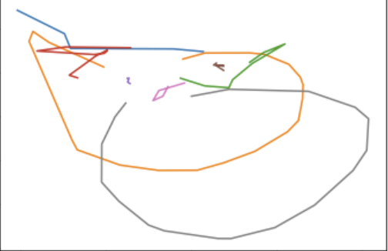
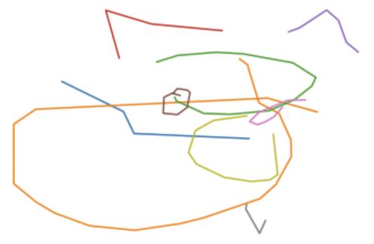
II- Conditional generation
Conditional generation on several datasets
Input image
Reconstructions
Single class dataset:
Owl
Multi-class dataset:
Owl-cat

Slide 8
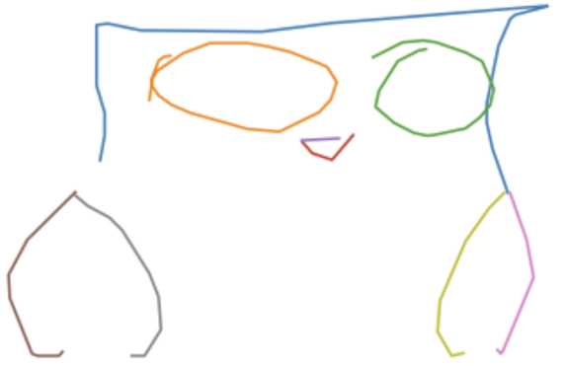
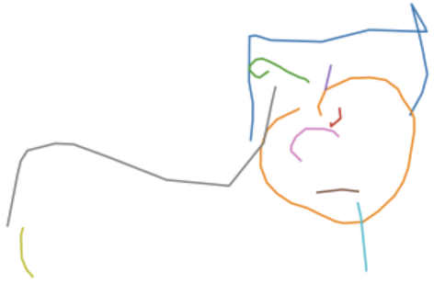
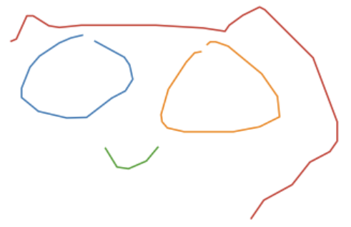
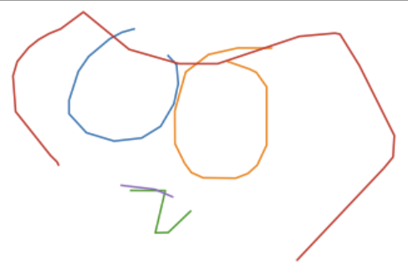
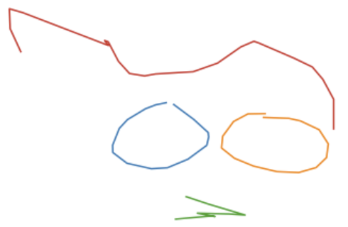
II- Conditional generation
Conditional generation on outlier images
Input image
Reconstruction example
Single class:
Cat dataset
Multi-class:
Owl-cat dataset

Slide 9
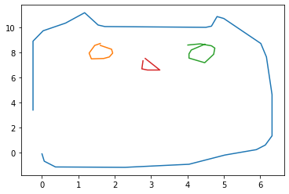
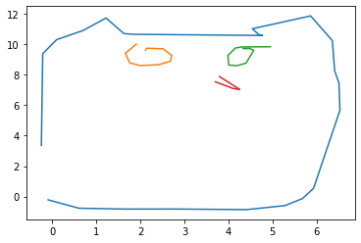
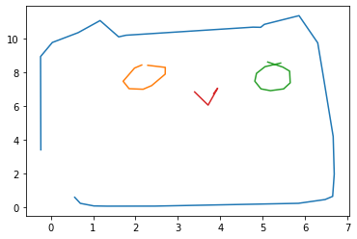
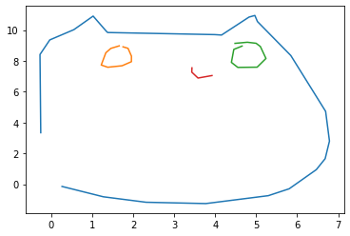
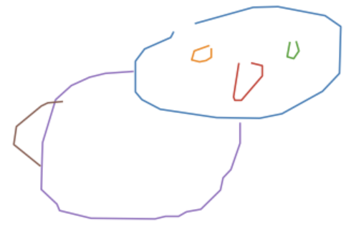
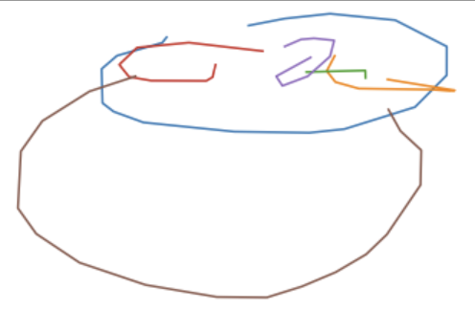
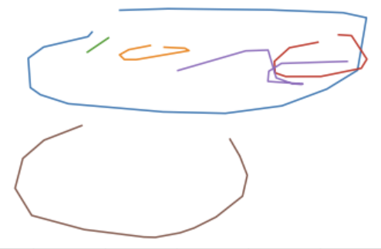
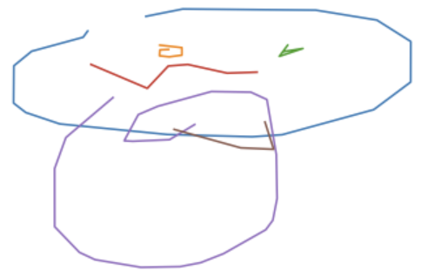



II- Conditional generation
$w_{KL}$ influence on conditional generation
Input image
Reconstructions
$w_{KL}=0,1$
$w_{KL}=0,5$
$w_{KL}=1$
Single class:
Owl
Multi-class:
Owl-cat

Slide 10
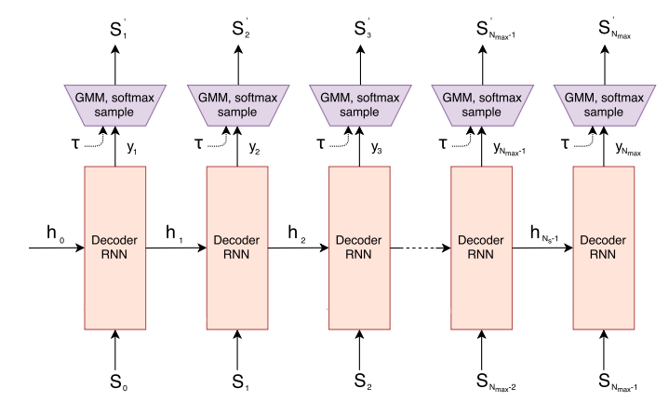
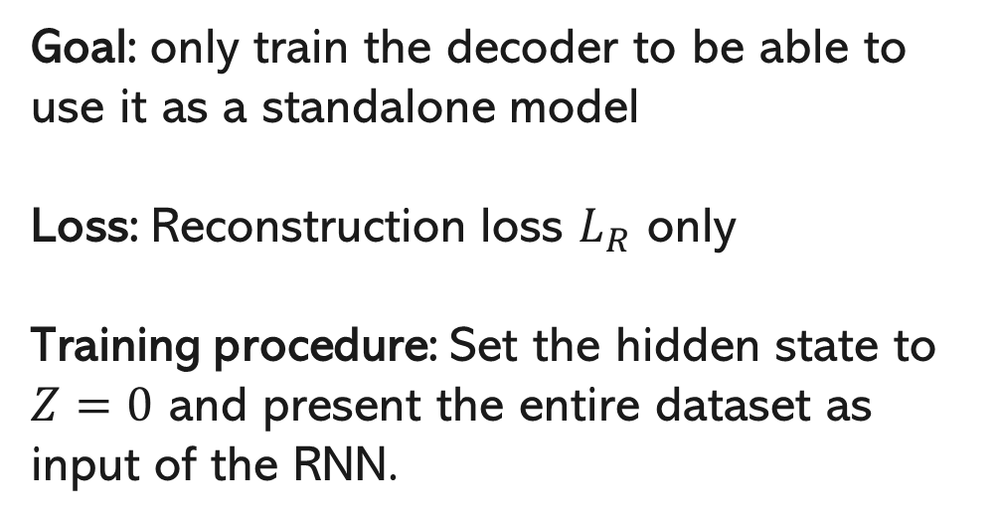

III- Unconditional generation
Decoder
RNN
Input:
$Z$=0
Goal: only train the decoder to be able to use it as a standalone model
Loss: Reconstruction loss $L_{R}$ only
Training procedure: Set the hidden state to $Z=0$ and present the entire dataset as input of the RNN.

Slide 11
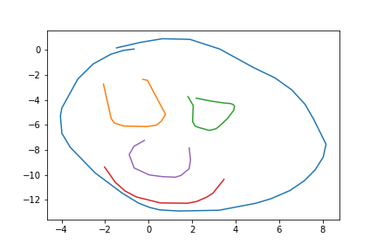
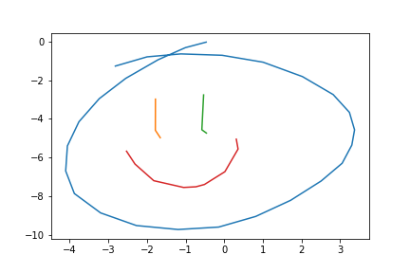
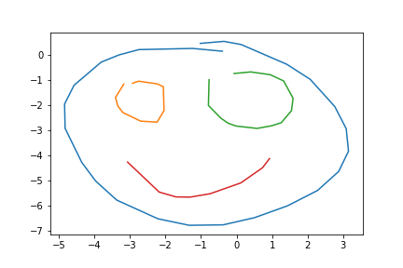
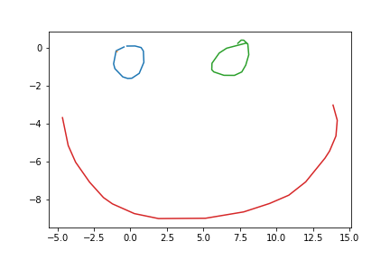
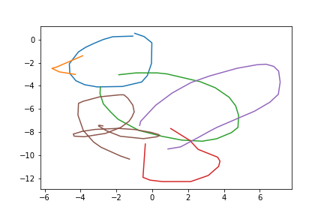
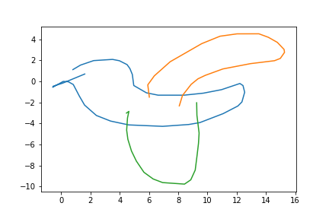
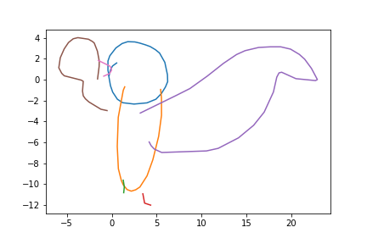
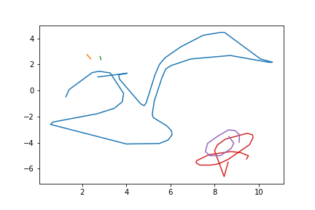
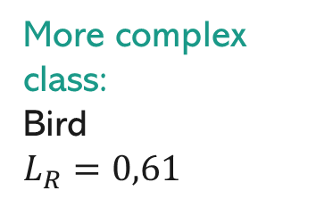
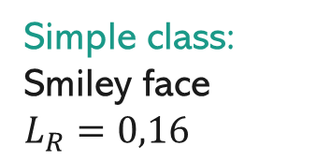
III- Unconditional generation
Unconditional generation on several datasets
Simple class:
Smiley face
$$L_{R}=0,16$$
More complex class:
Bird
$$L_{R}=0,61$$

Slide 12
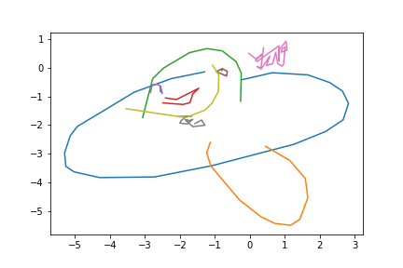
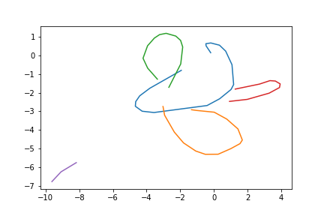
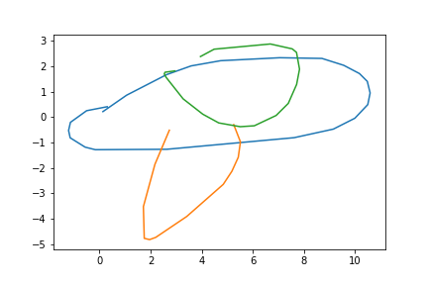
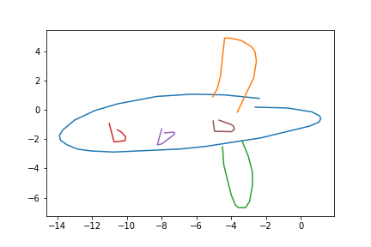
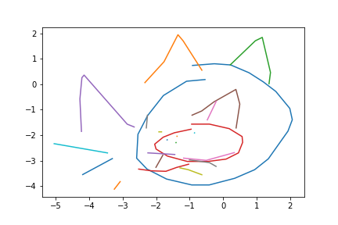
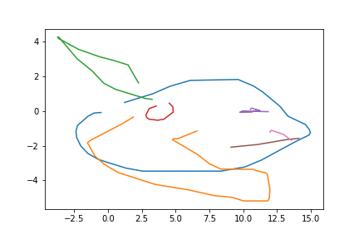
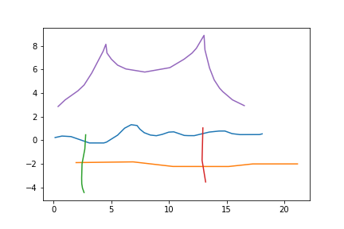



III- Unconditional generation
Unconditional generation on several datasets
Multiclass close datasets:
Bird-Airplane
$$L_{R}=0,56$$
Multiclass complex datasets:
Bridge-Cat-Owl-Airplane
$$L_{R}=0,20$$

Slide 13
















III- Unconditional generation
Temperature influence on unconditional generation on the “cat” single-class dataset
$$τ=0,9$$
$$τ=0,5$$
$$τ=0,2$$

Slide 14










III- Unconditional generation
Temperature influence on unconditional generation on the “bird-airplane” multi-class dataset
$$τ=0,9$$
$$τ=0,5$$
$$τ=0,2$$

Slide 15









IV- Latent space exploration
$$w_{KL}=0,5$$
Latent space linear interpolations with low $w_{KL}$
Single-class cat dataset
Multi-class “owl-cat” dataset

Slide 16






IV- Latent space exploration
$$w_{KL}=1,0$$
Latent space linear interpolations with high $w_{KL}$
Single-class cat dataset
Multi-class “owl-cat” dataset

Slide 17

IV- Latent space exploration
Visualizing the latent space with PCA
Procedure:
1- Choose 100 random drawings in the dataset
2- Encode these drawings
3- Apply PCA (2D) on this encoded point cloud
4- Visualize the original drawings at the position of the encoded points in the transformed space

Slide 18

IV- Latent space exploration
Visualizing the latent space with PCA on a multi-class dataset

Slide 19










IV- Latent space exploration
Sketch drawing analogies
Single-class cat dataset
$$+$$
$$−$$
$$=$$
Multi-class cat-owl dataset
$$+$$
$$−$$
$$=$$

Slide 20

V- Architecture tuning
Should we replace LSTMs with GRUs?
GRU cells are simpler and more computationally efficient than LSTM.

Slide 21
V- Architecture tuning
Should we replace LSTMs with GRUs?
GRU cells don’t significantly hamper performance.
Unconditional generation
Conditional generation with $w_{KL}=0,5$

Slide 22
V- Architecture tuning
Should we stack more than one layer on the RNNs?
Stacking more than one layer causes significant increase of training time and slight increase of precision.
Unconditional generation

Slide 23
VI- Sketch drawing completion
Working principle
Goal:
Predict the end of a sketch based on one line
Method:
Use the decoder RNN as a standalone model
1- “Encode” the first line thanks to the decoder
2- Draw the subsequent lines with decoder, initializing its hidden state with this value.

Slide 24








VI- Sketch drawing completion
Results (input line in red)
Single-class “cat” dataset
Multi-class “cat-owl” dataset

