Slide 1
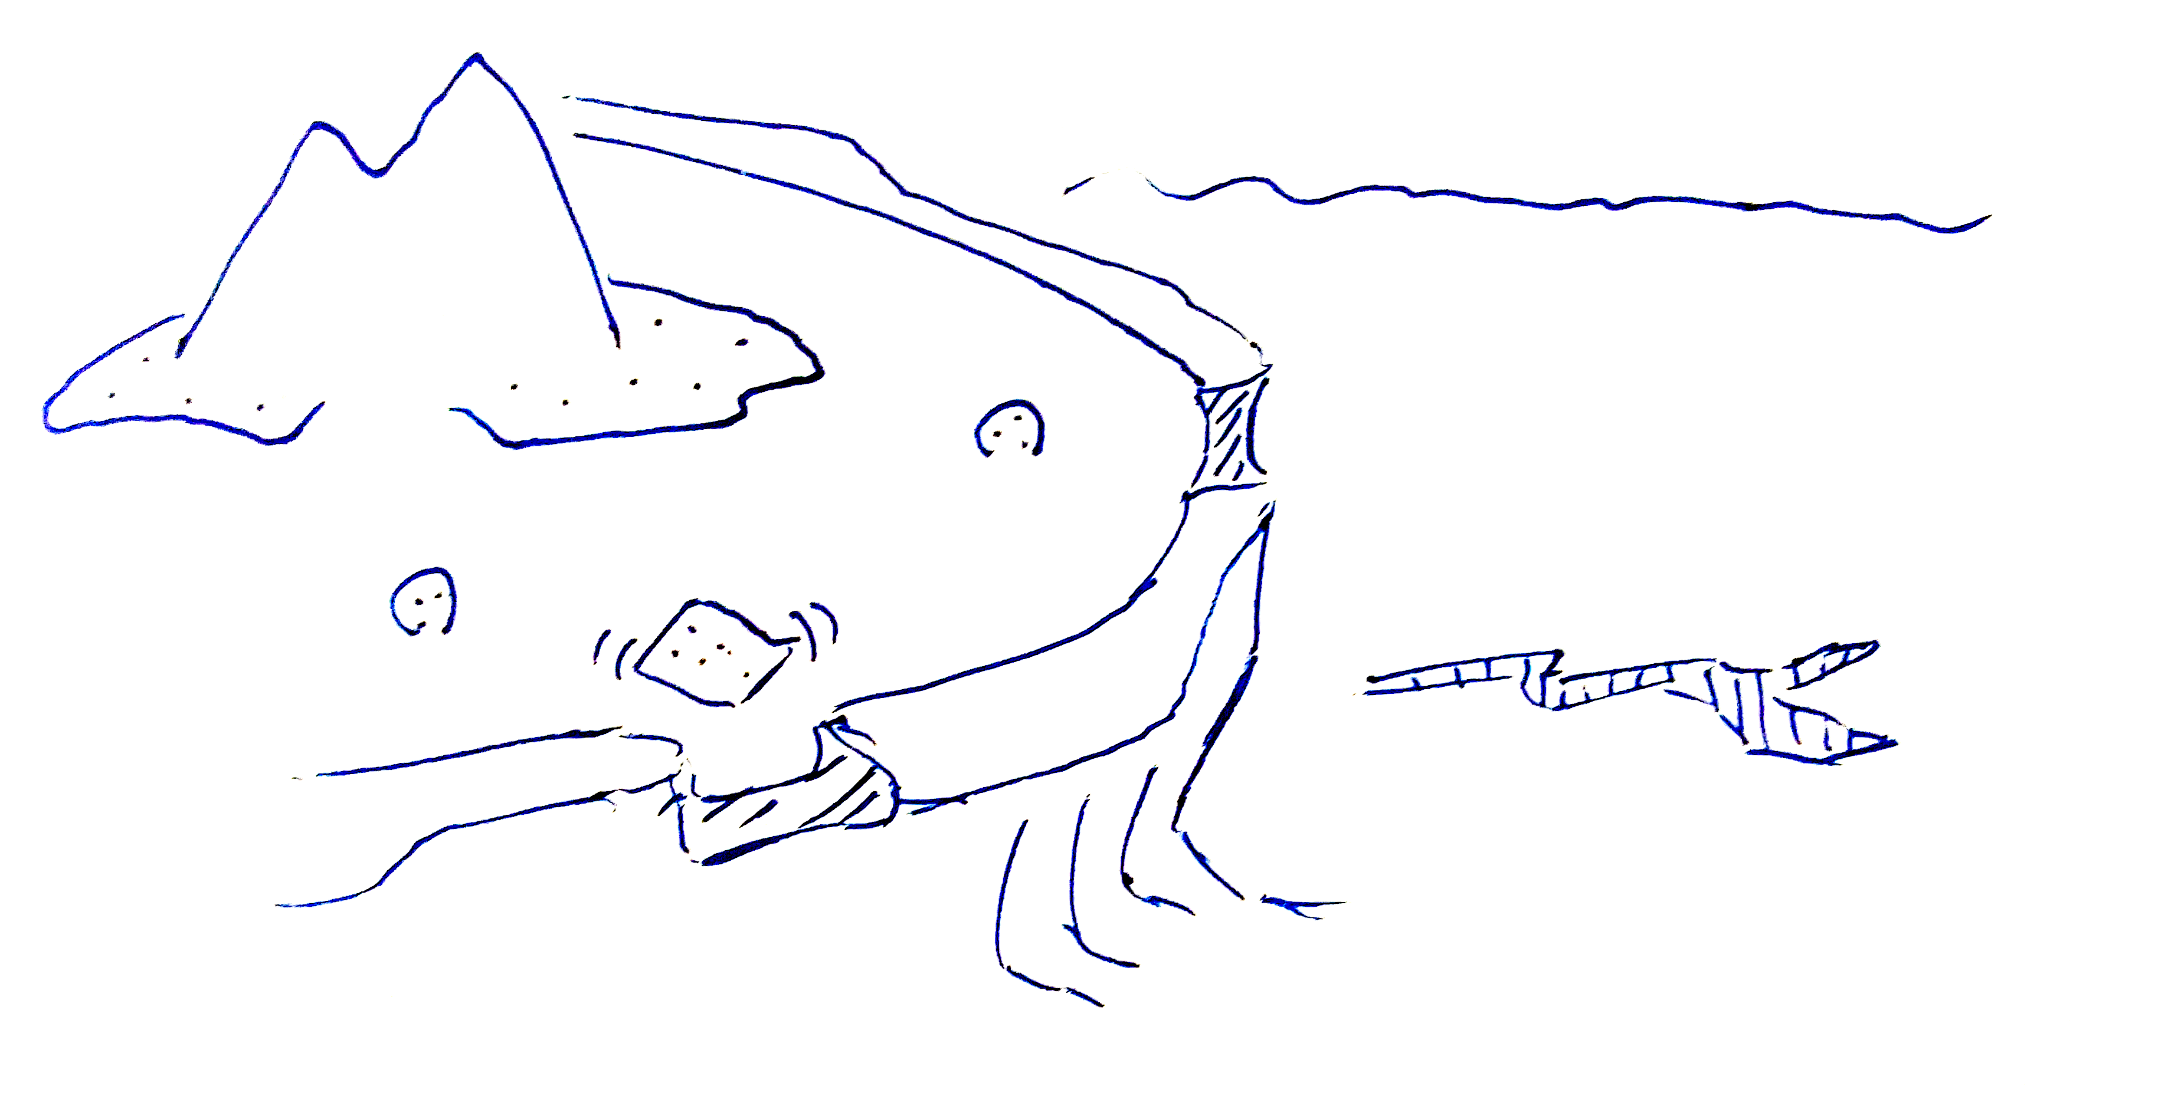
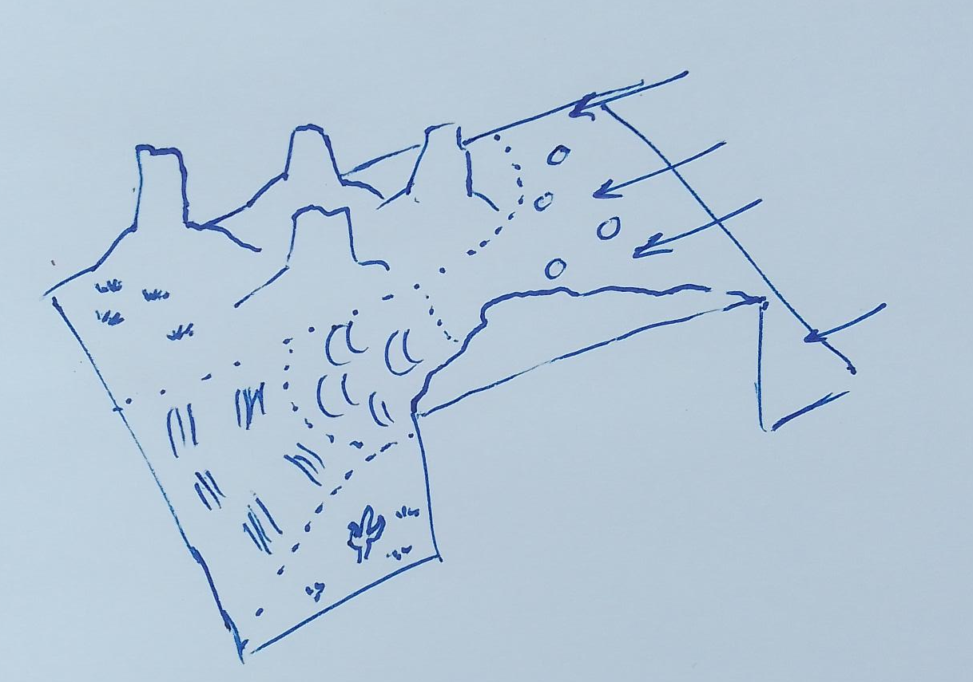
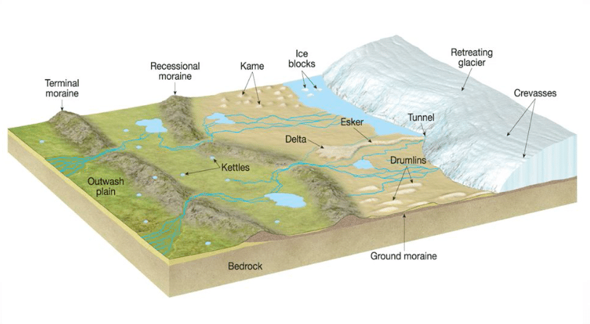
Scenarios
Coral island
Desertscape
Glacial landform

Slide 2
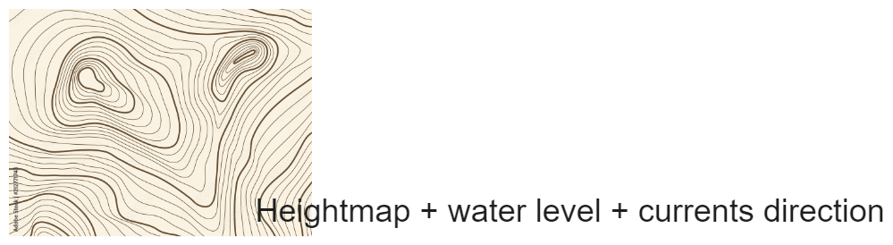
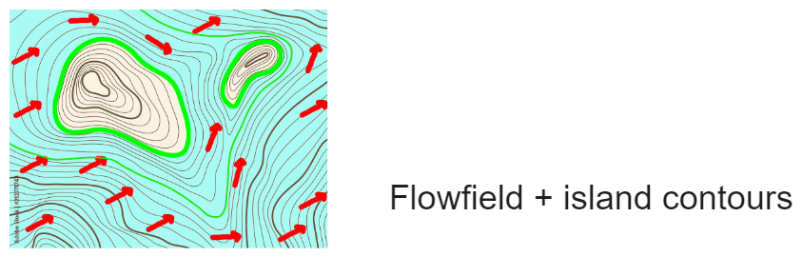
Input/Output
Input:
Heightfield
Wind/water direction
Generation rules
Output:
Instanced geological structures

Slide 3
Geological structures
Defined by
A label (reef, island, boulder, fracture, river, …)
A skeleton (point, curve, area)
Generation rules:
Properties about nearby primitives:
Distance,
Curve curvature
Properties about water/air flow
Direction,
Velocity
Effects:
Water/air flow increase/decrease/spread
Material spread

Slide 4
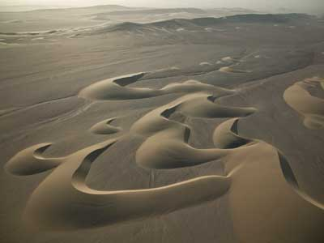
Examples
Label: Barchan dune field
Skeleton: area
Conditions:
Presence of a rock
High velocity wind
Low sand amount
Effects:
Sand deposition

Slide 5
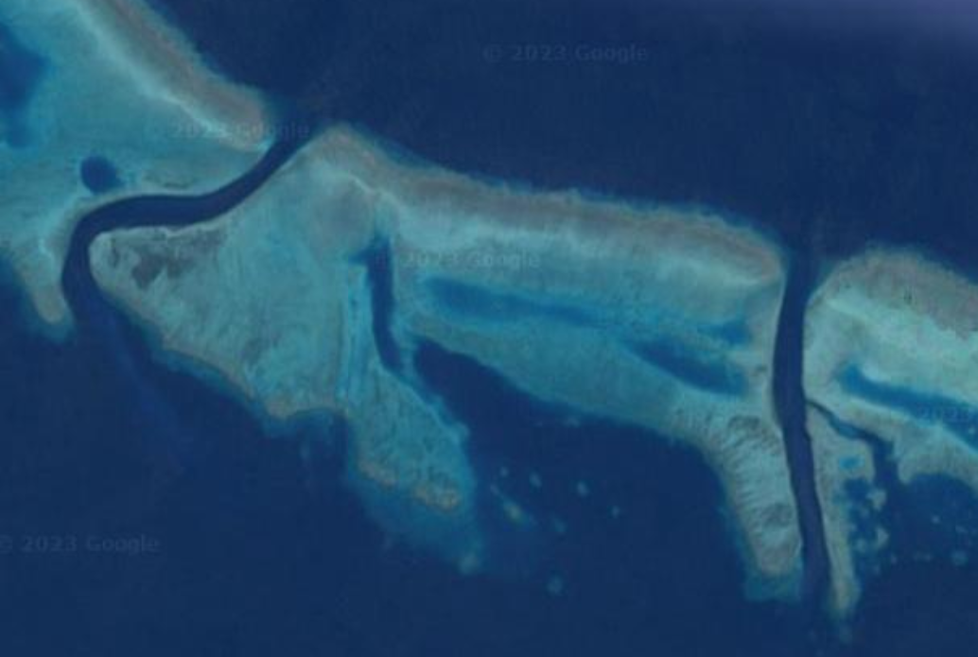
Examples
Label: Pass
Skeleton: curve
Conditions:
On the reef
Water flow perpendicular to curve
Effects:
Water flow increase (inside) and spreads (at exit)
Dead coral deposition

Slide 6
Pipeline
Base terrain and parameters given
Iterate:
Compute flows
Extract properties at surface of the terrain
Water flow direction/velocity, curvature/distance of structures, …
Select one generation rule with conditions fitting the properties
Instanciate new object
End

