Slide 1
inflation corrected consumption composite index aka I.C.C.C.I.
By Axèle #sql.expert__Louis #Py.prog.expert__Robin #AVG.dogooder

Slide 2
#INSERT SMALL INTRO HERE
On. The. Fly. = Communication was good, dynamic and respectful
Went for healthcare – mixed it with business – ended up in economics.
Comparing the scales /measurement units : compatible => greenlight
What would make sense ? How to exploit the data ?

Slide 3
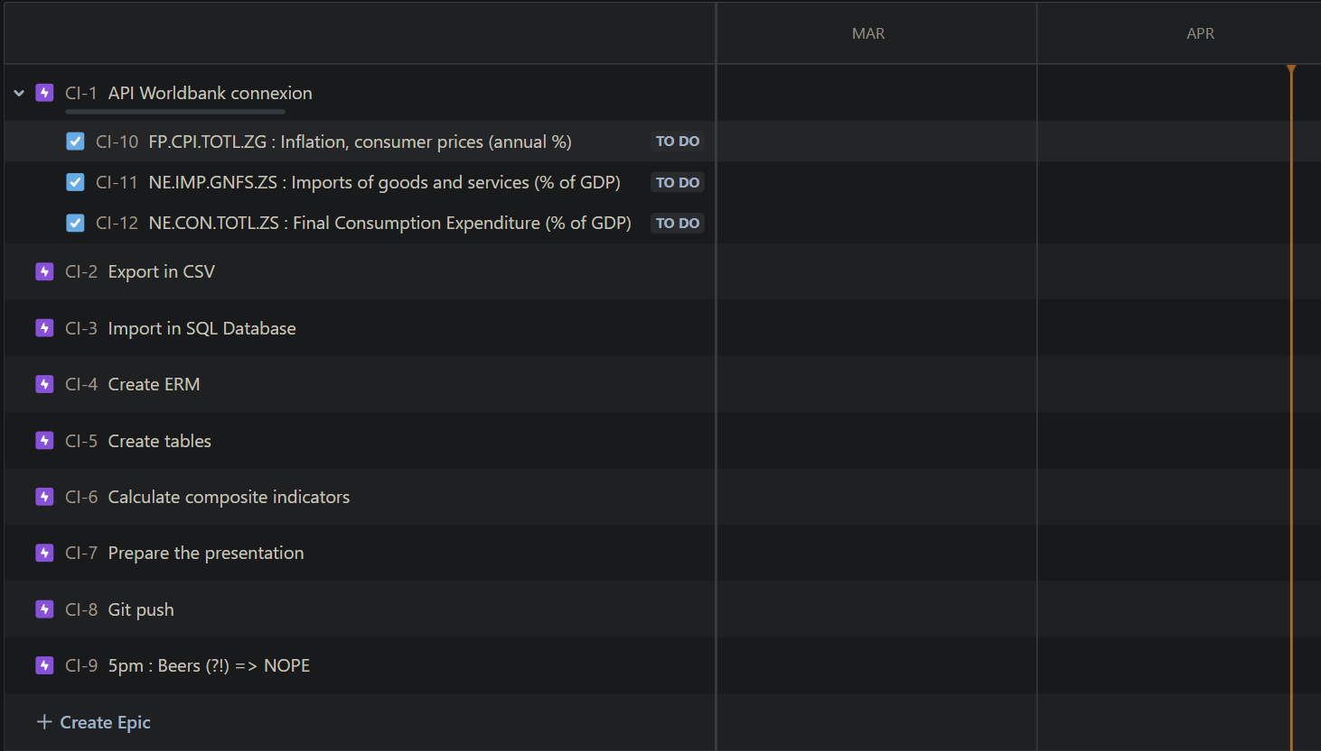
Planning through JIRA went really well at first but failed to carry us from the beginning until the end… R.I.P. BEERS ☹
6:15pm update

Slide 4
I.C.C.C.I.
CONSUMPTION * (1 – (INFLATION / 100))
_________________________________
IMPORTS
Calculates the ratio between consumption factored by yearly inflation, divided by imports. This gives us a score which we can monitor the evolution of.
The goal here being to understand how inflation influences the consumption on imports ratio.

Slide 5
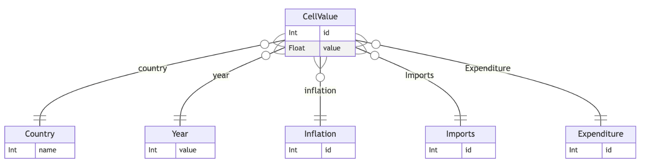
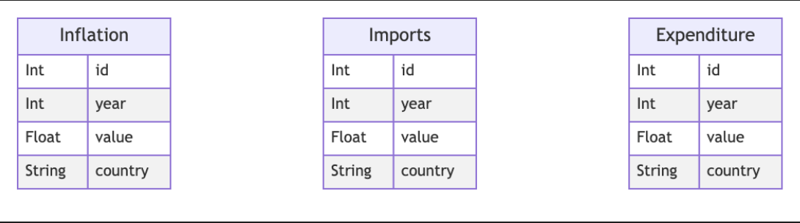
Original ERD – Quickly abandoned
SECOND ERD

Slide 6
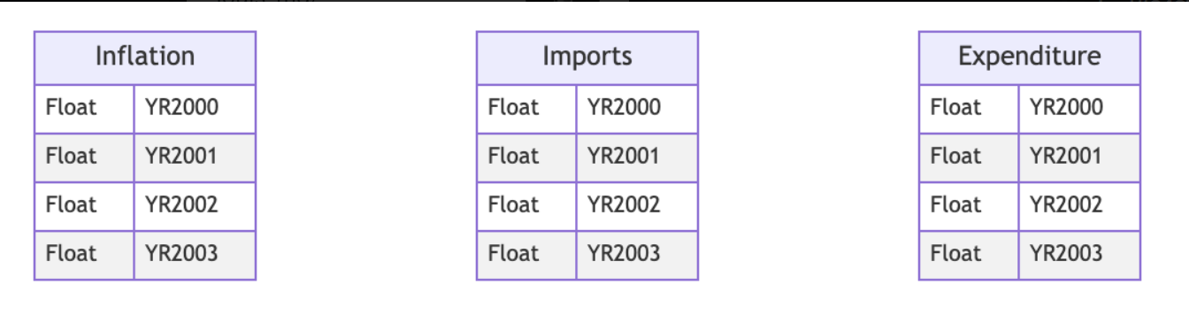
THIRD AND FiNAL ERD

Slide 7
Process
P1 – @10am Sketching the « Big Plan » and having a good start
P2 – @2pm – Getting stuck on the pivot/unpivot question through SQL
P3 – @5pm – Splitting the work (python, SQL, presentation)

Slide 8
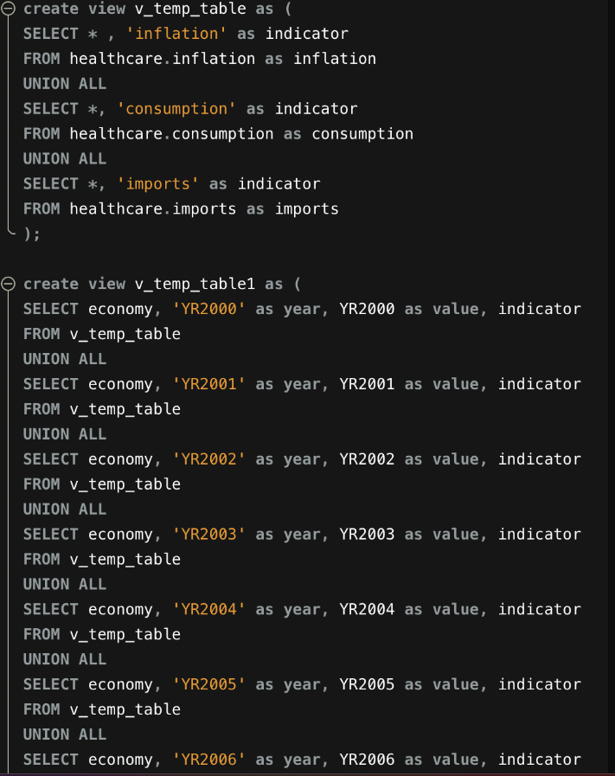
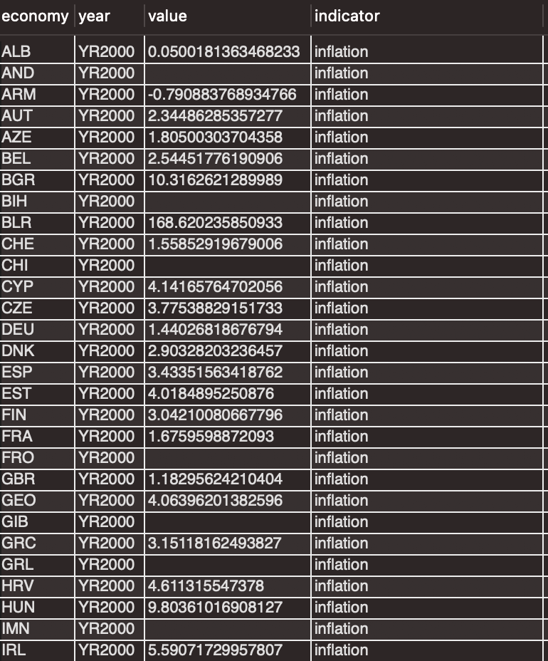

Slide 9
Challenges & Highlights :
Started to do SQL queries until we realized that it was too painful
Loved to work as a team, teasing each other all day long
Felt it would have been much more engaging if we had to collect some data and exploit it with an actual meaningful composite indicator
Pleasure to face difficulty, together; and come out on top, together

Slide 10
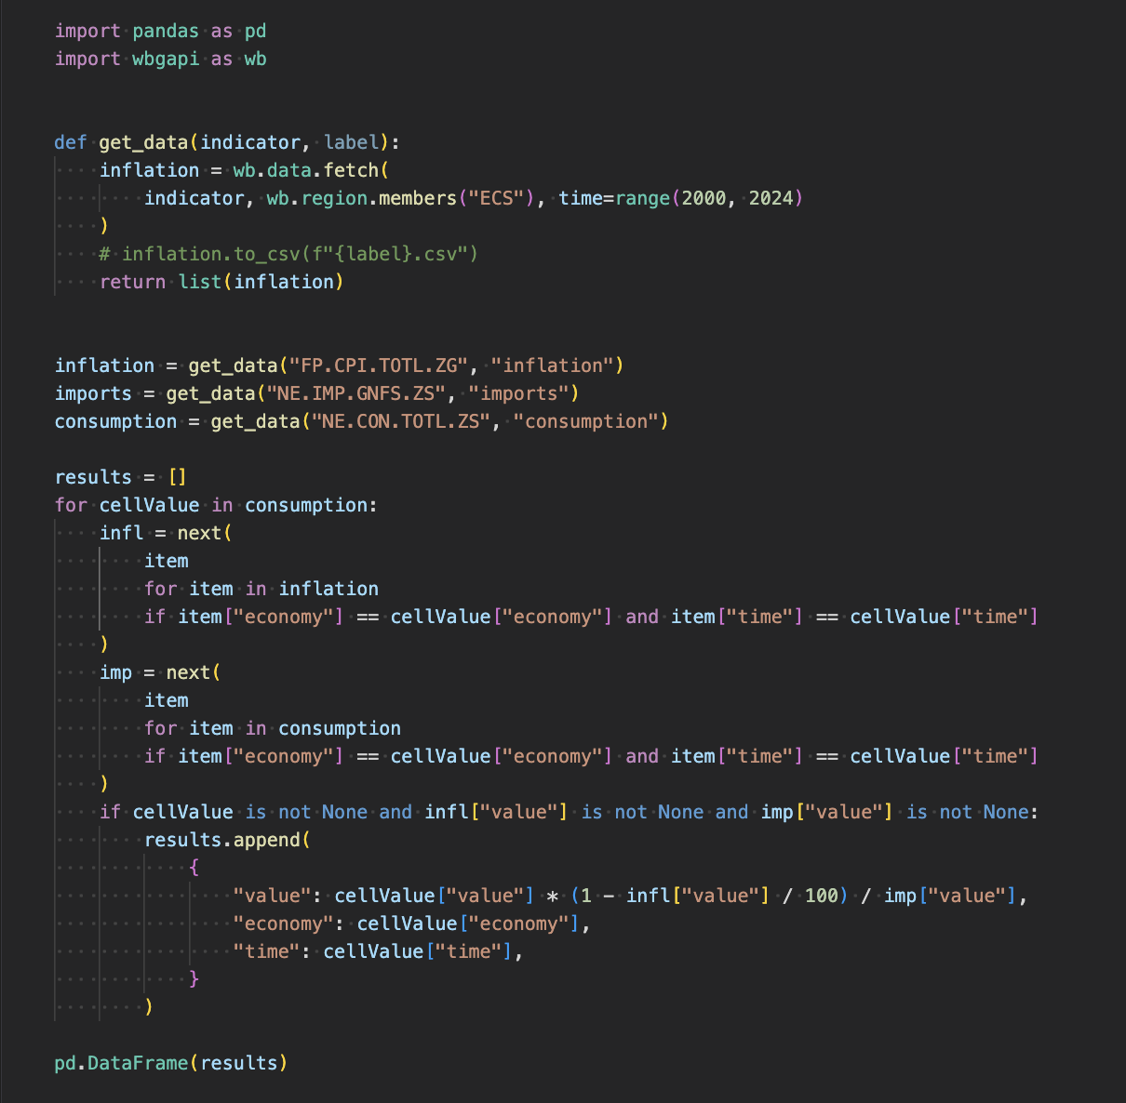
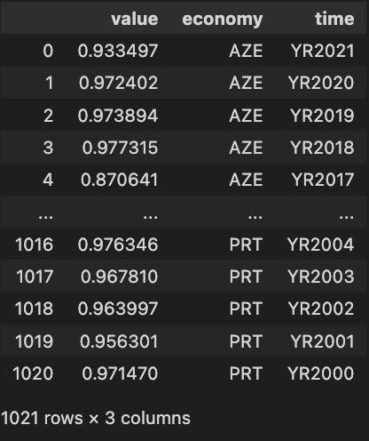
Main results & demo:
???
Computing…
!!!
= ICHCCI <3

Slide 11
Thanks :D
Now is your turn to ask questions !

