Slide 1
inflation corrected household consumption composite index aka I.C.H.C.C.I.
By Axèle #sql.expert__Louis #Py.prog.expert__Robin #AVG.dogooder

Slide 2
Description of your Project (Planning, ER, DataBase Schema, Queries, MethodoloGy for the composite indicator) :
On. The. Fly.
Went for healthcare – mixed it with business – ended up in economics.
Comparing the scales /measurement units : compatible => greenlight
Elaborating CSVs with Python Programming
Decided to export tables through the Wizard for more efficiency
ICHCCI ? What would make sense ? Evolution of Final Consumption Expenditure/Imports

Slide 3
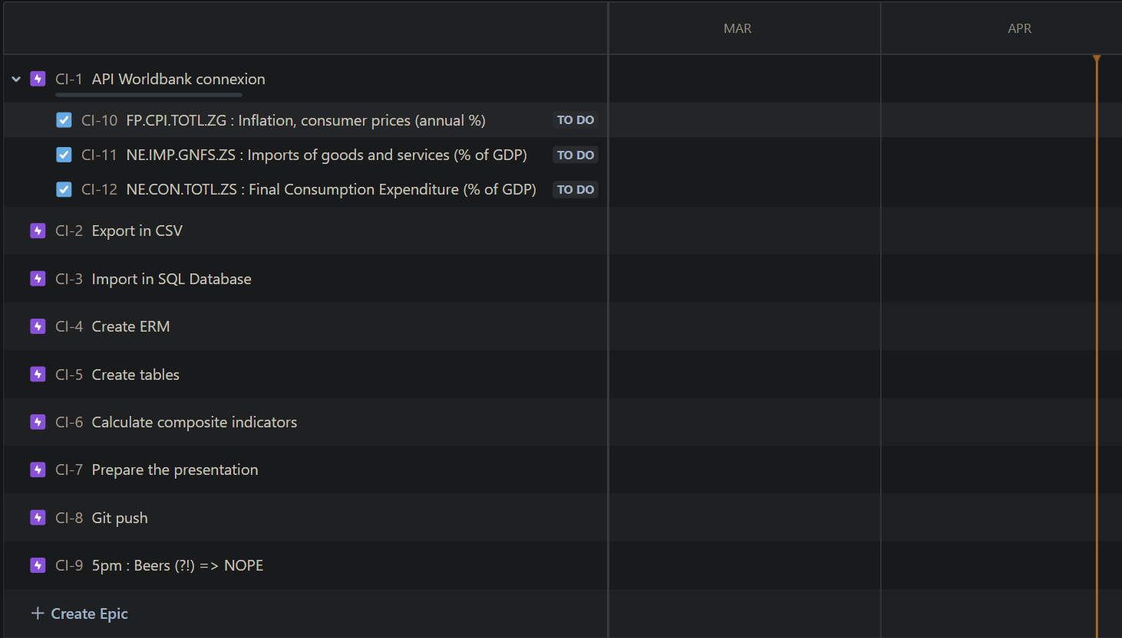
Planning through JIRA went really well at first but failed to carry us from the beginning until the end… R.I.P. BEERS ☹
6:15pm update

Slide 4
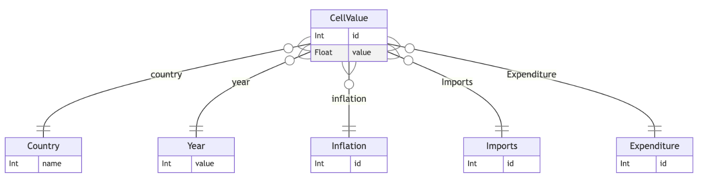
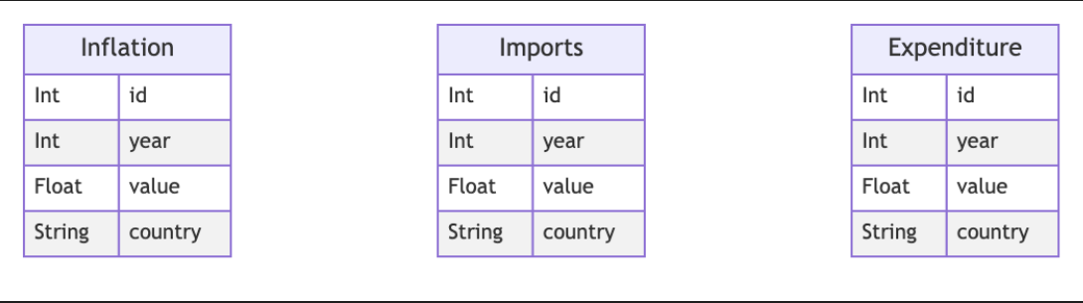
Original ERD – Quickly abandoned
SECOND AND FINAL ERD

Slide 5
Process
P1 – Sketching the « Big Plan » and having a good start
P2 – @~12pm - Getting stuck on the pivot/unpivot question through SQL and finally deciding to handle it BEFOREHAND through Python after 3 hours
P3 – Working on the presentation with a working Python code while still trying to make it work through mySQL

Slide 6
Challenges & Highlights :
Started to do SQL queries until we realized that it was painful. But we wanted to go through with it no matter what for glory, obviously #insert fireemoji
Loved to work as a team, teasing each other all day long on ours own technical or psychological limitations.
It’s still a pleasure to face diffculty, together; and come out on top, together.
We would like to adress the big issue that we had with this project compared to the first one : We feel it would be much more engaging if we had to collect some data and exploit it with an actual meaningful indicator.

Slide 7
Main result & demo:
???
Computing…
!!!
= ICHCCI

Slide 8
Thanks :D
Now is your turn to ask the difficult questions we probably don’t want to adress !
(But please, go ahead, we’re taking notes ☺)

