Slide 1
inflation corrected household consumption composite index aka I.C.H.C.C.I.
By Axèle #sql.expert__Louis #Py.prog.expert__Robin #AVG.dogooder

Slide 2
Description of your Project (Planning, ER, DataBase Schema, Queries, MethodoloGy for the composite indicator) :
On. The. Fly.
Went for healthcare – mixed it with business – ended up in economics.
Comparing the scales /measurement units : compatible => greenlight
Elaborating CSVs with Python Programming
Decided to export tables through the Wizard for more efficiency
ICHCCI ? What would make sense ? Evolution of Final Consumption Expenditure/Imports

Slide 3
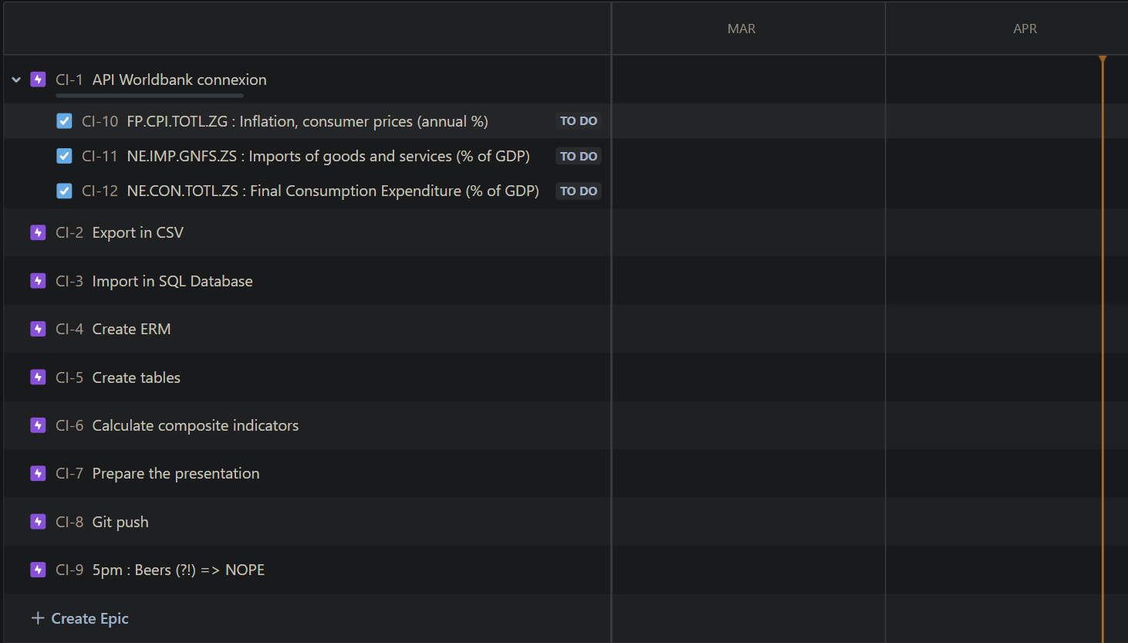
Planning through JIRA went really well at first but failed to carry us from the beginning until the end… R.I.P. BEERS ☹
6:15pm update

Slide 4
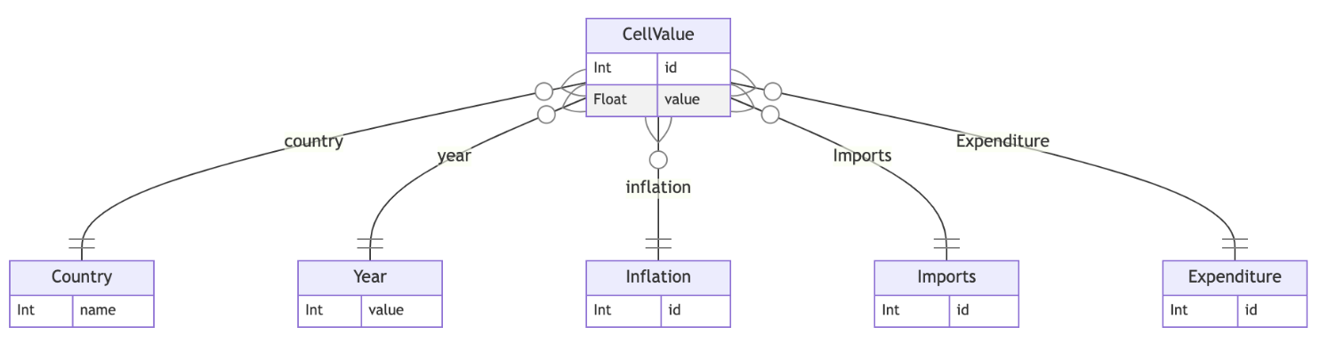
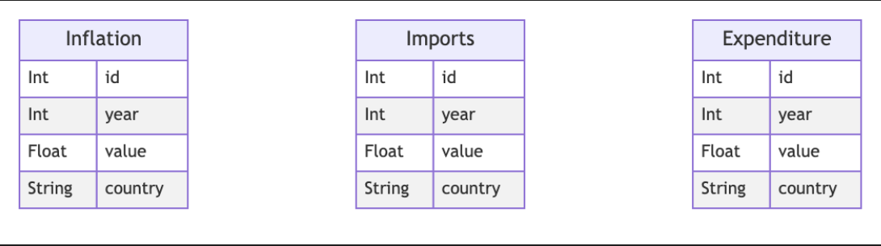
Original ERD – Quickly abandoned
SECOND AND FINAL ERD

Slide 5
Process
P1 – @10am Sketching the « Big Plan » and having a good start
P2 – @2pm – Getting stuck on the pivot/unpivot question through SQL
P3 – @5pm – Splitting the work (python, SQL, presentation)

Slide 6
Challenges & Highlights :
Started to do SQL queries until we realized that it was too painful
Loved to work as a team, teasing each other all day long
Felt it would have been much more engaging if we had to collect some data and exploit it with an actual meaningful composite indicator
Pleasure to face difficulty, together; and come out on top, together

Slide 7
Main result & demo:
???
Computing…
!!!
= ICHCCI

Slide 8
Thanks :D
Now is your turn to ask the difficult questions we probably don’t want to adress !
(But please, go ahead, we’re taking notes ☺)

