Slide 1
Hang(wo)man
Project week 1
Ironhack DAFT Paris
17 April 2023
By: the hung-ry analysts (Jamyang, Louis, Tatiana)

Slide 2
Description of the game
Basic principle : the user has to guess all the letters of a word to win. However, there are a limited number of guesses before the user is...hung.

Slide 3
Our process in 3 steps :
Brainstroming
Realization
Finalization with feedback and improvement.

Slide 4
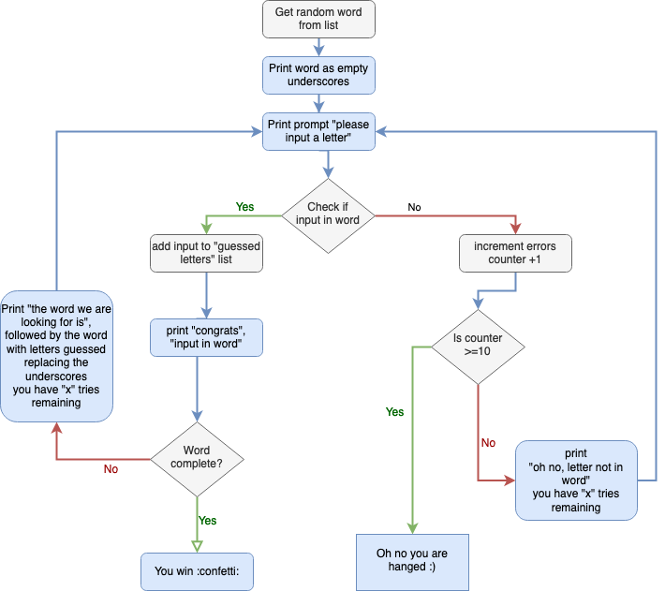
1/ Brainstroming
Flowchart

Slide 5
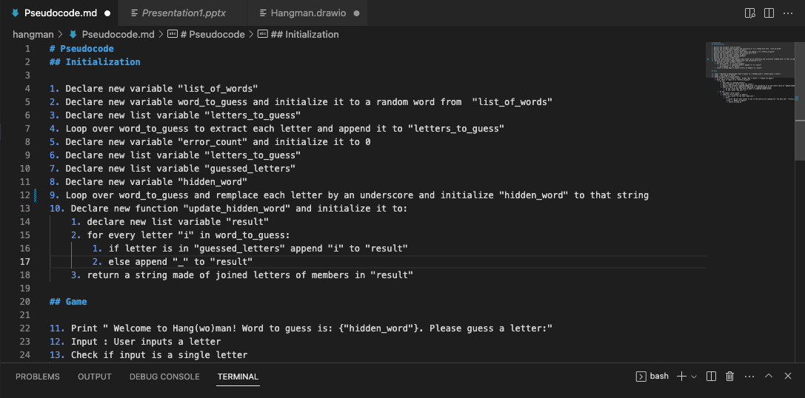
Pseudocode

Slide 6

2/ Realization
Key is coding .

Slide 7
3/ Finalization with improvement
Tested by Andy on Friday at 16h
Feedback:
1/ Put a space between each character _ _ _ _ _
2/Change the words and make it more fun.
3/ Show the missed word if game is lost.
Our bonuses:
1/ Drawing
2/ Two-player option

Slide 8
Flowchart

Slide 9
Pseudocode

Slide 10
Want to give it a try ?
DEMO TIME !

Slide 11
Challenges
Different software and levels of understanding of git
New issues found while coding (that we didn’t identify in the pseudocode)
We hadn’t planned the while loop which was necessary to keep asking for a letter until the game had ended
We had issues with the naming of the variable used to update the letters found and display them : it required keeping the same name but converting from string to list and back)
Don’t go to the sushi place (not too expensive but fish not good)

Slide 12
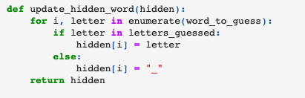
Highlights
A function to automatically update the word with found letters
A regex to identify if the input is a letter

