Slide 1

Music Streaming Performance Analysis(2024)
Louis Orozco
Cmp-262

Slide 2
Purpose
How does a song's performance on Spotify compare to other platforms?
What characteristics might explain a songs performance on a given platform.

Slide 3
Methodology
Datasets Used: Most Streamed Spotify Songs 2024
https://www.kaggle.com/datasets/nelgiriyewithana/most-streamed-spotify-songs-2024
Data Acquisition:
The dataset was provided as a CSV file, in which each individual record in the dataset represents a song, which is the primary unit of analysis.
Platform-specific streaming metrics (Spotify Streams, Pandora Streams, SoundCloud Streams, Shazam Counts, YouTube Views).
Tools and Software Used:
Jupyter Notebooks
Python Programming Language
Libraries:
Pandas, Seaborn, Matplotlib, NumPy

Slide 4
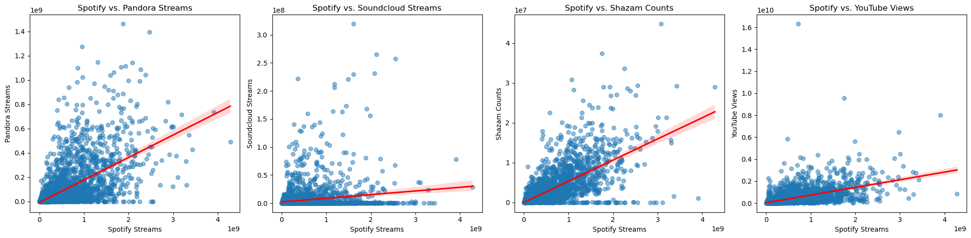
Results
Correlation between Spotify Streams and Pandora Streams: 0.57
Correlation between Spotify Streams and Soundcloud Streams: 0.17
Correlation between Spotify Streams and Shazam Counts: 0.66
Correlation between Spotify Streams and YouTube Views: 0.52

Slide 5
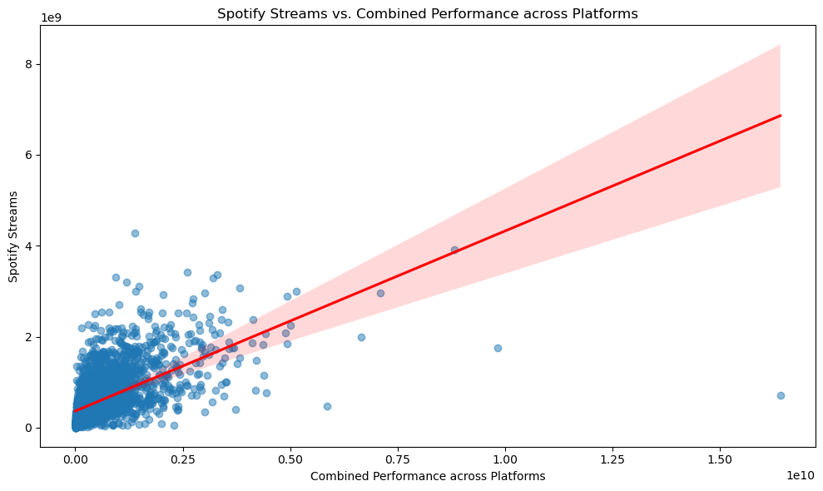
Results
Correlation between Spotify Streams and Combined Performance: 0.59
Average platform correlation: 0.48

Slide 6
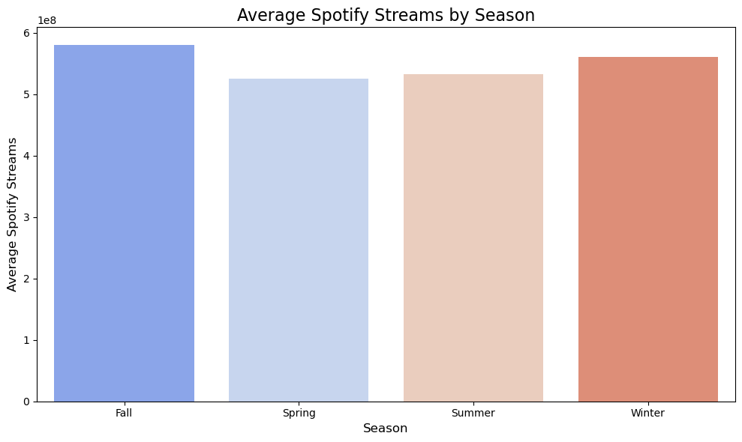
Results
January: Most Popular Day = 18.0, Spotify Streams = 7,962,301,914
February: Most Popular Day = 10.0, Spotify Streams = 8,539,702,674
March: Most Popular Day = 3.0, Spotify Streams = 10,424,878,779
April: Most Popular Day = 28.0, Spotify Streams = 6,732,076,711
May: Most Popular Day = 6.0, Spotify Streams = 17,141,321,501
June: Most Popular Day = 29.0, Spotify Streams = 11,742,070,221
July: Most Popular Day = 24.0, Spotify Streams = 9,820,836,256
August: Most Popular Day = 25.0, Spotify Streams = 9,499,586,284
September: Most Popular Day = 16.0, Spotify Streams = 10,938,931,756
October: Most Popular Day = 23.0, Spotify Streams = 10,779,301,542
November: Most Popular Day = 20.0, Spotify Streams = 25,758,538,171
December: Most Popular Day = 9.0, Spotify Streams = 10,090,854,361

Slide 7
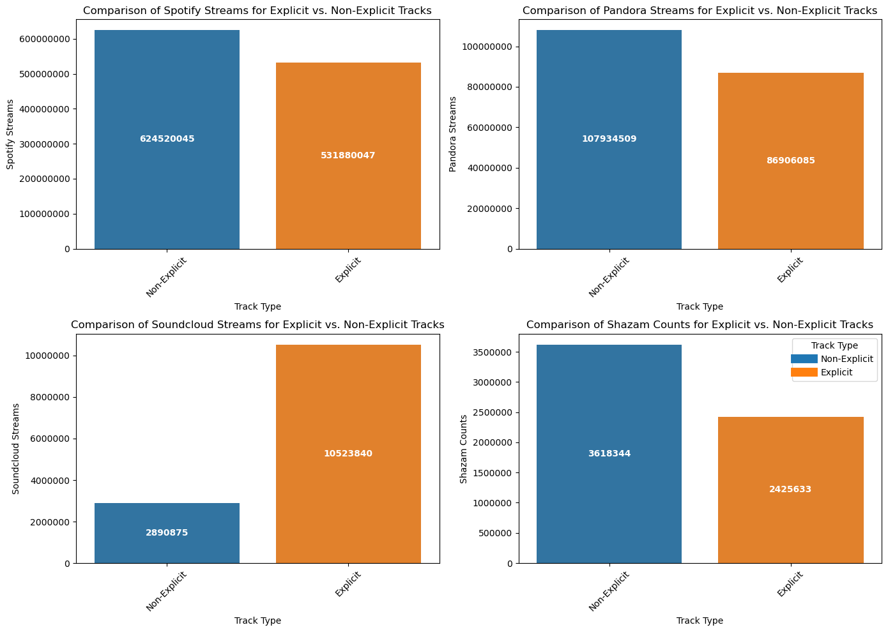
Results

Slide 8
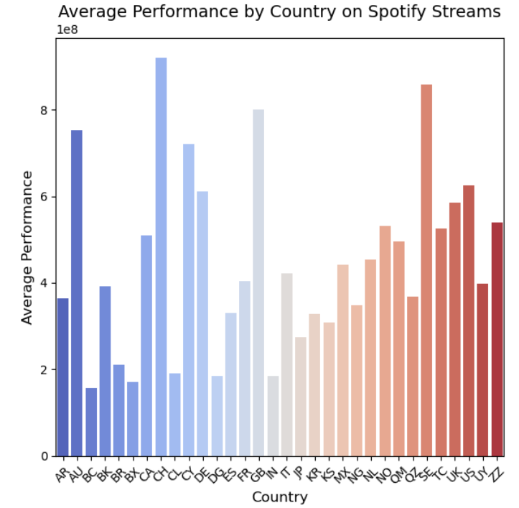
Results
Top 10 performing countries for Spotify Streams:
1. CH - 920,871,138
2. SE - 859,091,339
3. GB - 800,990,047
4. AU - 751,907,491
5. CY - 720,596,329
6. US - 625,506,696
7. DE - 612,042,351
8. UK - 586,044,166
9. ZZ - 538,917,370
10. NO - 531,338,393
Top 10 performing countries for Pandora Streams:
1. US - 125,242,011
2. GB - 117,211,920
3. SE - 111,481,571
4. AU - 98,596,660
5. CA - 63,091,139
6. TC - 62,696,701
7. CY - 58,430,592
8. CH - 57,523,622
9. DE - 54,730,656
10. MX - 54,035,544
Top 10 performing countries for Soundcloud Streams:
1. NL - 10,617,032
2. TC - 9,457,304
3. AU - 9,266,132
4. CA - 8,232,606
5. US - 7,085,661
6. QM - 6,807,460
7. QZ - 5,182,582
8. NG - 5,073,566
9. GB - 4,062,567
10. CY - 3,963,449
Top 10 performing countries for Shazam Counts:
1. SE - 9,147,797
2. CH - 6,940,438
3. AU - 6,940,217
4. DE - 5,719,334
5. NG - 5,687,900
6. GB - 5,443,380
7. FR - 4,732,680
8. CY - 4,616,359
9. NO - 4,562,786
10. NL - 4,248,917
Top 10 performing countries for YouTube Views:
1. KR - 876,492,225
2. MX - 822,910,960
3. CH - 784,477,454
4. NO - 709,850,739
5. SE - 690,785,438
6. IN - 652,112,656
7. FR - 615,064,074
8. CA - 566,323,711
9. GB - 513,556,252
10. US - 461,781,068

Slide 9
Future Work:
Genre-Specific Insights
Sentiment Analysis on Lyrics
Artist Analysis

Slide 10
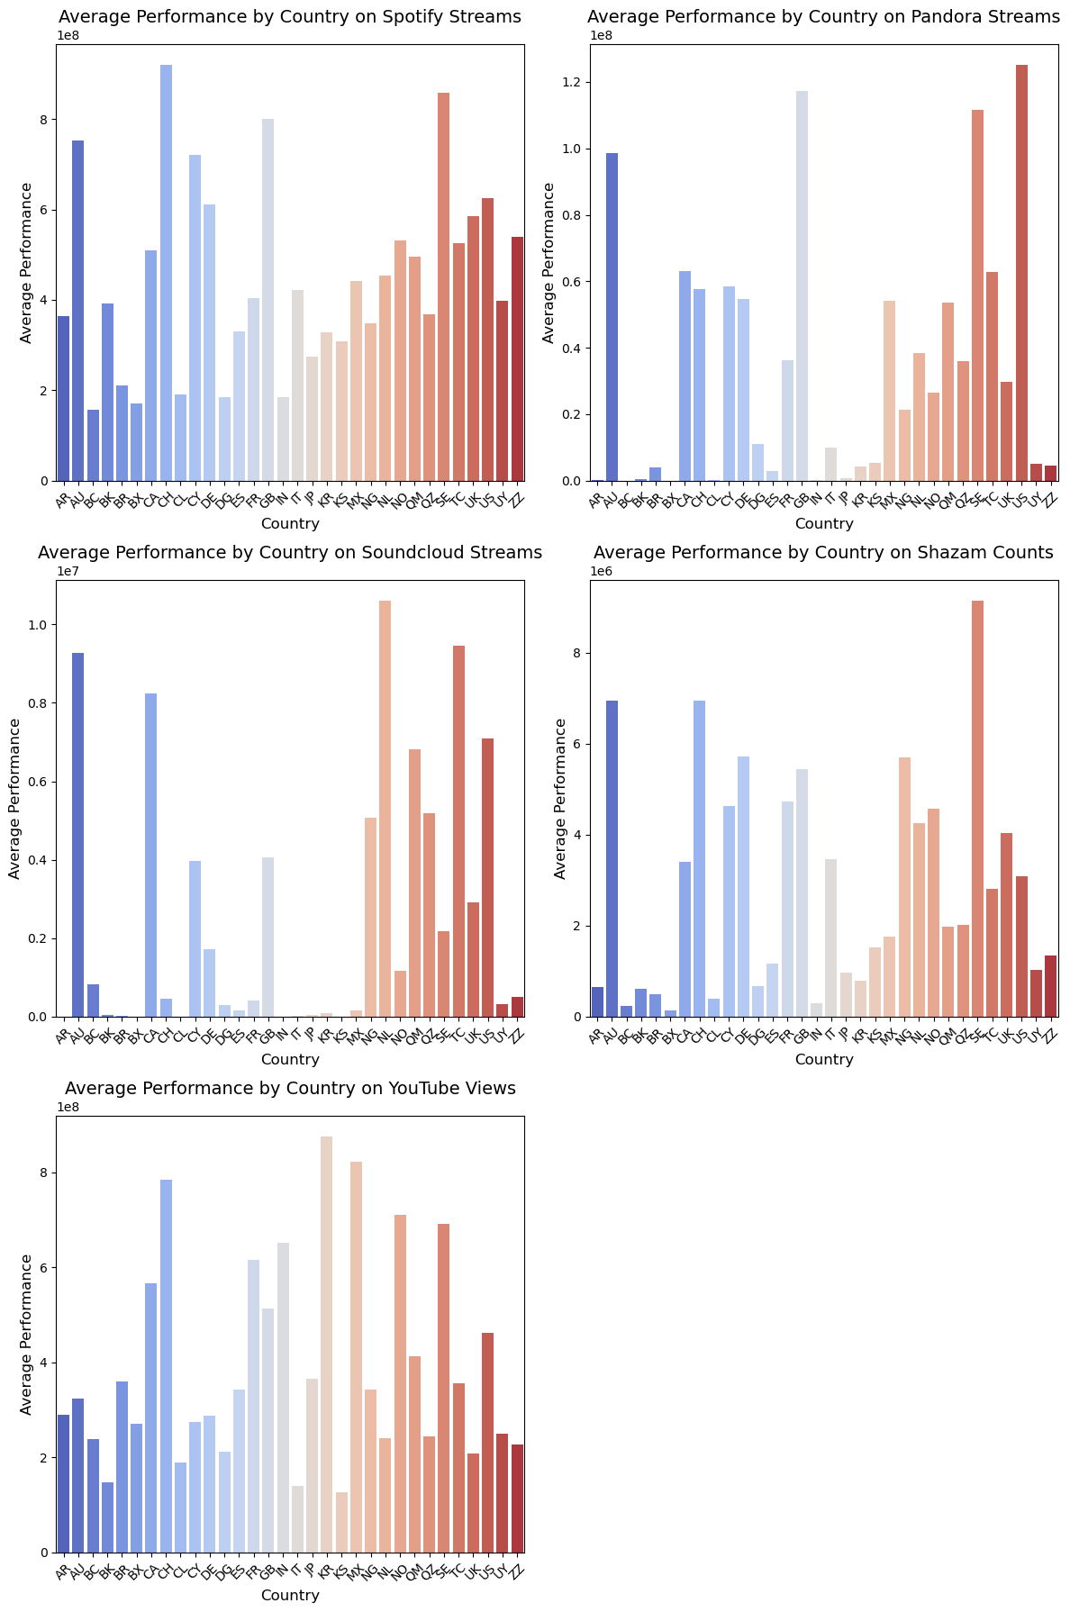
Appendix

Slide 11
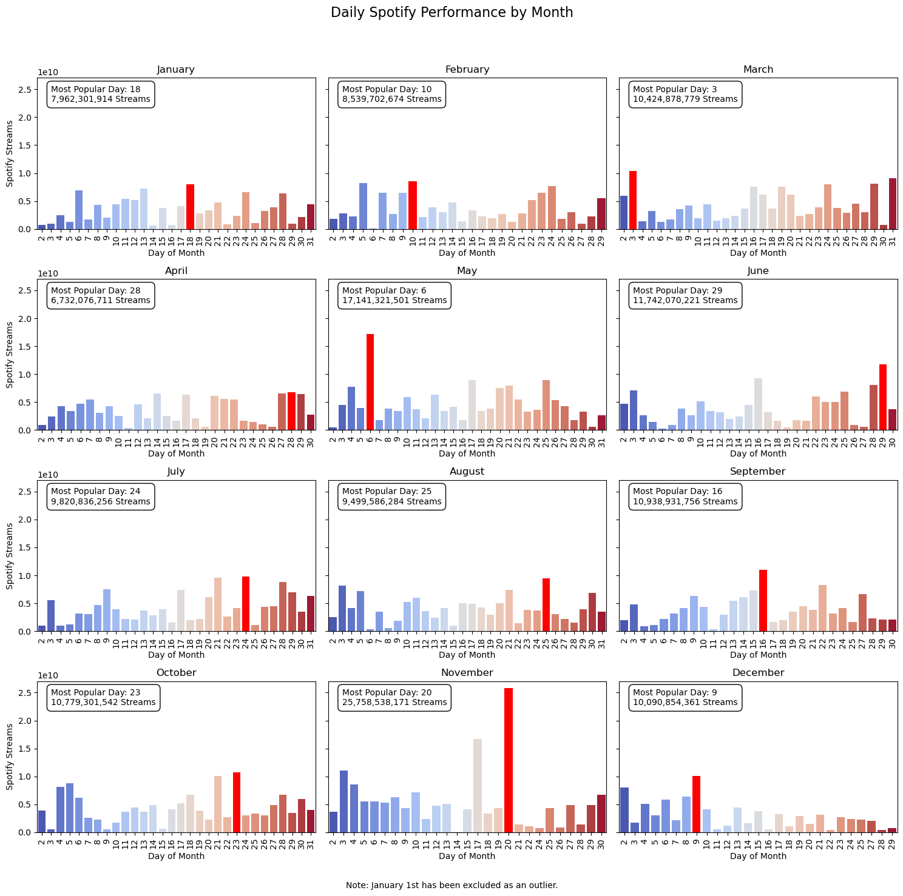
Appendix

