Slide 1
DatA Wrangling with Tidyverse

Slide 2
History of R
Stems from S created in 1975 – 1976
Created to make interactive work easier than Fortran
“[R] is very similar in appearance to S, the underlying implementation and semantics are derived from Scheme” (R-FAQ)
Notes:
----- Meeting Notes (18/02/20 11:44) -----

Slide 3
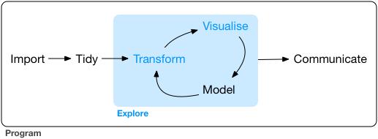
Analysing Data

Slide 4
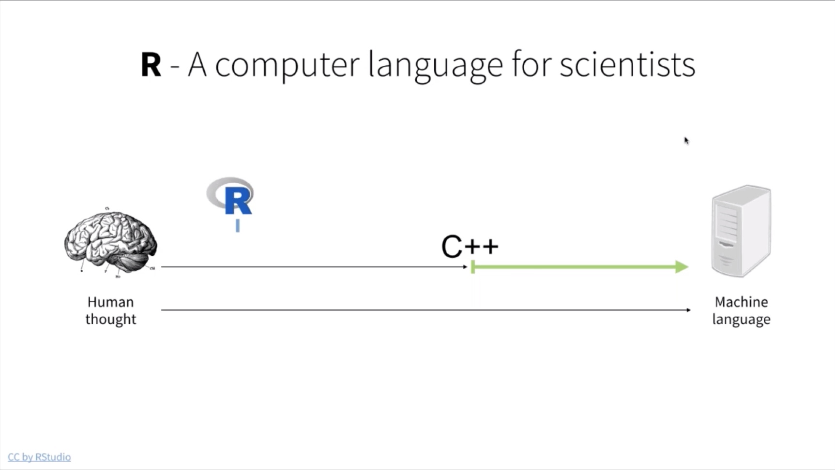

Slide 5
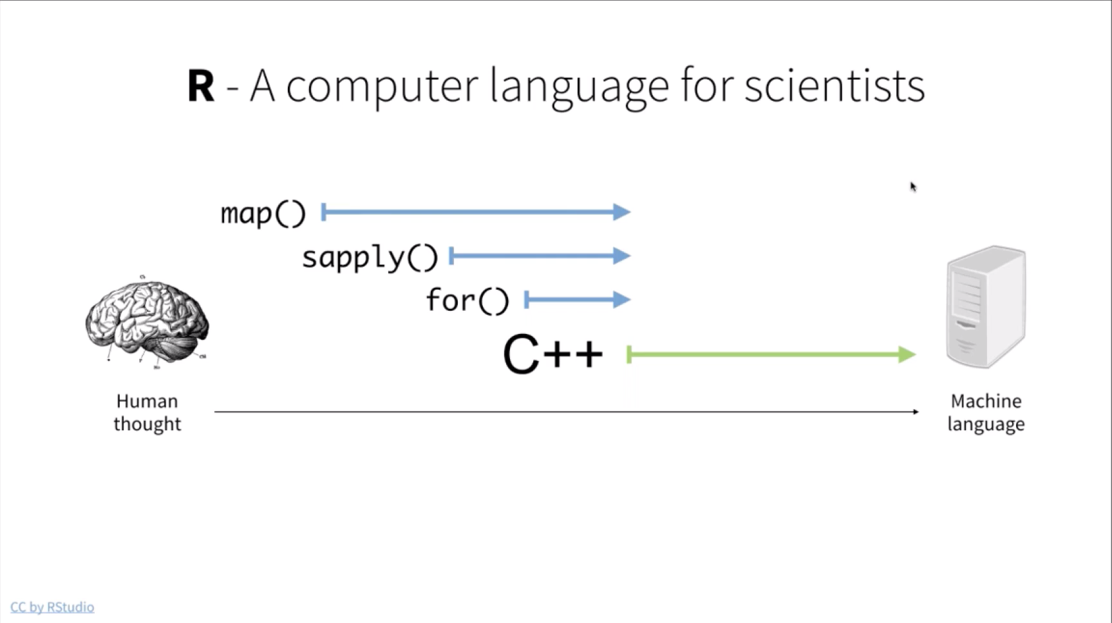

Slide 6
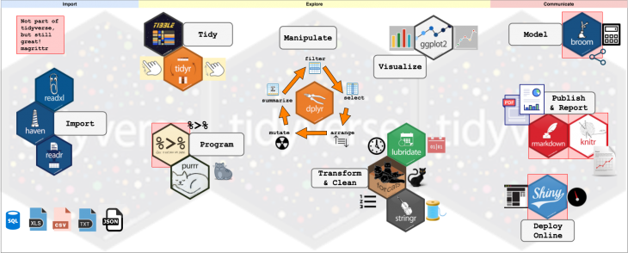
Tidyverse Ecosystem

Slide 7
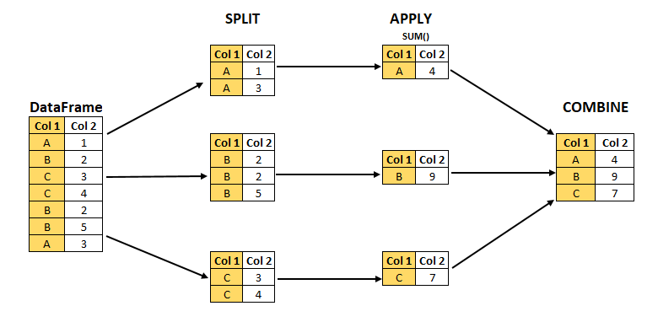
Split Apply Combine

