Slide 1
Investigating semi-supervised methods for enhancing text transformers with dimension reduction techniques
Group: Chau Yu Hei

Slide 2
Text information pairing problem
Given two sets (T, C), try to find if some t in T is correlated to c in C
Textual information are available for t and c
Extra structure available on T, C (e.g graph structure on T)

Slide 3
Usual methods
Fine tune a pretrained sentence-transformers model to obtain text embeddings
Use a 1-2 step approach to narrow down top 1k possible pairs, and a downstream model for final selection
Pretrained sentence-transformers models embedding vectors are suitable for cosine similarity metric

Slide 4
Problems
Transformers require a lot of computational resources to train/finetune
Hard to finetune transformers on resource constrained devices
End users may prefer not to upload data to cloud computing servers due to privacy concerns
Goal: See whether a semi-supervised approach can leverage the extra structure of the data to increase the performance of the transformers

Slide 5
Case study: Kaggle competition
Some winning solutions:
https://www.kaggle.com/competitions/learning-equality-curriculum-recommendations/discussion/395110
https://www.kaggle.com/competitions/learning-equality-curriculum-recommendations/discussion/394984
Can we leverage the information of tree structure without fine-tuning the transformer?

Slide 6
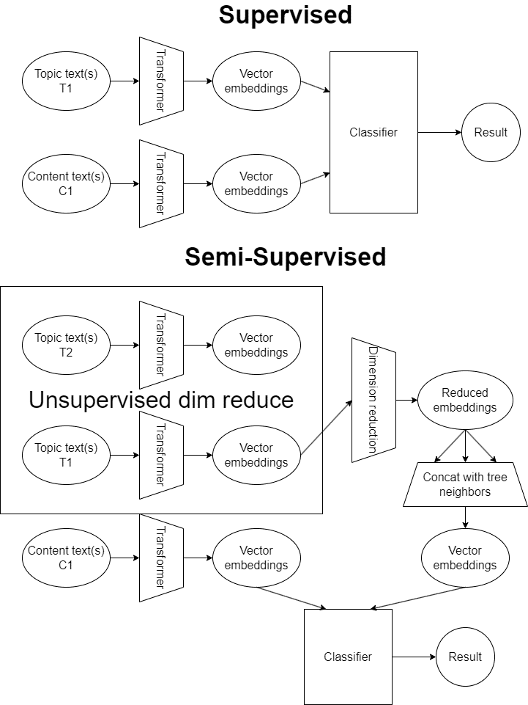
Supervised vs Semi supervised approach

Slide 7
Unsupervised dimension reduction
Train a neural network with same architecture
To use additional structure, we have to compress the original data
Use PCA/manifold learning approaches to compress the data

Slide 8
Unsupervised graph clustering methods
Clustering with given graph structure
Provided graph structure is a tree
Does not really make sense to use graph Laplacian / topological methods to cluster the tree into subgraphs
Clustering with graph structure induced by nearest neighbors on text vector embeddings
Reusing same information given by transformers
Intuitively, this would not improve performance of downstream NN classifier
NNs can do universal approximation already
In this case, graph clustering methods are not really useful

Slide 9
Hypothesis
Dimension can remember the “important” info of text embeddings
Sentence-transformer trained in large corpus
Learning curriculums correspond to a submanifold of the entire corpus space
Information “gained” by using text embeddings of neighbors
→ Better accuracy
Manifold learning methods fit better than PCA

Slide 10
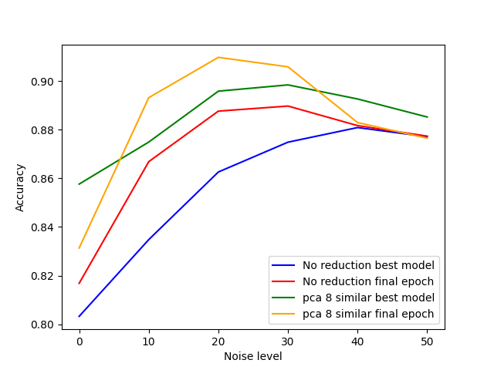
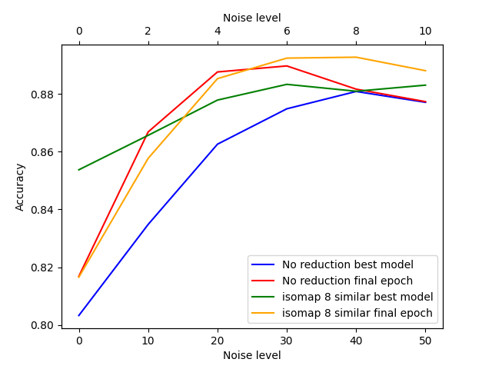
Results:
Using information of 8 neighbors (for graphs below)
As expected, the accuracy of models has increased
Surprisingly, manifold learning methods perform worse compared to PCA

Slide 11
Limitations of experiment
“Unfair” comparison between PCA and manifold learning methods
PCA compared as usual
Manifold learning methods require a pairwise distance matrix, takes up a lot of memory (70k topics in dataset)
Used landmark choice-like algorithm isomap in sklearn
Random 10k points chosen
Remaining embedding points computed with geodesic distances to the 10k points which forms a weighted sum of the 10k points
With enough memory, manifold learning methods trained on full set may perform better than PCA

Slide 12
PCA vs Manifold learning methods
Possible reasons PCA > Manifold Learning
Downstream neural network learns non-linearities
NN is robust to noise, a precise reconstruction of data is not necessary
Data from upstream transformer model may actually lie on an open set in the text embedding space
Practical problems
Resource constrained
Manifold learning methods on large dataset (70k) require a lot of memory (~40GB)
If we have that many memory, we could train / finetune a transformer model directly, which will surely be better in performance

Slide 13
Possible future work
Interestingly, there is a paper about the low-rankedness of weights inside transformer models: https://arxiv.org/pdf/2106.09685.pdf
LoRA (Hu et. al)
Possible to investigate whether PCA performs well because the produced text embeddings are actually in a linear subspace.

