Slide 1
Experiment of a framework for automated testing of Android Applications.
Graduate Institute of Electrical Engineering, National Taiwan University
學生 : 蔣汶宏
指導教授 : 王凡 教授
電機所碩二 計算機科學組
Verification Automation Lab & Software Testing Lab

Slide 2
Outline
Graduate Institute of Electrical Engineering, National Taiwan University
Introduction
Proposed framework
Trace Collector
Abstraction
Experiment
Conclusion
Future work
Verification Automation Lab & Software Testing Lab

Slide 3
Outline
Graduate Institute of Electrical Engineering, National Taiwan University
Introduction
Proposed framework
Trace Collector
Abstraction
Experiment
Conclusion
Future work
Verification Automation Lab & Software Testing Lab

Slide 4
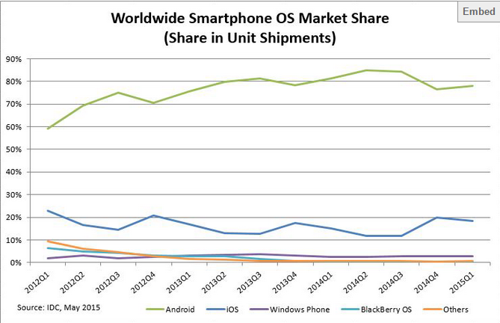
Background
Graduate Institute of Electrical Engineering, National Taiwan University
In 2014, the market share of the Android smart phones is 81.5%, and the market share of IOS is 14.8%.
Source: http://www.idc.com/prodserv/smartphone-os-market-share.jsp
Verification Automation Lab & Software Testing Lab

Slide 5
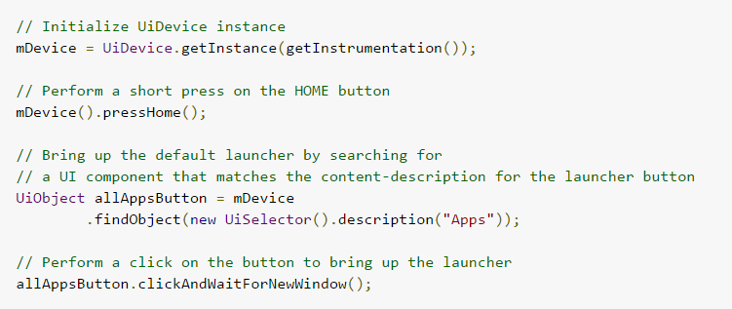
Motivation
Graduate Institute of Electrical Engineering, National Taiwan University
Most of the current automated testing tools for Android applications need to write test scripts by the test engineers.
For example, Robotium, Monkey Runner, Ranorex, UI Automator and so on.
Source: http://developer.android.com/tools/testing-support-library/index.html
Verification Automation Lab & Software Testing Lab

Slide 6
Purpose
Graduate Institute of Electrical Engineering, National Taiwan University
We proposed a framework of automated testing tool for Android applications without writing test scripts.
This framework includes the followings:
  Web User Interface (for Users)
  Spec Elicitor (manpower)
  Task Scheduler (automated)
  Trace Collector (automated)
  Trace Evaluator (automated)
Verification Automation Lab & Software Testing Lab

Slide 7
Outline
Graduate Institute of Electrical Engineering, National Taiwan University
Introduction
Proposed framework
Trace Collector
Abstraction
Experiment
Conclusion
Future work
Verification Automation Lab & Software Testing Lab

Slide 8
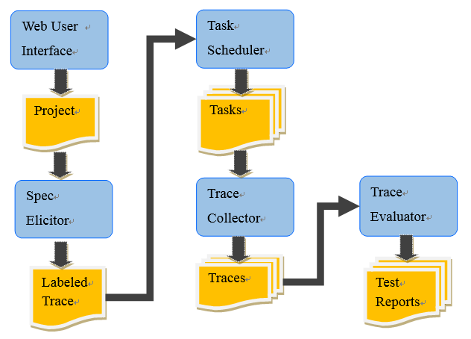
Proposed framework
Graduate Institute of Electrical Engineering, National Taiwan University
Verification Automation Lab & Software Testing Lab

Slide 9
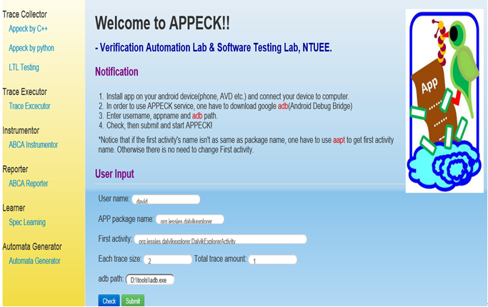
Web User Interface
Graduate Institute of Electrical Engineering, National Taiwan University
Verification Automation Lab & Software Testing Lab

Slide 10
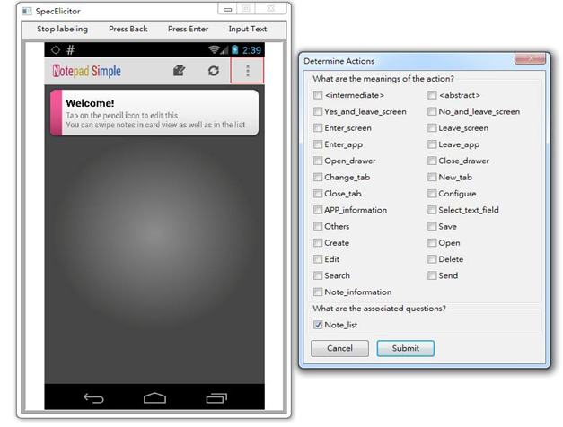
Spec Elicitor
Graduate Institute of Electrical Engineering, National Taiwan University
Label each screen and button with some tags.
Label “pass” or “fail” of traces.
Increase the accuracy of the Trace Evaluator.
Verification Automation Lab & Software Testing Lab

Slide 11
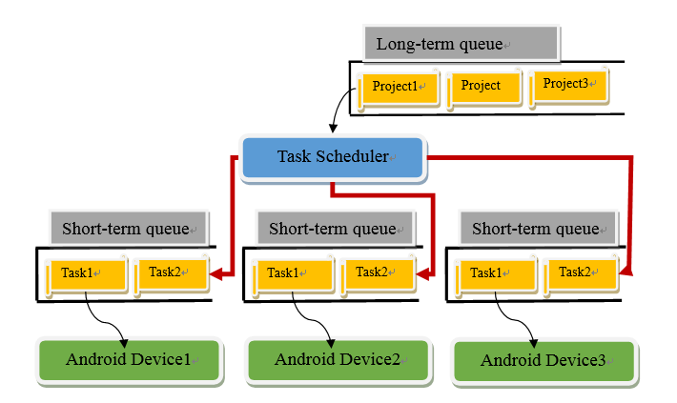
Task Scheduler
Graduate Institute of Electrical Engineering, National Taiwan University
Test SUTs on different platforms.
Schedule tasks on each device.
Verification Automation Lab & Software Testing Lab

Slide 12
Trace Collector
Graduate Institute of Electrical Engineering, National Taiwan University
Simulate human behaviors → Generate large amount of traces automatically.
Construct automata → Build model by those traces to represent the SUT behaviors.
Instrument SUTs→ Get the line coverage information in black-box testing.
Verification Automation Lab & Software Testing Lab

Slide 13
Trace Evaluator
Graduate Institute of Electrical Engineering, National Taiwan University
Generate traces randomly is easy, but evaluate these traces automatically is hard.
We only have a simple Trace Evaluator now.
It can only check is there a crash happened.
Verification Automation Lab & Software Testing Lab

Slide 14
Outline
Graduate Institute of Electrical Engineering, National Taiwan University
Introduction
Proposed framework
Trace Collector
Abstraction
Experiment
Conclusion
Future work
Verification Automation Lab & Software Testing Lab

Slide 15
Trace Collector
Graduate Institute of Electrical Engineering, National Taiwan University
The procedure of Trace Collector is the followings:
  Parse the task given by the Task Scheduler.
  Set the abstraction information.
  Construct the folders which are used to store our traces.
  Instrument the SUT and install it into the Android smart phone.
  Call the different testcase generators with different algorithms, such as the monkey or DFS-like.
  Start to collect traces by using the given algorithm, trace length and trace amount.
Verification Automation Lab & Software Testing Lab

Slide 16
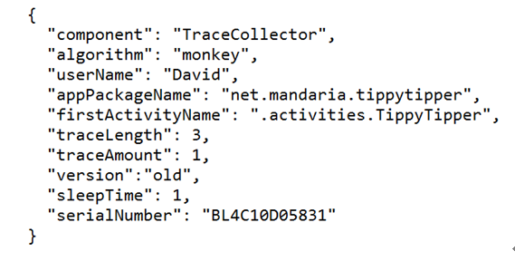
Task in JSON format
Graduate Institute of Electrical Engineering, National Taiwan University
The full name of JSON is JavaScript Object Notation.
Just like XML, JSON is a syntax for storing and exchanging data.
Verification Automation Lab & Software Testing Lab

Slide 17
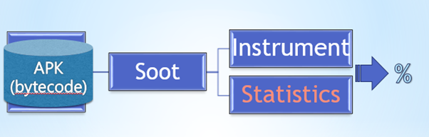
Instrument
Graduate Institute of Electrical Engineering, National Taiwan University
Instrumentation helps us get the line coverage information.
Users should provide their APK file to us.
We use Soot to help us instrument the APK file.
Not every APK file can be instrumented successfully.
Verification Automation Lab & Software Testing Lab

Slide 18
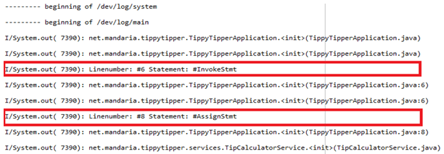
Instrument message
Graduate Institute of Electrical Engineering, National Taiwan University
Numerator is how many lines are covered.
Denominator is the number of how many lines we instrument in the APK file.
Line coverage = numerator / denominator
Verification Automation Lab & Software Testing Lab

Slide 19
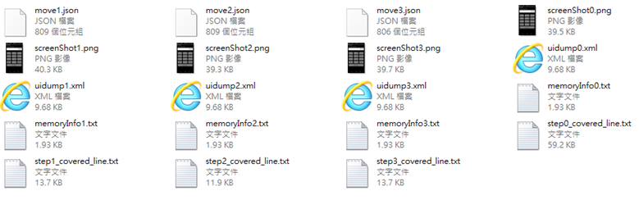
Trace structure
Graduate Institute of Electrical Engineering, National Taiwan University
A trace : state -> move -> state -> move -> state -> …
The state description : screenShot.png, uidump.xml, memoryInfo.txt and step_covered_line.txt
The move description: move.json.
Verification Automation Lab & Software Testing Lab

Slide 20
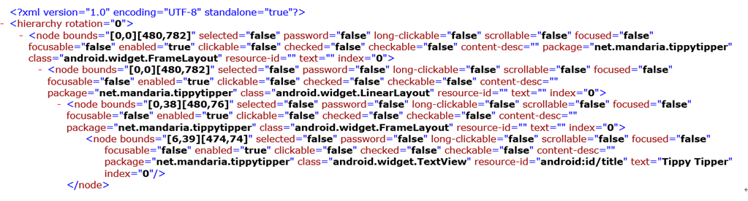
XML file
Graduate Institute of Electrical Engineering, National Taiwan University
Our framework relies greatly on the XML file.
We can’t support the applications that can’t dump XML files successfully, such as games.
Verification Automation Lab & Software Testing Lab

Slide 21
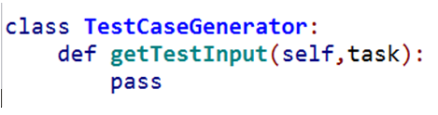
Interface
Graduate Institute of Electrical Engineering, National Taiwan University
We build an interface to separate the algorithm from the actual commands that communicate with the Android smart phones.
All the other testcase generators should inherit this class and write their algorithm in the getTestInput() function.
Verification Automation Lab & Software Testing Lab

Slide 22
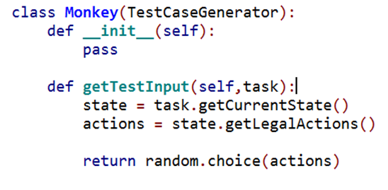
Monkey
Graduate Institute of Electrical Engineering, National Taiwan University
Verification Automation Lab & Software Testing Lab

Slide 23
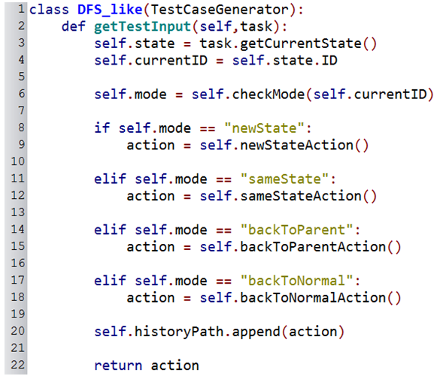
DFS-like
Graduate Institute of Electrical Engineering, National Taiwan University
This testcase generator cannot fit all SUTs.
Verification Automation Lab & Software Testing Lab

Slide 24
Outline
Graduate Institute of Electrical Engineering, National Taiwan University
Introduction
Proposed framework
Trace Collector
Abstraction
Experiment
Conclusion
Future work
Verification Automation Lab & Software Testing Lab

Slide 25
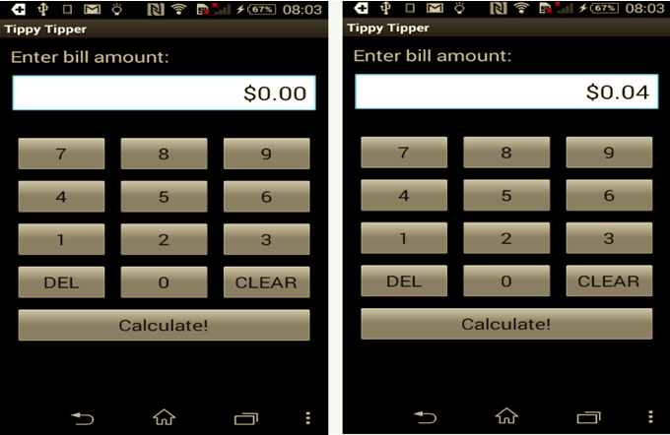
Abstraction
Graduate Institute of Electrical Engineering, National Taiwan University
Compare two screens by their XML files .
Verification Automation Lab & Software Testing Lab

Slide 26
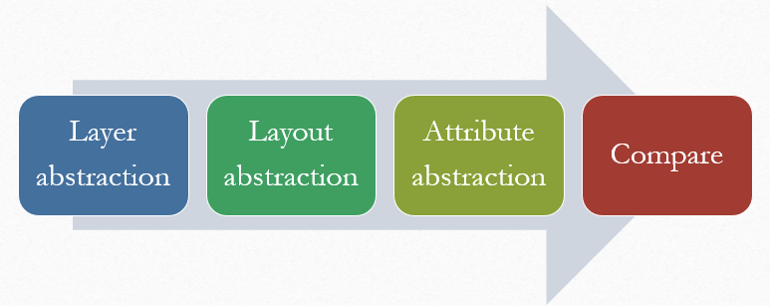
Abstraction -- components
Graduate Institute of Electrical Engineering, National Taiwan University
There are three components in the Abstraction, such as Layer abstraction, Layout abstraction and Attribute abstraction.
Layer abstraction and Layout abstraction reduce the nodes need to be compared.
Attribute abstraction reduce the attributes need to be compared.
Verification Automation Lab & Software Testing Lab

Slide 27
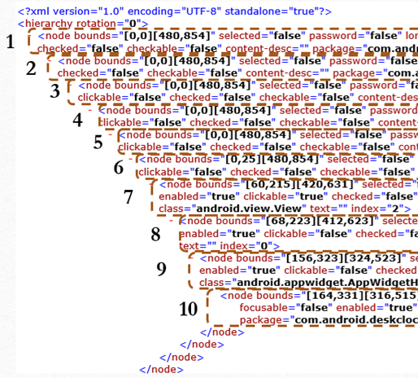
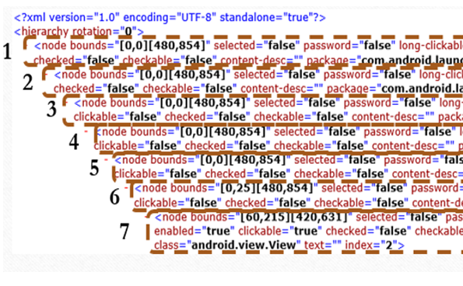
Layer abstraction
Graduate Institute of Electrical Engineering, National Taiwan University
Ignore the nodes in too deep layer.
For example: set abstraction layer = 7
Verification Automation Lab & Software Testing Lab

Slide 28
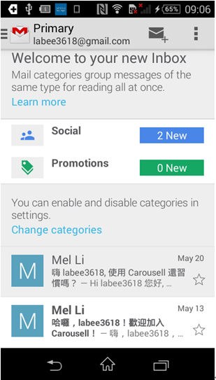
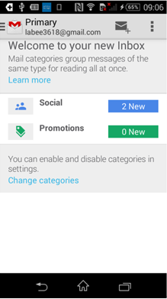
Layout abstraction
Graduate Institute of Electrical Engineering, National Taiwan University
Ignore the nodes in a layout we don’t want.
For example, set ignored classes = “android.widget.ListView”
Verification Automation Lab & Software Testing Lab

Slide 29

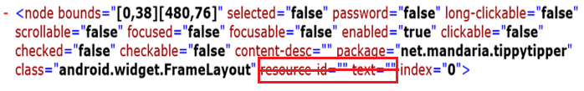
Attribute abstraction
Graduate Institute of Electrical Engineering, National Taiwan University
Ignore the attributes we don’t want.
For example, set ignored attributes = [“resource-id”,”text”]
Verification Automation Lab & Software Testing Lab

Slide 30
Compare
Graduate Institute of Electrical Engineering, National Taiwan University
Two XML files are different if the numbers of nodes after the previous abstraction are different.
If the numbers of nodes are the same, then we put these nodes in one-to-one correspondence and compare the attributes need to be compared.
Verification Automation Lab & Software Testing Lab

Slide 31
Outline
Graduate Institute of Electrical Engineering, National Taiwan University
Introduction
Proposed framework
Trace Collector
Abstraction
Experiment
Conclusion
Future work
Verification Automation Lab & Software Testing Lab

Slide 32
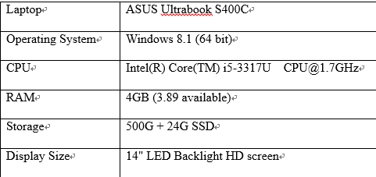
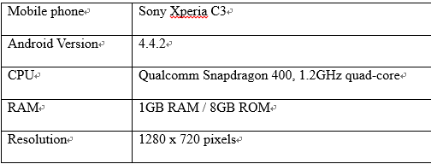
Environment
Graduate Institute of Electrical Engineering, National Taiwan University
We need to install the following tools:
Windows
Python3
Android SDK
JDK
Verification Automation Lab & Software Testing Lab

Slide 33
Experiment design
Graduate Institute of Electrical Engineering, National Taiwan University
Because our tool relies greatly on the XML files, we want to know how many percentage of applications we can support.
In experiment 1, we test one hundred the most famous applications (including 35 games) on the Google play store.
Another important thing, we want to prove that our framework has the ability to find bugs.
In experiment 2, we use the monkey and DFS-like testcase generators to find bugs and compare their performance.
Verification Automation Lab & Software Testing Lab

Slide 34
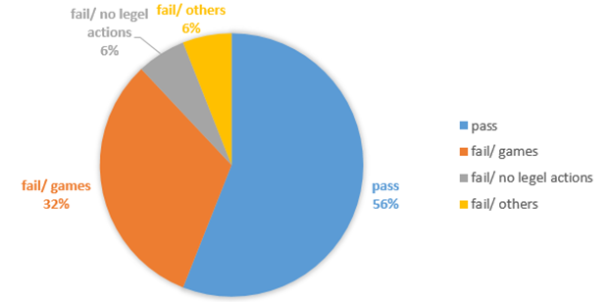
Experiment 1 – without the instrumentation
Graduate Institute of Electrical Engineering, National Taiwan University
We use the monkey algorithm with the traceAmount equals to 1 and the traceLength equals to 5 to test the applications.
Verification Automation Lab & Software Testing Lab

Slide 35
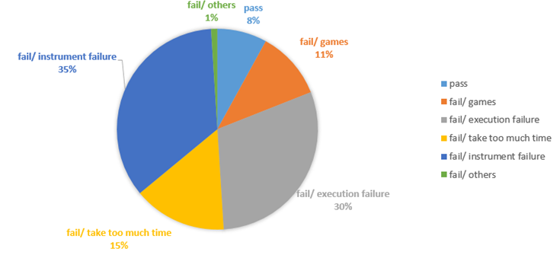
Experiment 1 – with the instrumentation
Graduate Institute of Electrical Engineering, National Taiwan University
We use the same experiment setting.
Verification Automation Lab & Software Testing Lab

Slide 36
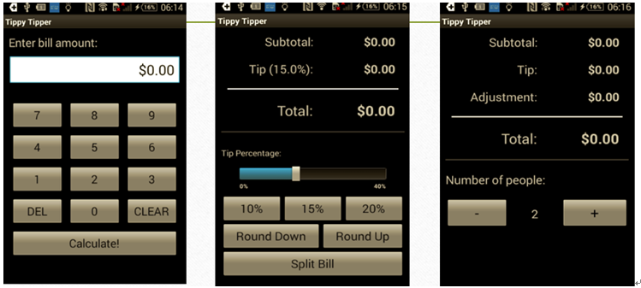
Experiment 2 -- benchmark
Graduate Institute of Electrical Engineering, National Taiwan University
Our benchmark is Tippy Tipper.
Tippy Tipper is an open source Tip calculator.
There are 100,000 to 500,000 downloads.
Screen 1 Screen 2 Screen 3
Verification Automation Lab & Software Testing Lab

Slide 37
Experiment 2
Graduate Institute of Electrical Engineering, National Taiwan University
We insert a crash bug in a button of each screen.
We collect one trace with one hundred moves to find the bug.
 | Sub-experiment 1 |  | Sub-experiment 2 |  | Sub-experiment 3
algorithm | DFS-like | Monkey | DFS-like | Monkey | DFS-like | Monkey
Repeat 1 | 13 | 5 | 19 | 14 | 22 | 22
Repeat 2 | 13 | 54 | 19 | 11 | 22 | 10
Repeat 3 | 13 | 61 | 19 | 22 | 22 | 11
Repeat 4 | 13 | 74 | 19 | 42 | 22 | 100
Repeat 5 | 13 | 100+ | 19 | 33 | 22 | 35
Verification Automation Lab & Software Testing Lab

Slide 38
Outline
Graduate Institute of Electrical Engineering, National Taiwan University
Introduction
Proposed framework
Trace Collector
Abstraction
Experiment
Conclusion
Future work
Verification Automation Lab & Software Testing Lab

Slide 39
Conclusion
Graduate Institute of Electrical Engineering, National Taiwan University
The biggest difference between our framework and the other related frameworks is that we don’t need to write the test scripts.
We can test approximately 56% of applications automatically without the instrumentation.
Although there are 8% left after doing the instrumentation, it still has a big potential to be improved.
According to the result of the experiment 2, we prove that our framework can exactly find crash bugs.
Verification Automation Lab & Software Testing Lab

Slide 40
Outline
Graduate Institute of Electrical Engineering, National Taiwan University
Introduction
Proposed framework
Trace Collector
Abstraction
Experiment
Conclusion
Future work
Verification Automation Lab & Software Testing Lab

Slide 41
Future work
Graduate Institute of Electrical Engineering, National Taiwan University
Our framework currently stores the data as files. However, it should be stored in database in the future.
With the memory information and the line coverage information, we can develop some new testcase generators.
In addition to XML files, we should figure out some alternative methods to recognize the screens, such as computer vision.
Verification Automation Lab & Software Testing Lab

Slide 42
Thanks for listening.
Graduate Institute of Electrical Engineering, National Taiwan University
Verification Automation Lab & Software Testing Lab

