Slide 1
Techniques and Tools for Android Application Testing with Common Sense
Presenter：Yuan-hong Luo
advisor：farn wang, Ph.D.

Slide 2
Outline
Introduction
Related work
Common Sense and SpecElicitor
Application
Experiment
Conclusion

Slide 3
Outline
Introduction
Related work
Common Sense and SpecElicitor
Application
Experiment
Conclusion

Slide 4
Introduction Motivation
The highly competitive market of the mobile applications.
Lack of source codes, specifications, or any test scripts.
Bringing understanding of an application into testing.

Slide 5
Introduction Purpose
A structure named “Common Sense” modeling a GUI application.
A tool called “SpecElicitor” to extract human knowledge of applications.
A systematic method to construct the model.
Testing applications with common sense database.

Slide 6
Outline
Introduction
Related work
Common Sense and SpecElicitor
Application
Experiment
Conclusion

Slide 7
Related Work
A study proposes a graphical structure called “Event-Flow Graph” to model GUI applications.
A. M. Memon, M. Lou Soffa, and M. E. Pollack(2001), “Coverage criteria for GUI testing,” ACM SIGSOFT Softw. Eng. Notes, vol. 26, no. 5, p. 256, 2001.
ADAutomation uses UML activity diagram to improve event-flow graph for modeling mobile applications.
A. Li, Z. Qin, M. Chen, and J. Liu, “ADAutomation : An Activity Diagram Based Automated GUI Testing Framework for Smartphone Applications,” IEEE International Conference on Software Security and Reliability, pp. 68–77, 2014.
MobiGUITAR, Dynodroid, Monkey, etc.

Slide 8
Outline
Introduction
Related work
Common Sense and SpecElicitor
Application
Experiment
Conclusion

Slide 9
Common Sense & SpecElicitor
Apps
SpecElicitor
Common Sense
AUT
Test Case Generator & Evaluator
Test Report

Slide 10



Common Sense
“The basic level of practical knowledge and judgment that we all need to help us live in a reasonable and safe way.”
—Cambridge Dictionaries
Understanding of an application or a kind of applications.
Social Media
Find friends
Share articles
Post photos

Slide 11
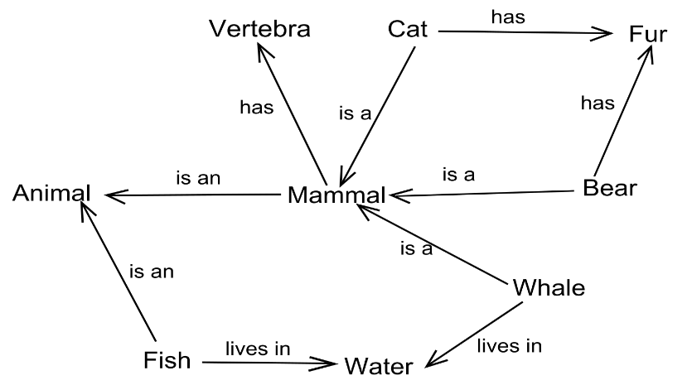
Common Sense Semantic Network
Source: https://en.wikipedia.org/?title=Semantic_network

Slide 12
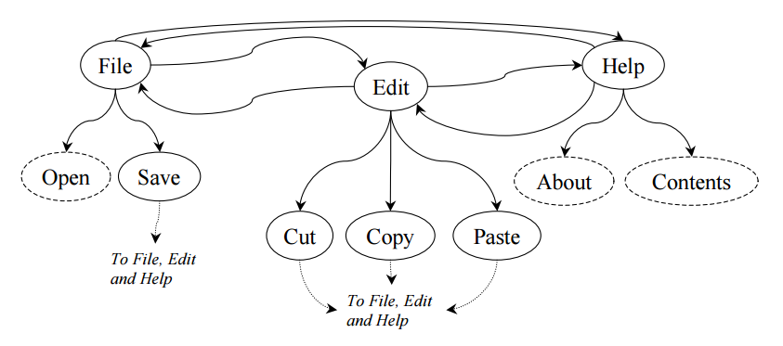
Common Sense Event-Flow Graph
Atif Memon, Mary Soffa, Martha Pollack, (2001)
“Coverage Criteria for GUI Testing”

Slide 13
Common Sense
Directed graphical structure
Node: a meaning of a screen
Edge: a meaning of an action
Weight: a quantized value of the importance
Note List: 10
Configure: 8
Configuration:
15
Open Note: 7
Note:
7

Slide 14
Common Sense Overlap
To present a common sense of multiple applications, we combine the common sense of each application.
Note List: 10
Search: 3
Search: 3
+
Note List: 15
→
Note: 5
Note: 5
Note List: 5
Send: 3
Send: 3

Slide 15
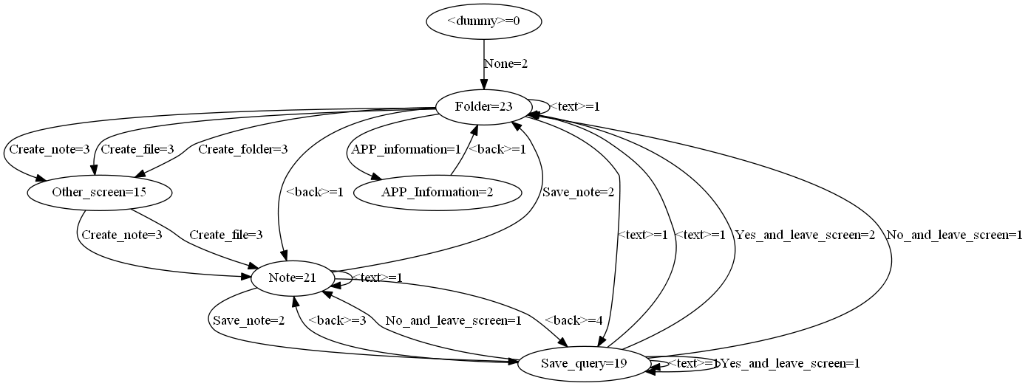
Common Sense Example

Slide 16
Normalized Term
Map different words and phrases into a normalized term.
“Create ZIP”, “Archive”, “壓縮”, etc.➔“Compress”
Define sets of normalized terms
For each kind of applications
For general functionalities and UI template.

Slide 17
SpecElicitor
A GUI tool to efficiently extract human concepts from an application.
A middleman between an application and a tester.
Producing a common sense model after a number of operations.

Slide 18
SpecElicitor Flow Chart
Execute
SpecElicitor
Give a
Verdict
Determine the
Screen
Snapshot
End?
Common Sense
Perform the
Action
Choose an
Action
Determine the
Action
Terminate

Slide 19
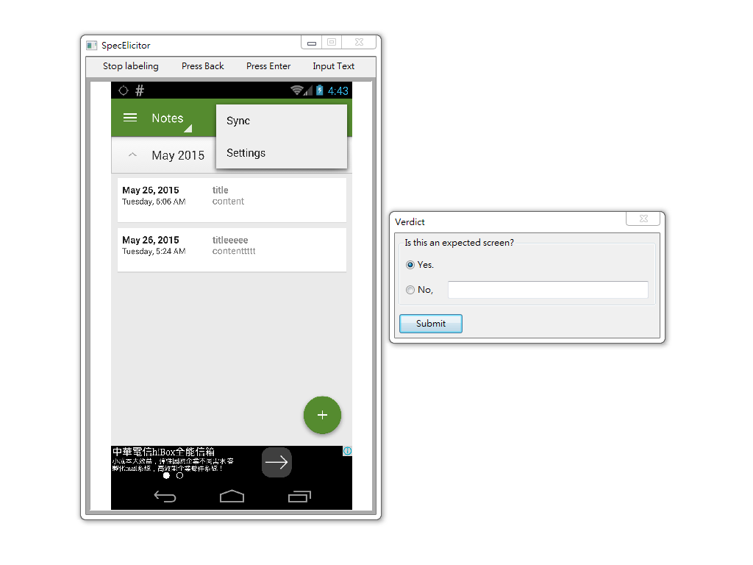
SpecElicitor GUI
Key Events
Text Input
Termination
Interactive Panel

Slide 20
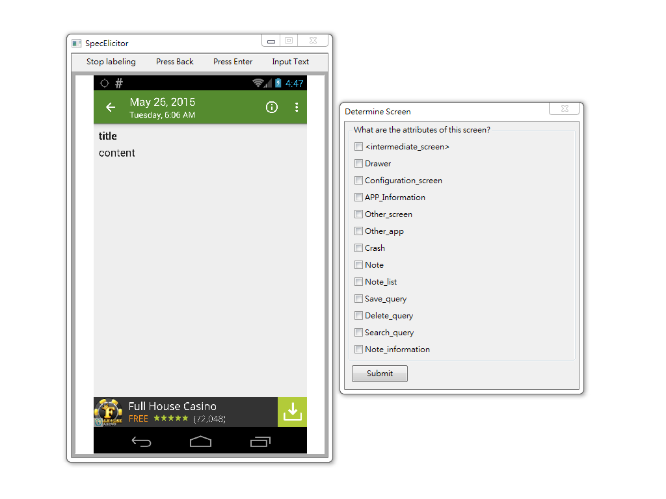
SpecElicitor Give a Verdict
Start App: 1
Verdict?
?

Slide 21
SpecElicitor Determine the Screen
Start App: 1
Verdict: Pass
Note List: 1

Slide 22
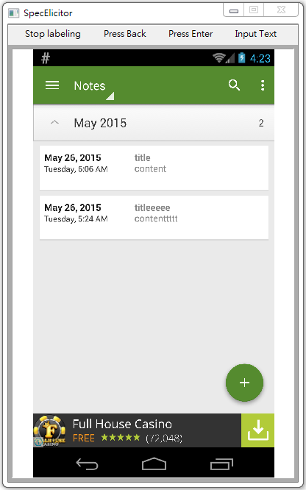
SpecElicitor Choose an Action or terminate
Start App: 1
Verdict: Pass
Note List: 1

Slide 23
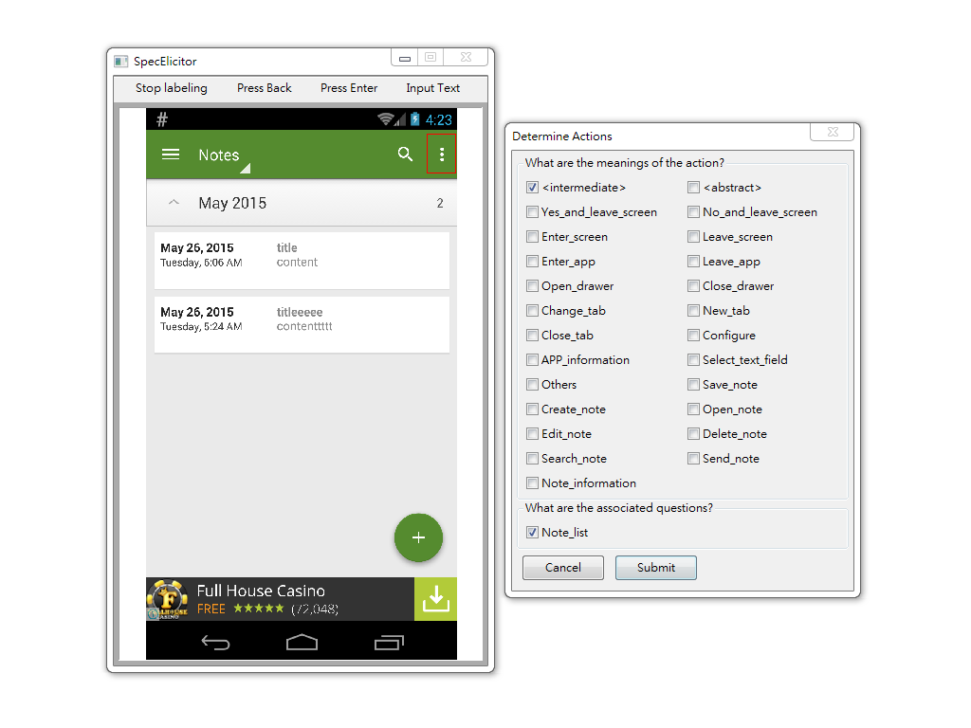
SpecElicitor Determine the Action
Start App: 1
Verdict: Pass
Note List: 1
Open Menu: 1

Slide 24
SpecElicitor Give a Verdict (Again)
Start App: 1
Verdict: Pass
Note List: 1
Open Menu: 1
Verdict?
?

Slide 25
Outline
Introduction
Related work
Common Sense and SpecElicitor
Application
Experiment
Conclusion

Slide 26
Test Case Generation
Find general behaviors of apps by overlapping models
Choose an action randomly from a node based on their weight.
Probability:
Open Note: 5/8
Search: 2/8
Configure: 1/8
Note List
Open Note: 5
Configure: 1
Search: 2

Slide 27
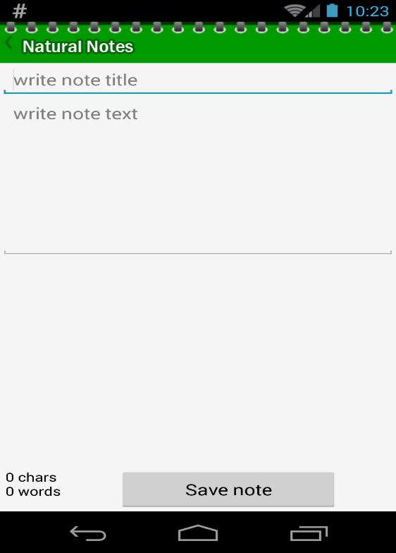
Test Case Generation
Leave Screen
Text
?
Note
Select Text Field
Save Note

Slide 28
Test Case Generation
Leave Screen
Leave Screen: 6
Text
Text: 9
Select Text Field
Select Text Field: 6
Save Note
Save Note: 7

Slide 29
Test Case Generation
?
Unknown

Slide 30
Test Case Evaluation
Crash
Failed transition
Invalid transition
Defect of the model
Note List
Open Note
Open Note
Open Note Verdict:Fail
Crash
Search Query
Note

Slide 31
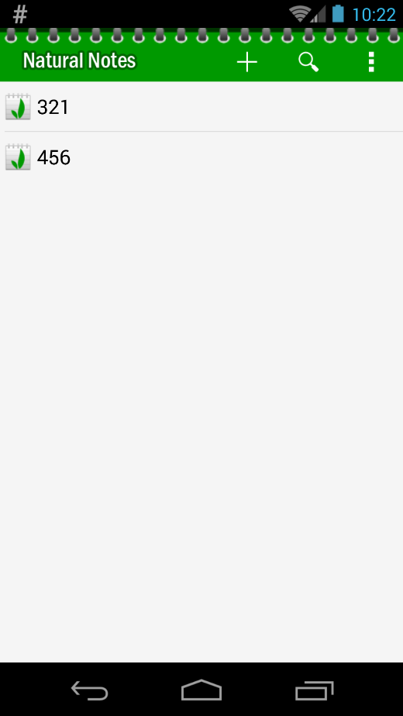

Test Case Evaluation
?
?
?

Slide 32
Test Case Evaluation
Open Note
Note List
Note
Passed

Slide 33
Outline
Introduction
Related work
Common Sense and SpecElicitor
Application
Experiment
Conclusion

Slide 34
Experiment
The results of evaluation.
The proportions of actions are in accordance with the distribution of weights of the actions.
A number of unidentifiable screens.

Slide 35
Experiment Implementation
Developed based on our Android testing framework
Programming Language and GUI Library
Python 3.4.3
wxPython Phoenix
AUT | Version | # of installed | Google Play Rate
Natural Notes | 2.9 | 100,000 – 500,000 | 4.0
Fo File Manager | 1.8.6 | 50,000 – 100,000 | 4.6
Omnidroid | 0.2.1 | N/A | N/A

Slide 36
Experiment Result
AUT | Crash | Failed Transition | Invalid Transition | Total Fail Traces | Total Traces
Natural Notes | 0 | 0 | 0 | 0 | 100
Fo File Manager | 0 | 0 | 0 | 0 | 100
Omnidroid | 12 | 0 | 0 | 12 | 100

Slide 37
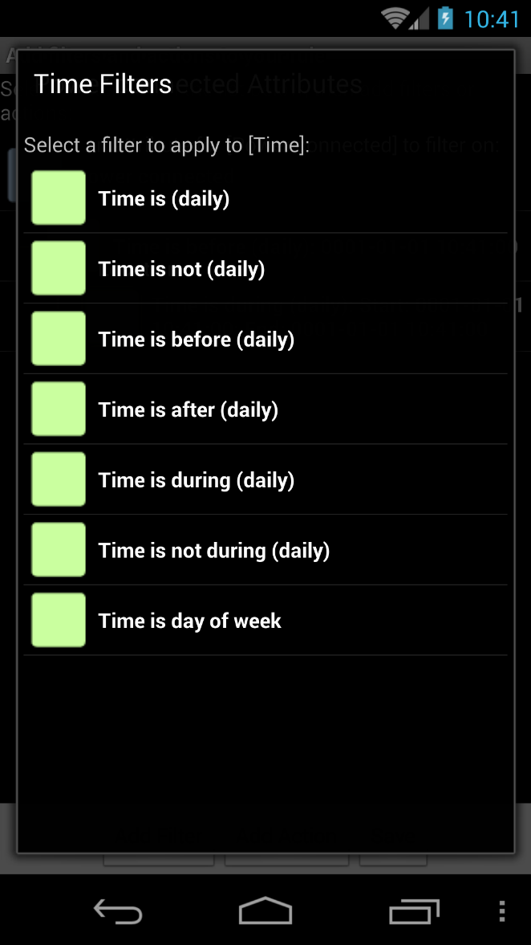
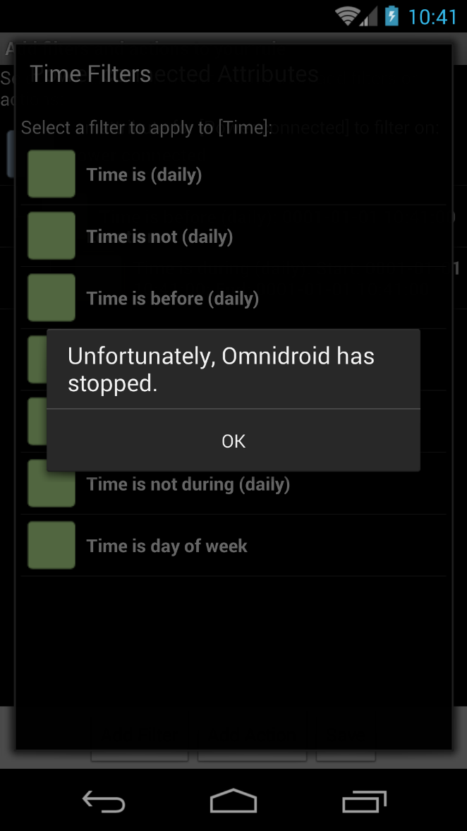
Experiment Omnidroid

Slide 38
Experiment Action Distribution

Slide 39
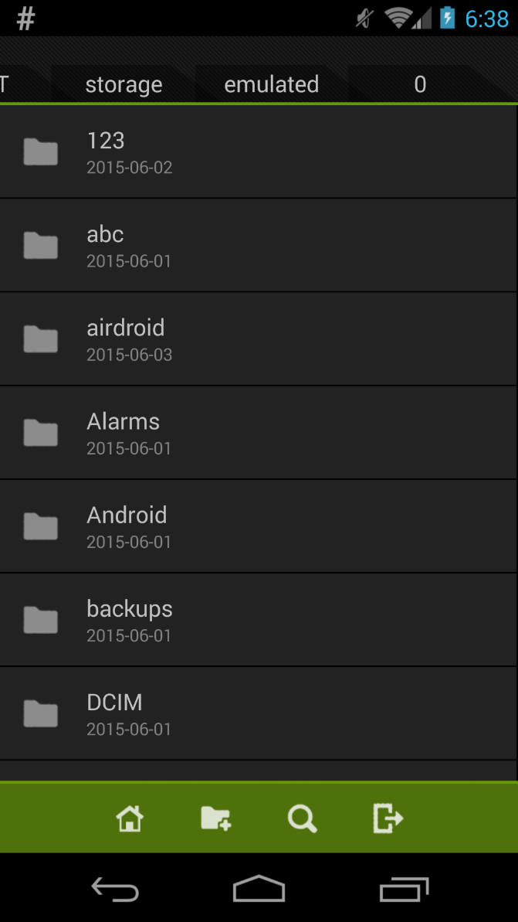
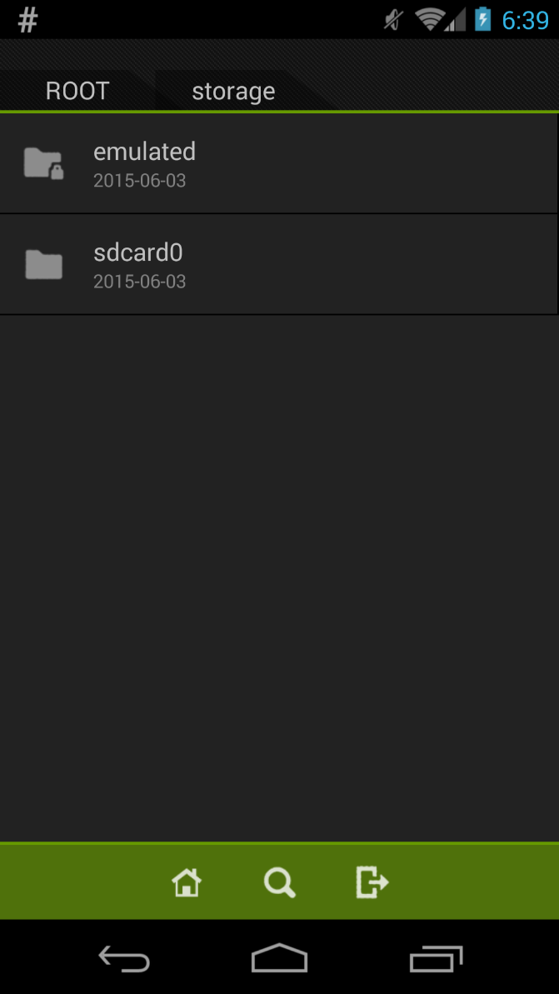
Experiment Action Distribution

Slide 40
Experiment Unidentifiable Screens

Slide 41
Outline
Introduction
Related work
Common Sense and SpecElicitor
Application
Experiment
Conclusion

Slide 42
Conclusion Summary
Introducing the human common sense into software testing.
A tool extracts human knowledge from a tester.
Generating and evaluating test cases by applying common sense models.
Limitation
Labor training and fault tolerance
Techniques for identification

Slide 43
Conclusion Future Works
Improvements of SpecElicitor
Test Case Generation
Meaningful sequence of inputs
Common Sense Model
Automatic identification and construction

Slide 44
Thank you !
Q&A

