Slide 1
📊 Advanced Business Analytics
Quarterly Performance Review
Presented by: Analytics Team Date: December 2024 Quarter: Q4

Slide 2
Executive Summary
Key Achievements This Quarter
• Revenue Growth: 15.2% increase
• Market Position: 2nd in industry
• Customer Satisfaction: 91.2%
• Target Achievement: 108.0%
p data-bid="b17">TechCorp Solutions continues to lead in innovation and customer satisfaction./p>

Slide 3
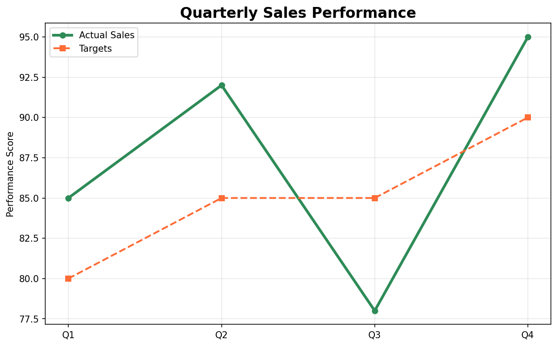
Sales Performance Analysis
Our quarterly sales performance shows consistent improvement:

Slide 4
Key Insights
• Q4 exceeded targets by 5.6%
• Average performance: 87.5%
• Trend is positive across all quarters

Slide 5
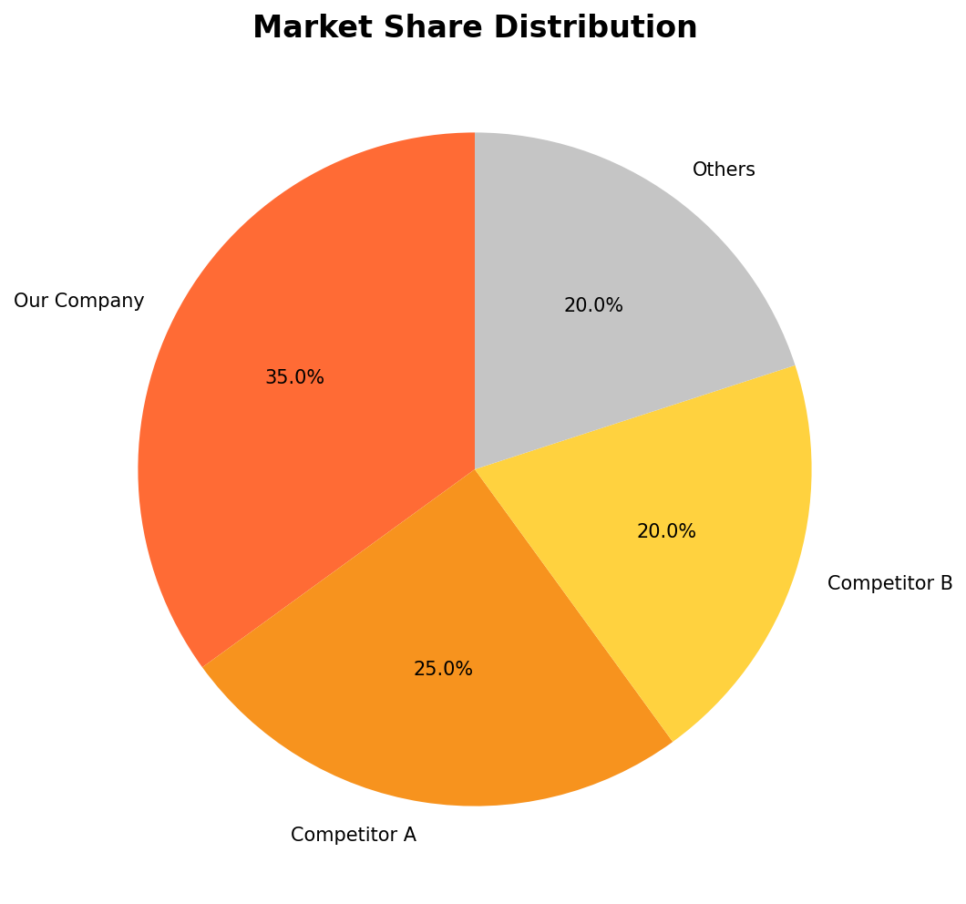
Market Position
Our market share remains strong in the competitive landscape:
Strategic Advantages

Slide 6
1. Market Leader: 35% market share
2. Strong brand recognition
3. Customer loyalty: 84.7%

Slide 7
Regional Performance Analysis
Performance by Region
Region | Revenue | Growth | Satisfaction
North | 1200000 | 12.5 | 4.2
East | 1100000 | 15.2 | 4.5
South | 950000 | 8.3 | 3.8
West | 800000 | 6.7 | 3.6
Regional Insights
• North leads in revenue with $1.20M
• East shows highest growth at 15.2%
• West region requires attention for growth improvement

Slide 8
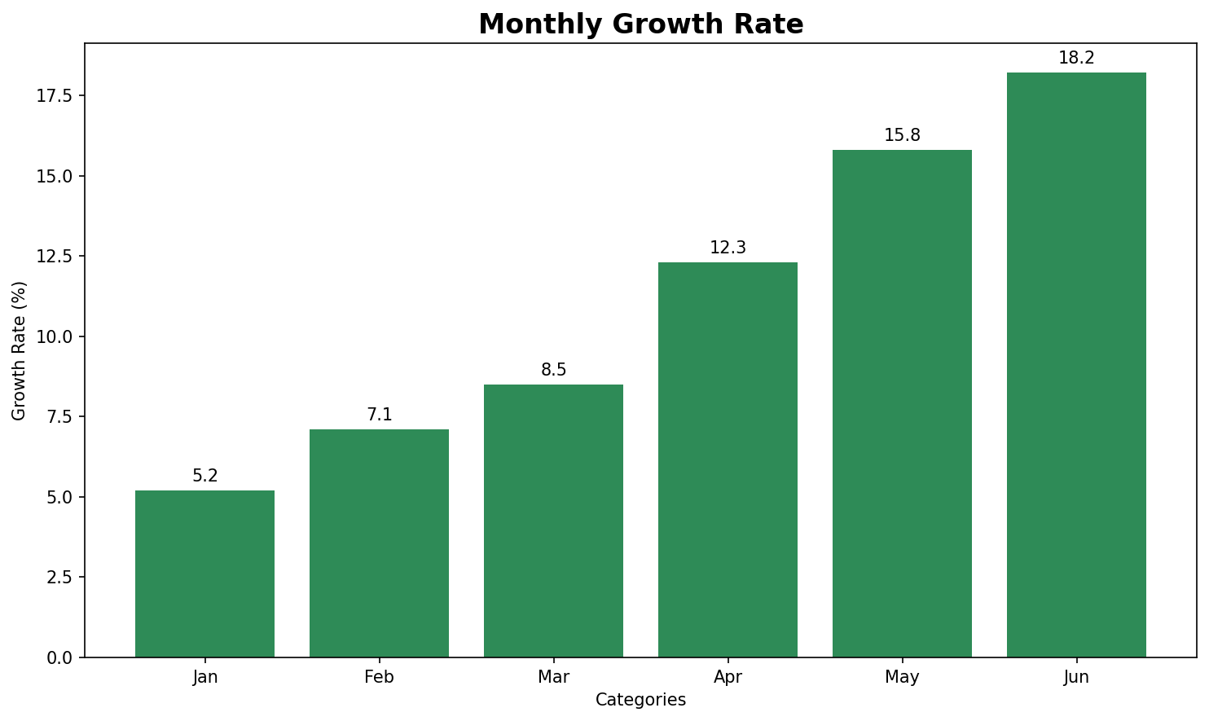
Growth Trajectory
Monthly Growth Analysis

Slide 9
Growth Drivers
• Product Innovation: 32.0% impact
• Market Expansion: 28.0% contribution
• Customer Acquisition: 15.0% new customers
Sustained growth expected into next quarter

Slide 10
Comprehensive Overview
Performance Metrics
Quarterly Summary
Quarter | Sales | Target | Performance
Q1 | 85 | 80 | Good
Q2 | 92 | 85 | Excellent
Q3 | 78 | 85 | Fair
Q4 | 95 | 90 | Excellent
Status: On Track
Key Highlights:
• Revenue: $4.05M
• Growth: 12.6%

Slide 11
Action Items & Next Steps
Immediate Actions
1. Implement growth strategy
2. Target: 10.0% improvement
Success Metrics
• Overall growth target: 18.0%
• Customer satisfaction: 95.0%
• Market share goal: 38%

Slide 12
Inline Formatting Test
This slide tests various inline formatting options:
• Bold text and italic text
• Red text and Blue text
• Regular underline with underline
• Wavy underlined text using double caret for emphasized information
• Strikethrough text for deleted content
• Highlighted text for important notes
All formatting should render correctly in both HTML and PowerPoint.

