Slide 1
Business Analytics Report
Q4 2024 Performance Review
Prepared by: Data Science Team Date: December 2024
This presentation covers our quarterly performance metrics, growth trends, and customer insights.

Slide 2
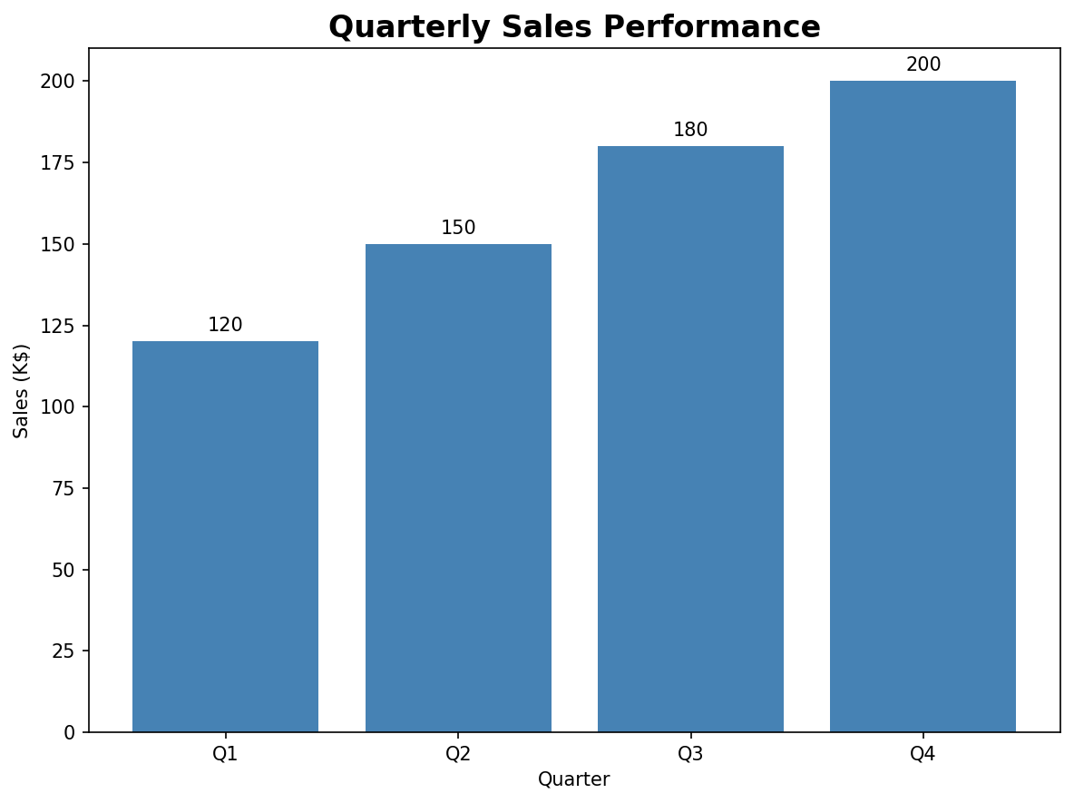
Quarterly Sales Performance
Our sales team has shown consistent growth throughout the year:

Slide 3
Key Insights:
• Q4 achieved highest sales at $200K
• 67% growth from Q1 to Q4
• Exceeded annual target by 15%

Slide 4
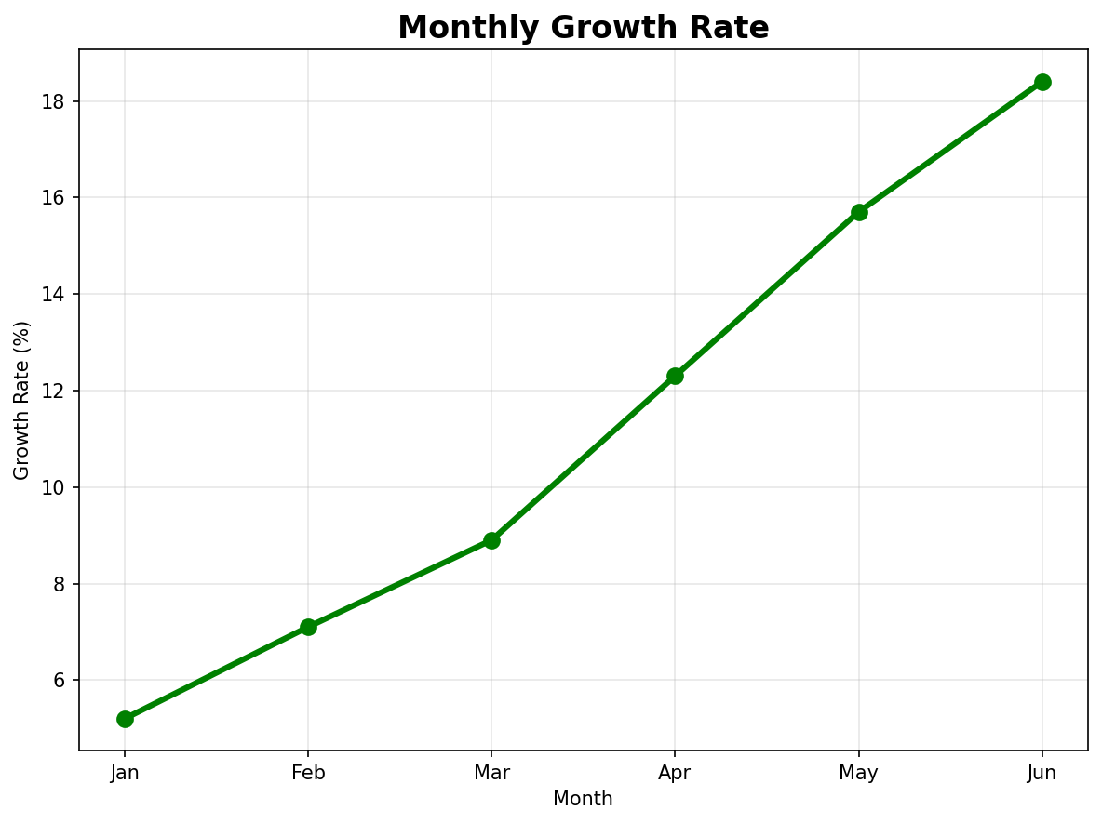
Monthly Growth Analysis
The growth trajectory shows strong momentum:

Slide 5
Growth Highlights:
• Consistent month-over-month improvement
• Peak growth of 18.4% in June
• Average monthly growth: 11.3%

Slide 6
Customer Insights
Satisfaction vs Loyalty Analysis

Slide 7
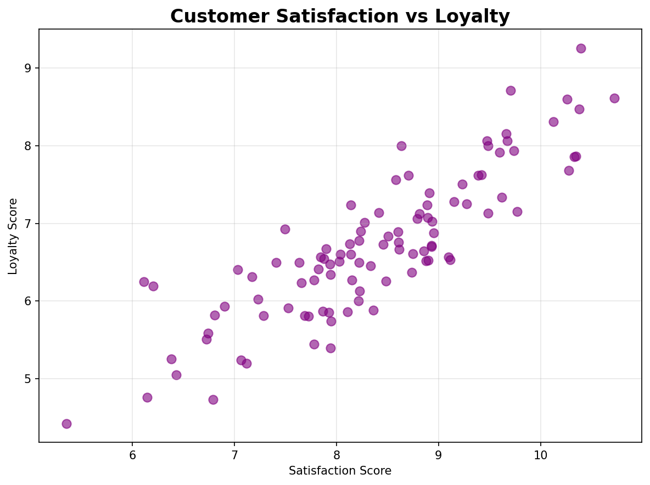

Slide 8
Regional Performance
Region | Customers | Satisfaction | Retention
North | 1250 | 8.7 | 94%
South | 980 | 8.2 | 89%
East | 1100 | 8.5 | 91%
West | 750 | 7.9 | 86%
Key Findings:
• Strong correlation between satisfaction and loyalty
• North region leads in customer retention
• West region shows highest growth potential

Slide 9
Market Share Analysis
Product Portfolio Performance

Slide 10
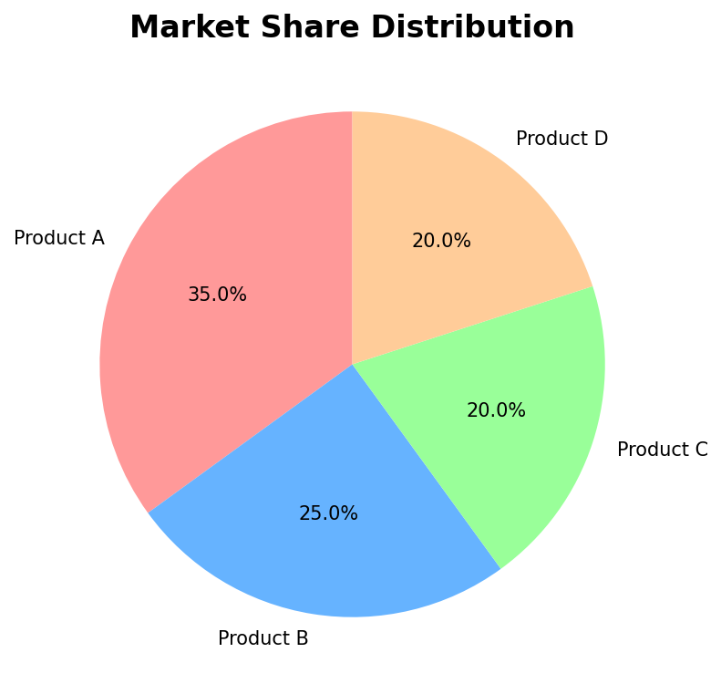

Slide 11
Product Performance:
• Product A maintains market leadership
• Product B shows strong competitive position
• Products C & D have equal market share
• Total market coverage: 100%

Slide 12
Financial Projections
Revenue Growth Model
Our revenue follows the exponential growth model:
Where:
• = Initial revenue
• = Growth rate
• = Time period
Projected Revenue for 2025:
Given our current growth rate of $r = 0.15$, we project:
This represents a 504% increase from our current baseline.

Slide 13
Investment Analysis
Portfolio Performance
Asset | Weight | Return | Risk
Stocks | 60% | 8.5% | 15.2%
Bonds | 30% | 4.2% | 6.8%
REITs | 10% | 6.8% | 12.1%
Risk Assessment
The portfolio risk can be calculated using:
Current Portfolio Risk: $\sigma_p = 12.3\%$

Slide 14
Key Takeaways
Summary of Results
1. Strong Financial Performance
1. Q4 sales exceeded targets
2. Consistent growth trajectory
3. Positive customer feedback
2. Market Position
1. Leading market share in Product A
2. Balanced portfolio across regions
3. High customer satisfaction scores
3. Future Outlook
1. Projected 504% revenue growth
2. Low portfolio risk (12.3%)
3. Continued expansion opportunities
Next Steps
• Expand into West region
• Invest in Product B development
• Maintain customer satisfaction initiatives

