Slide 1
📊 Advanced Business Analytics (1/4)
Quarterly Performance Review
Presented by: Analytics Team Date: December 2024 Quarter: Q4

Slide 2
Executive Summary (2/4)
Key Achievements This Quarter
• Revenue Growth: 15.2% increase
• Market Position: 2nd in industry
• Customer Satisfaction: 91.2%
• Target Achievement: 108.0%
p data-bid="b17">TechCorp Solutions continues to lead in innovation and customer satisfaction./p>

Slide 3
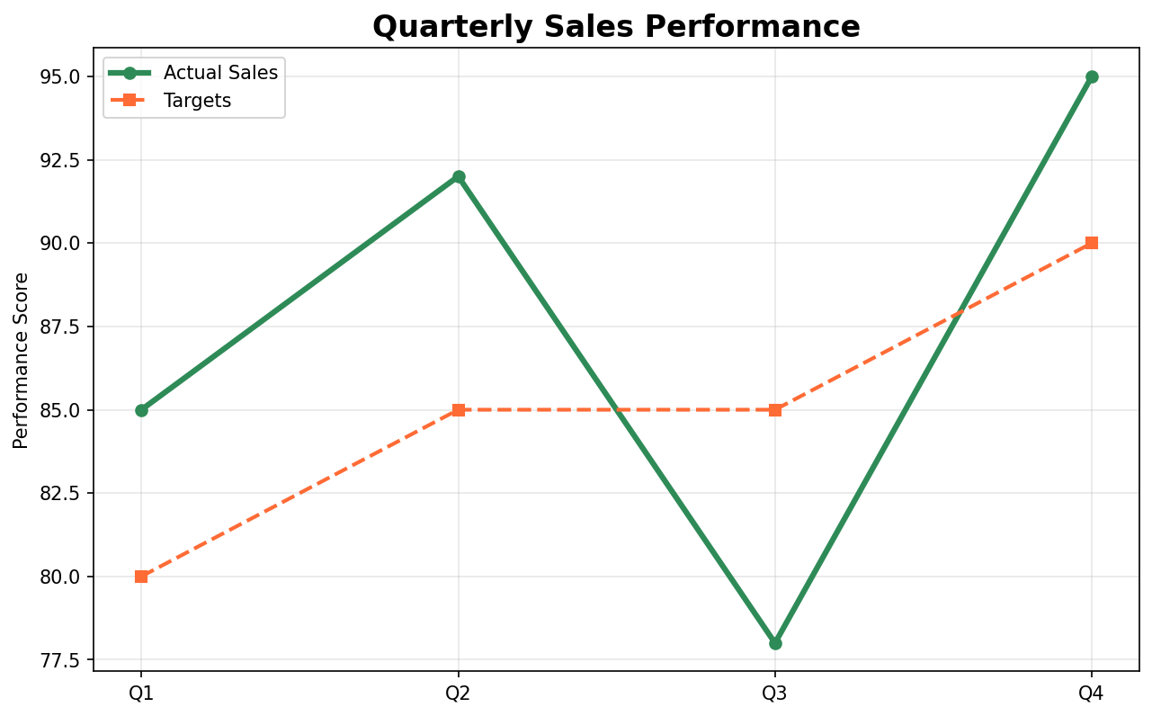
Sales Performance Analysis
Our quarterly sales performance shows consistent improvement:
Quarterly sales performance vs targets showing steady improvement
Key Insights
• Q4 exceeded targets by 5.6%
• Average performance: 87.5%
• Trend is positive across all quarters

Slide 4
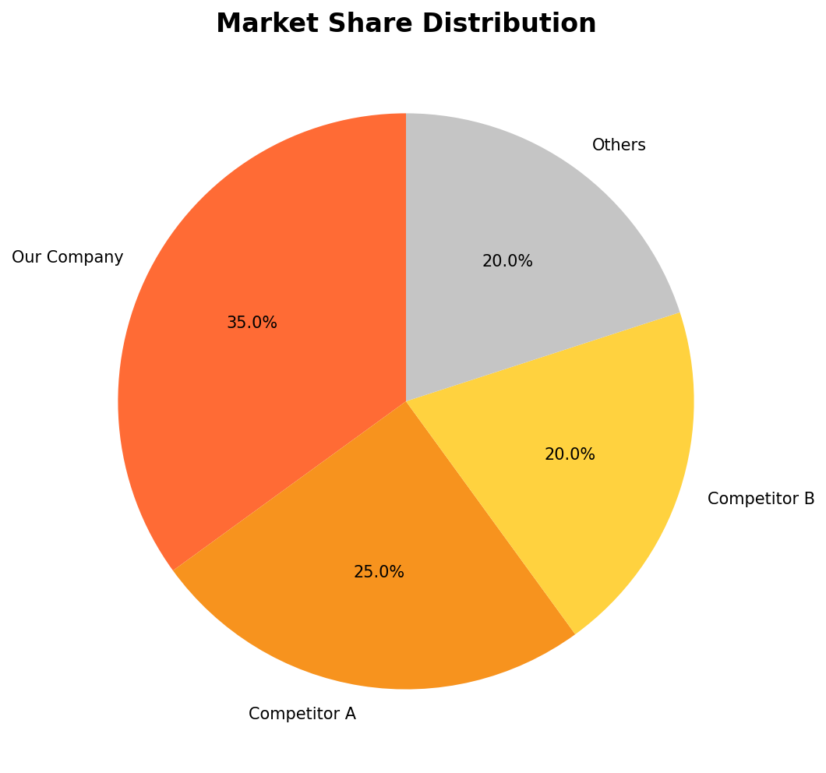
Market Position
Our market share remains strong in the competitive landscape:
Current market share distribution showing our leadership position
Strategic Advantages
1. Market Leader: 35% market share
2. Strong brand recognition
3. Customer loyalty: 84.7%

Slide 5
Regional Performance Analysis (1/3)
Performance by Region
Region | Revenue | Growth | Satisfaction
North | 1200000 | 12.5 | 4.2
East | 1100000 | 15.2 | 4.5
South | 950000 | 8.3 | 3.8
West | 800000 | 6.7 | 3.6
Regional Insights
• North leads in revenue with $1.20M
• East shows highest growth at 15.2%
• West region requires attention for growth improvement

Slide 6
Advanced Table Styling (●●○)
Financial Performance with Row Styling
Metric | Q1 | Q2 | Q3 | Q4
Revenue | $2.15M | $2.84M | $3.12M | $3.75M
Profit | 320000.0 | 445000.0 | 512000.0 | 680000.0
Growth Rate | 0.125 | 0.087 | 0.156 | 0.203
Market Rank | 3.0 | 2.0 | 1.0 | 1.0
Key Features Demonstrated
• Row styling: Revenue row (index 0) automatically formatted as currency
• Clean numeric formatting without conflicts
• Green styling applied to entire revenue row
This demonstrates basic row-based numeric styling.

Slide 7
Advanced Table Styling (●●●)
Financial Performance with Column Styling
 | Q1 | Q2 | Q3 | Q4
Revenue | 2150000.0% | 2.84e+06 | 3.12e+06 | $3.75M
Profit | 320000.0% | 445000 | 512000 | $680.00K
Growth Rate | 12.5% | 0.087 | 0.156 | $0
Market Rank | 3.0% | 2 | 1 | $1
Key Features Demonstrated
• Column styling: Q1 column as percentages and Q4 as currency
• Index displayed to show meaningful row labels (Revenue, Profit, etc.)
• Column-specific formatting applied correctly
This demonstrates column-based styling with visible index.

Slide 8
Advanced Table Styling (●●●●)
Financial Performance with Conditional Rules
Metric | Q1 | Q2 | Q3 | Q4
Revenue | 2.15e+06 | 2.84e+06 | 3.12e+06 | 3.75e+06
Profit | 320000 | 445000 | 512000 | 680000
Growth Rate | 0.125 | 0.087 | 0.156 | 0.203
Market Rank | 3 | 2 | 1 | 1
Key Features Demonstrated
• Lambda rules: Rows where Q4 > Q3 get green bold formatting
• Conditional styling based on row data comparisons
• Clean rule application without style conflicts
This demonstrates string-based conditional formatting rules.

Slide 9
Advanced Table Styling (●●●●●)
Financial Performance with Cell Highlighting
Metric | Q1 | Q2 | Q3 | Q4
Revenue | 2150000.0 | 2.84e+06 | 3.12e+06 | 3750000.0
Profit | 320000.0 | 445000 | 512000 | 680000.0
Growth Rate | 0.125 | 0.087 | 0.156 | 0.203
Market Rank | 3.0 | 2 | 1 | 1.0
Key Features Demonstrated
• Cell highlighting: Specific cells get targeted styling
• Profit Q4 (row 1, Q4 column): bold blue
• Growth Rate Q1 (row 2, Q1 column): red italic
• Precise cell-level control
This demonstrates precise cell-level highlighting.

Slide 10
Advanced Table Styling (●●●●●●)
Smart Index Auto-Detection
Metric | Q1 | Q4
Revenue | 2150000.0 | 3750000.0
Profit | 320000.0 | 680000.0
Growth Rate | 0.125 | 0.203
Market Rank | 3.0 | 1.0
Key Features Demonstrated
• Smart index: Automatically detected 'Metric' column as meaningful index
• String-based highlighting: Reference rows by name, not position
• Revenue Q4: green bold
• Market Rank Q1: red italic
• No need to manually set_index() or worry about dropindex
This demonstrates automatic index detection for better user experience.

Slide 11
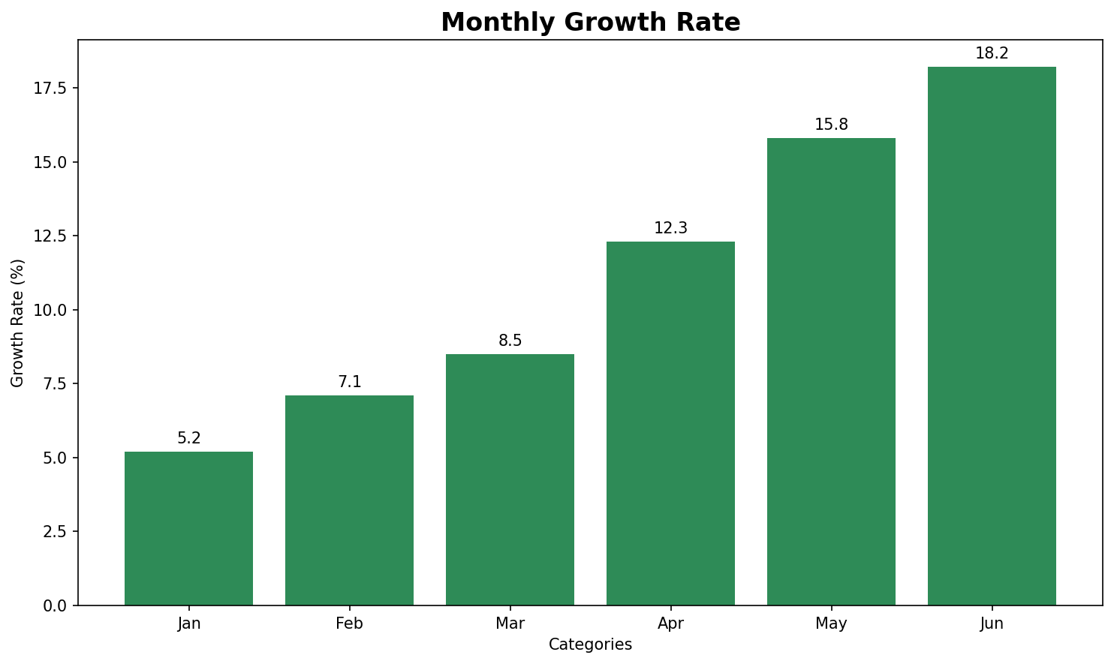
Growth Trajectory
Monthly Growth Analysis
Monthly growth rate showing accelerating trend throughout the year
Growth Drivers
• Product Innovation: 32.0% impact
• Market Expansion: 28.0% contribution
• Customer Acquisition: 15.0% new customers

Slide 12
Sustained growth expected into next quarter

Slide 13
Comprehensive Overview (1/2)
Performance Metrics
Quarterly Summary
Quarter | Sales | Target | Performance
Q1 | 85 | 80 | Good
Q2 | 92 | 85 | Excellent
Q3 | 78 | 85 | Fair
Q4 | 95 | 90 | Excellent
Status: On Track
Performance overview
Key Highlights:
• Revenue: $4.05M
• Growth: 12.6%

Slide 14
Action Items & Next Steps (●●)
Immediate Actions
1. Implement growth strategy
2. Target: 10.0% improvement
Success Metrics
• Overall growth target: 18.0%
• Customer satisfaction: 95.0%
• Market share goal: 38%

Slide 15
Inline Formatting Test
This slide tests various inline formatting options:
• Bold text and italic text
• Red text and Blue text
• Regular underline with underline
• Wavy underlined text using double caret for emphasized information
• Strikethrough text for deleted content
• Highlighted text for important notes
All formatting should render correctly in both HTML and PowerPoint.

