Slide 1
📊 Advanced Business Analytics (1/4)
Quarterly Performance Review
Presented by: Analytics Team Date: December 2024 Quarter: Q4

Slide 2
Executive Summary (2/4)
Key Achievements This Quarter
• Revenue Growth: 15.2% increase
• Market Position: 2nd in industry
• Customer Satisfaction: 91.2%
• Target Achievement: 108.0%
p data-bid="b17">TechCorp Solutions continues to lead in innovation and customer satisfaction./p>

Slide 3
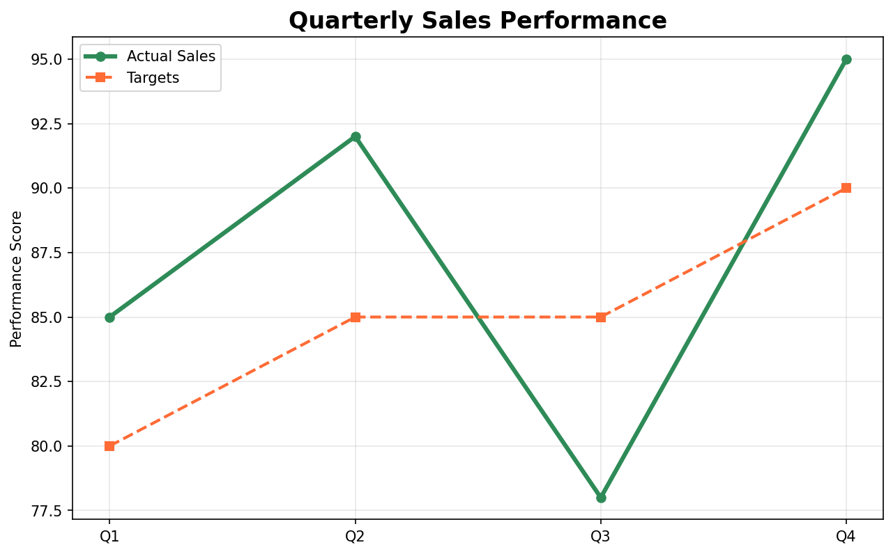
Sales Performance Analysis
Our quarterly sales performance shows consistent improvement:
Quarterly sales performance vs targets showing steady improvement

Slide 4
Key Insights
• Q4 exceeded targets by 5.6%
• Average performance: 87.5%
• Trend is positive across all quarters

Slide 5
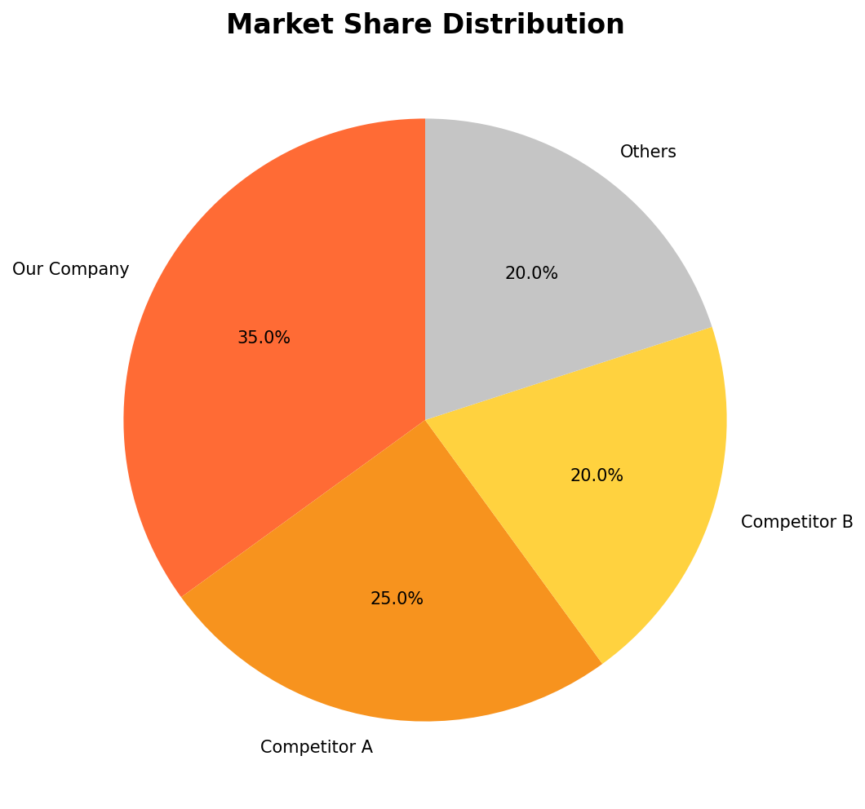
Market Position
Our market share remains strong in the competitive landscape:
Current market share distribution showing our leadership position
Strategic Advantages
1. Market Leader: 35% market share
2. Strong brand recognition
3. Customer loyalty: 84.7%

Slide 6
Regional Performance Analysis (1/3)
Performance by Region
Region | Revenue | Growth | Satisfaction
North | 1200000 | 12.5 | 4.2
East | 1100000 | 15.2 | 4.5
South | 950000 | 8.3 | 3.8
West | 800000 | 6.7 | 3.6
Regional Insights
• North leads in revenue with $1.20M
• East shows highest growth at 15.2%
• West region requires attention for growth improvement

Slide 7
Advanced Table Styling (●●○)
Financial Performance with Row Styling
Metric | Q1 | Q2 | Q3 | Q4
Revenue | $2.15M | $2.84M | $3.12M | $3.75M
Profit | 320000.0 | 445000.0 | 512000.0 | 680000.0
Growth Rate | 0.125 | 0.087 | 0.156 | 0.203
Market Rank | 3.0 | 2.0 | 1.0 | 1.0
Key Features Demonstrated
• Row styling: Revenue row (index 0) automatically formatted as currency
• Clean numeric formatting without conflicts
• Green styling applied to entire revenue row
This demonstrates basic row-based numeric styling.

Slide 8
Advanced Table Styling (●●●)
Financial Performance with Column Styling
 | Q1 | Q2 | Q3 | Q4
Revenue | 2150000.0% | 2.84e+06 | 3.12e+06 | $3.75M
Profit | 320000.0% | 445000 | 512000 | $680.00K
Growth Rate | 12.5% | 0.087 | 0.156 | $0
Market Rank | 3.0% | 2 | 1 | $1
Key Features Demonstrated
• Column styling: Q1 column as percentages and Q4 as currency
• Index displayed to show meaningful row labels (Revenue, Profit, etc.)
• Column-specific formatting applied correctly
This demonstrates column-based styling with visible index.

Slide 9
Advanced Table Styling (●●●●)
Financial Performance with Conditional Rules
Metric | Q1 | Q2 | Q3 | Q4
Revenue | 2.15e+06 | 2.84e+06 | 3.12e+06 | 3.75e+06
Profit | 320000 | 445000 | 512000 | 680000
Growth Rate | 0.125 | 0.087 | 0.156 | 0.203
Market Rank | 3 | 2 | 1 | 1
Key Features Demonstrated
• Lambda rules: Rows where Q4 > Q3 get green bold formatting
• Conditional styling based on row data comparisons
• Clean rule application without style conflicts
This demonstrates string-based conditional formatting rules.

Slide 10
Advanced Table Styling (●●●●●)
Financial Performance with Cell Highlighting
Metric | Q1 | Q2 | Q3 | Q4
Revenue | 2150000.0 | 2.84e+06 | 3.12e+06 | 3750000.0
Profit | 320000.0 | 445000 | 512000 | 680000.0
Growth Rate | 0.125 | 0.087 | 0.156 | 0.203
Market Rank | 3.0 | 2 | 1 | 1.0
Key Features Demonstrated
• Cell highlighting: Specific cells get targeted styling
• Profit Q4 (row 1, Q4 column): bold blue
• Growth Rate Q1 (row 2, Q1 column): red italic
• Precise cell-level control
This demonstrates precise cell-level highlighting.

Slide 11
Advanced Table Styling (●●●●●●)
Smart Index Auto-Detection
Metric | Q1 | Q4
Revenue | 2150000.0 | 3750000.0
Profit | 320000.0 | 680000.0
Growth Rate | 0.125 | 0.203
Market Rank | 3.0 | 1.0
Key Features Demonstrated
• Smart index: Automatically detected 'Metric' column as meaningful index
• String-based highlighting: Reference rows by name, not position
• Revenue Q4: green bold
• Market Rank Q1: red italic
• No need to manually set_index() or worry about dropindex
This demonstrates automatic index detection for better user experience.

Slide 12
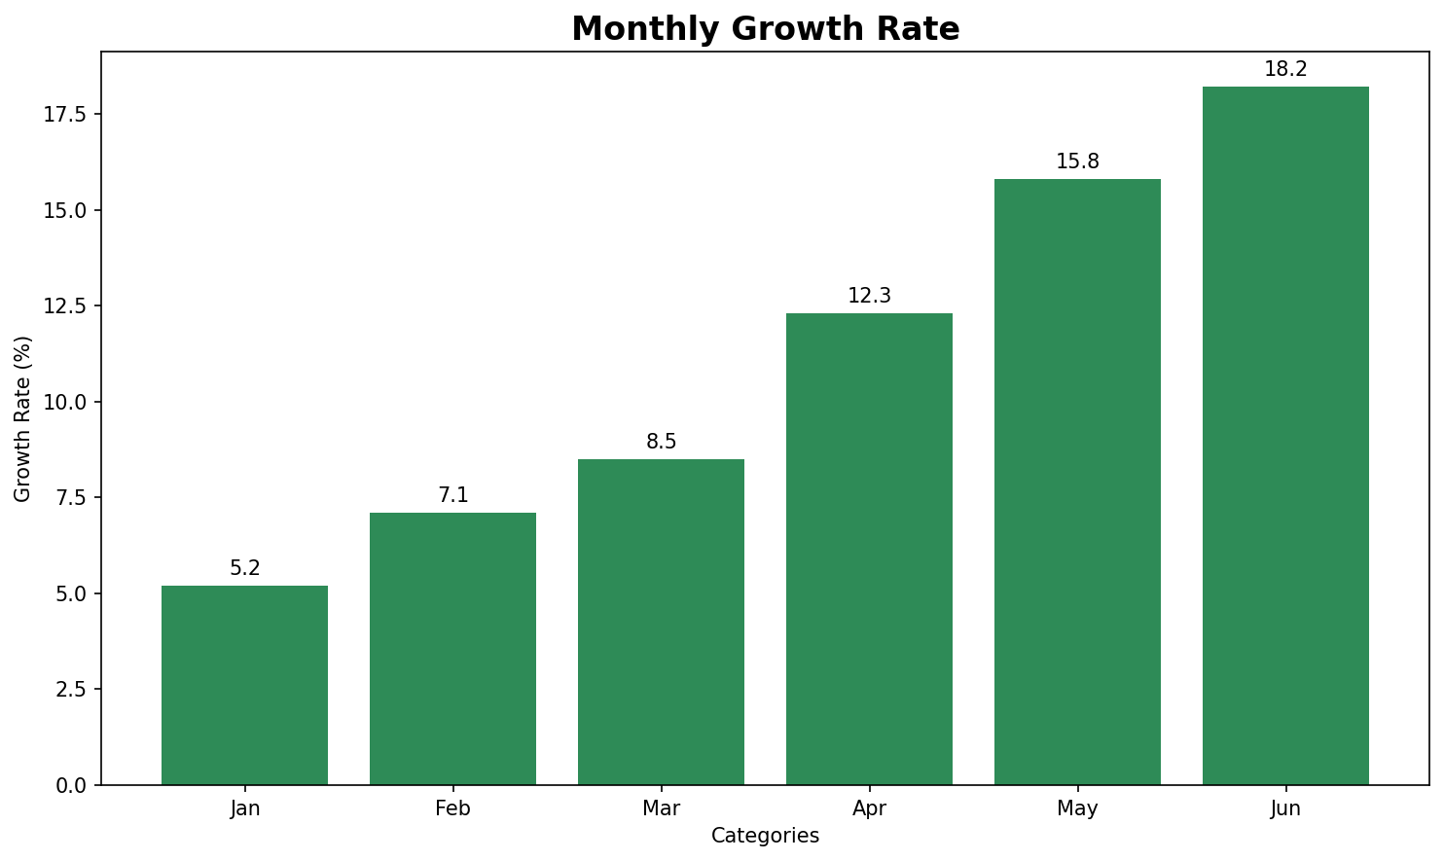
Growth Trajectory
Monthly Growth Analysis

Slide 13
Monthly growth rate showing accelerating trend throughout the year
Growth Drivers
• Product Innovation: 32.0% impact
• Market Expansion: 28.0% contribution
• Customer Acquisition: 15.0% new customers
Sustained growth expected into next quarter

Slide 14
Comprehensive Overview (1/2)
Performance Metrics
Quarterly Summary
Quarter | Sales | Target | Performance
Q1 | 85 | 80 | Good
Q2 | 92 | 85 | Excellent
Q3 | 78 | 85 | Fair
Q4 | 95 | 90 | Excellent
Status: On Track
Performance overview
Key Highlights:
• Revenue: $4.05M
• Growth: 12.6%

Slide 15
Action Items & Next Steps (●●)
Immediate Actions
1. Implement growth strategy
2. Target: 10.0% improvement
Success Metrics
• Overall growth target: 18.0%
• Customer satisfaction: 95.0%
• Market share goal: 38%

Slide 16
Inline Formatting Test
This slide tests various inline formatting options:
• Bold text and italic text
• Red text and Blue text
• Regular underline with underline
• Wavy underlined text using double caret for emphasized information
• Strikethrough text for deleted content
• Highlighted text for important notes
All formatting should render correctly in both HTML and PowerPoint.
Notes:
This slide demonstrates comprehensive inline formatting capabilities. Key points to cover: bold/italic basics, color customization, various underline styles, and highlighting for emphasis.

Slide 17
🎤 Advanced Demo - Speaker Notes Demo
This demonstrates speaker notes functionality with various styling and template integration.
Key features to highlight:
• Template variables work with speaker notes: 95.0%
• Bold emphasis for important points
• Links to documentation for reference
The TechCorp Solutions team has achieved excellent results this quarter.
Notes:
Template variables in speaker notes also work: 95.0% success rate. Remember to emphasize the speaker notes functionality capabilities and mention the TechCorp Solutions achievements. This slide showcases both speaker notes and template variable parsing working together seamlessly.

