Slide 1
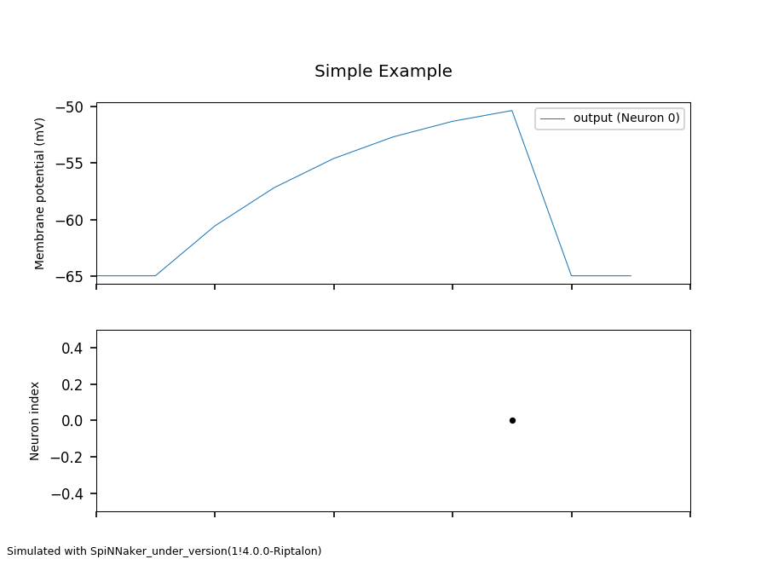
Action potential building up
Spike at time t=7

