Slide 1
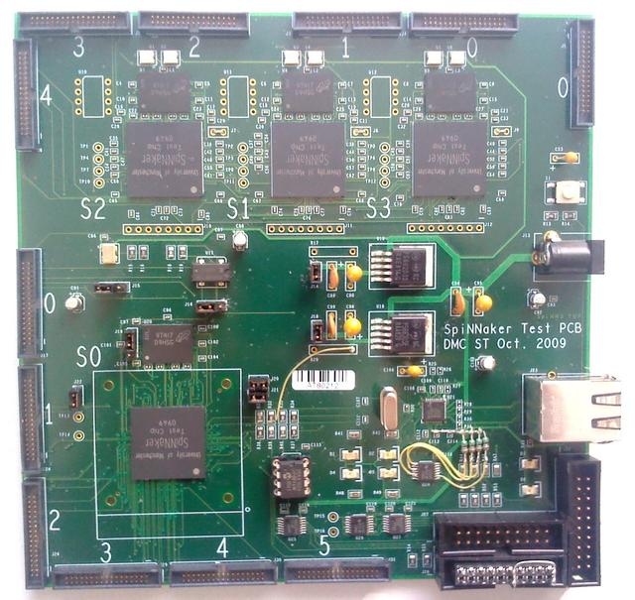
LEDs (for debugging)
128MB DDR SDRAM
(coupled to chip)
SpiNNaker chip
(w/ 2 ARM968 cores)
Reset button
Power supply
Ball Grid Array (BGA) (socket to change the chip mounted)
Ethernet interface (host machine communication)
SpiNNaker link connectors
(chain boards to run simulations)
JTAG interface
(chaining boards for software debugging)

