Slide 1
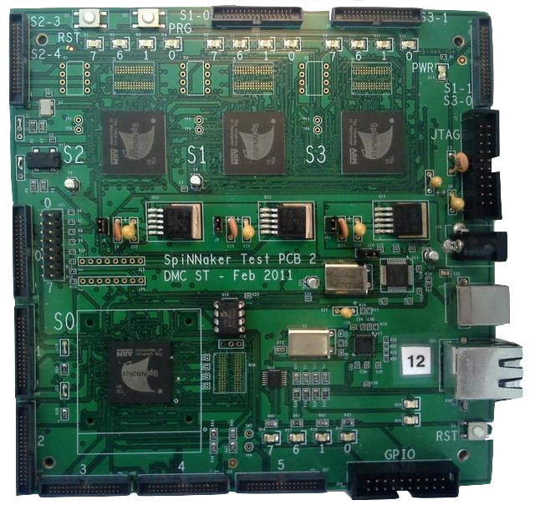
Empty DDR slots
(as backup in case in-package DDR failed)
LEDs (for debugging)
SpiNNaker chip
18 ARM968 cores
128MB DDR SDRAM
JTAG interface
(chaining boards for software debugging)
Power supply
USB interface
(for remote reset)
Ball Grid Array (BGA) (socket to change the chip mounted)
Ethernet interface (host machine communication)
SpiNNaker link connectors
(chain boards to run simulations)
Reset button

