Slide 1
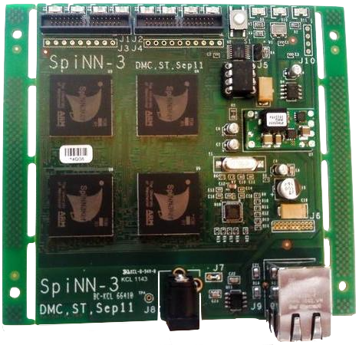
LEDs (2 per chip)
LEDs (board state)
Reset button
SpiNNaker link connectors
(chain boards to run simulations)
JTAG interface
(chaining boards for software debugging)
SpiNNaker chip
18 ARM968 cores
128MB DDR SDRAM
Power supply
Ethernet interface (host machine communication)

