Slide 1
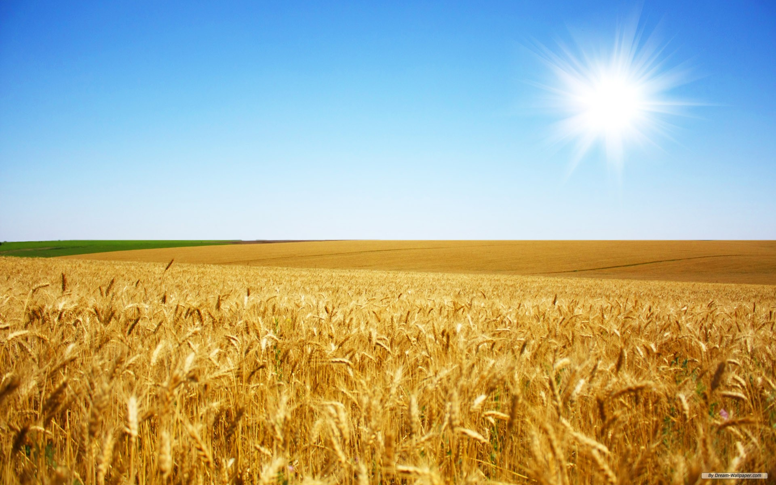

Farm 4.0: Technologies for smart agriculture
Carmen Fernandez Uriarte
Francisco Varandas de Sousa
Gergely Patonay
Jasper Soetemans
Louise Loesch
Raquel Ruiz de la Reina

Slide 2
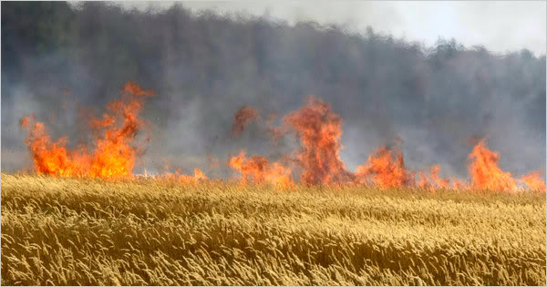
SAFA
Smart Agricultural Fire Alarm

Slide 3

Alert for fire hazard
Dry and warm climate:
Spain
Portugal
Italy
USA
…

Slide 4
Causes and clues
Low humidity (<30%)
High temperature (>30°C)
Smoke detected
Flames spotted

Slide 5
Sensors
Humiture sensor (Humidity and temperature)
MQ-2 gas sensor
Flame sensor

Slide 6
Applications
Drone
Robot
Automatic watering

Slide 7
Alert farmer
LED
Green: no hazard and no air pollution
Orange: hazard
Red: Fire and air polluted
Buzzer (fire)

Slide 8
Improvements
Ir camera
Wind sensor
Localisation of fire
Weather forecast

Slide 9
Questions?
Thanks for listening

