Slide 1
High energy states in superconducting cavity quantum electrodynamics
Louise McCann
Supervisor: Eran Ginossar

Slide 2
Introduction
Semiconducting circuits
Qubits
Josephson Junction
Cooper pairs

Slide 3
Methods
Analytical computing
Numerical calculations
Mathieu equations

Slide 4
Key Ideas
Hamiltonian of system
Charge operator
Coupled states

Slide 5
Key Ideas
Energy formula
Wavefunction formula

Slide 6
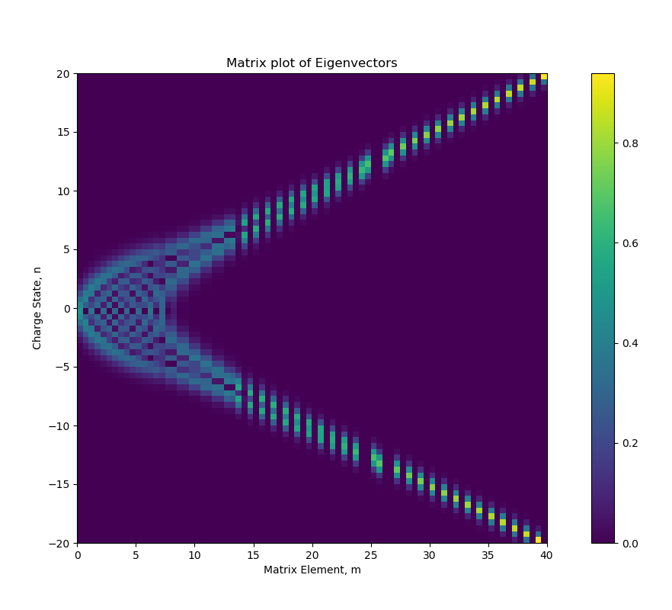
Results

Slide 7
eigenvalues
Koch
Cottett
Python/mathematica

Slide 8
Wavefuntion/Probability distrobution

Slide 9
Conclusion

