Slide 1
High energy states in superconducting cavity quantum electrodynamics
Louise McCann
Supervisor: Eran Ginossar

Slide 2
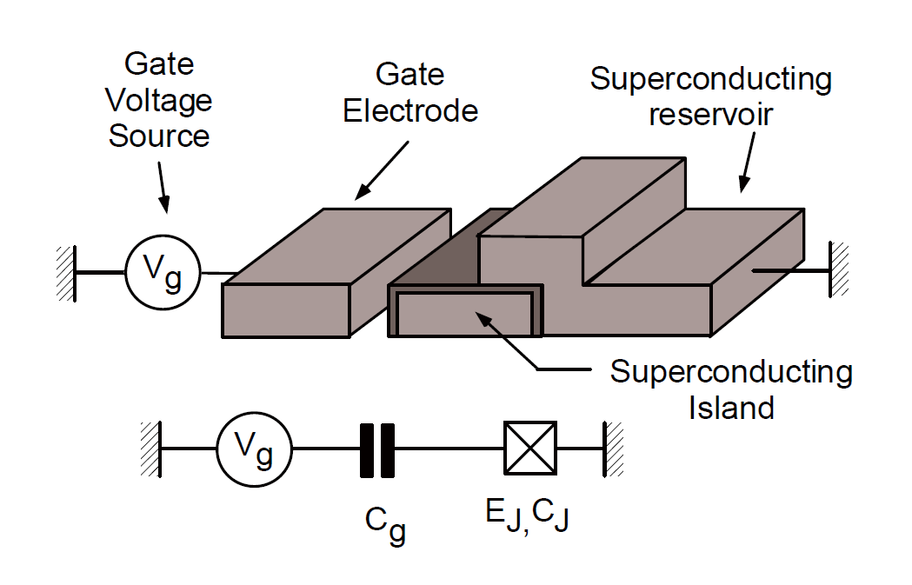
Introduction
.
Josephson Junction
Cottet, A., 2002. Implementation of a quantum bit in a superconducting circuit
Notes:
The aim of this project is to investigate the quantum mechanical properties of a superconducting circuit. This is a microscopic device that consists of two layers of superconducting material separated by an insulating barrier, as shown in this diagram. This is called a Josephson junction, and it is used to make qubits in quantum computing, or SQUIDS (superconducting quantum interference device) to measure magnetic fields. A Josephson junction works by allowing superconducting cooper pairs to tunnel through the barrier. Cooper pairs are bound electrons at that give rise to superconductivity. This Josephson junction is studied by placing it in a cavity and
The Hamiltonian for this system is well defined and this system has been studied experimentally, however only for low quantum states

Slide 3
Motivation
Notes:
There is a large body of work investigating the properties of the transmon both theoretically and experimentally. However this has mainly focussed on the lower states of the transmon, ie the ground state and first state. This project aims to use established methods to simulate the transmon in very high states. This simulation will involve comparing analytical methods with computational numerical methods, using a mix of Python and Mathematica.

Slide 4
Key Ideas
Koch, Jens, et al. "Charge-insensitive qubit design derived from the Cooper pair box." Physical Review A 76.4 (2007): 042319.
Notes:
This is the Hamiltonian of the system, where *explain all the things*
Ec – charge/capacitance energy
Ej – josphson energy
Ng – reduced gate charge
The charge operator tells you the difference between the amount of cooper pairs on either side of the junction. It is not the rate of change of cooper pairs, it is the change

Slide 5
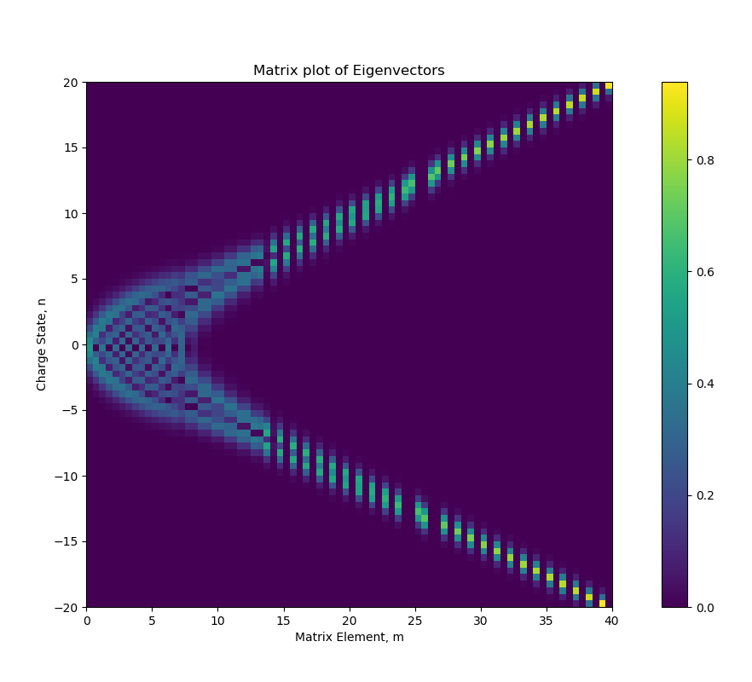
Numerical Results
Todo – get rid of title
Notes:
Key points – becomes like a charge state for high values of n
- opposite states are degenerate
- adjacent states aren’t really coupled

Slide 6
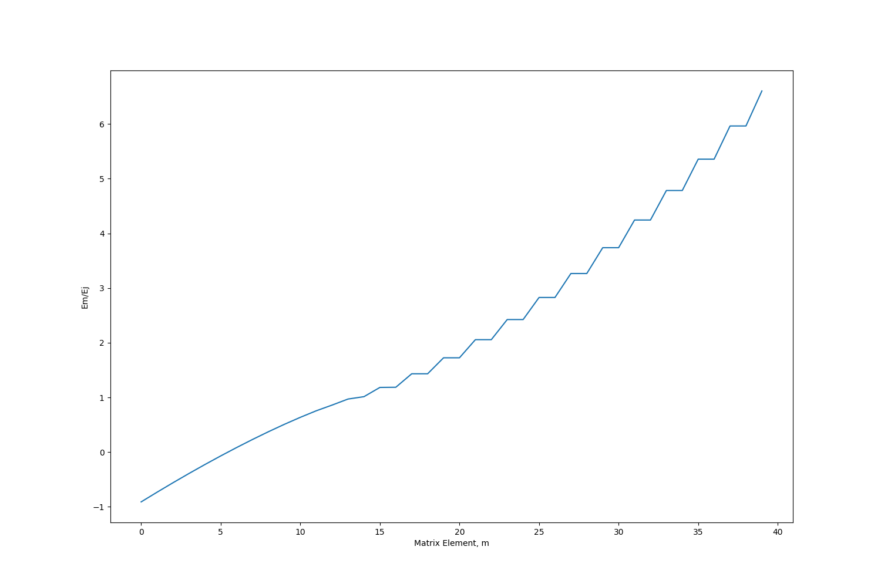
Numerical results
Notes:
Strongly coupled states are degenerate – these correspond to opposite charge states

Slide 7
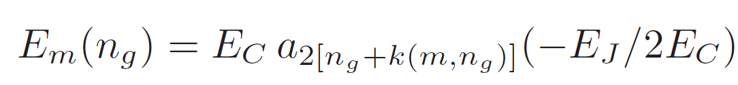
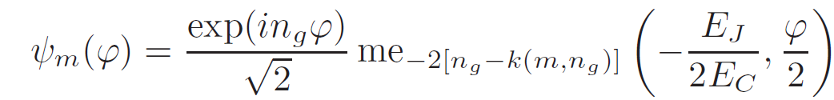
Key Ideas

Slide 8
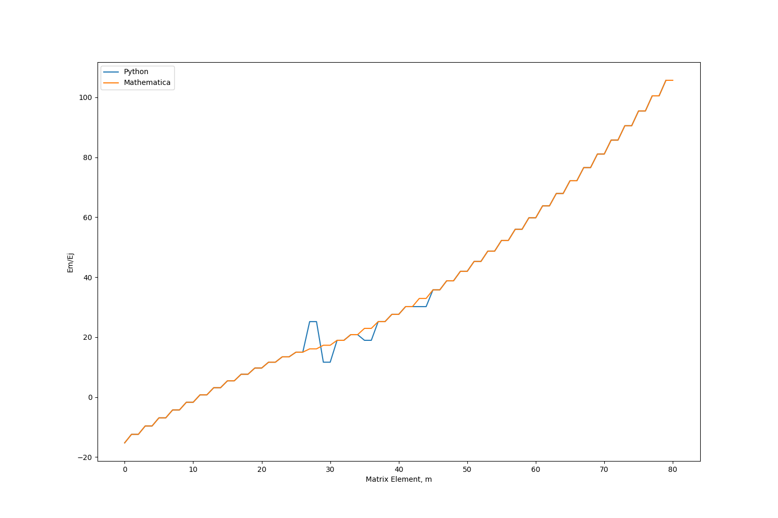
Analytic Results

Slide 9
Analytic Results

Slide 10
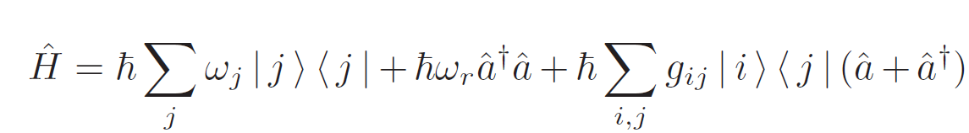
Additional points

Slide 11
Conclusion

