Slide 1
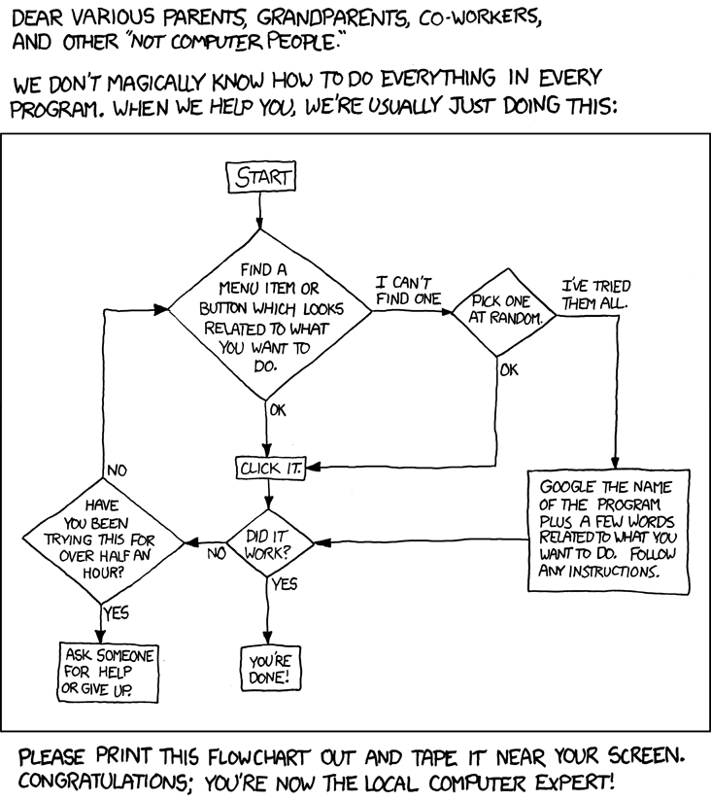
Decision Trees
A type of flowchart

Slide 2
How it works
Supervised learning
Categorical data
Nodes (root, decision, leaf)

Slide 3
Strengths
Weaknesses
Easy to read
Identifies significant variables
Limited to binary outcomes
Struggles with large data

Slide 4
Application
Categorizing outcomes against known outcomes
Can find non-linear relations and cause/effect
Example is customer recommendations

