Slide 1
Visit Scotland
Louise Shambrook – Final Project DE11 CodeClan

Slide 2
Overview of the presentation
Notes:
I was drawn to this dataset because I first visited Scotland on my honeymoon, when I went to Edinburgh, Loch Lomond, and the Isle of Skye, and on this holiday my husband and I fell in love with Scotland and decided to move to Scotland one day. I was interested in understanding the demographics.
Limitations of the data / where have I had to make assumptions / what are they.

Slide 3
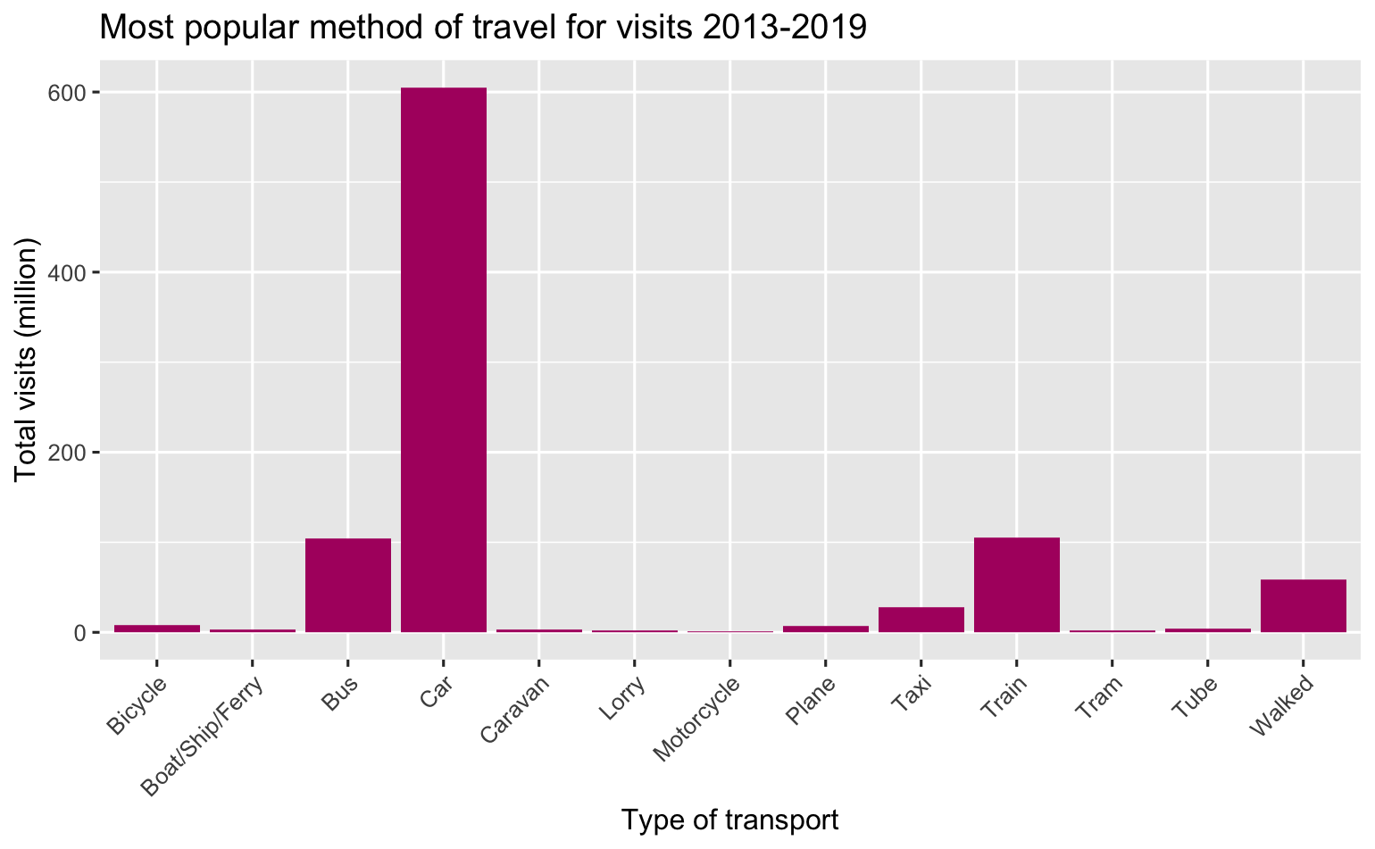
Transport How do people get to Scotland?
Notes:
Answer to question:
Is there a particular method of travel our visitors arrive by? Some of our locations are remote and not easily accessible by public transport, so this would be good information to have.

Slide 4
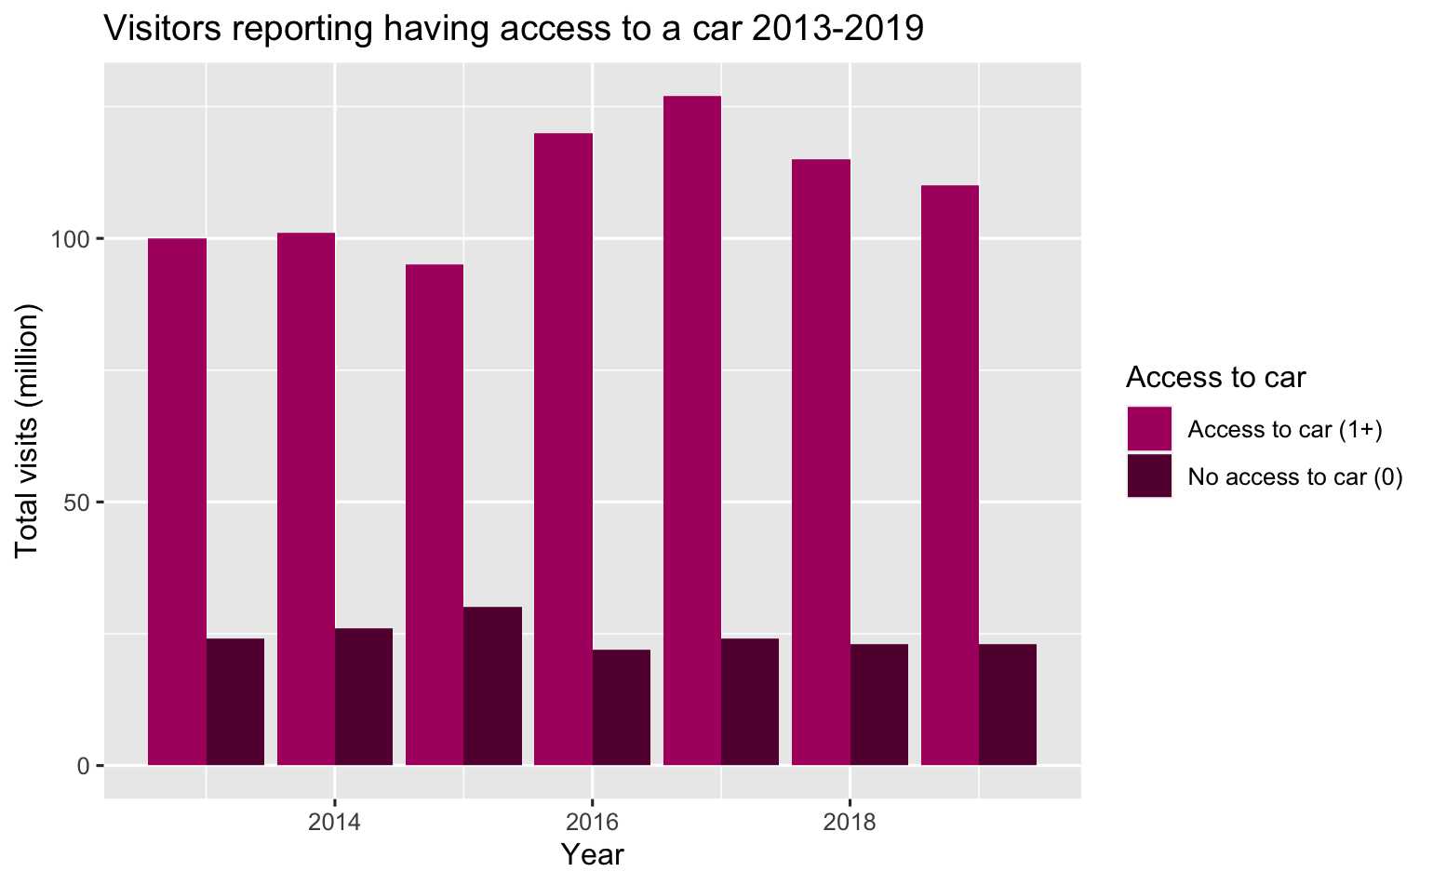
Transport
Notes:
Answer to question:
Is there a particular method of travel our visitors arrive by? Some of our locations are remote and not easily accessible by public transport, so this would be good information to have.

Slide 5
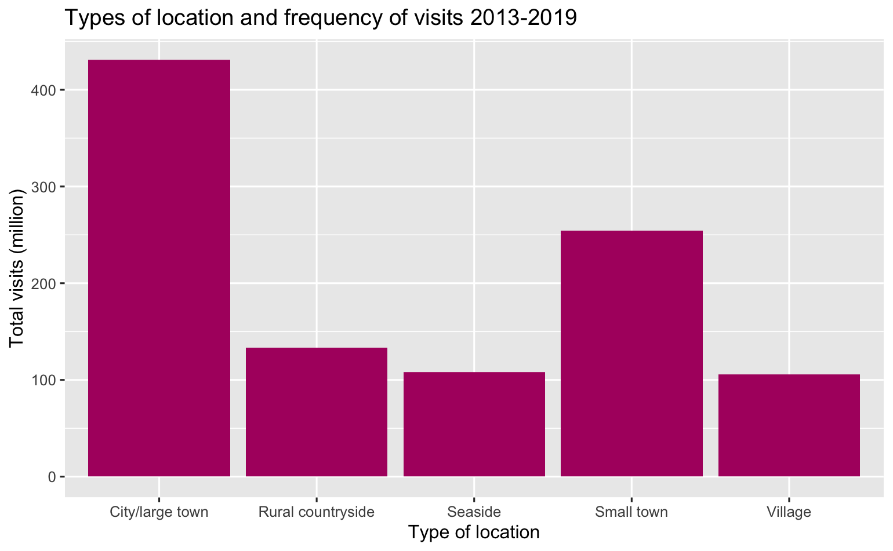
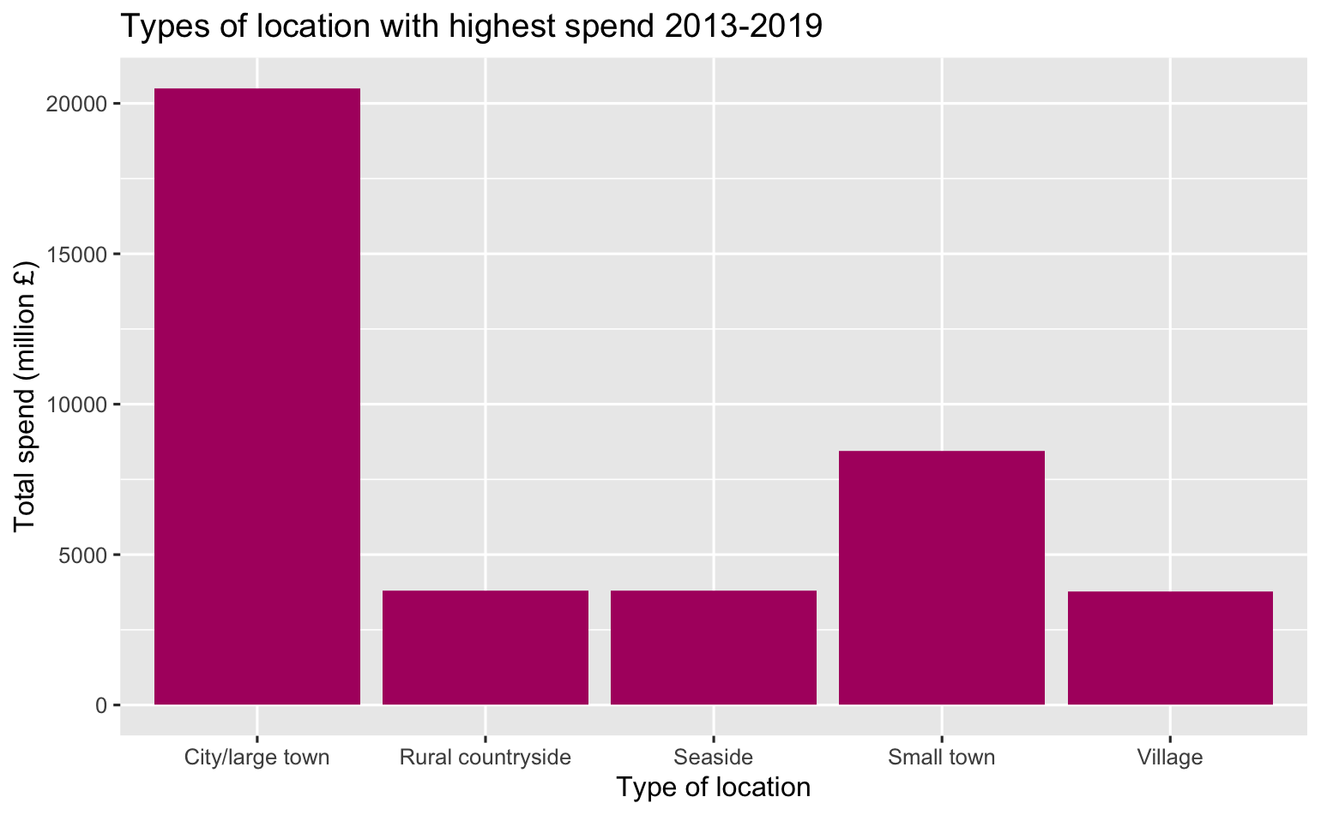
Locations Where do people go in Scotland?
Notes:
Answer to question:
What type of locations receive the most visits? What kinds of locations do people spend the most in?

Slide 6
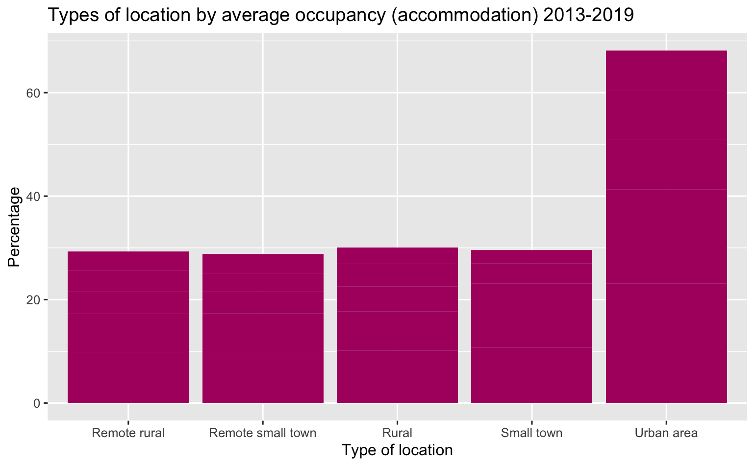
Locations
Notes:
Answer to question:
What type of locations receive the most visits? What kinds of locations do people spend the most in?

Slide 7
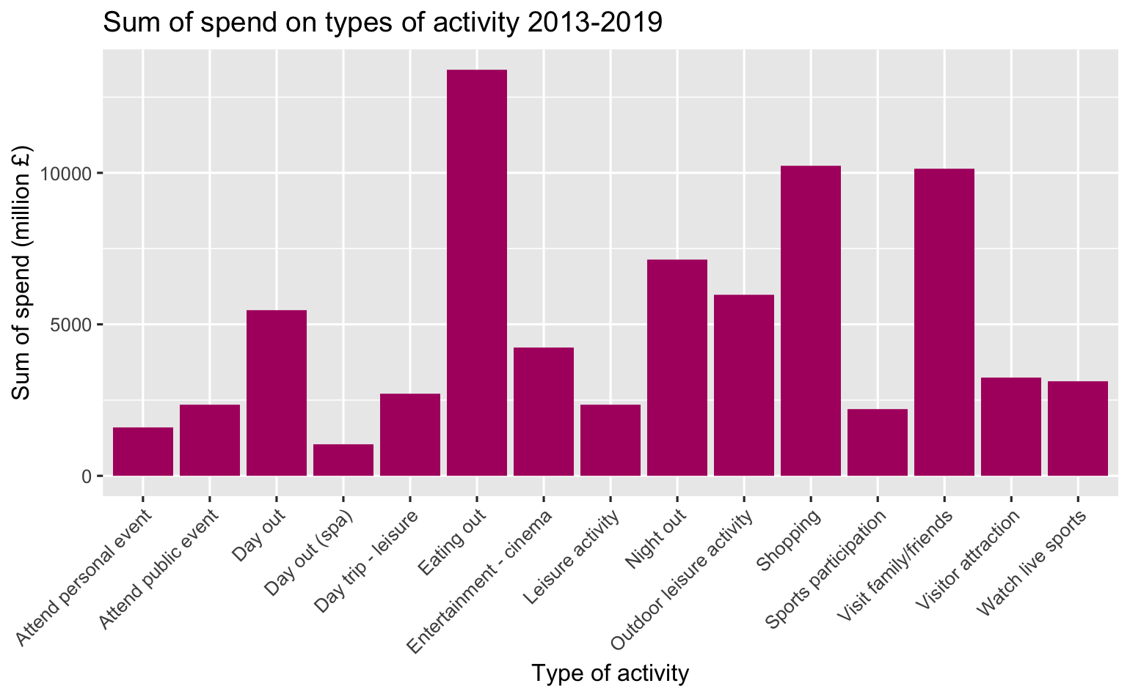
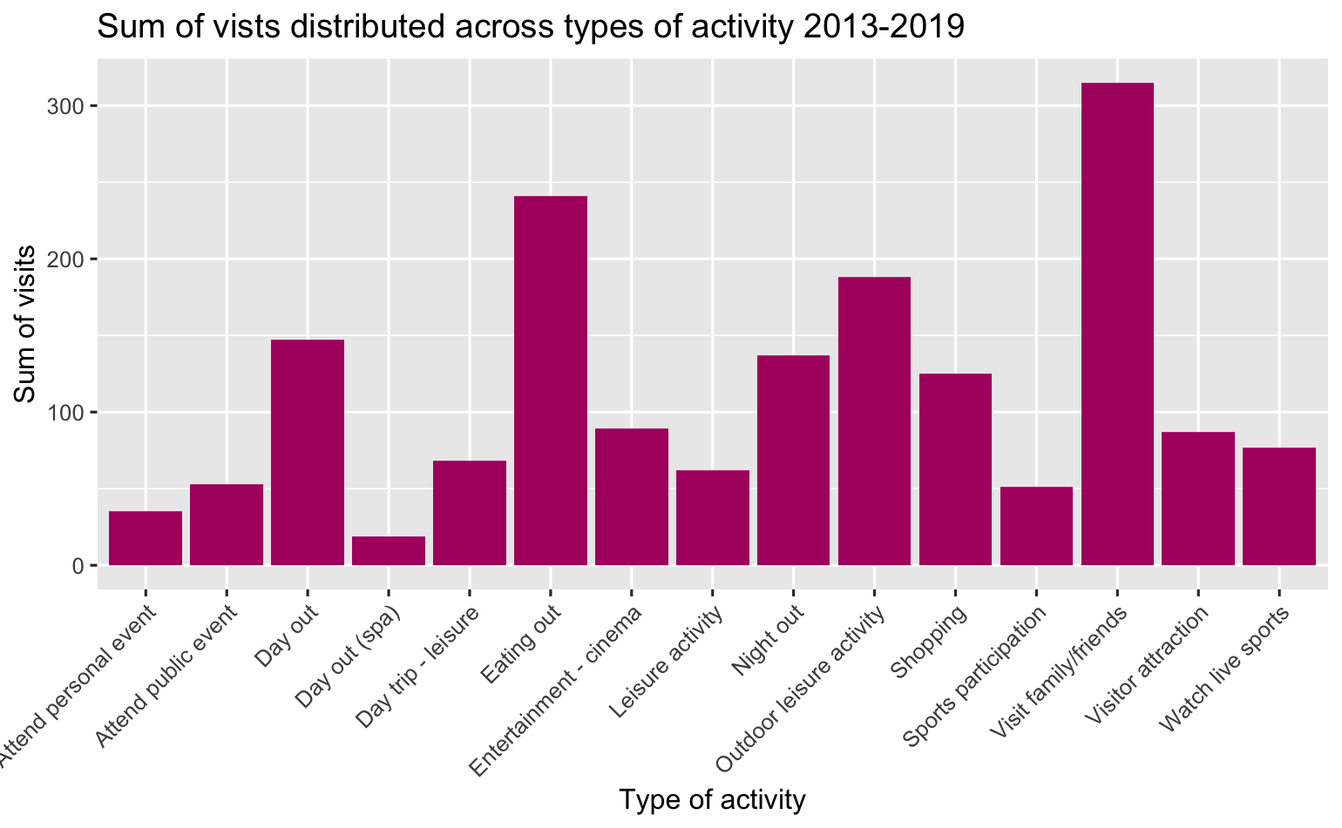
Activities What do people do when visiting Scotland?
Notes:
Answer to questions:
What kind of tourism activity generates the highest income for Scotland? Which kind of activity generates the most visits to sites?

Slide 8
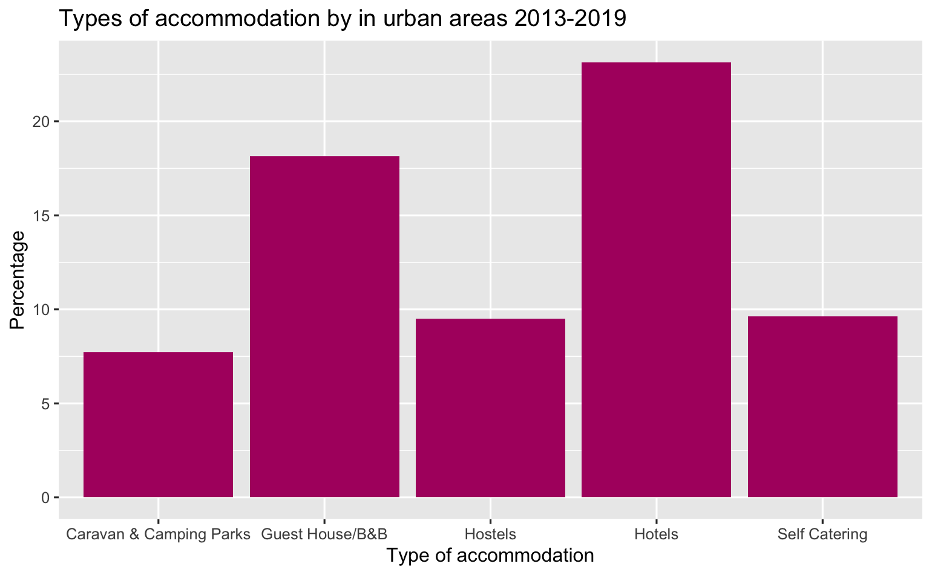
Accommodation Where do people stay in Scotland?
Notes:
Answer to Q:
What type of accomodation is most popular? Is there a difference by location?

Slide 9
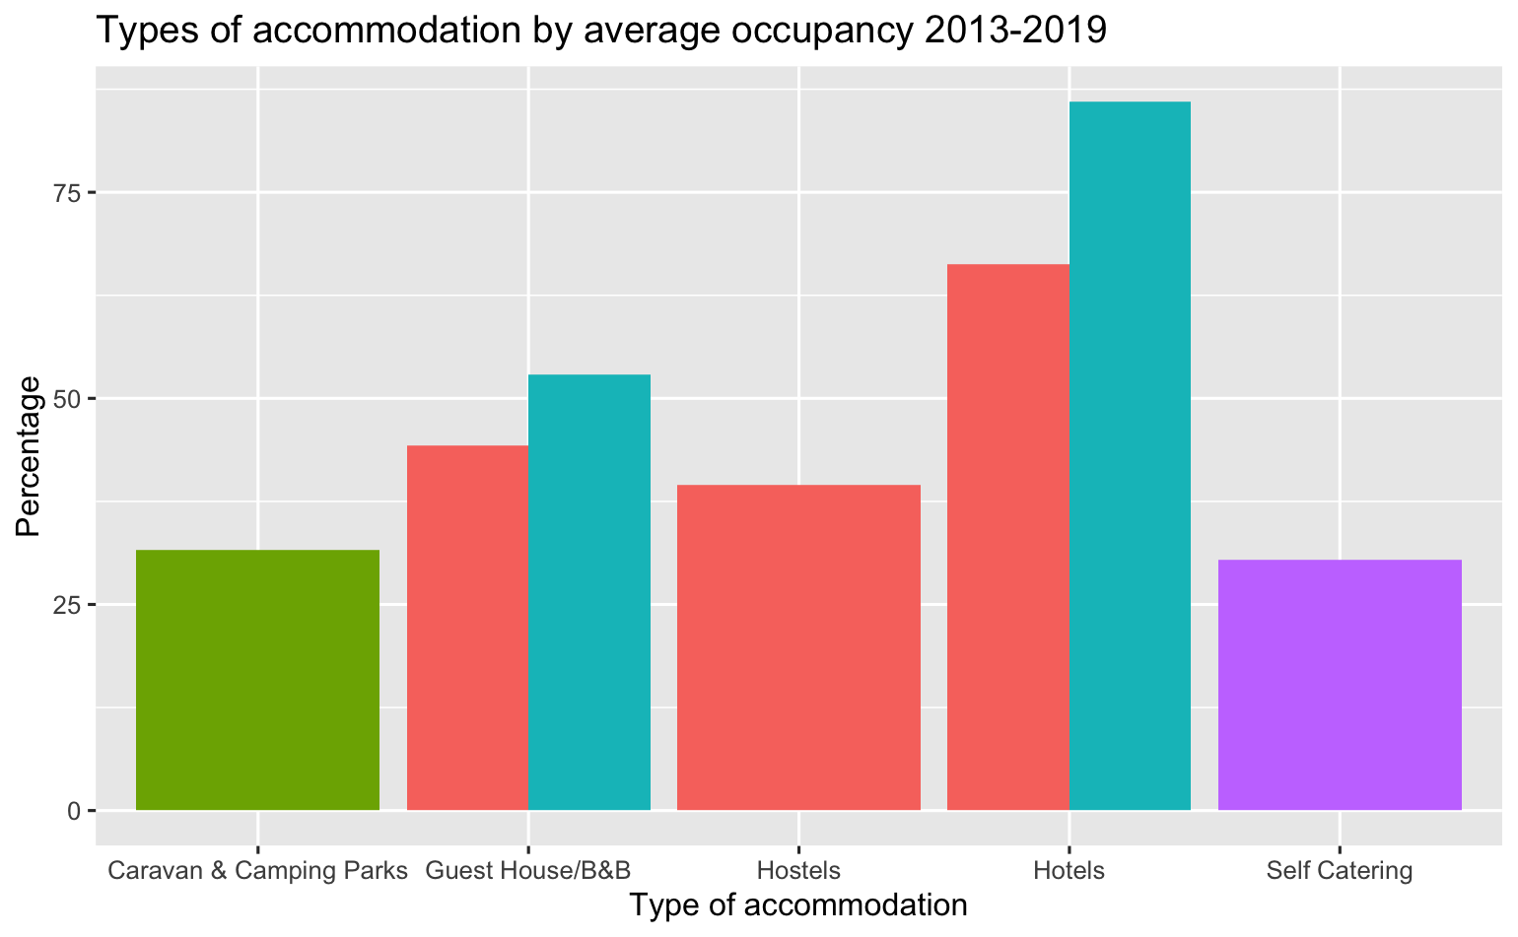
Accommodation
Notes:
Answer to Q:
What type of accomodation is most popular? Is there a difference by location?

Slide 10
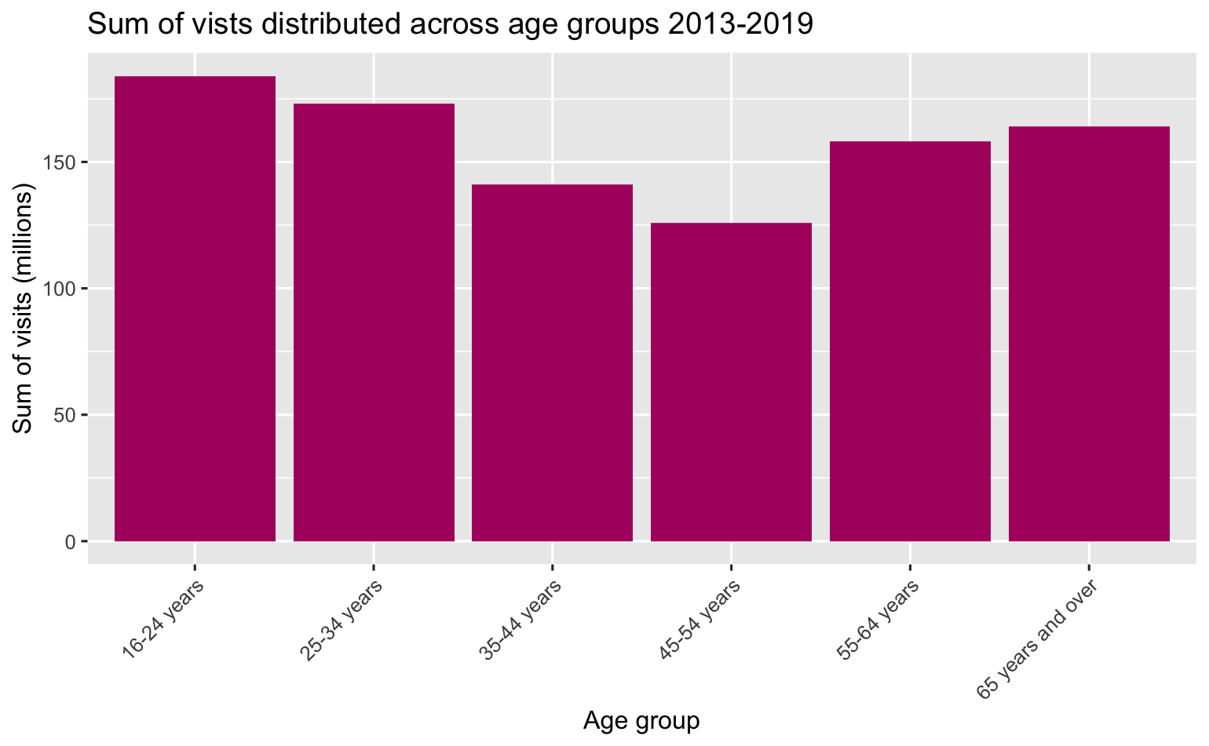
Demographic Who are the people visiting Scotland?
Notes:
Answer to question:
Is there a particular key demographic of visitors we should be focusing on? Who spends the most? Who visits the most?
When looking at regional tourism, what insights can we gain? Where are our visitors from? How do they differ in the money they spend, nights they spend in Scotland, or number of visits they do?

Slide 11
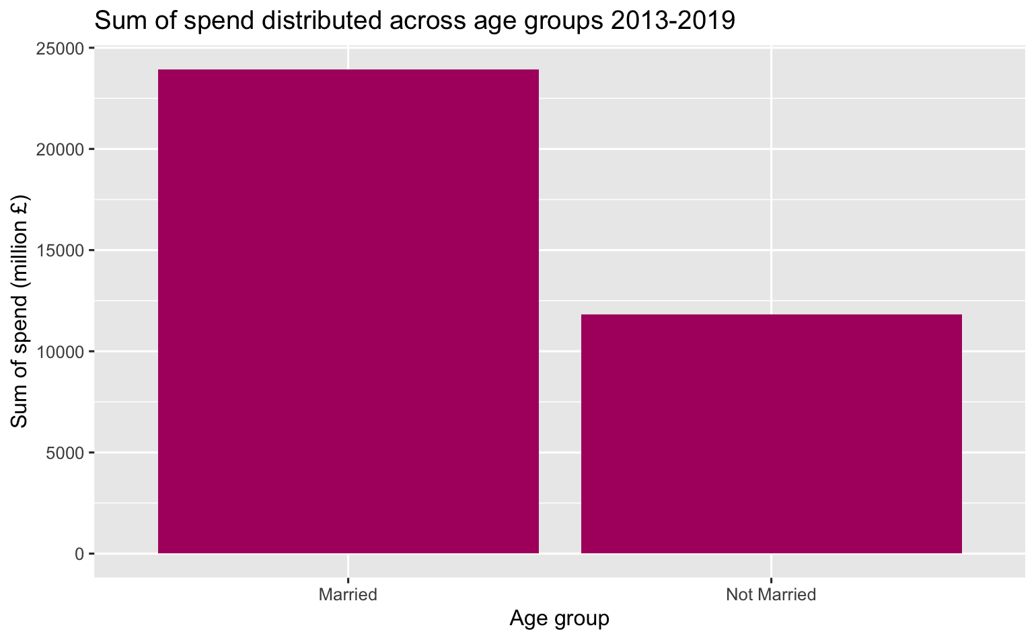
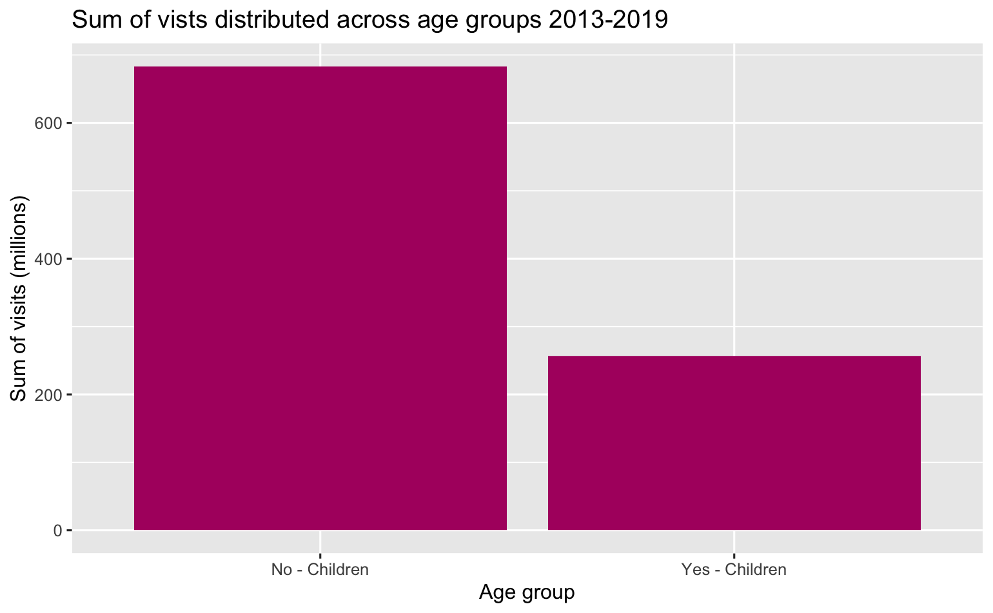
Demographic
Notes:
Answer to question:
Is there a particular key demographic of visitors we should be focusing on? Who spends the most? Who visits the most?
When looking at regional tourism, what insights can we gain? Where are our visitors from? How do they differ in the money they spend, nights they spend in Scotland, or number of visits they do?

Slide 12
Demographic
Notes:
Answer to question:
Is there a particular key demographic of visitors we should be focusing on? Who spends the most? Who visits the most?
When looking at regional tourism, what insights can we gain? Where are our visitors from? How do they differ in the money they spend, nights they spend in Scotland, or number of visits they do?

Slide 13
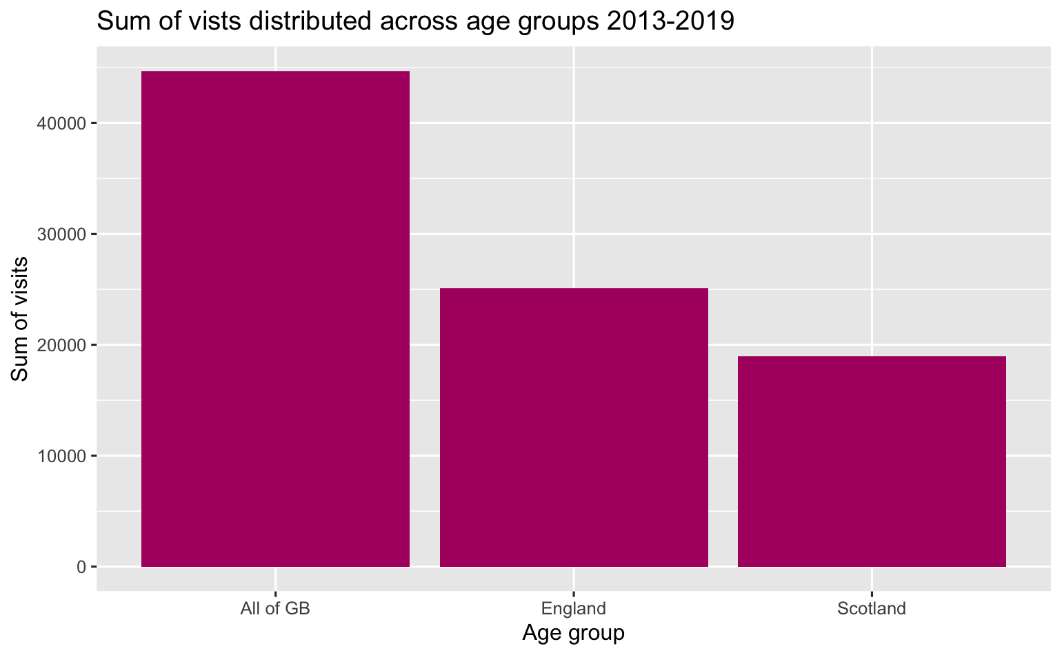
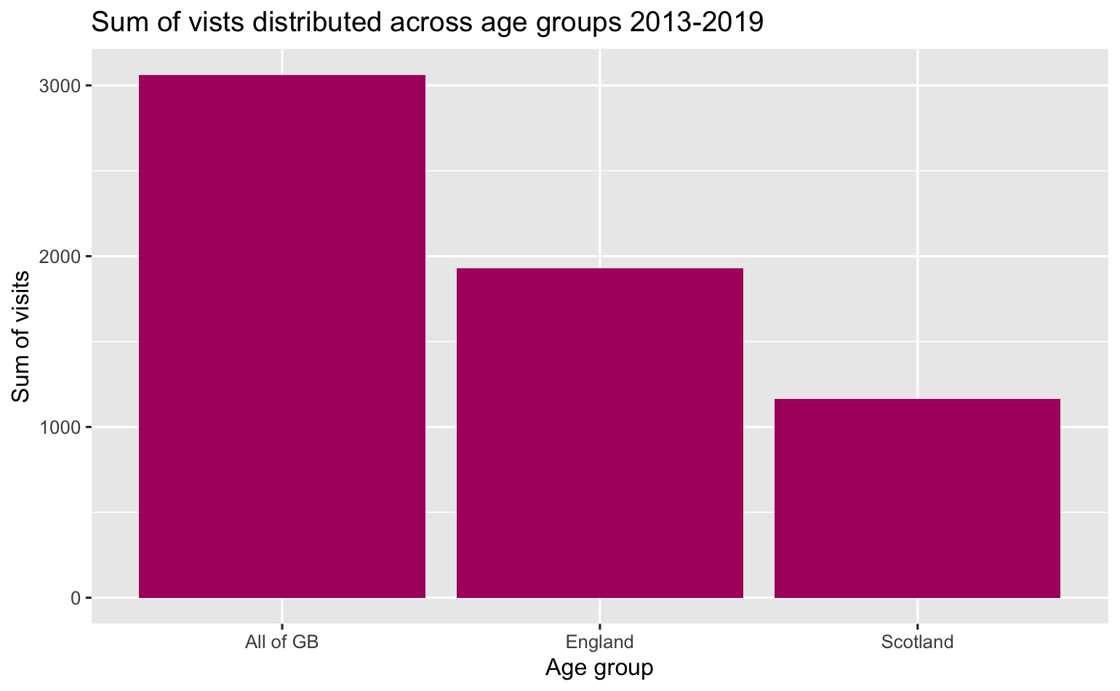
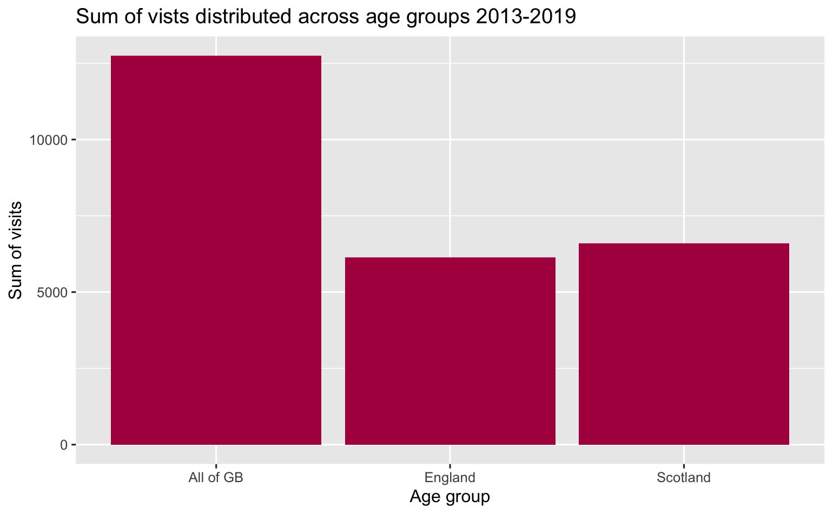
Demographic – by Region
Notes:
Answer to question:
Is there a particular key demographic of visitors we should be focusing on? Who spends the most? Who visits the most?
When looking at regional tourism, what insights can we gain? Where are our visitors from? How do they differ in the money they spend, nights they spend in Scotland, or number of visits they do?

Slide 14
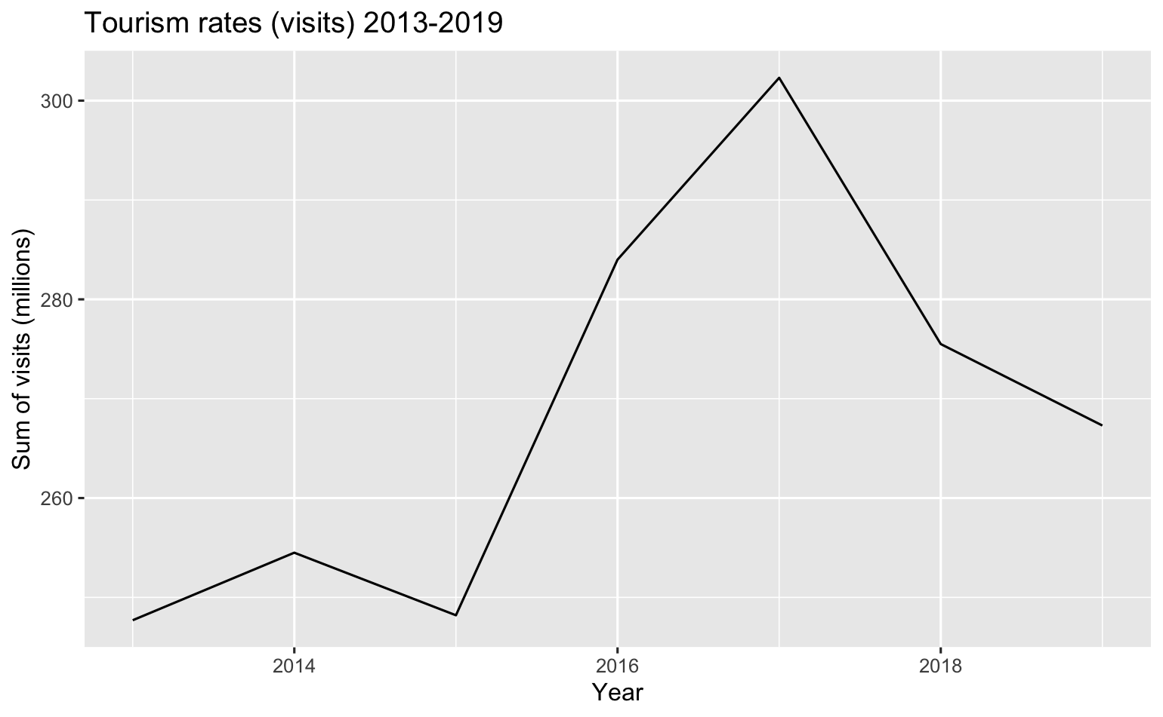
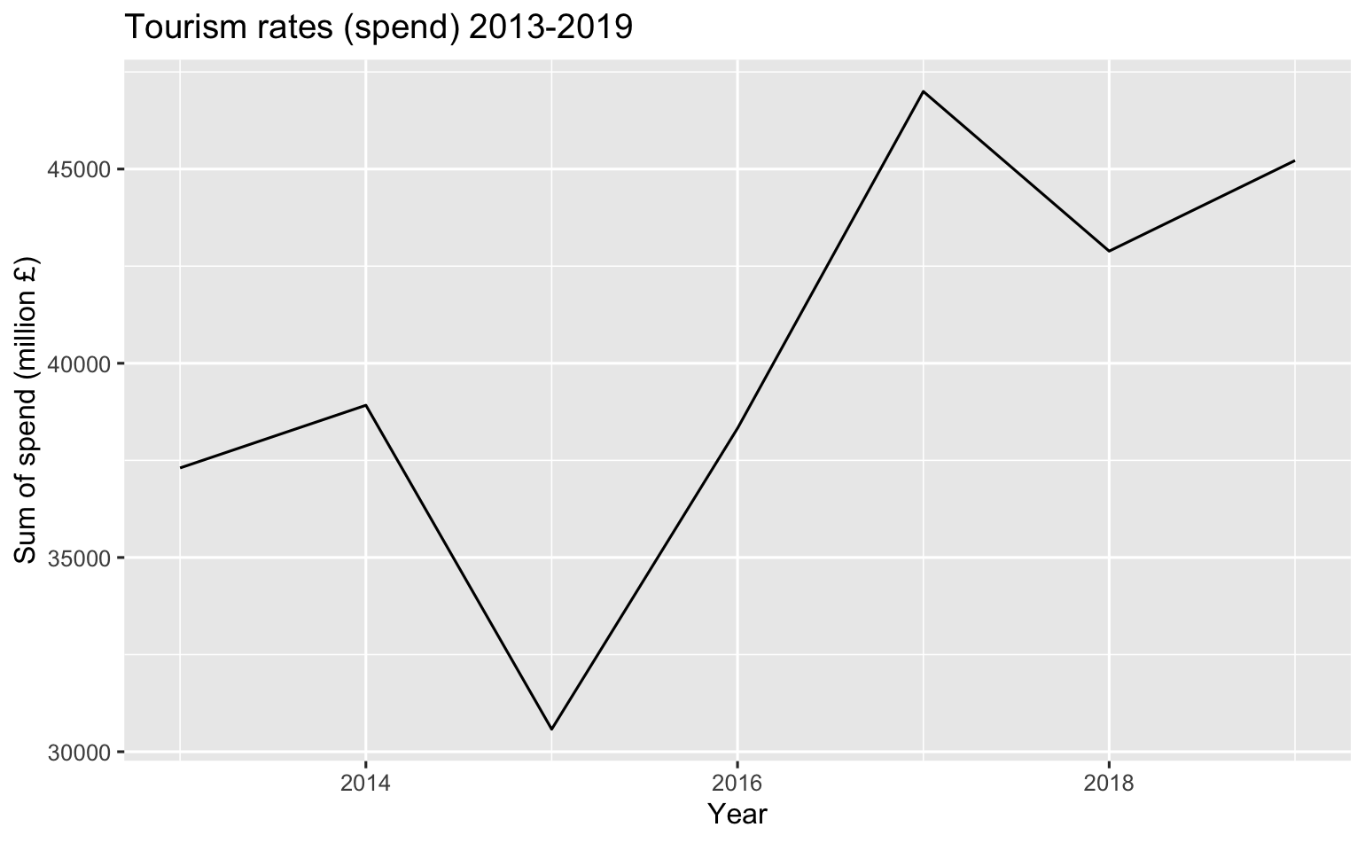
Time How have visits and spend to Scotland changed over time?
Notes:
Answer to q:
How have general tourism rates changed over time?

Slide 15
Improving visits / spend How could visits be improved?
Notes:
Answer to Q:
Is there any way to predict spending and visits for Visit Scotland?

Slide 16
Recommendations to company
Notes:
Answer to Q:
Is there any way to predict spending and visits for Visit Scotland?

Slide 17
Summary
Notes:
Answer to Q:
Is there any way to predict spending and visits for Visit Scotland?

Slide 18
Questions?
Notes:
Answer to Q:
Is there any way to predict spending and visits for Visit Scotland?

