Slide 1


Louise Shambrook – DE11 CodeClan – Final project

Slide 2

In this presentation
The brief
Main findings
Future models
recommendations
Notes:
what’s the brief
Why did I pick it
What will I cover
I was drawn to this dataset because I first visited Scotland on my honeymoon, when I went to Edinburgh, Loch Lomond, and the Isle of Skye, and on this holiday my husband and I fell in love with Scotland and decided to move to Scotland one day. I was interested in understanding the demographics.
Limitations of the data / where have I had to make assumptions / what are they.

Slide 3
The brief
VisitScotland.com is the official consumer website of VisitScotland, Scotland’s national tourist board
Visitscotland works to ensure that visitors experience the very best of Scotland and that the country makes the most of its outstanding tourism assets and realises its potential
Data for VisitScotland provided
9 business questions asked around 6 key areas
Notes:
what’s the brief
Why did I pick it
What will I cover
I was drawn to this dataset because I first visited Scotland on my honeymoon, when I went to Edinburgh, Loch Lomond, and the Isle of Skye, and on this holiday my husband and I fell in love with Scotland and decided to move to Scotland one day. I was interested in understanding the demographics.
Limitations of the data / where have I had to make assumptions / what are they.

Slide 4
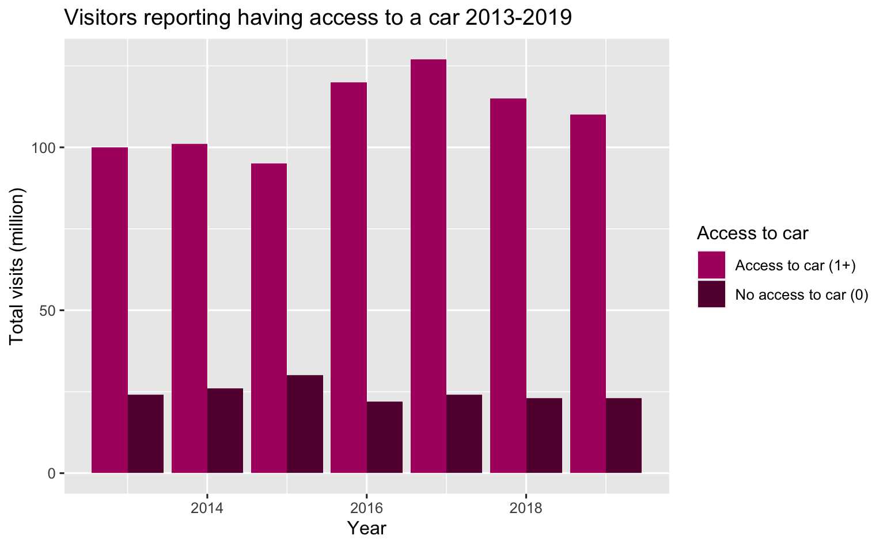
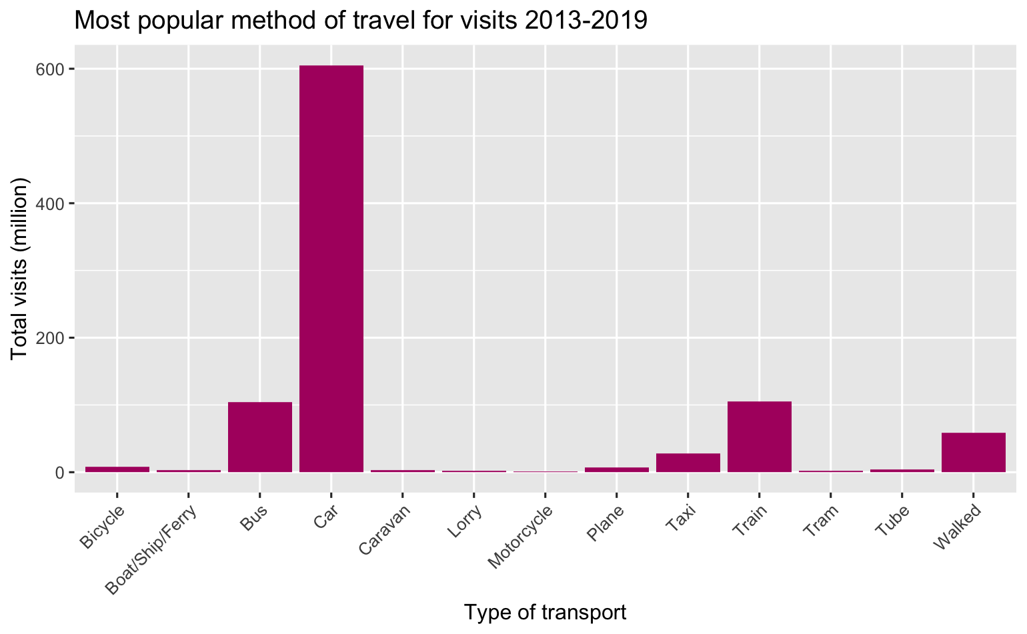
Transport
Notes:
Answer to question:
Is there a particular method of travel our visitors arrive by? Some of our locations are remote and not easily accessible by public transport, so this would be good information to have.

Slide 5
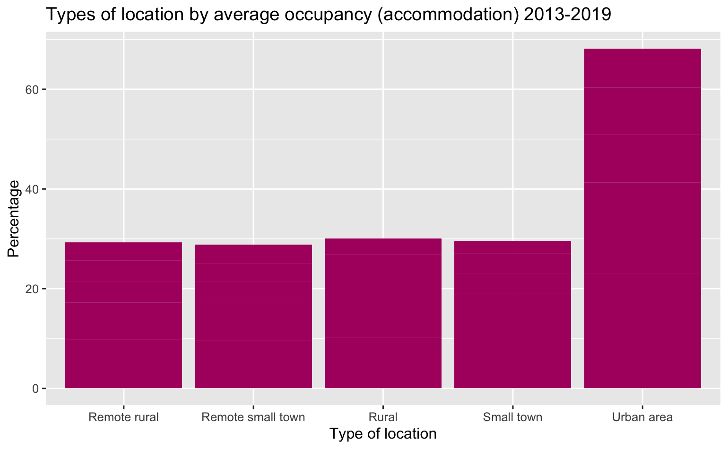
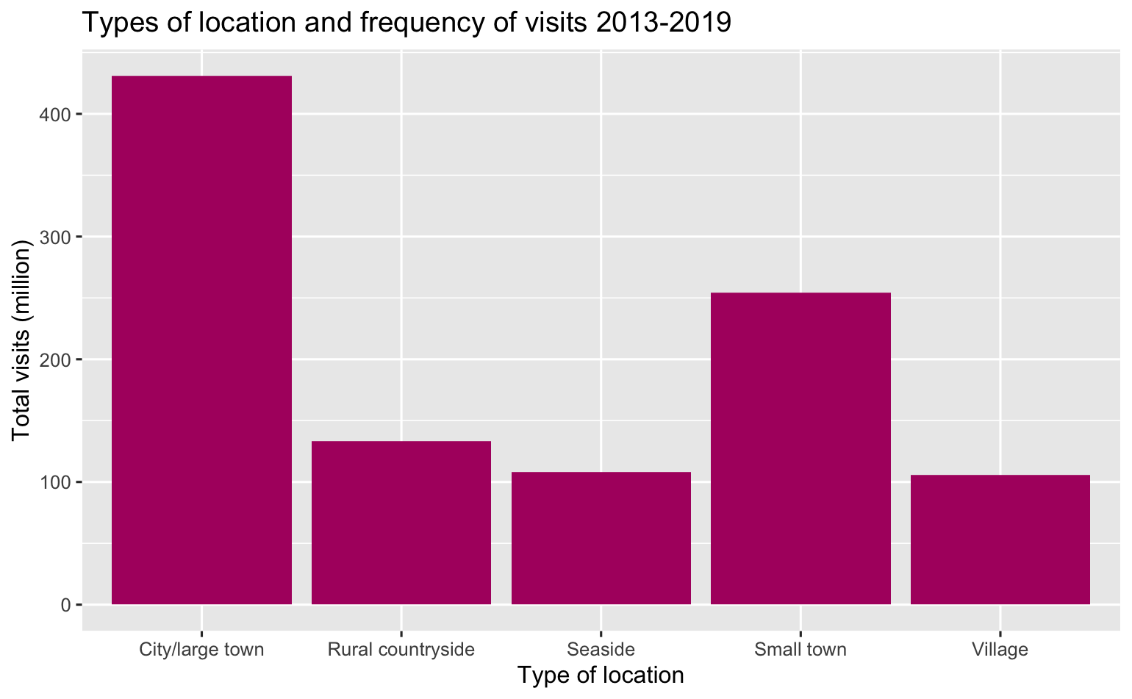
Locations
Notes:
Answer to question:
What type of locations receive the most visits? What kinds of locations do people spend the most in?
This is for spend, but it is the same for visits

Slide 6
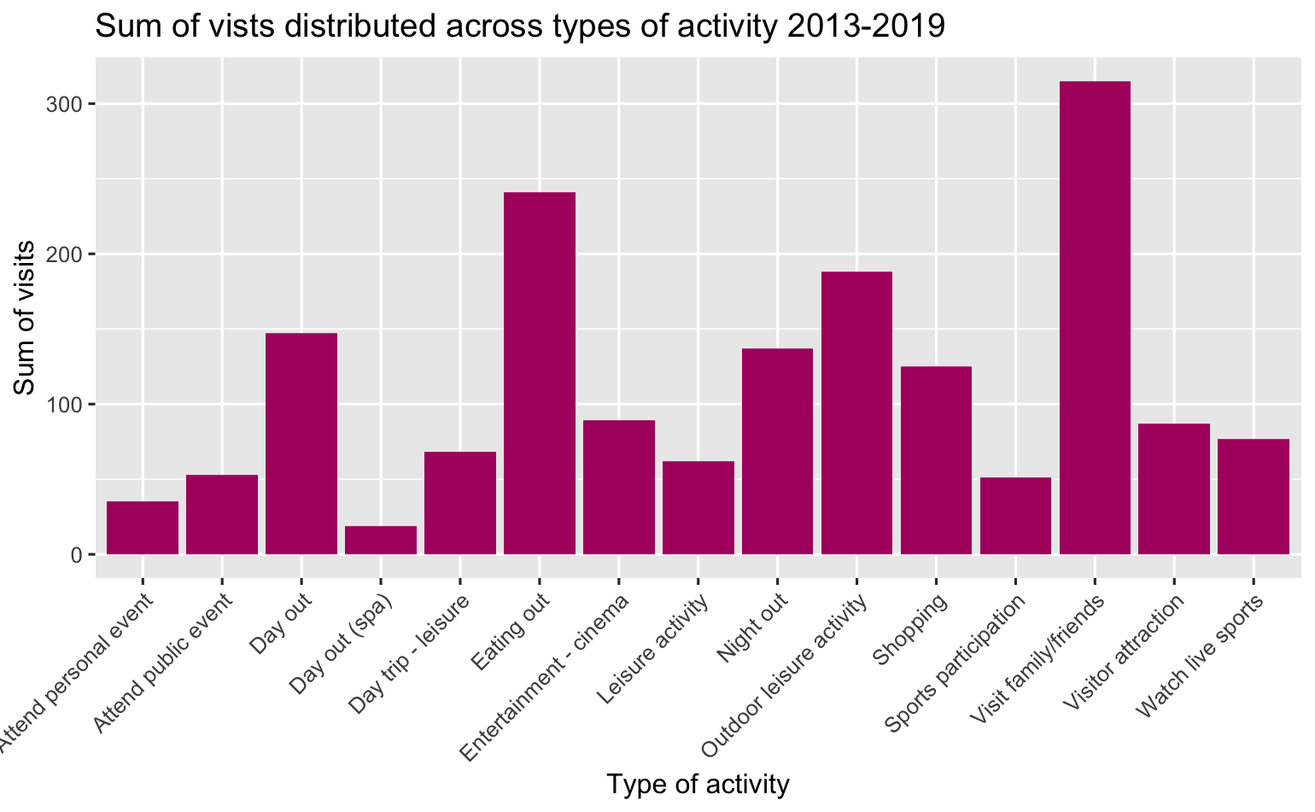
Activities
Notes:
Answer to questions:
What kind of tourism activity generates the highest income for Scotland? Which kind of activity generates the most visits to sites?

Slide 7
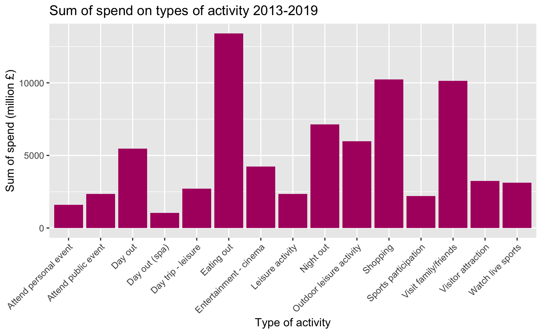
Activities
Notes:
Answer to questions:
What kind of tourism activity generates the highest income for Scotland? Which kind of activity generates the most visits to sites?

Slide 8
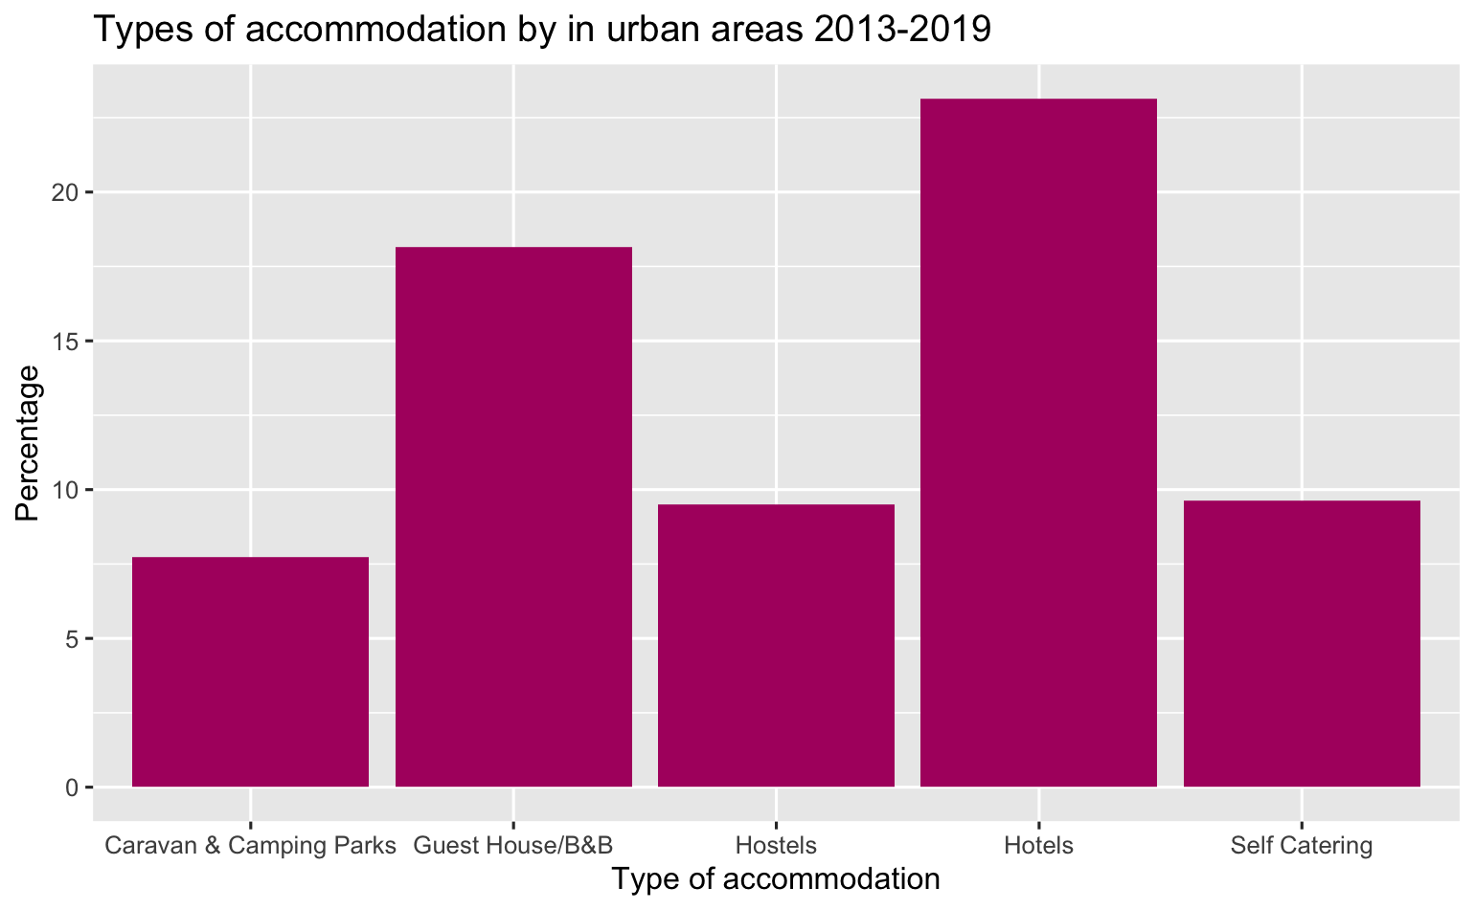
Accommodation
Notes:
Answer to Q:
What type of accomodation is most popular? Is there a difference by location?

Slide 9
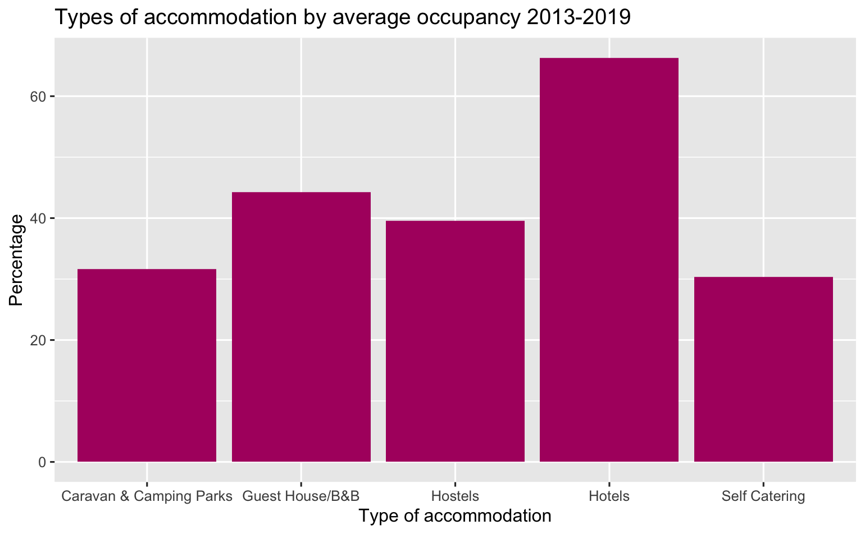
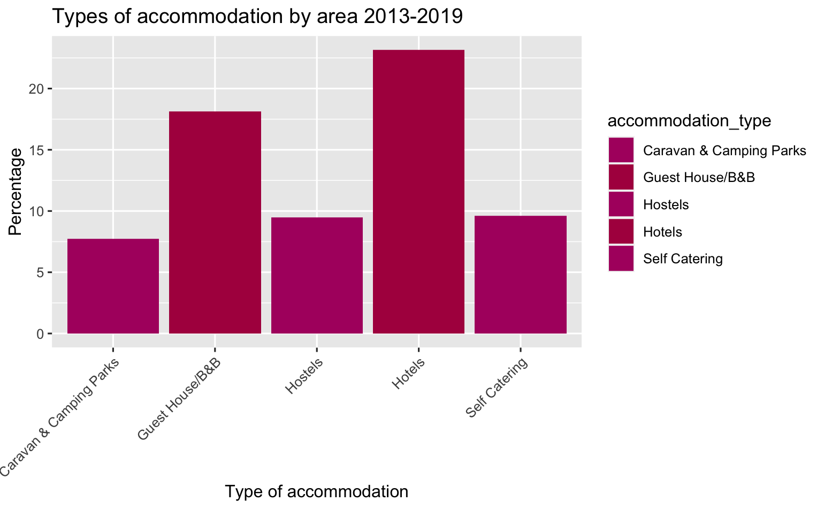
Accommodation
Notes:
Answer to Q:
What type of accomodation is most popular? Is there a difference by location?

Slide 10
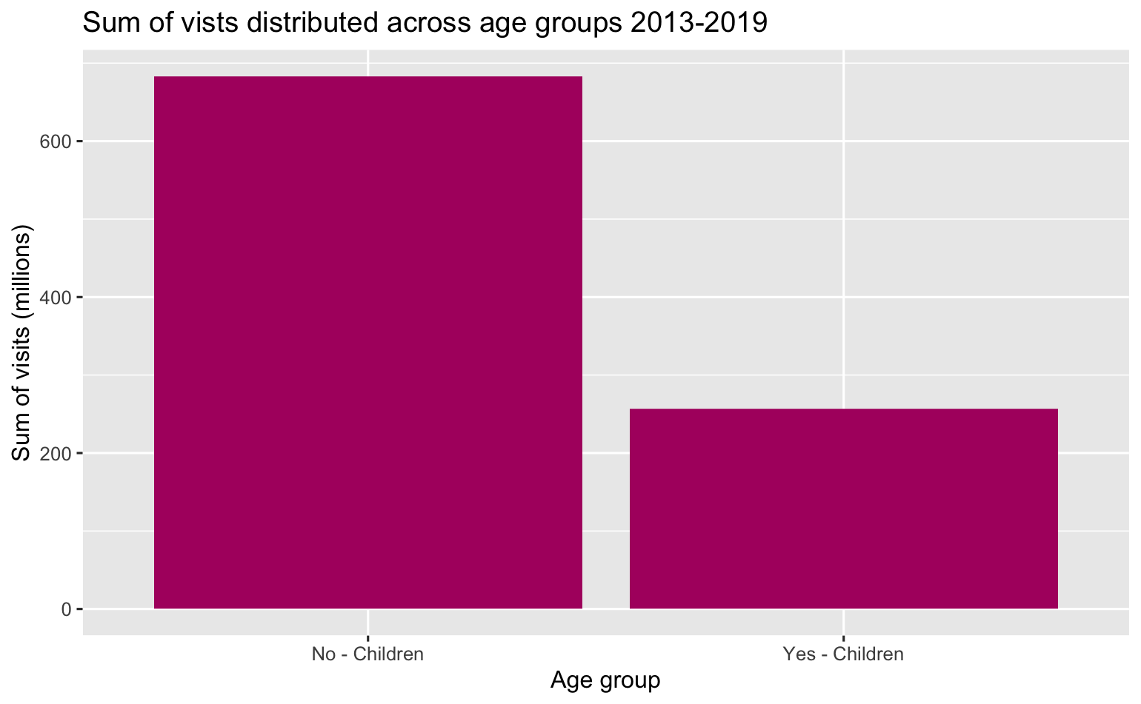
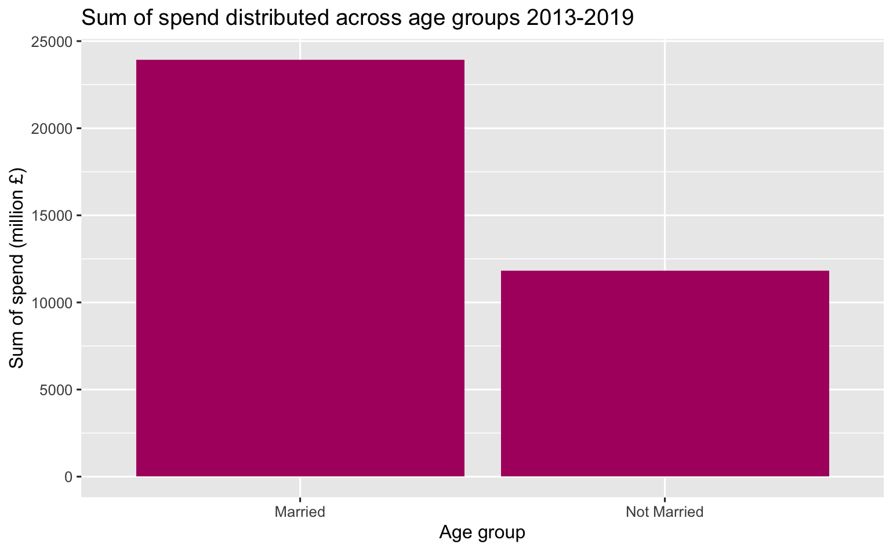
Demographic
Notes:
Answer to question:
Is there a particular key demographic of visitors we should be focusing on? Who spends the most? Who visits the most?
When looking at regional tourism, what insights can we gain? Where are our visitors from? How do they differ in the money they spend, nights they spend in Scotland, or number of visits they do?

Slide 11
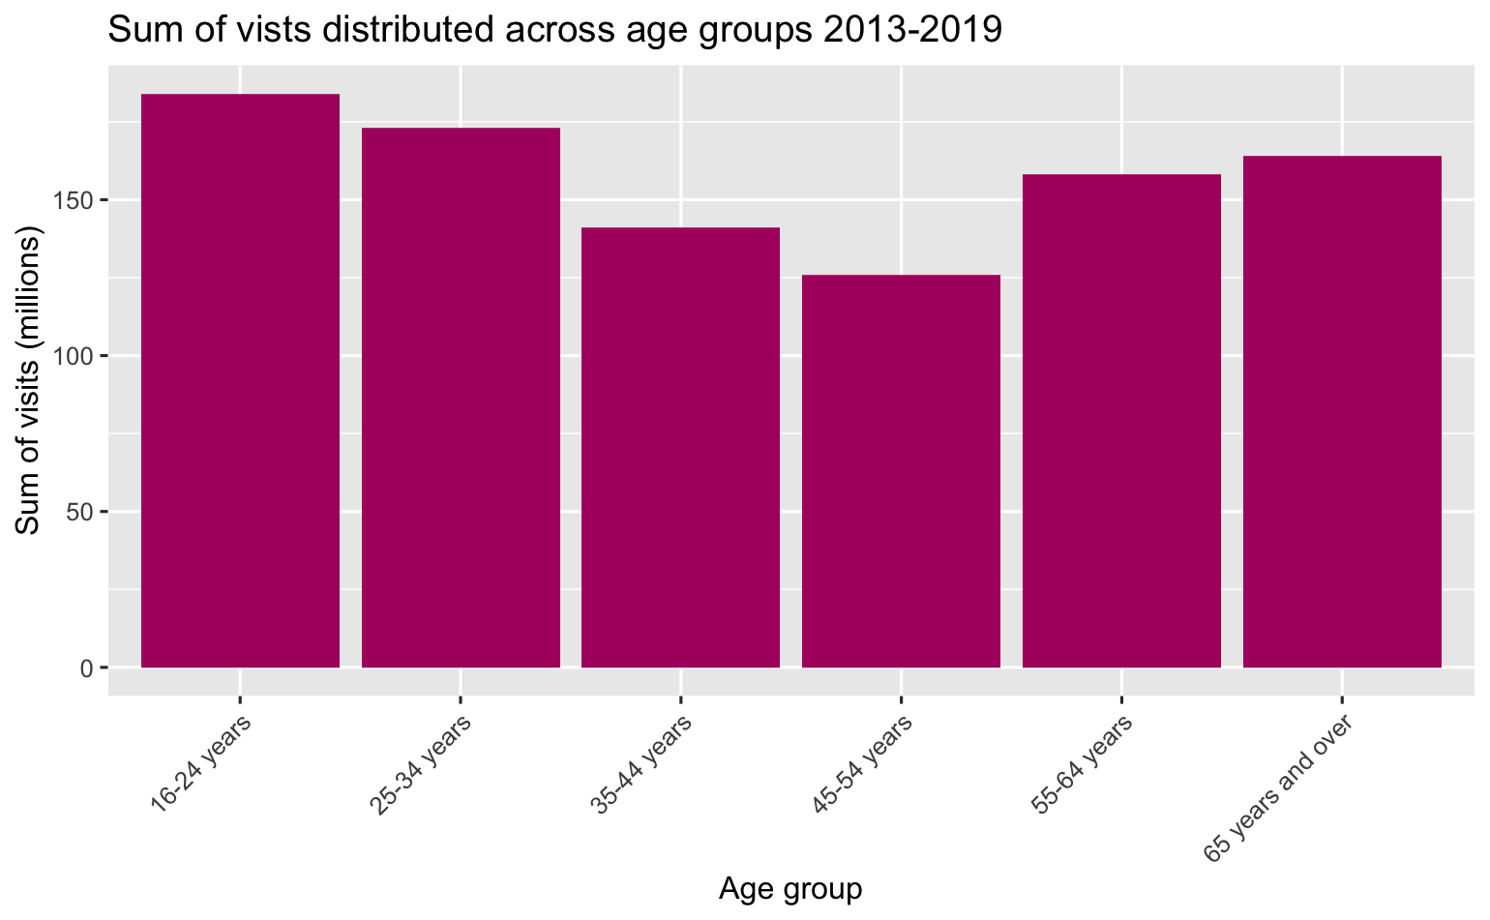
Demographic
Notes:
Answer to question:
Is there a particular key demographic of visitors we should be focusing on? Who spends the most? Who visits the most?
When looking at regional tourism, what insights can we gain? Where are our visitors from? How do they differ in the money they spend, nights they spend in Scotland, or number of visits they do?

Slide 12
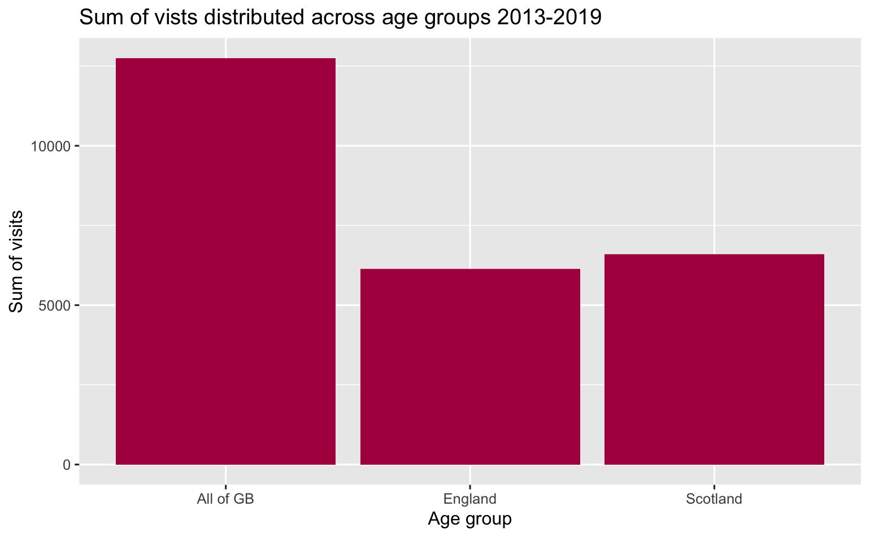
By region
Notes:
Answer to question:
Is there a particular key demographic of visitors we should be focusing on? Who spends the most? Who visits the most?
When looking at regional tourism, what insights can we gain? Where are our visitors from? How do they differ in the money they spend, nights they spend in Scotland, or number of visits they do?

Slide 13
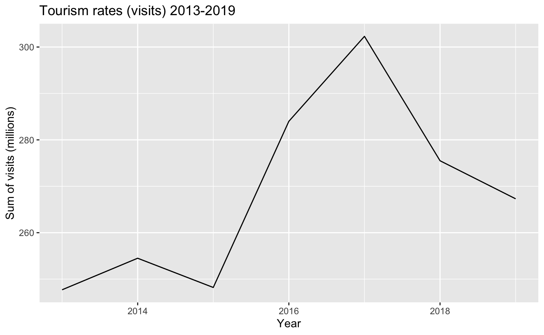
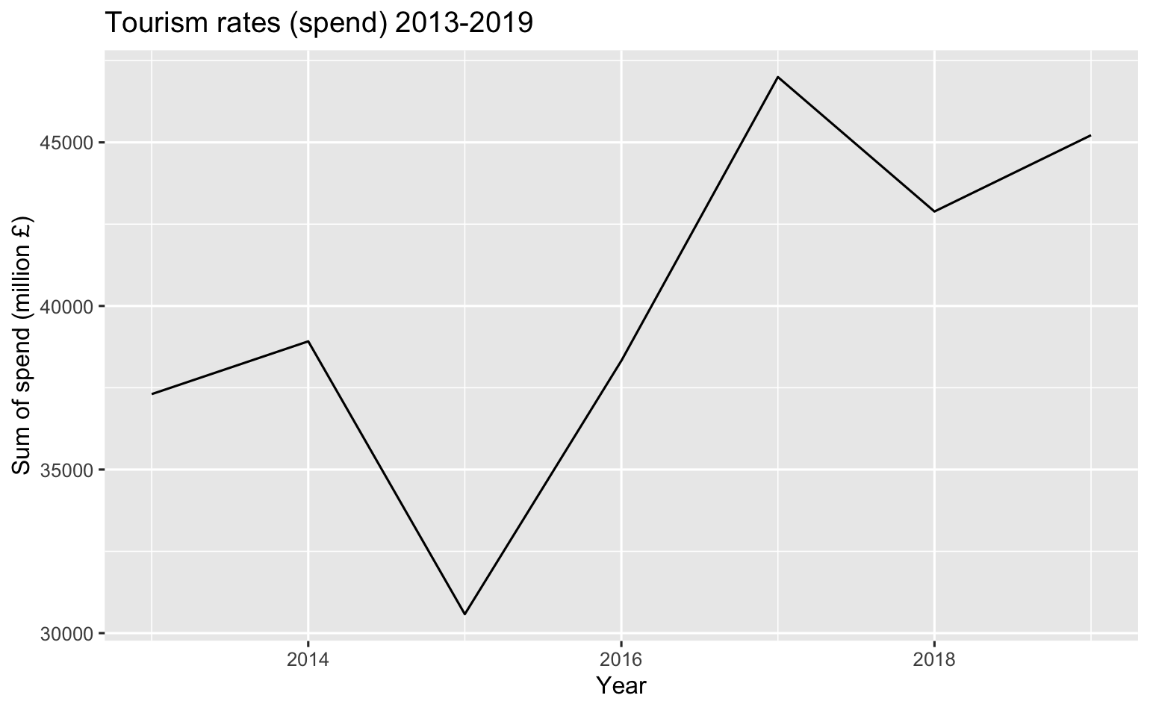
Across time
Notes:
Answer to q:
How have general tourism rates changed over time?

Slide 14
Improving visits and spend
Notes:
Answer to Q:
Is there any way to predict spending and visits for Visit Scotland?

Slide 15
Recommendations
Change how demographics data is collected
Notes:
Answer to Q:
Is there any way to predict spending and visits for Visit Scotland?

Slide 16
Summary
Notes:
Answer to Q:
Is there any way to predict spending and visits for Visit Scotland?

Slide 17
Questions?
Notes:
Answer to Q:
Is there any way to predict spending and visits for Visit Scotland?

