Slide 1
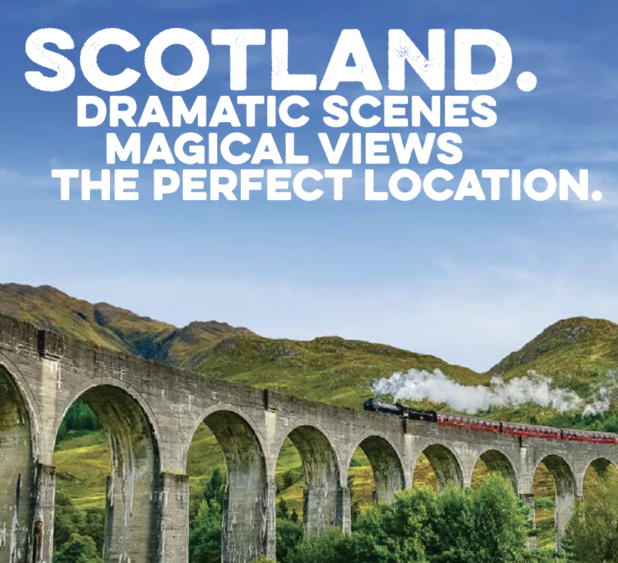

Louise Shambrook – DE11 CodeClan – Final project

Slide 2

In this presentation
The brief
Main findings
recommendations
Notes:
what’s the brief
Why did I pick it
What will I cover
I was drawn to this dataset because I first visited Scotland on my honeymoon, when I went to Edinburgh, Loch Lomond, and the Isle of Skye, and on this holiday my husband and I fell in love with Scotland and decided to move to Scotland one day. I was interested in understanding the demographics.
Limitations of the data / where have I had to make assumptions / what are they.

Slide 3
The brief
VisitScotland.com - official consumer website of VisitScotland, Scotland’s national tourist board
works to ensure that visitors experience the very best of Scotland
9 questions around 6 datasets
The datasets had no missing data, but many columns with “all”; these have been filtered out
Notes:
Introduce the brief
Why my choice
Main assumptions / caveats (i.e. that there is no missing data, but that much data is filled in as “All” or “Other” which has been excluded from the results presented)
Why did I pick it
What will I cover
I was drawn to this dataset because I first visited Scotland on my honeymoon, when I went to Edinburgh, Loch Lomond, and the Isle of Skye, and on this holiday my husband and I fell in love with Scotland and decided to move to Scotland one day. I was interested in understanding the demographics.
Limitations of the data / where have I had to make assumptions / what are they.

Slide 4
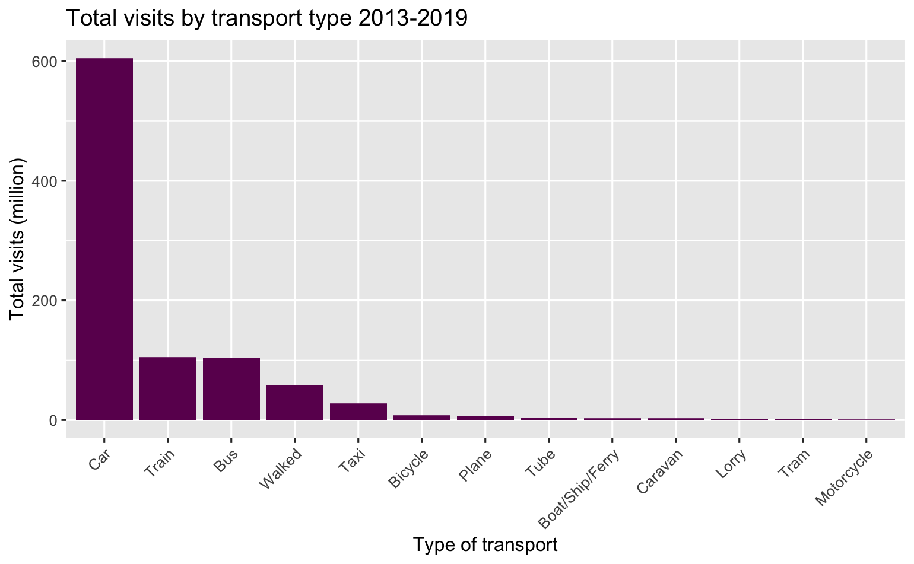

Transport Is there a particular method visitors travel by?
65% report travelling by car
81% report having access to a car - totaling 768 million visitors across 6 years or 109 million on average per year
Notes:
65% of people who visit report travelling by car (605 million)
81% report having access to a car (768 million)
Q: Is there a particular method of travel our visitors arrive by? Some of our locations are remote and not easily accessible by public transport, so this would be good information to have.

Slide 5
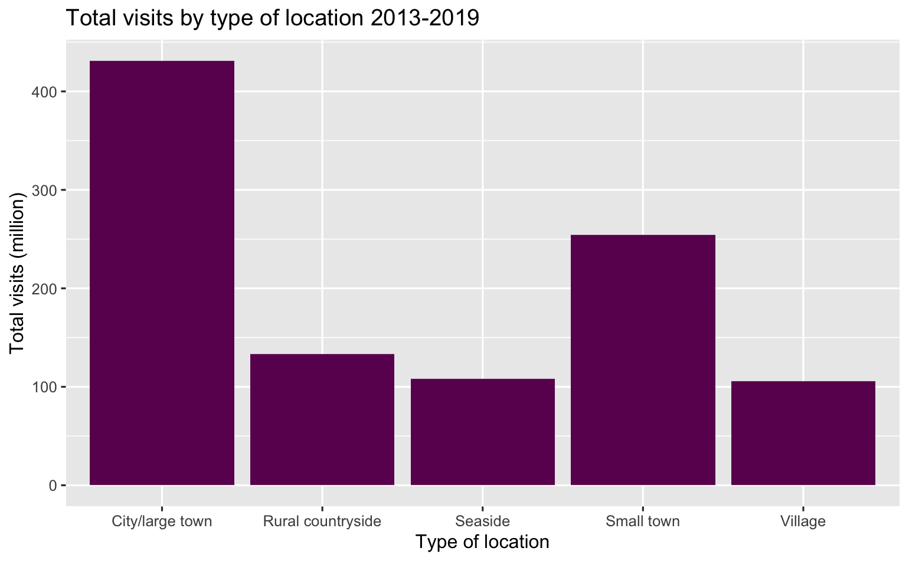

Location What type of location receives visits?
41% of visits are to cities – 431 million between 2013 and 2019
68% of average accommodation occupation is in urban areas
Notes:
Spend is the same as visits by location.
NOTE TO SELF – the accommodation plot here, or on the accommodation slide needs to go. It’s duplicated.
41% of visits are to cities (431 million)
68% on average are to urban areas (note self: there is no number here)
Q: What type of locations receive the most visits? What kinds of locations do people spend the most in?

Slide 6
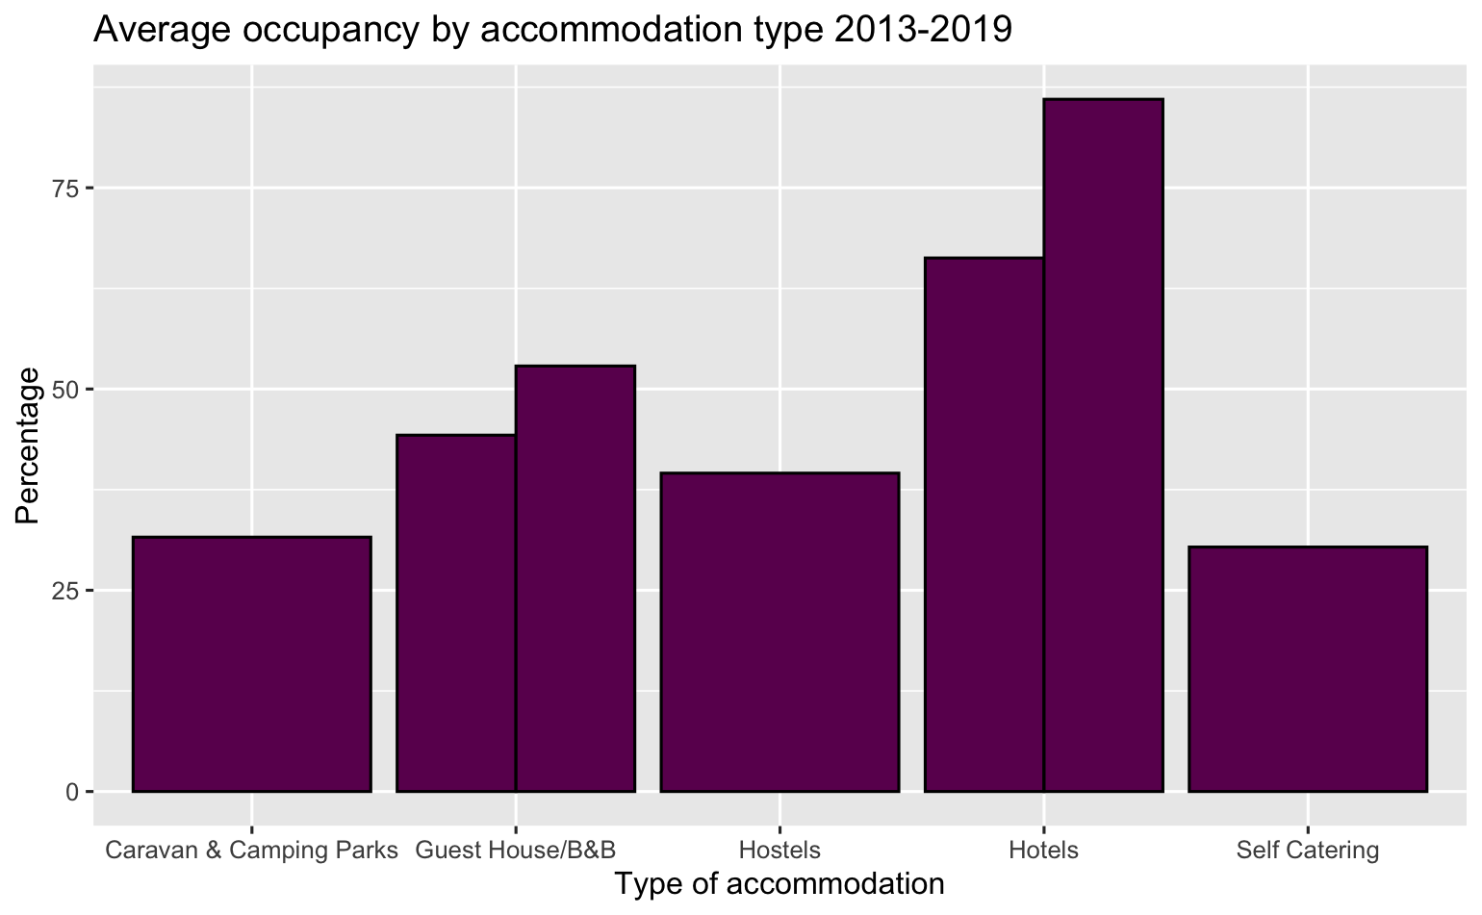

Accommodation What type of accommodation is popular?
Hotels and B&Bs are the most popular types of accommodation
Hotels have 86% average room occupancy, and B&B’s have 53% average room occupancy
Notes:
Hotels are most popular, 66% is the average bed occupancy and 86% room occupancy – with B&B second at 44% bed occ, and 53% room occ.
Q: What type of accommodation is most popular?

Slide 7
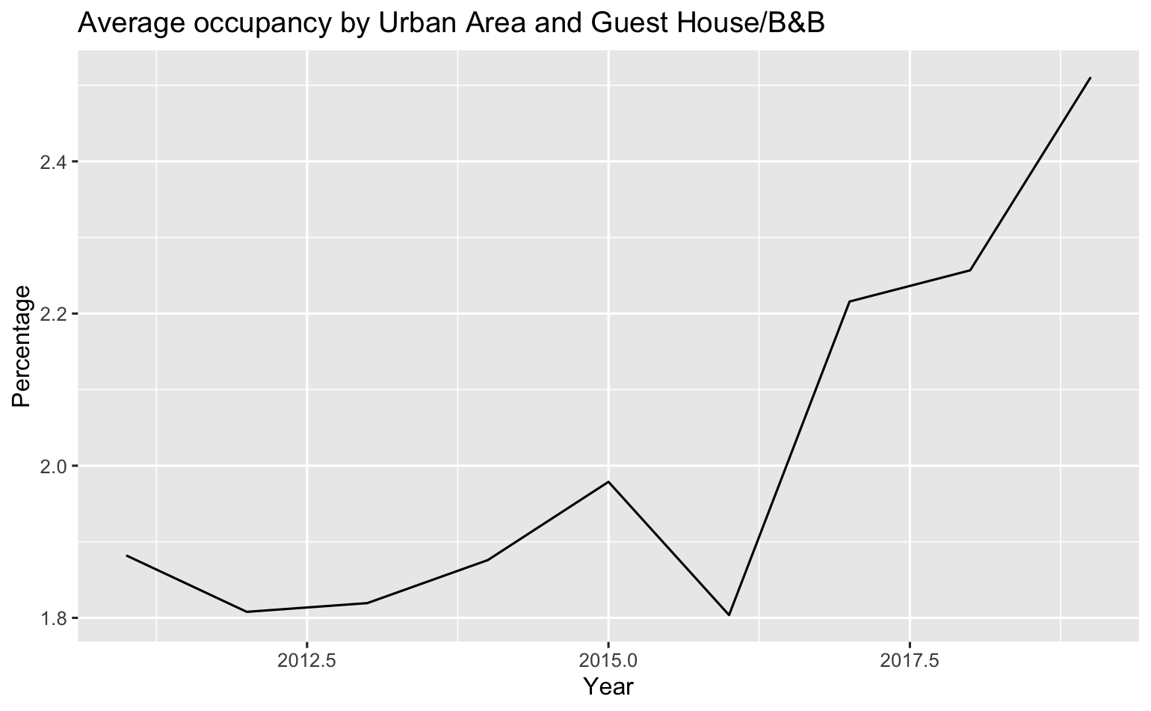
Accommodation
B&Bs are the second most popular type of accommodation, and urban areas are the most popular area
An interesting observation is the steady increase of occupancy in this intersection of data
Notes:
Urban area – 68%
Q: Is there a difference by location?

Slide 8
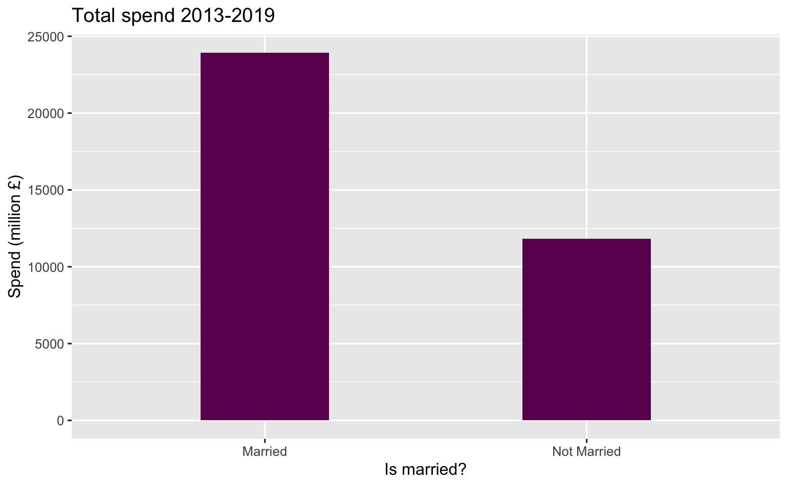
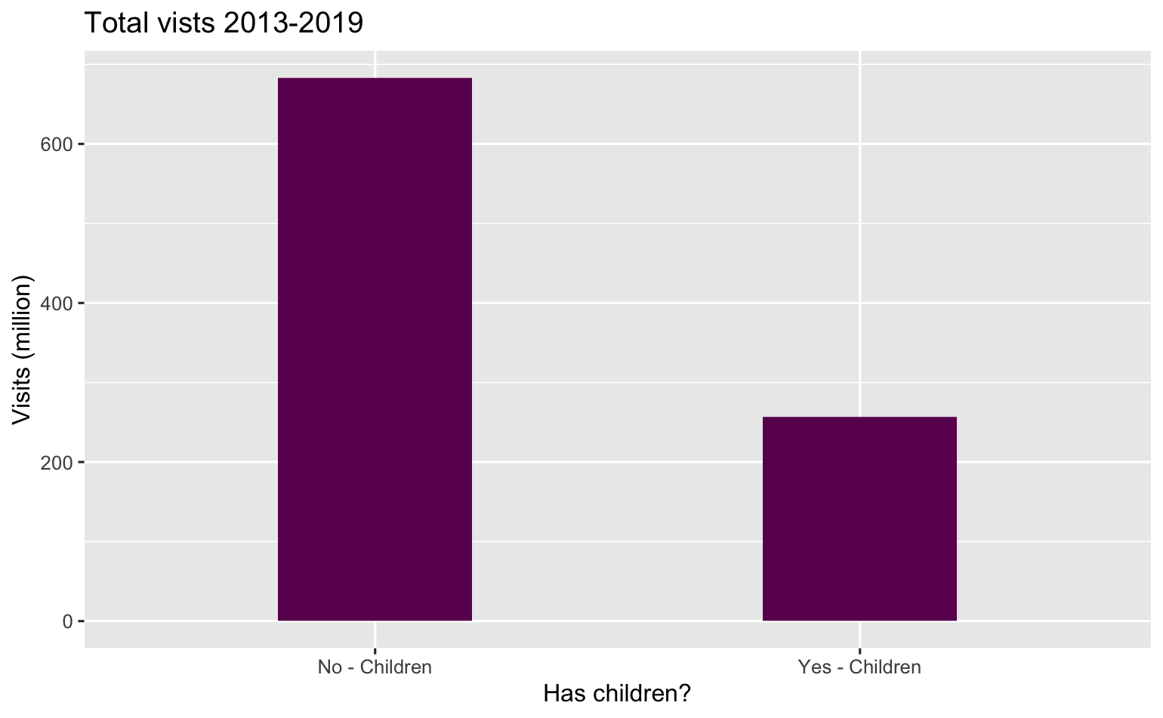

Demographics Who spends and visits the most?
Those who are married account for 67% (measured by spend)
Those who report having no children account for 72%
Notes:
Married – 66.9% spend (23928 million)
No children – 72% visits (683 million)
Q: Who spends the most? Who visits the most? (demographics)

Slide 9
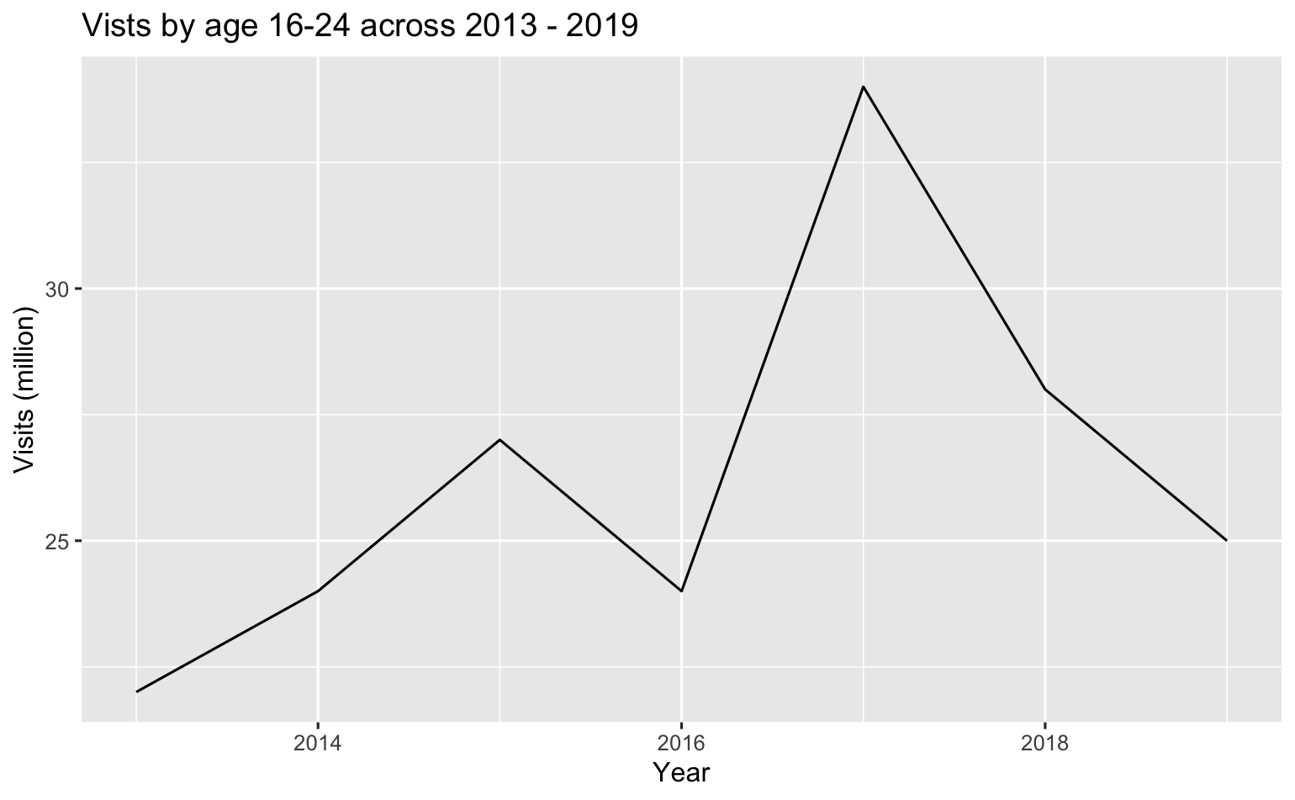

Demographics
Most effective measure is age (split into 6 groups)
16-24 year olds account for 19%
Notes:
16-24 year olds total 184 million (19%)
Q: Is there a particular key demographic of visitors we should be focusing on?

Slide 10
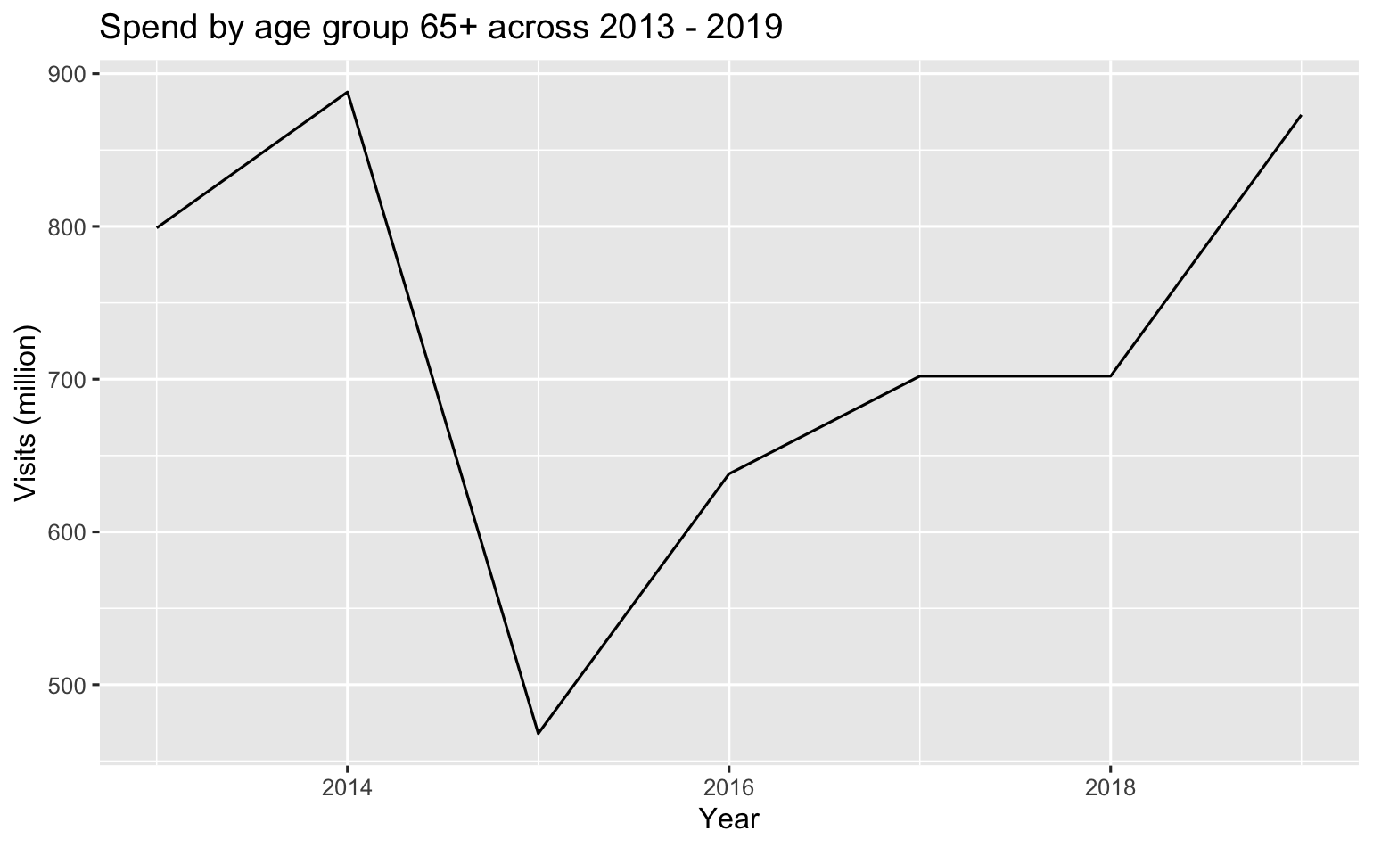
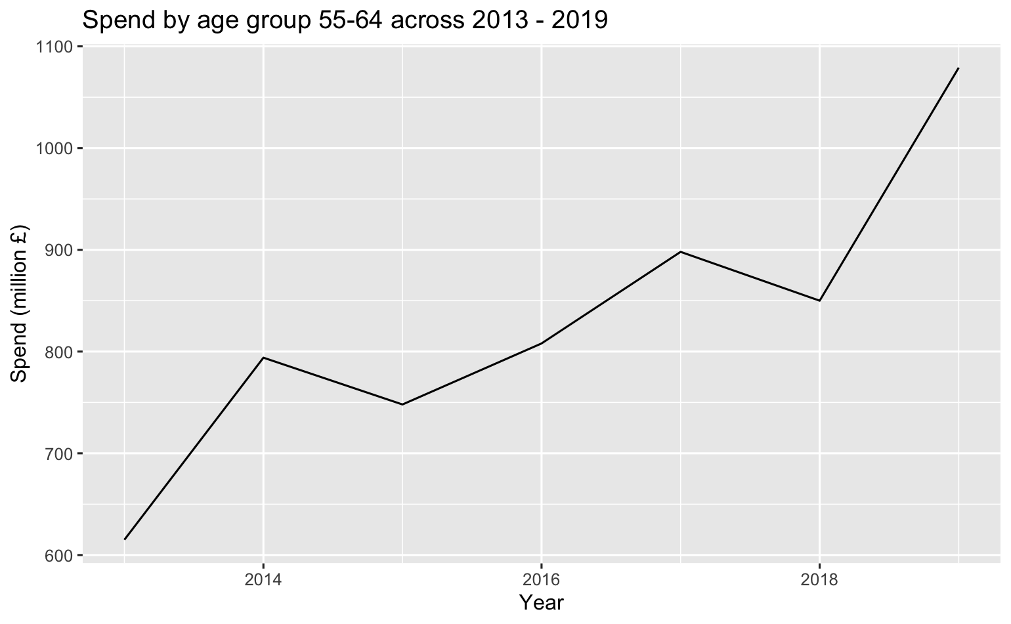
Demographics
These two age groups total over 10 billion in income across the 7 years
More importantly, this has been increasing since 2015 for both
Notes:
These groups total 10862 million across this period, with 65+ increasing from 638m to 888m
Q: Is there a particular key demographic of visitors we should be focusing on?

Slide 11
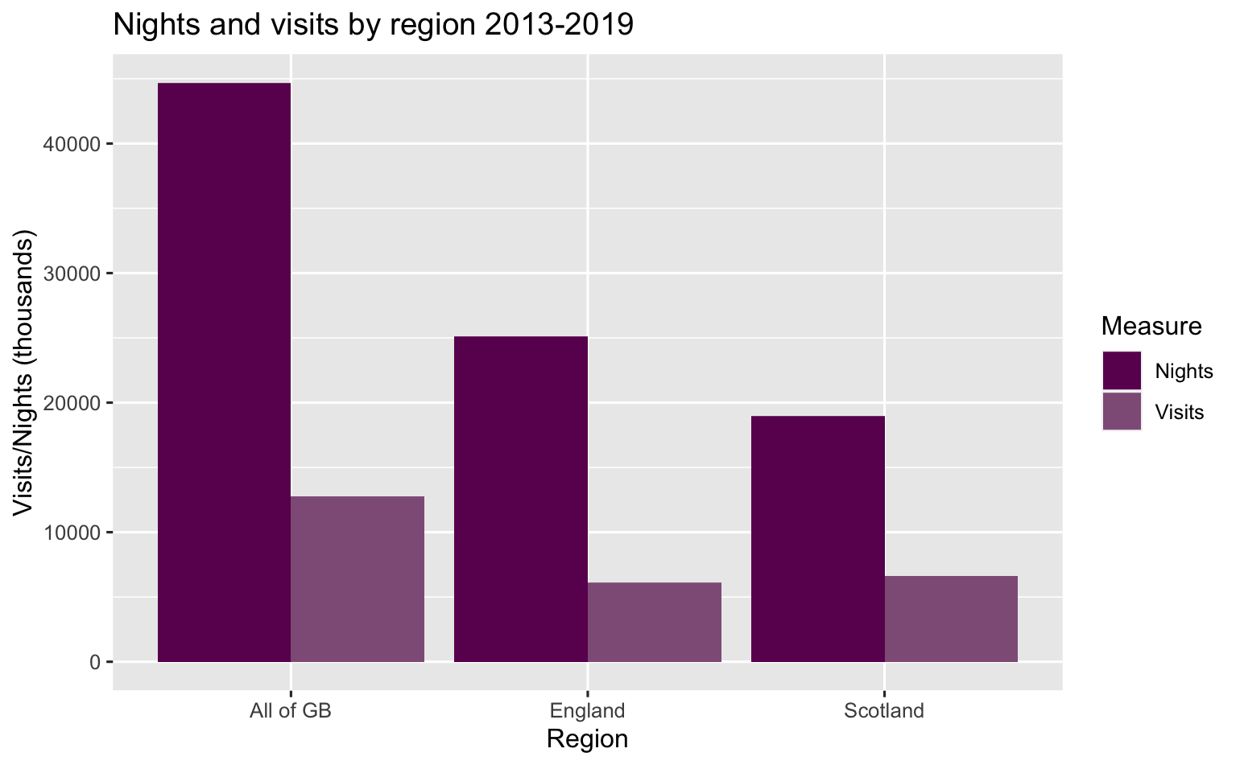
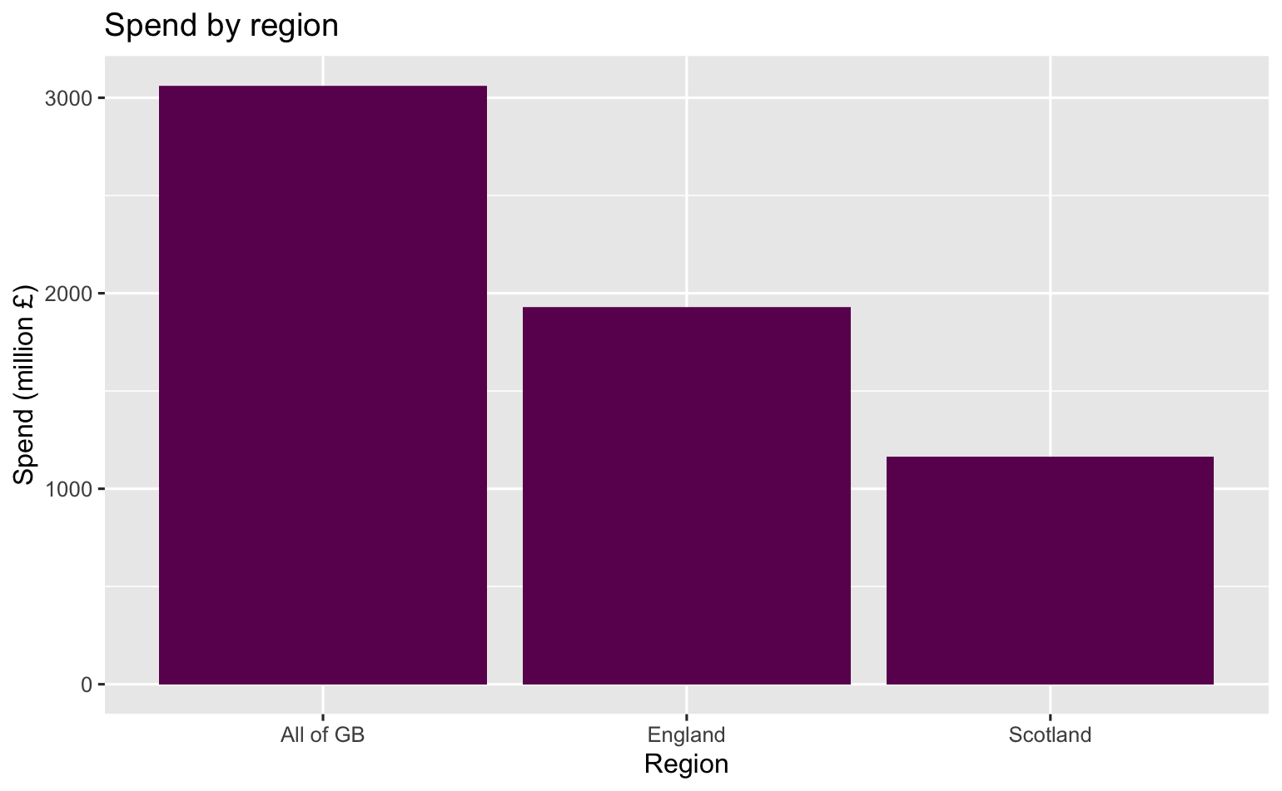
Region
Notes:
Q: When looking at regional tourism, what insights can we gain? Where are our visitors from? How do they differ in the money they spend, nights they spend in Scotland, or number of visits they do?

Slide 12
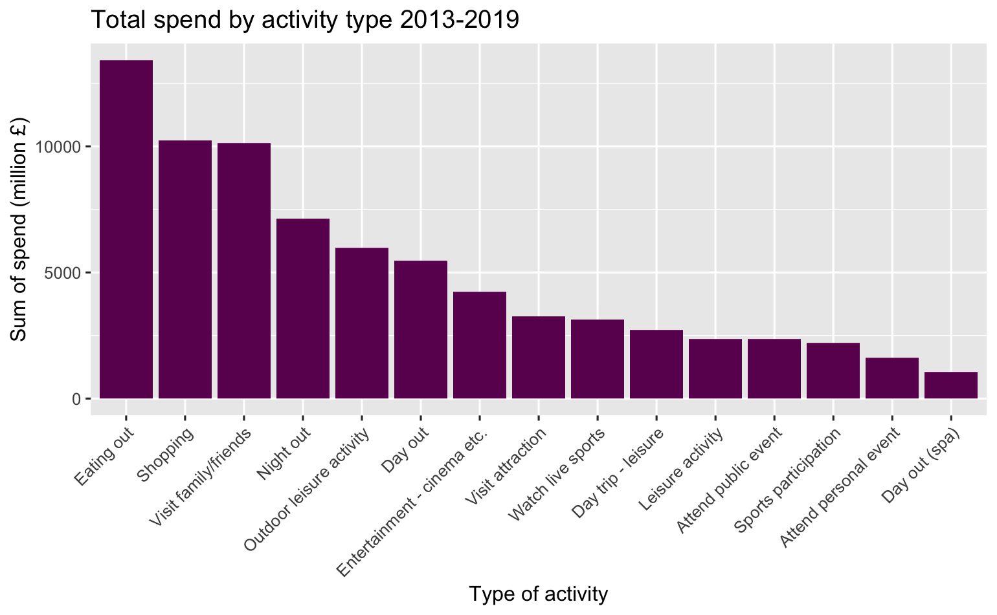
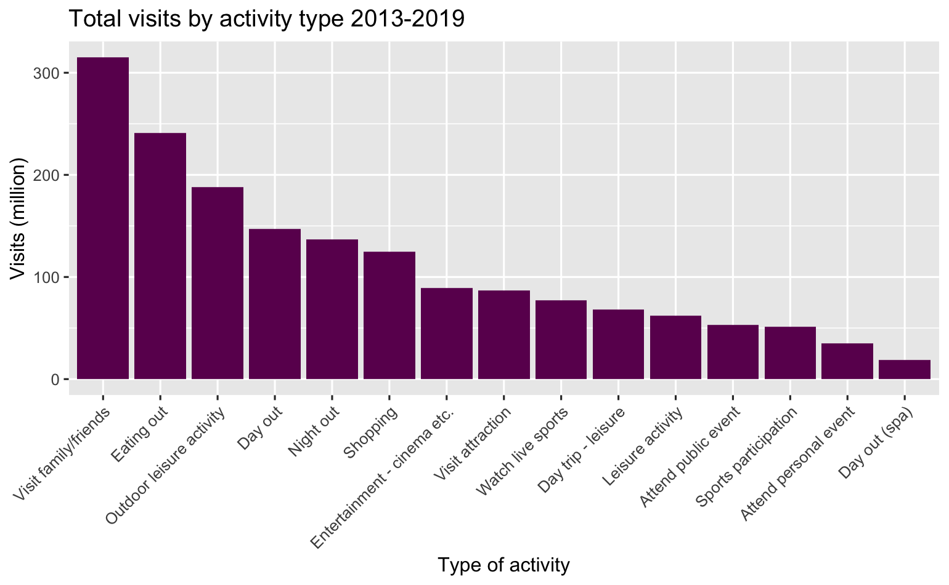
Activities
Across both measures, eating out, visiting family/friends, and going for nights out are popular – these remain unchanged across the years in the data
Eating out accounts for 13 billion which is 17.8%
Visiting family/friends accounts for 315 million visits, which is 18.5%
Notes:
Eating out accounts for 13409 million – 17.8% of the total
Visiting family/friends 315 million – 18.5%
Q:Which kind of activity generates the most visits to sites?
What kind of tourism activity generates the highest income for Scotland?

Slide 13
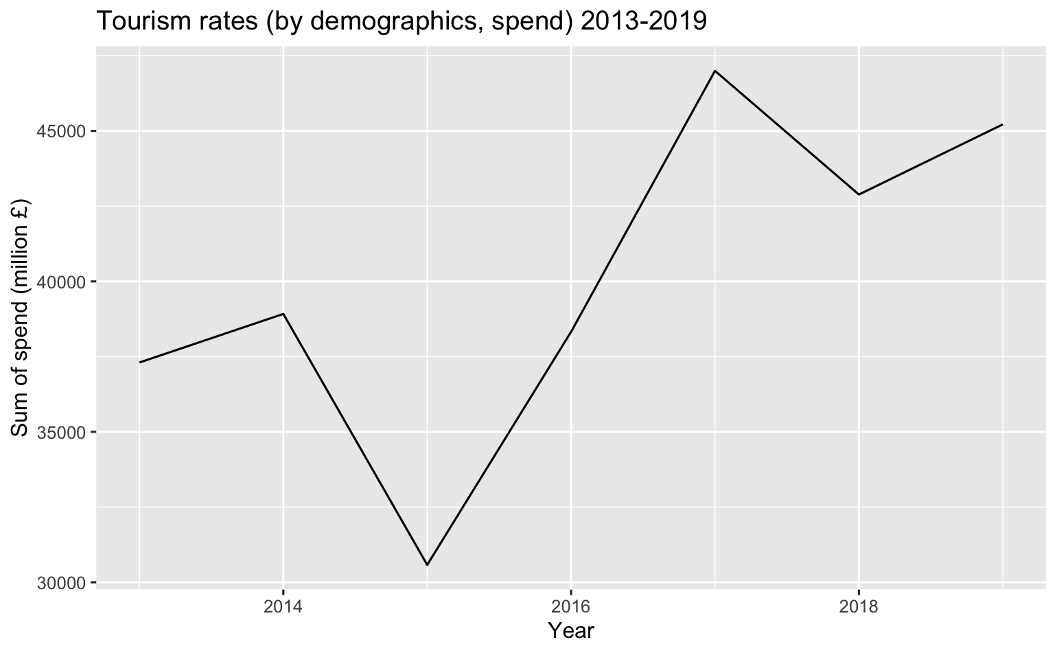
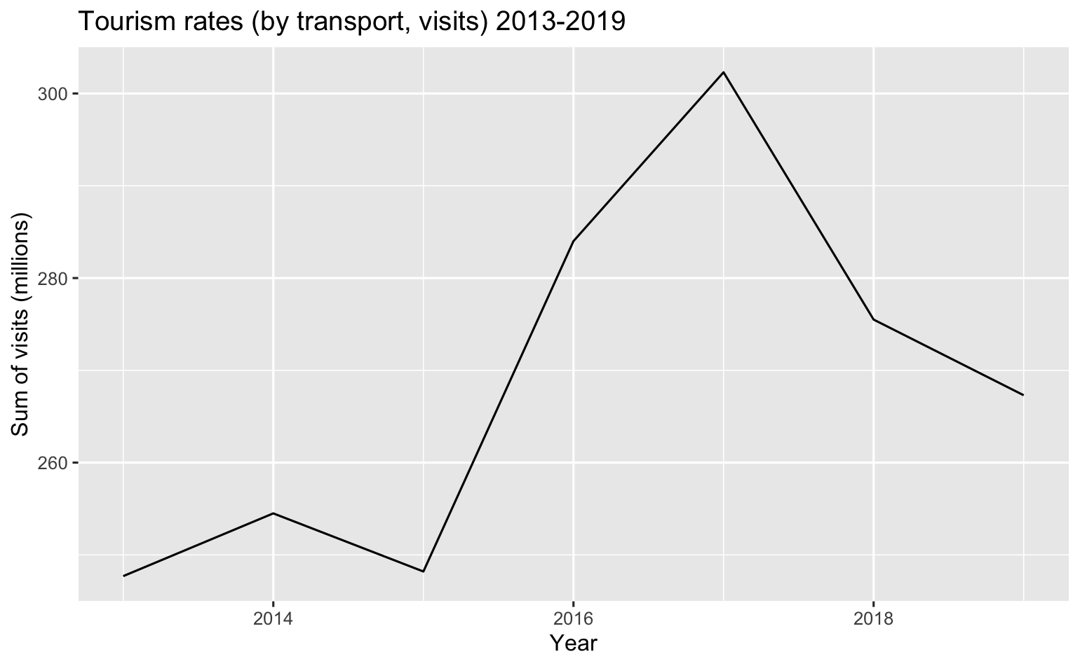
Change over time
Generally visits have decreased since 2017
Whilst spend also hit a peak in 2017 and decreased, they are on the rise again
Notes:
Q: How have general tourism rates changed over time?

Slide 14
Predicting change
Graphs demonstrate trends
Insufficient data to build model
No data since 2019
Notes:
Trend is one of visits spending more, across fewer visits - but to build an effective and accurate model to predict and explore this. A clear recommendation to change their collection method to collect monthly.
Q: Is there any way to predict spending and visits for Visit Scotland?

Slide 15
Summary
There is a trend of visitors travelling by car
customers generally visit urban areas
Hotels and B&b are the most popular accommodation types
Demographics indicate a profile of no children, but being married
16-24 is the highest age group, but there are increasing trends in the elder age groups
England higher in spend and nights, but Scotland higher in visits
Most common activities are eating out, visiting friends/family

Slide 16
Recommendations
Promote remote locations in marketing
Develop partnerships with b&b providers
Focus on urban areas
Target elder age groups
Develop the questions asked for demographics
Collect data more frequently

Slide 17

Questions?
Notes:
Answer to Q:
Is there any way to predict spending and visits for Visit Scotland?

