Slide 1


Louise Shambrook – DE11 CodeClan – Final project

Slide 2

In this presentation
The brief
Main findings
recommendations
Notes:
what’s the brief
Why did I pick it
What will I cover
I was drawn to this dataset because I first visited Scotland on my honeymoon, when I went to Edinburgh, Loch Lomond, and the Isle of Skye, and on this holiday my husband and I fell in love with Scotland and decided to move to Scotland one day. I was interested in understanding the demographics.
Limitations of the data / where have I had to make assumptions / what are they.

Slide 3
The brief
VisitScotland.com - official consumer website of VisitScotland, Scotland’s national tourist board
works to ensure that visitors experience the very best of Scotland
that the country makes the most of its outstanding tourism assets and realises its potential
9 questions around 6 datasets
Notes:
Introduce the brief
Why my choice
Main assumptions / caveats (i.e. that there is no missing data, but that much data is filled in as “All” or “Other” which has been excluded from the results presented)
Why did I pick it
What will I cover
I was drawn to this dataset because I first visited Scotland on my honeymoon, when I went to Edinburgh, Loch Lomond, and the Isle of Skye, and on this holiday my husband and I fell in love with Scotland and decided to move to Scotland one day. I was interested in understanding the demographics.
Limitations of the data / where have I had to make assumptions / what are they.

Slide 4
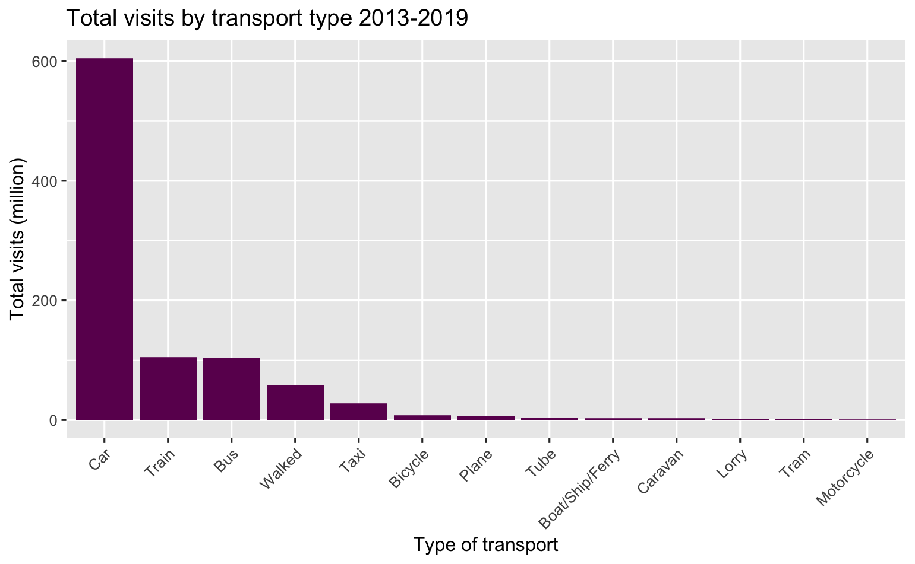
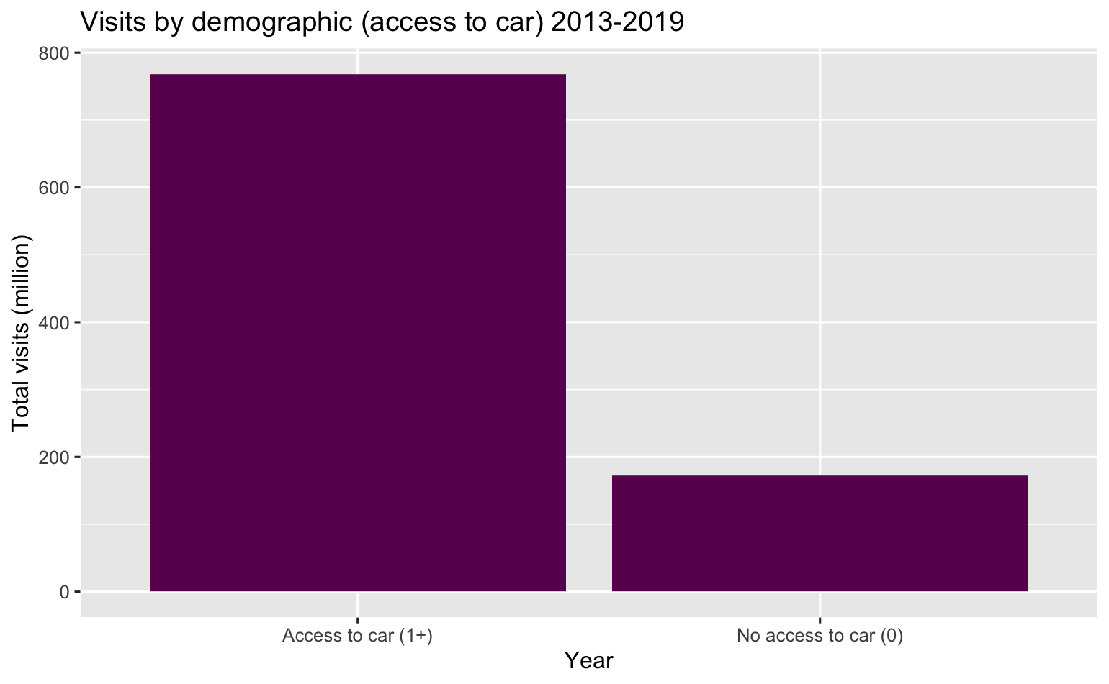
Transport
Notes:
65% of people who visit report travelling by car (605 million)
81% report having access to a car (768 million)
Q: Is there a particular method of travel our visitors arrive by? Some of our locations are remote and not easily accessible by public transport, so this would be good information to have.

Slide 5
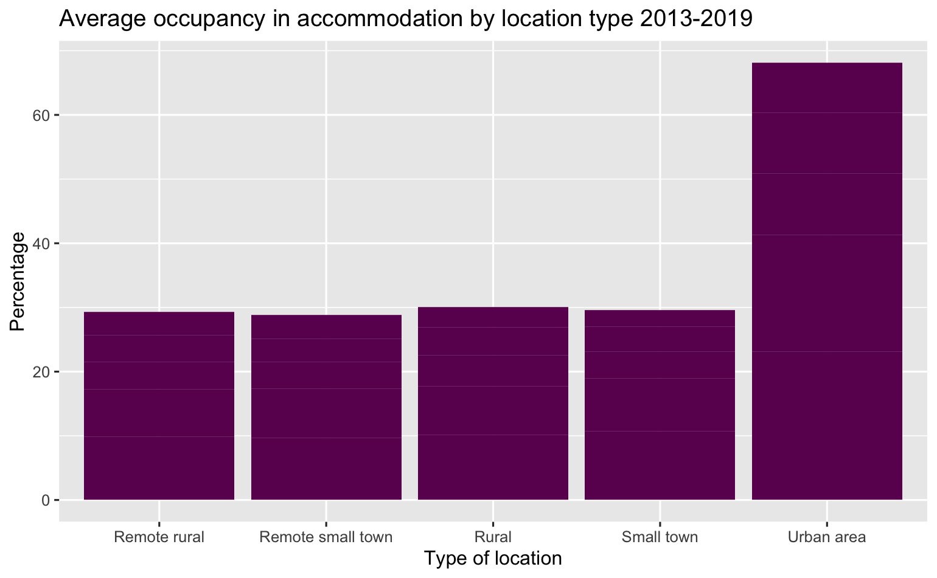
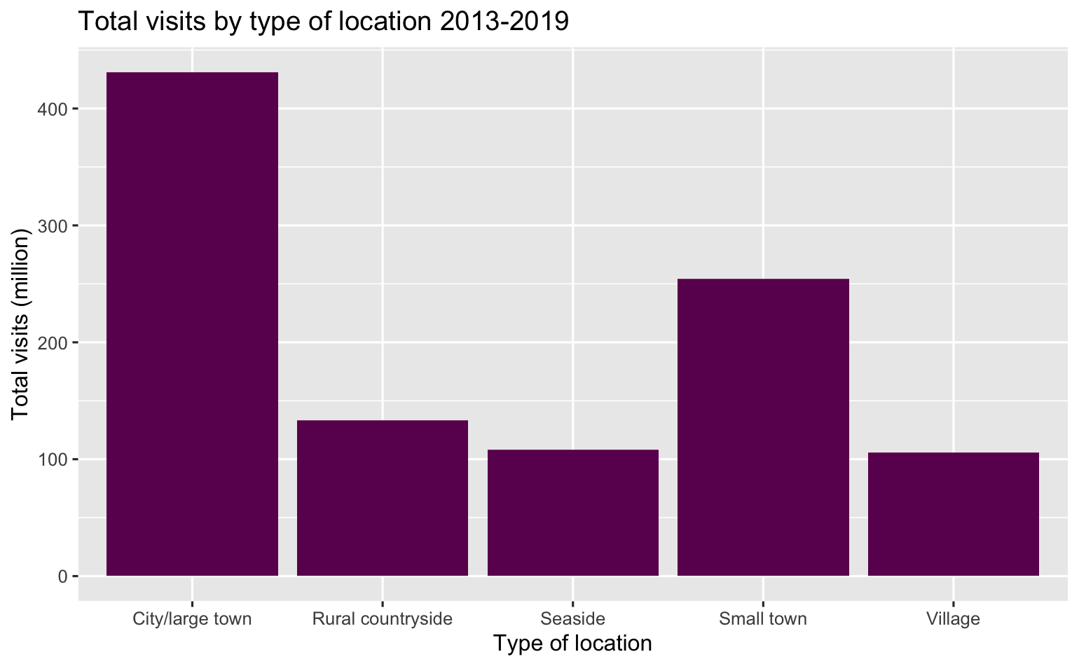
Location
Notes:
Spend is the same as visits by location.
41% of visits are to cities (431 million)
68% on average are to urban areas (note self: there is no number here)
Q: What type of locations receive the most visits? What kinds of locations do people spend the most in?

Slide 6
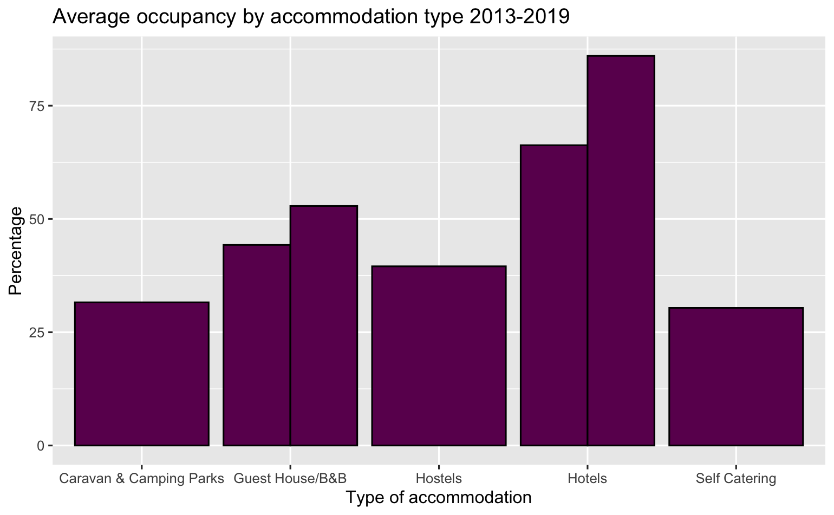
Accommodation
Notes:
Hotels are most popular, 66% is the average occupancy – with B&B second at 44%
Q: What type of accommodation is most popular?

Slide 7
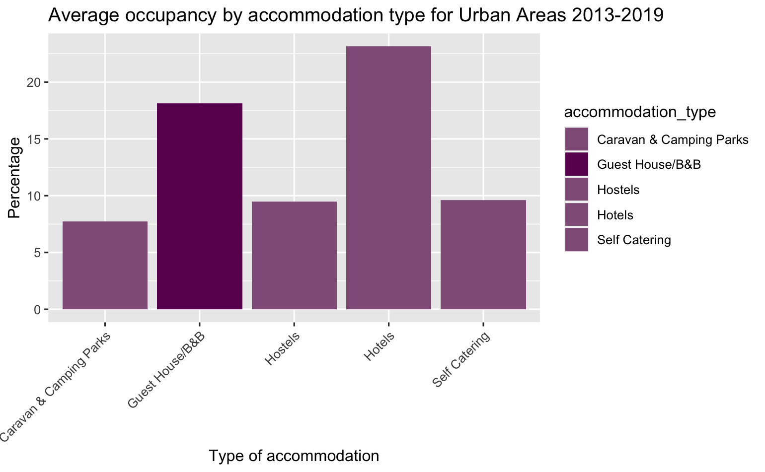
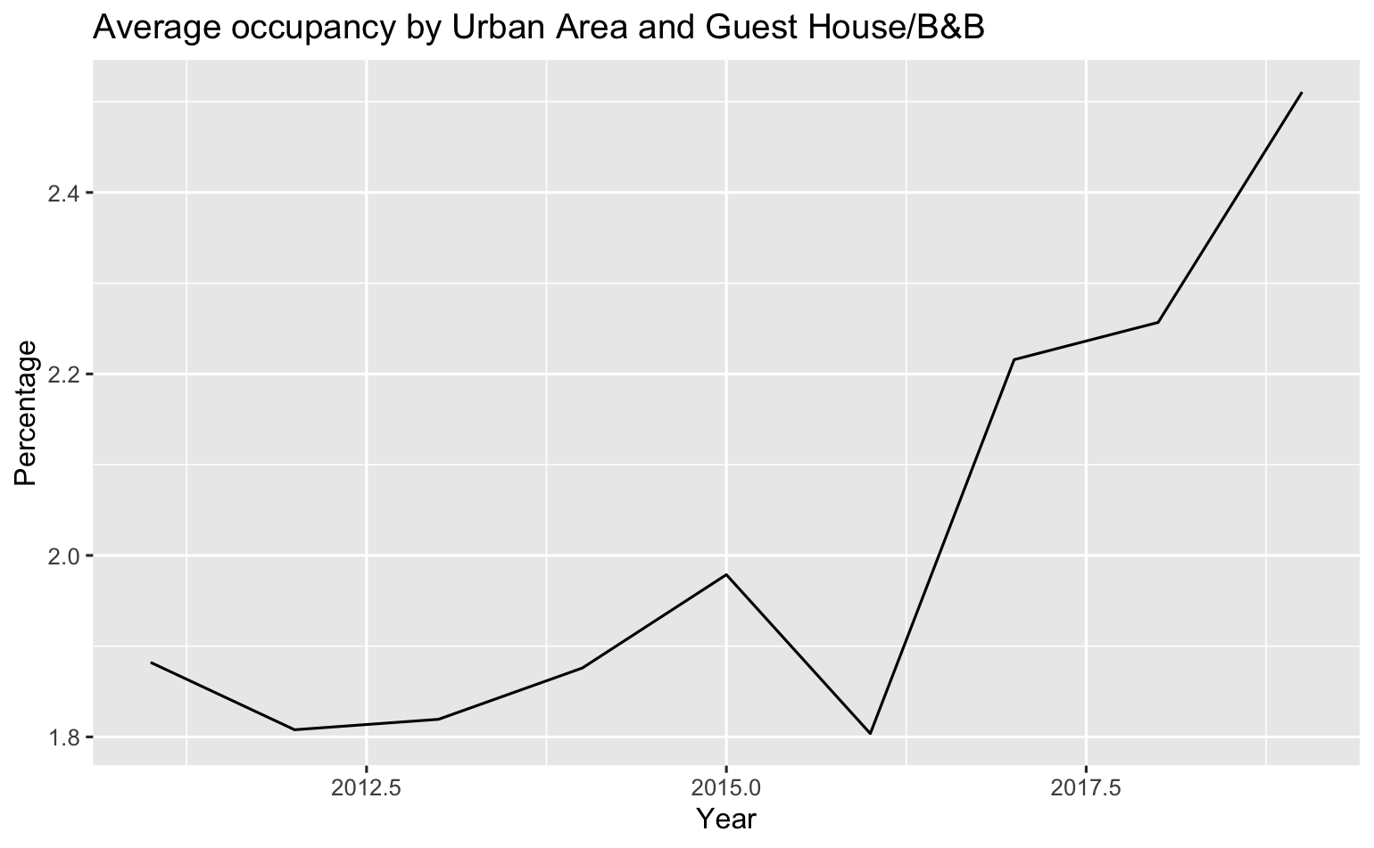
Accommodation
Notes:
As just outlined, the difference between hotels and B&B’s is quite significant when looking overall (20 percentage points) – but when breaking down by urban areas, it is 23% and 18% respectively.
Q: Is there a difference by location?

Slide 8
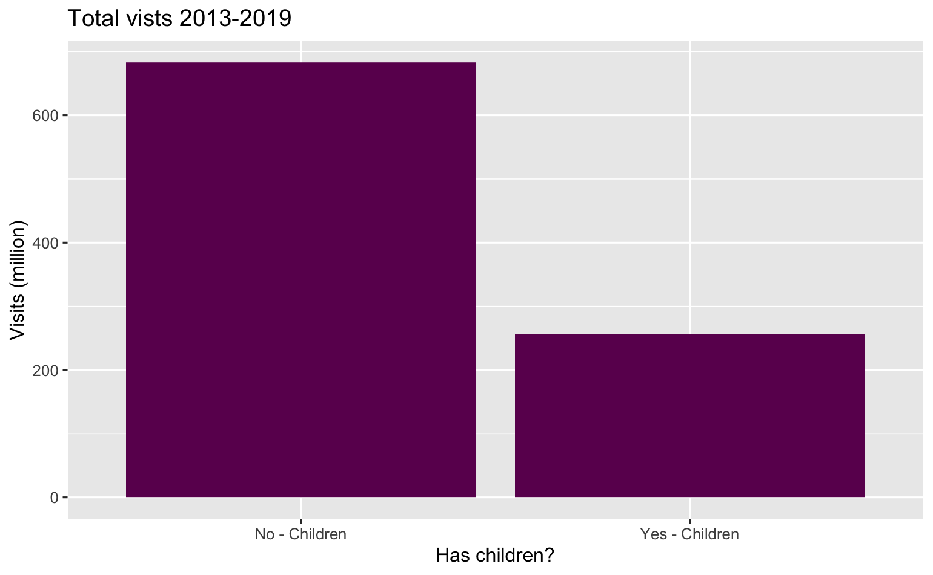
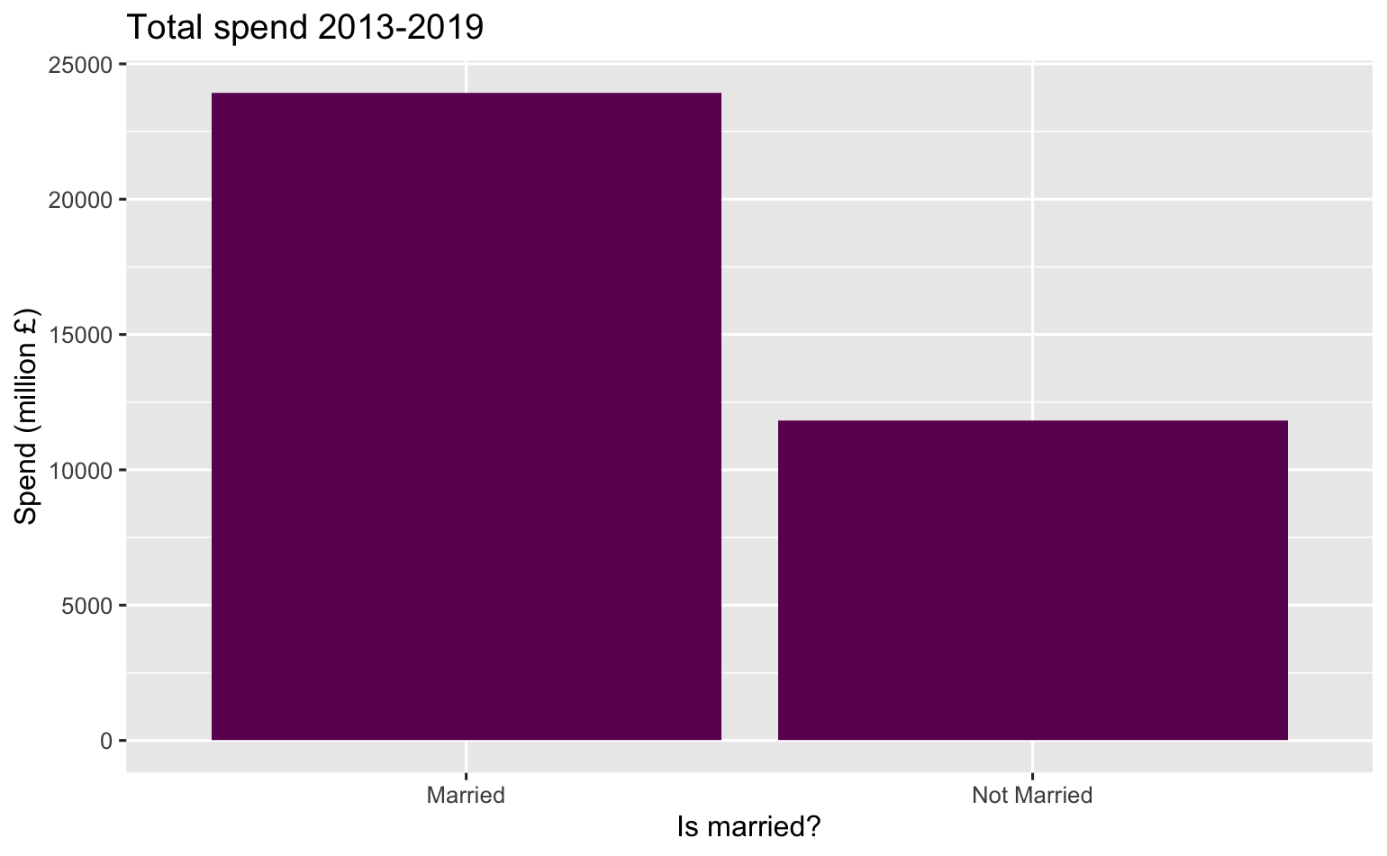
Demographics
Notes:
Married – 66.9% spend (23928 million)
No children – 72% visits (683 million)
Q: Who spends the most? Who visits the most? (demographics)

Slide 9
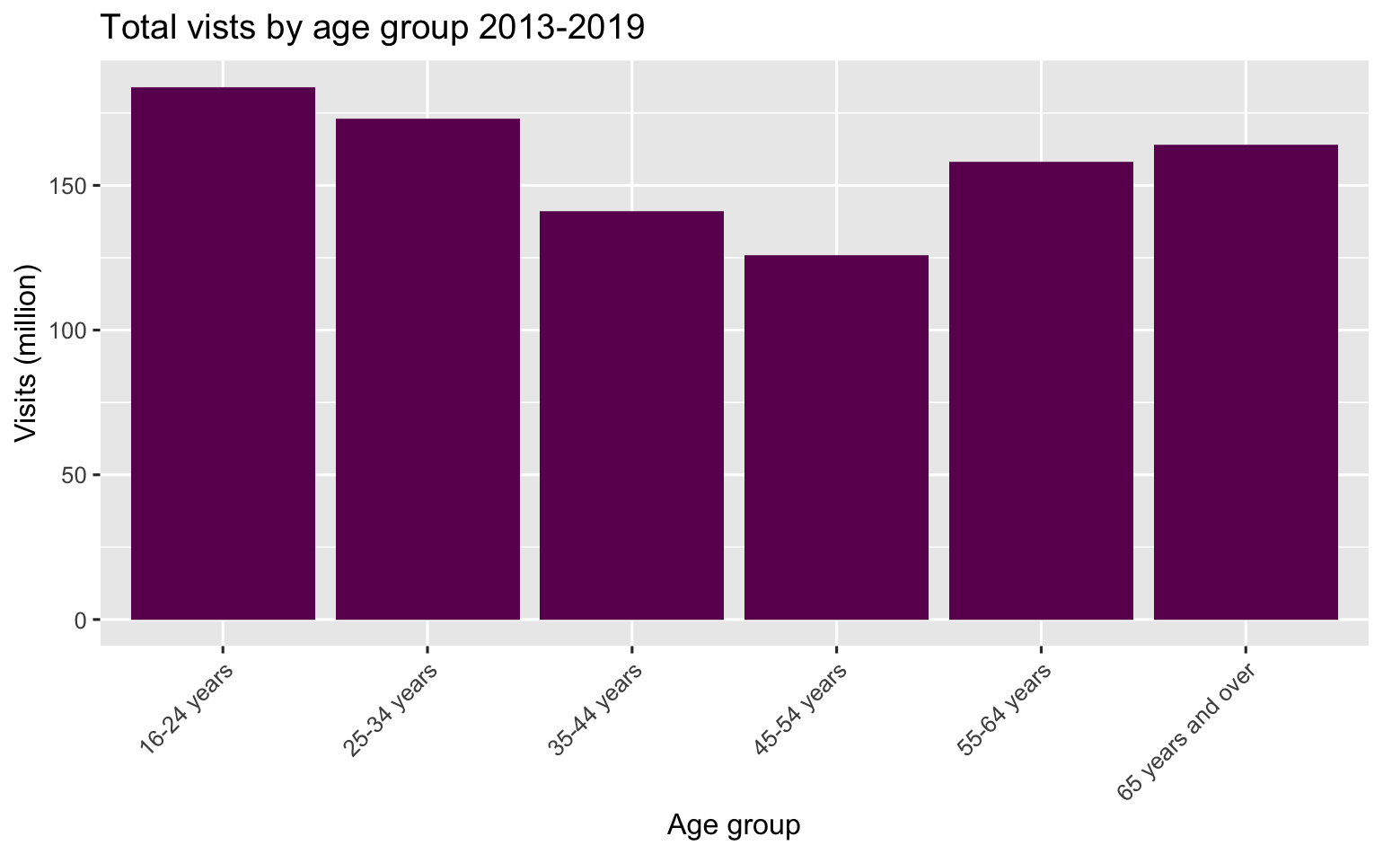
Demographics
Notes:
16-24 year olds total 184 million (19%)
Q: Is there a particular key demographic of visitors we should be focusing on?

Slide 10
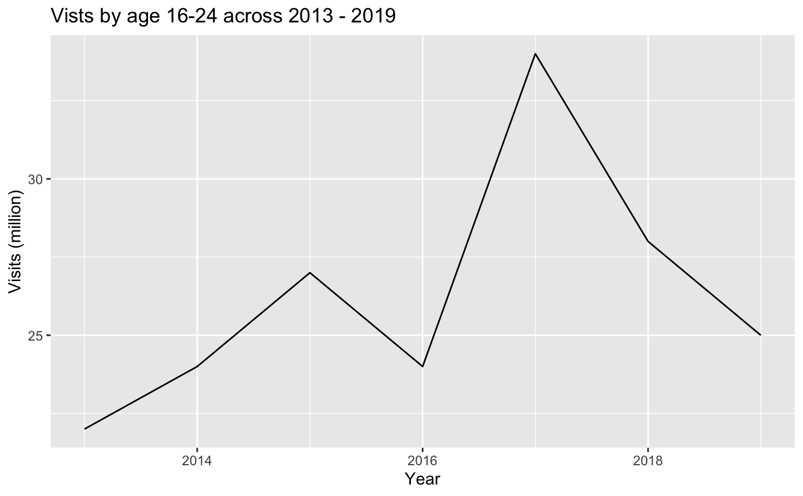
Demographics
Notes:
Q: Is there a particular key demographic of visitors we should be focusing on?

Slide 11
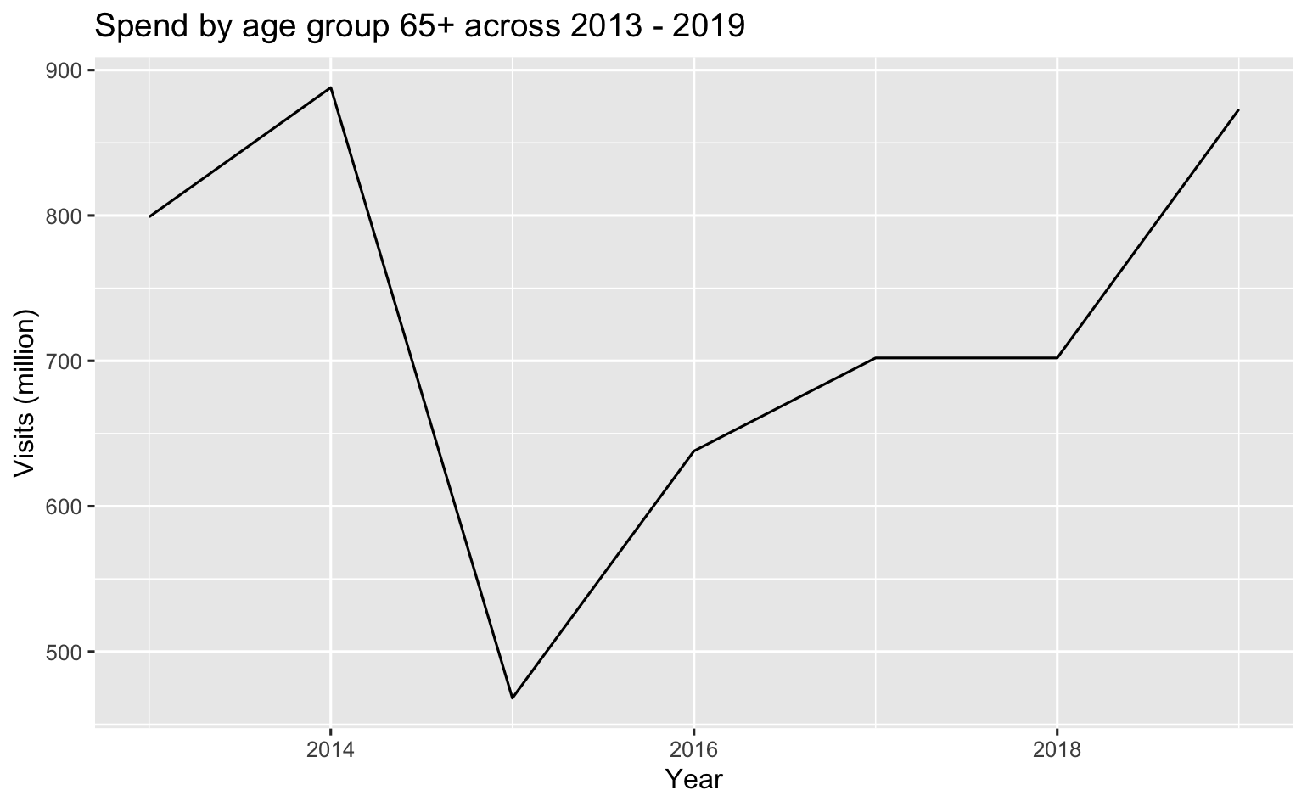
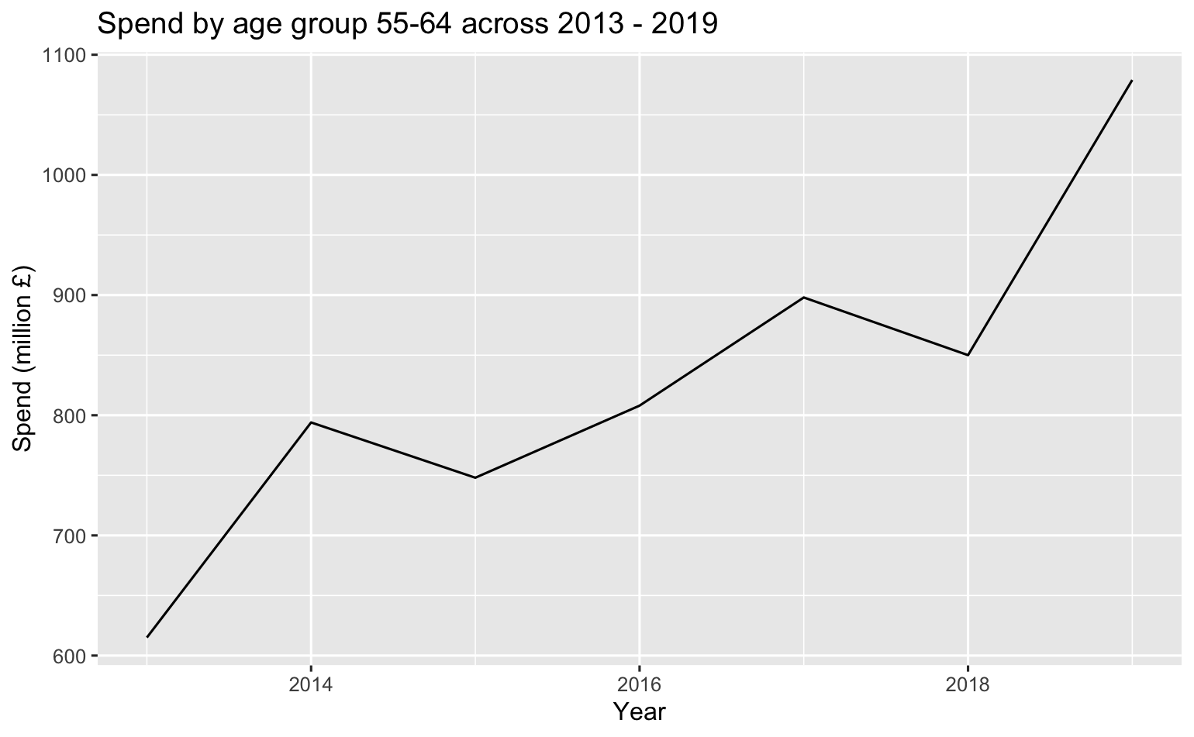
Demographics
Notes:
These groups total 10862 million across this period, with 65+ increasing from 638m to 888m
Q: Is there a particular key demographic of visitors we should be focusing on?

Slide 12
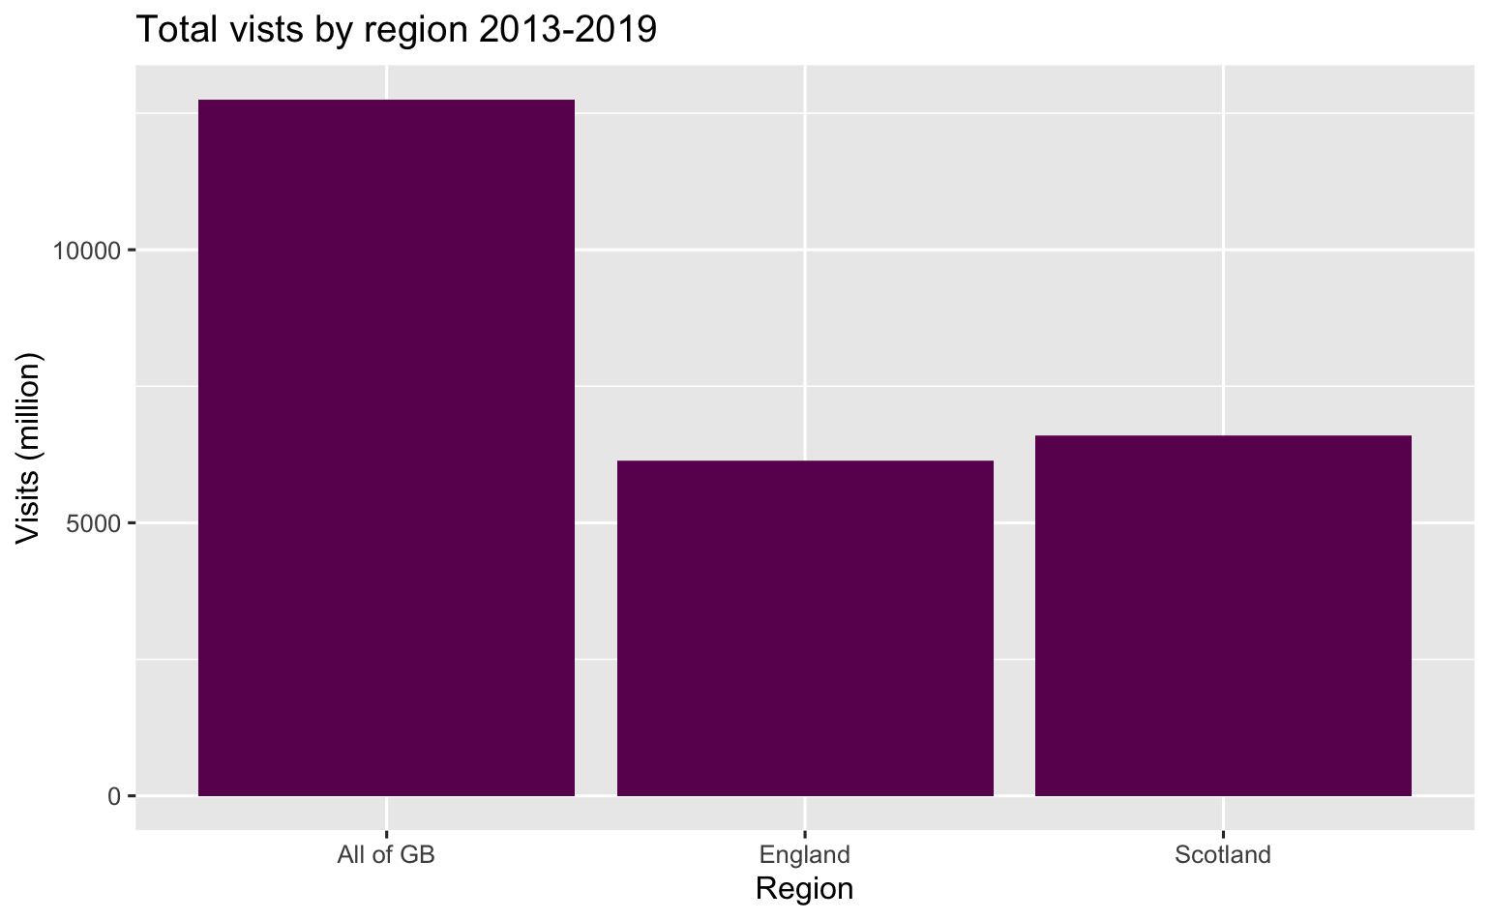
Region
Notes:
Q: When looking at regional tourism, what insights can we gain? Where are our visitors from? How do they differ in the money they spend, nights they spend in Scotland, or number of visits they do?

Slide 13
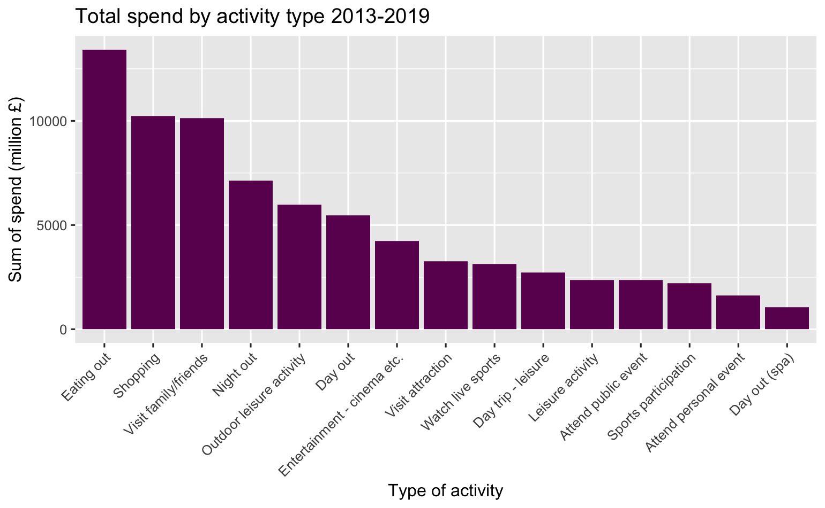
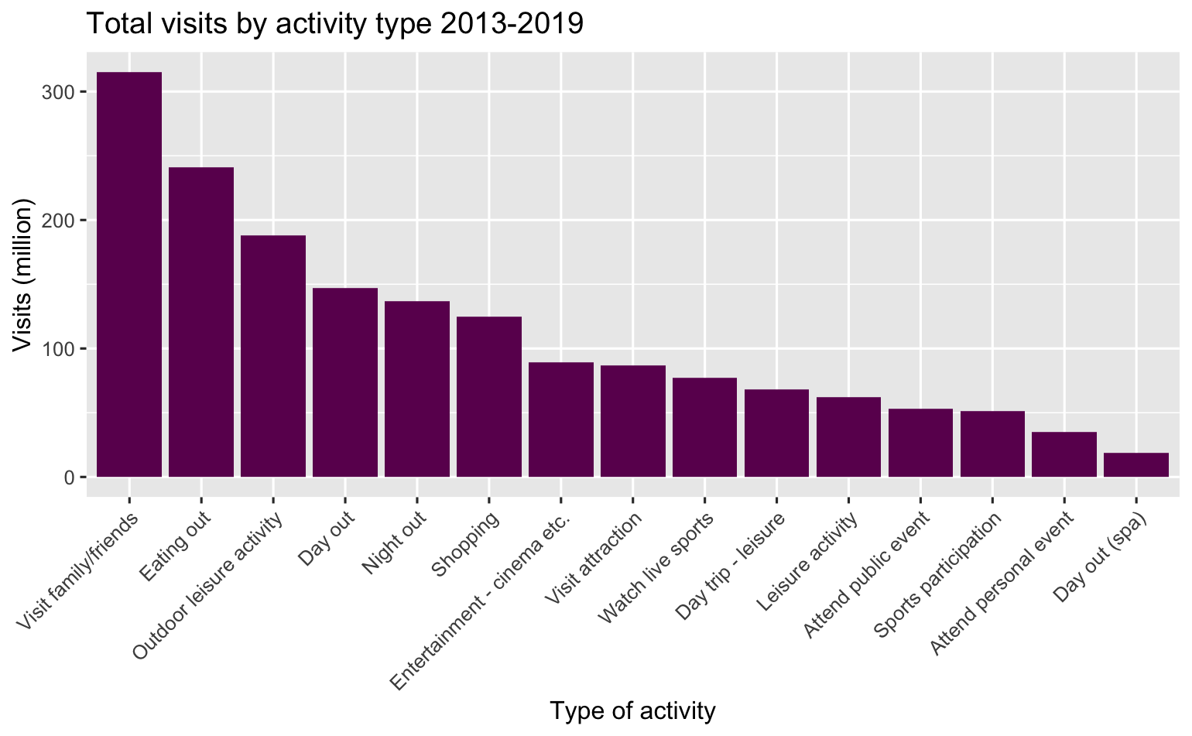
Activities
Notes:
Eating out accounts for 13409 million – 17.8% of the total
Visiting family/friends 315 million – 18.5%
Q:Which kind of activity generates the most visits to sites?
What kind of tourism activity generates the highest income for Scotland?

Slide 14
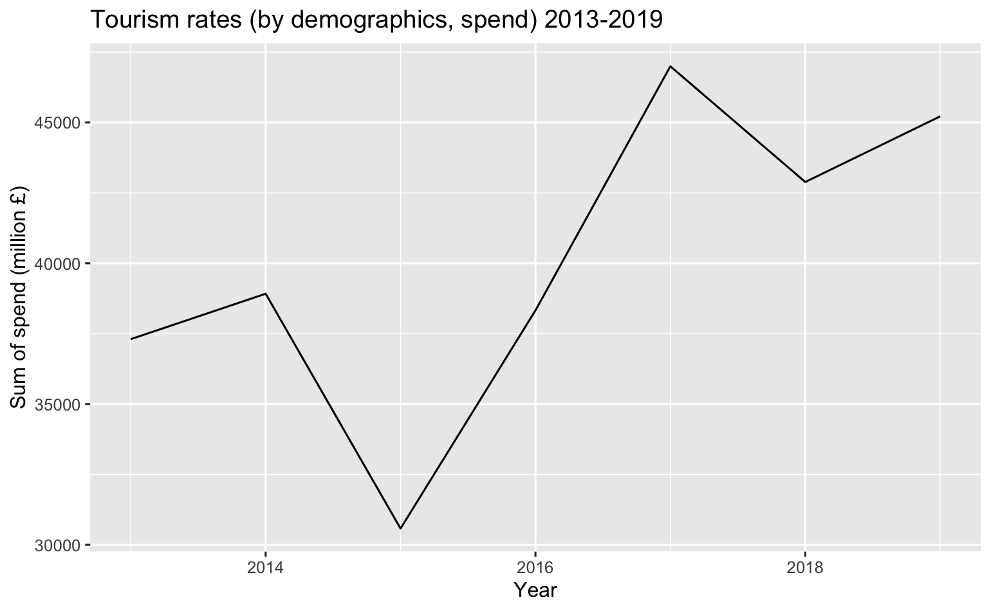
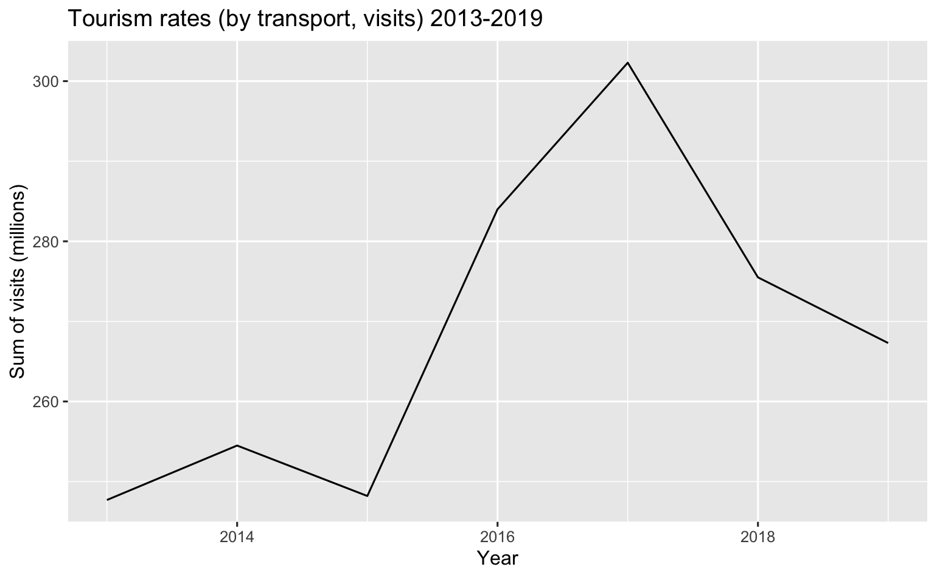
Change over time
Notes:
Q: How have general tourism rates changed over time?

Slide 15
Predicting change
Graphs demonstrate trends
Insufficient data to build model
Notes:
Trend is one of visits spending more, across fewer visits - but to build an effective and accurate model to predict and explore this. A clear recommendation to change their collection method to collect monthly.
Q: Is there any way to predict spending and visits for Visit Scotland?

Slide 16
Summary
Majority of visitors have access to / travel by car
Visitors generally visit urban areas / cities
Hotels and b&b most popular accommodation
no children - are married
16-24 most popular age group, but decreasing
England higher in spend and nights, but Scotland higher in visits
Most common activities: eating out, visiting friends/family

Slide 17
Recommendations
Confidently Promote remote locations
Develop partnerships with b&b providers
Focus on urban areas
Target elder age groups
Develop the questions asked for demographics
Collect data more frequently

Slide 18

Questions?
Notes:
Answer to Q:
Is there any way to predict spending and visits for Visit Scotland?

