Slide 1

Hit or miss: ANN agent and RL to play Breakout
Louis Fabrice Tshimanga
Ennio Guzmán

Slide 2
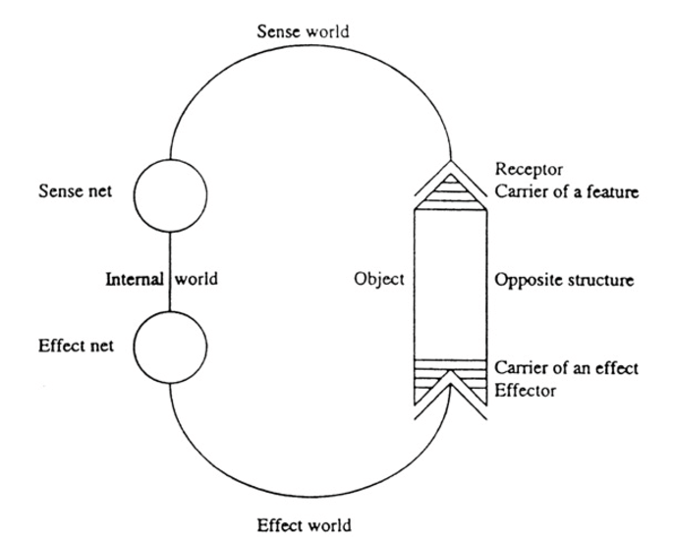
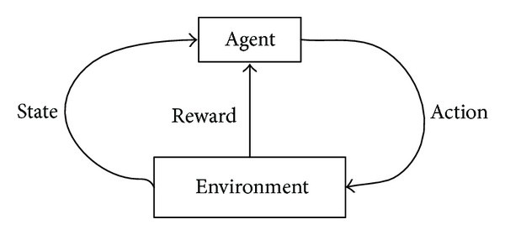
Introduction
Reinforcement Learning (RL) as a model for learning, i.e. build a model of reality.
An agent receives information on the state of the environment, and modifies it interacting with it.

Slide 3
Introduction
In animal agents, behaviour is guided by the nervous system, which:
- receives, processes sensory stimuli;
- guides physical reactions
Biological Neural Nets are optimal for action-policies learning.
Reinforcements happen on various levels:
- «neurons that fire together wire together» Donald Hebb
- «actions associated with benefits are repeated, avoided if associated with damage or distress» E. Thorndike

Slide 4
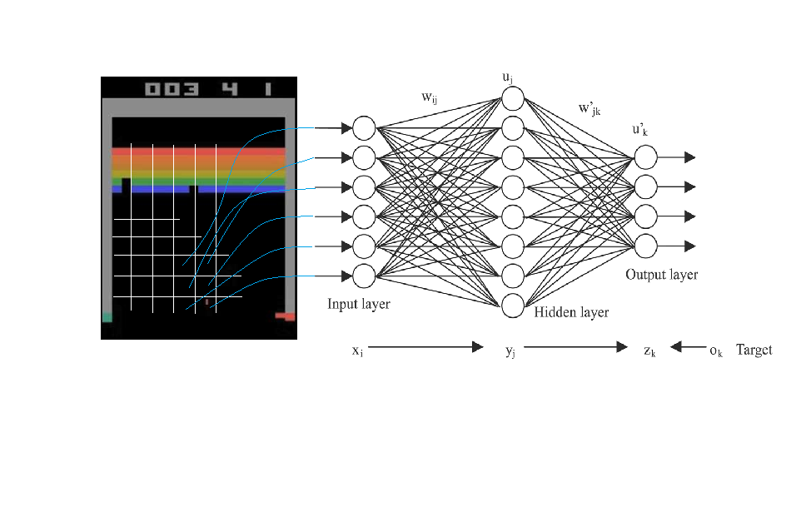
Methodology
Breakout is in a simple environment, where you can put a NN-guided agent.
The «sense of sight» guides movement, scores induce rewards or punishments.

Slide 5
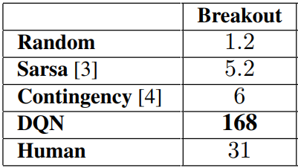
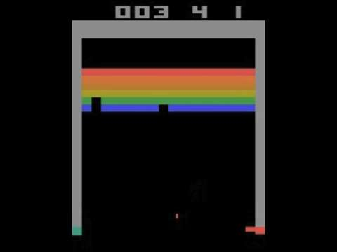
Methodology
Classic RL approach obtain low scores. Instead some NNs, biological or artificial, obtain high scores.

Slide 6
Methodology
The approach here developed considered the simplicity of the NN of 6400:200:1 neurons (by layer).
Rewards were assigned differently in 3 stages, to progressively train the agents:
- Hit {+ 1}, 1000 games
- Survive {+0.01}, Miss {-1}, 1000 games
- Hit {+2 * combo}, Miss {-1, -2 if combo breaker}, 200 games

Slide 7
Methodology
The gradient of the cost function, measuring the classification error (where the class is «situation where to move left/right), is modulated in amplitude by the reward assigned (discounted) at each step (with gamma = 0.99).
Every 10-62 games (phases 1-2, phases 3 respectively), the gradient registered and modulated is used to update the weights.

Slide 8
Results
Agents trained with this methodology can play to human level.
The policies learned and instantiated in the NN give rise to recurring specific behaviours, that make sense with regards to scoring (strategy, tactics, playing style)

Slide 9
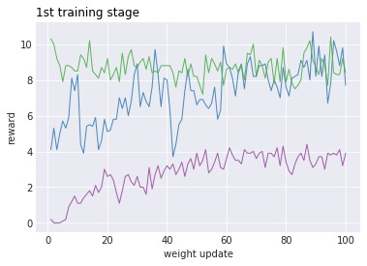
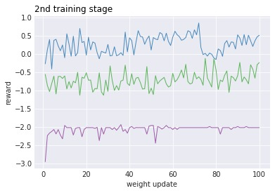
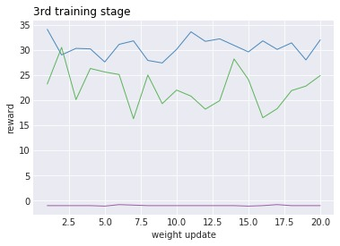
Results Three agents in their three training stages

Slide 10
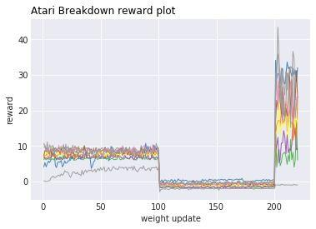
Results

Slide 11
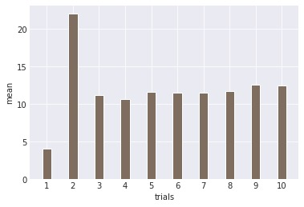
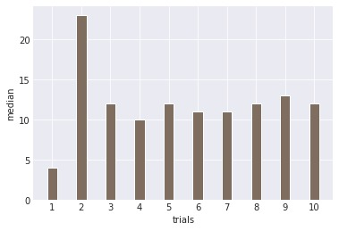
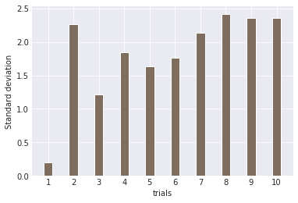
Results Game stats for 10 agents, in 150 games:

Slide 12
Conclusions
The training methodology for Reinforcement Learning here presented is both efficient and effective.
Agents consistently play at human level (medium and expert), regularly beat random policy and results obtained by traditional methods (i.e. non-Deep-Q-Learning)
Not human, nor ours!
But we can watch our…

